Slide 1
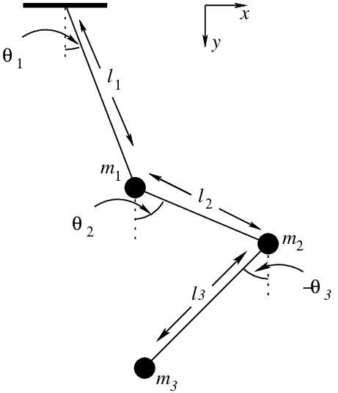
Animating The Triple Pendulum
By Noah Jaspal Reinhardt

Slide 2

Structure
The Equations of Motion
Numerical Simulation
Creating Animations
Results

Slide 3
The Equations of Motion
Choice of Coordinates
$$\vec{x_{1}}=l_{1}⋅\left(\begin{matrix}\sin\left(θ_{1}\right),\cos\left(θ_{1}\right)\end{matrix}\right)$$
$$\vec{x_{2}}=\vec{x_{1}}+l_{2}⋅\left(\begin{matrix}\sin\left(θ_{2}\right), \cos\left(θ_{2}\right)\end{matrix}\right)$$
$$\vec{x_{3}}=\vec{x_{2}}+l_{3}⋅\left(\begin{matrix}\sin\left(θ_{3}\right), \cos\left(θ_{3}\right)\end{matrix}\right)$$
[1]

Slide 4


The Equations of Motion
The Euler-Lagrange Formalism
$$E_{kin}=\frac{1}{2}m_{1}\dot{{\vec{x}}_{1}^{2}}+\frac{1}{2}m_{2}\dot{{\vec{x}}_{2}^{2}}+\frac{1}{2}m_{3}\dot{{\vec{x}}_{3}^{2}}$$
$E_{pot}=g⋅m_{1}y_{1}+g⋅m_{2}y_{2}+g⋅m_{3}y_{3}$
$$ℒ=E_{kin}−E_{pot}\text{ ;} \frac{∂ℒ}{∂θ_{i}}−\frac{d}{dt}\left(\frac{∂ℒ}{∂\dot{θ_{i}}}\right)=0$$
[1]

Slide 5



The Equations of Motion
The Euler-Lagrange Formalism
$$0=\frac{∂ℒ}{∂θ_{1}}−\frac{d}{dt}\left(\frac{∂ℒ}{∂\dot{θ_{1}}}\right)=g⋅\left(m_{1}+m_{2}+m_{3}\right)\sin\left(θ_{1}\right)−\left(m_{2}+m_{3}\right)l_{2}\dot{θ_{2}^{2}}\sin\left(θ_{1}−θ_{2}\right)−m_{3}l_{3}\dot{θ_{3}^{2}}\sin\left(θ_{1}−θ_{3}\right) +\left(m_{1}+m_{2}+m_{3}\right)l_{1}\ddot{θ_{1}}+\left(m_{2}+m_{3}\right)l_{2}\ddot{θ_{2}}+m_{3}l_{3}\ddot{θ_{3}}$$
$$0=\frac{∂ℒ}{∂θ_{2}}−\frac{d}{dt}\left(\frac{∂ℒ}{∂\dot{θ_{2}}}\right)=g⋅\left(m_{2}+m_{3}\right)\sin\left(θ_{2}\right)−\left(m_{2}+m_{3}\right)l_{1}\dot{θ_{1}^{2}}\sin\left(θ_{1}−θ_{2}\right)−m_{3}l_{3}\dot{θ_{3}^{2}}\sin\left(θ_{2}−θ_{3}\right) +\left(m_{2}+m_{3}\right)l_{1}\cos\left(θ_{1}−θ_{2}\right)\ddot{θ_{1}}+\left(m_{2}+m_{3}\right)l_{2}\ddot{θ_{2}}+m_{3}l_{3}\cos\left(θ_{2}−θ_{3}\right)\ddot{θ_{3}}$$
$$0=\frac{∂ℒ}{∂θ_{3}}−\frac{d}{dt}\left(\frac{∂ℒ}{∂\dot{θ_{3}}}\right)$$
$$=g⋅m_{3}\sin\left(θ_{3}\right)−m_{3}l_{1}\dot{θ_{1}^{2}}\sin\left(θ_{1}−θ_{3}\right)−m_{3}l_{2}\dot{θ_{2}^{2}}\sin\left(θ_{2}−θ_{3}\right)$$
$$m_{3}l_{1}\cos\left(θ_{1}−θ_{3}\right\}\ddot{θ_{1}}+m_{3}l_{2}\cos\left(θ_{2}−θ_{3}\right\}\ddot{θ_{2}}+m_{3}l_{3}\ddot{θ_{3}}$$

Slide 6
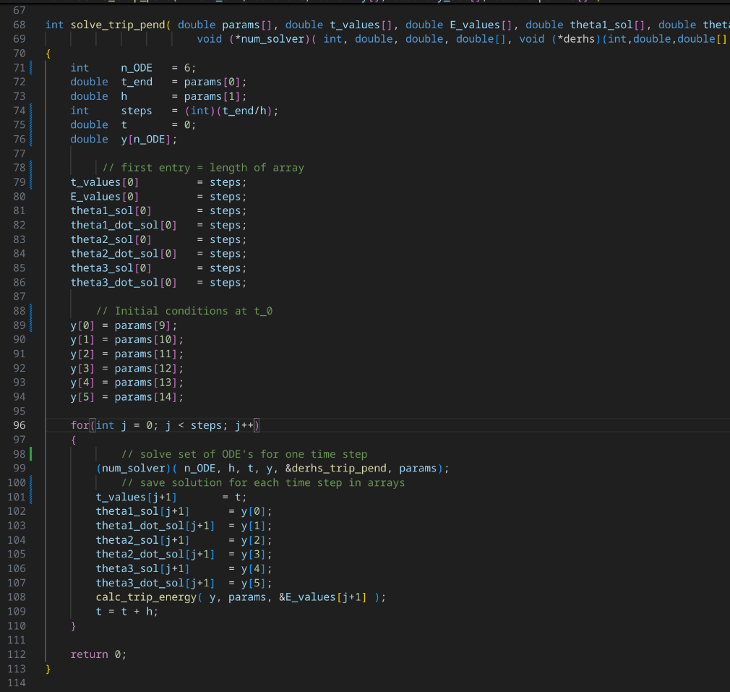
Numerical Simulation: full solver

Slide 7
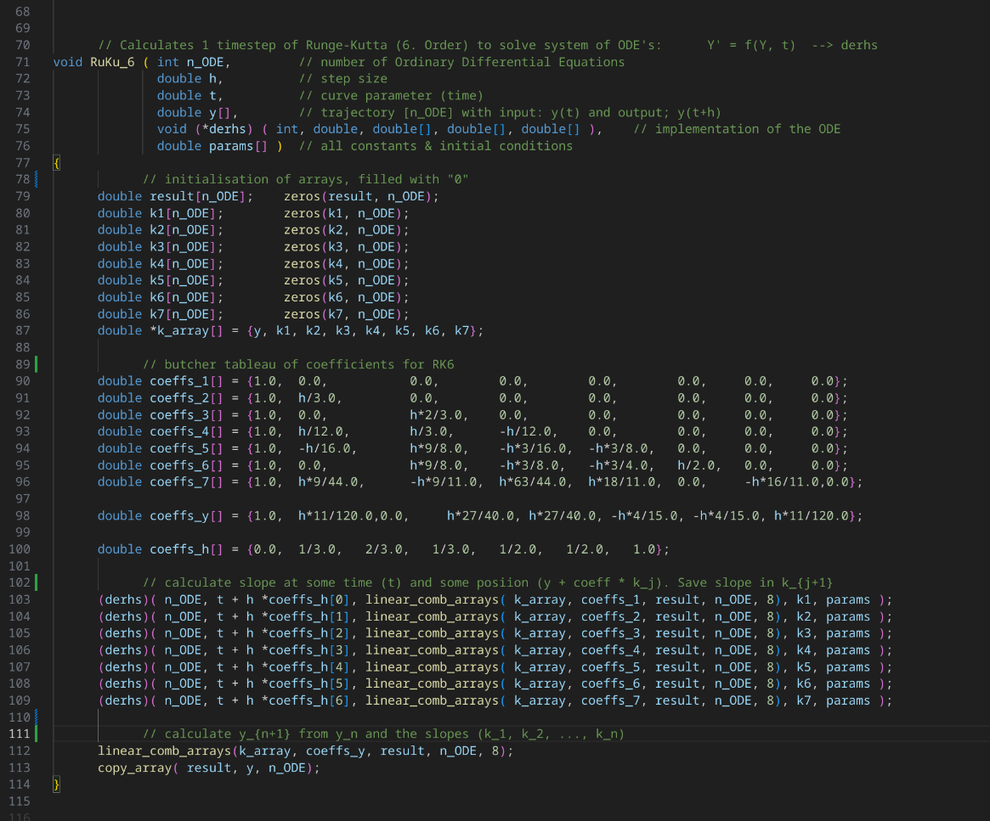
Numerical Simulation: RK6 method

Slide 8
Numerical Simulation: RK6 method (2)

Slide 9
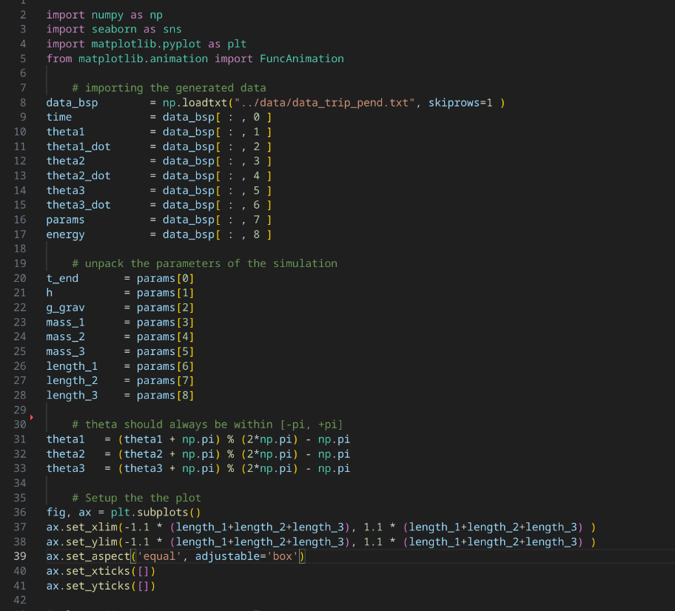
Creating Animations: Import Data

Slide 10
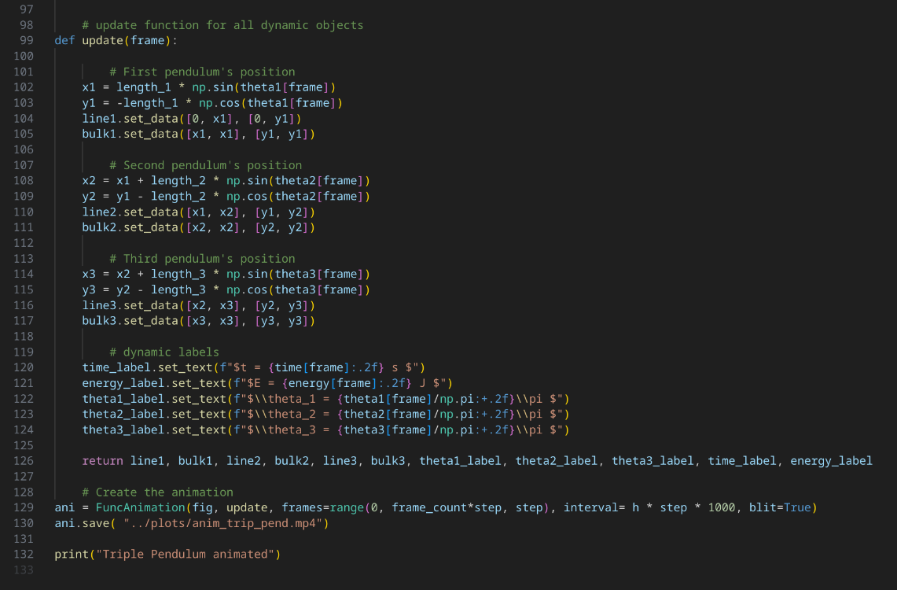
Creating Animations: Update Objects

Slide 11

Results:
$$\text{m}\text{1} \text{= }\text{m}\text{2 }\text{= }\text{m}\text{3}$$

Slide 12

Results:
$$\text{m}\text{1} \text{≫ }\text{m}\text{2 }\text{+} \text{m}\text{3}$$

Slide 13
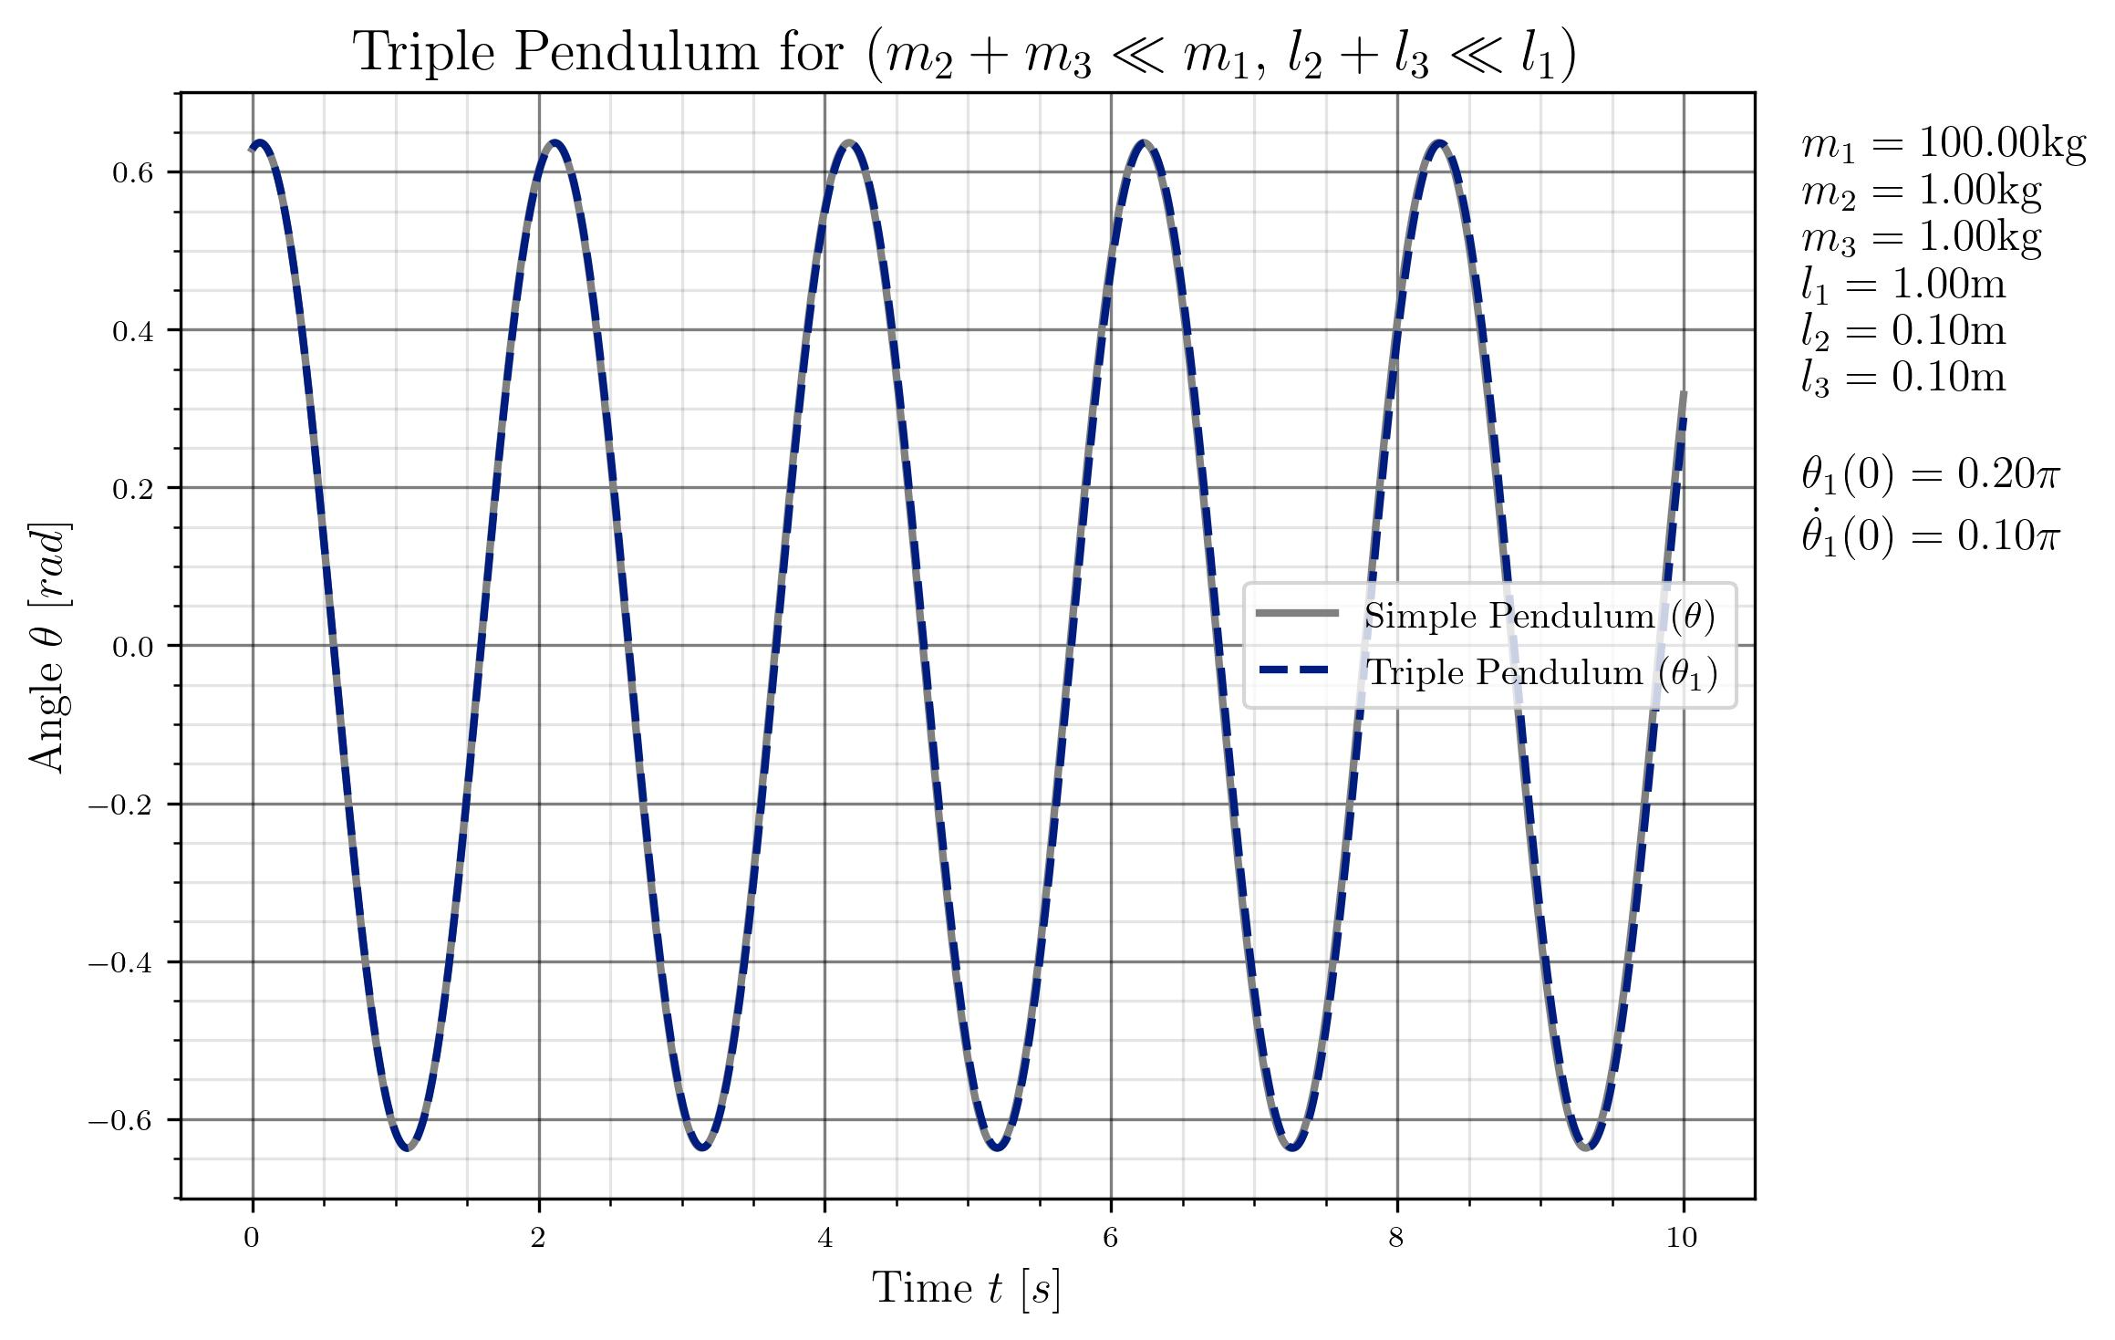
Results:
$$\text{m}\text{1} \text{≫ }\text{m}\text{2 }\text{+} \text{m}\text{3}$$

Slide 14

Results:
$$\text{m}\text{2 }\text{≫ }\text{m}\text{1} \text{+} \text{m}\text{3}$$

Slide 15
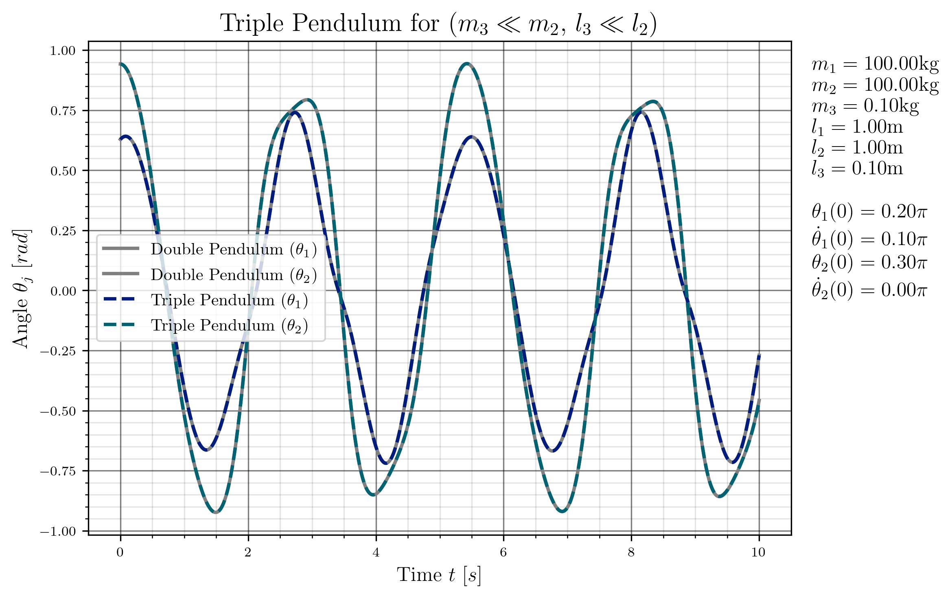

Results:
$$\text{m}\text{1} \text{+} \text{m}\text{2 }\text{≫ }\text{m}\text{3}$$

Slide 16

Results:
$$\text{Sensitivity} \text{to} \text{initial} \text{conditons}$$
$$∆θ_{1}\left(0\right)={10}^{−4}π$$

Slide 17
Results:
$$\text{Sensitivity} \text{to} \text{Numerical} \text{Solvers}\text{ / }\text{Step} \text{size}$$

Slide 18
Thank you for your attention!
References:
[1] https://www.researchgate.net/figure/The-simple-triple-pendulum_fig4_341399839 [accessed 4 Feb 2025]

