Slide 1
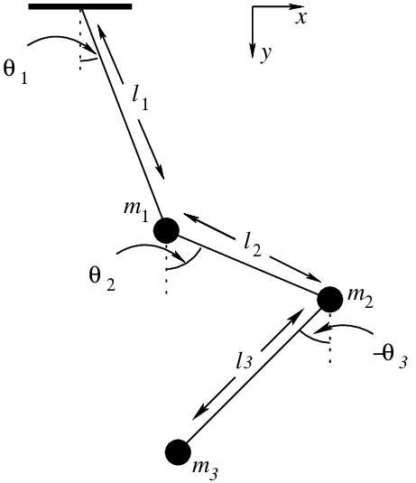
Animating The Triple Pendulum
By Noah Jaspal Reinhardt

Slide 2

Contents
Structure
The Equations of Motion
Numerical Simulation
Results

Slide 3


The Equations of Motion
Choice of Coordinates
$$\vec{x_{1}}=l_{1}⋅\left(\begin{matrix}\sin\left(θ_{1}\right),\cos\left(θ_{1}\right)\end{matrix}\right)$$
$$\vec{x_{2}}=\vec{x_{1}}+l_{2}⋅\left(\begin{matrix}\sin\left(θ_{2}\right), \cos\left(θ_{2}\right)\end{matrix}\right)$$
$$\vec{x_{3}}=\vec{x_{2}}+l_{3}⋅\left(\begin{matrix}\sin\left(θ_{3}\right), \cos\left(θ_{3}\right)\end{matrix}\right)$$
The Euler-Lagrange Formalism
$$ℒ=E_{kin}−E_{pot}\text{ ;} \frac{∂ℒ}{∂θ_{i}}−\frac{d}{dt}\left(\frac{∂ℒ}{∂\dot{θ_{i}}}\right)=0$$
$$E_{kin}=\frac{1}{2}m_{1}\dot{{\vec{x}}_{1}^{2}}+\frac{1}{2}m_{2}\dot{{\vec{x}}_{2}^{2}}+\frac{1}{2}m_{3}\dot{{\vec{x}}_{3}^{2}}$$
$E_{pot}=g⋅m_{1}y_{1}+g⋅m_{2}y_{2}+g⋅m_{3}y_{3}$
[1]

Slide 4



The Equations of Motion
The Euler-Lagrange Formalism
$$0=\frac{∂ℒ}{∂θ_{1}}−\frac{d}{dt}\left(\frac{∂ℒ}{∂\dot{θ_{1}}}\right)=g⋅\left(m_{1}+m_{2}+m_{3}\right)\sin\left(θ_{1}\right)−\left(m_{2}+m_{3}\right)l_{2}\dot{θ_{2}^{2}}\sin\left(θ_{1}−θ_{2}\right)−m_{3}l_{3}\dot{θ_{3}^{2}}\sin\left(θ_{1}−θ_{3}\right) +\left(m_{1}+m_{2}+m_{3}\right)l_{1}\ddot{θ_{1}}+\left(m_{2}+m_{3}\right)l_{2}\ddot{θ_{2}}+m_{3}l_{3}\ddot{θ_{3}}$$
$$0=\frac{∂ℒ}{∂θ_{2}}−\frac{d}{dt}\left(\frac{∂ℒ}{∂\dot{θ_{2}}}\right)=g⋅\left(m_{2}+m_{3}\right)\sin\left(θ_{2}\right)−\left(m_{2}+m_{3}\right)l_{1}\dot{θ_{1}^{2}}\sin\left(θ_{1}−θ_{2}\right)−m_{3}l_{3}\dot{θ_{3}^{2}}\sin\left(θ_{2}−θ_{3}\right) +\left(m_{2}+m_{3}\right)l_{1}\cos\left(θ_{1}−θ_{2}\right)\ddot{θ_{1}}+\left(m_{2}+m_{3}\right)l_{2}\ddot{θ_{2}}+m_{3}l_{3}\cos\left(θ_{2}−θ_{3}\right)\ddot{θ_{3}}$$
$$0=\frac{∂ℒ}{∂θ_{3}}−\frac{d}{dt}\left(\frac{∂ℒ}{∂\dot{θ_{3}}}\right)$$
$$=g⋅m_{3}\sin\left(θ_{3}\right)−m_{3}l_{1}\dot{θ_{1}^{2}}\sin\left(θ_{1}−θ_{3}\right)−m_{3}l_{2}\dot{θ_{2}^{2}}\sin\left(θ_{2}−θ_{3}\right)$$
$$m_{3}l_{1}\cos\left(θ_{1}−θ_{3}\right\}\ddot{θ_{1}}+m_{3}l_{2}\cos\left(θ_{2}−θ_{3}\right\}\ddot{θ_{2}}+m_{3}l_{3}\ddot{θ_{3}}$$

Slide 5

Numerical Simulation: Principles
Set initial condition: $f\left(t=0\right)=f$₀
Calculate slopes using the ODE: $\frac{df}{dt}$ = $ODE(f,t)$
Estimate function at $t_{n+1}=t_{n}+h$
Numerical solver: method to estimate the function using its slope
solver of n^{th} order: method with global error of $h^{n}$

Slide 6
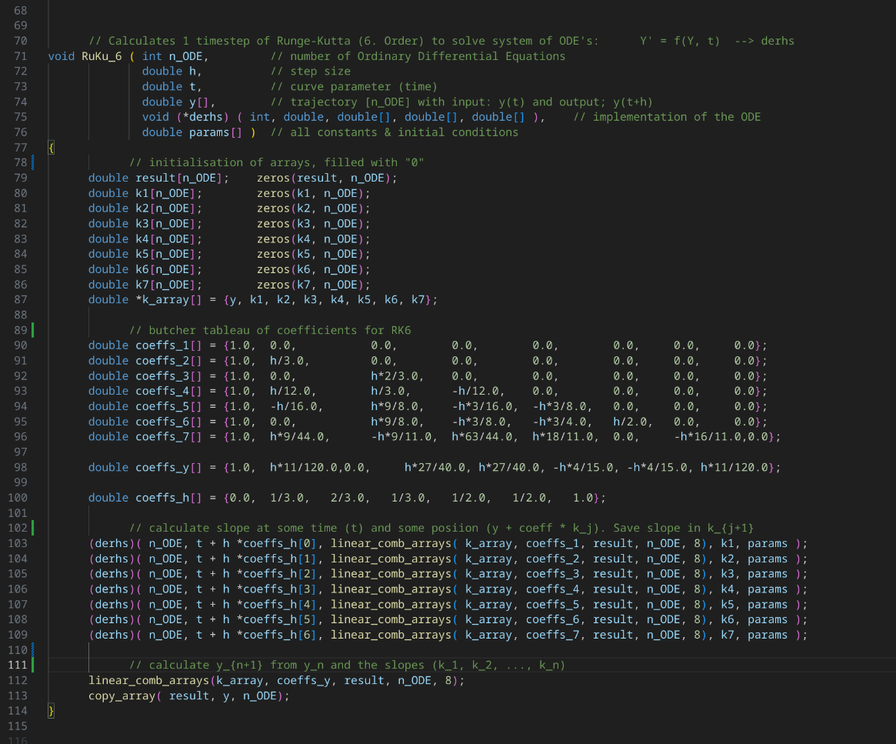
Numerical Simulation: RK6 method

Slide 7

Results: Equal Masses
$$\text{m}\text{1} \text{= }\text{m}\text{2 }\text{= }\text{m}\text{3}$$

Slide 8

Results: The Simple Pendulum Approx.
$$\text{m}\text{1} \text{≫ }\text{m}\text{2 }\text{+} \text{m}\text{3}$$

Slide 9
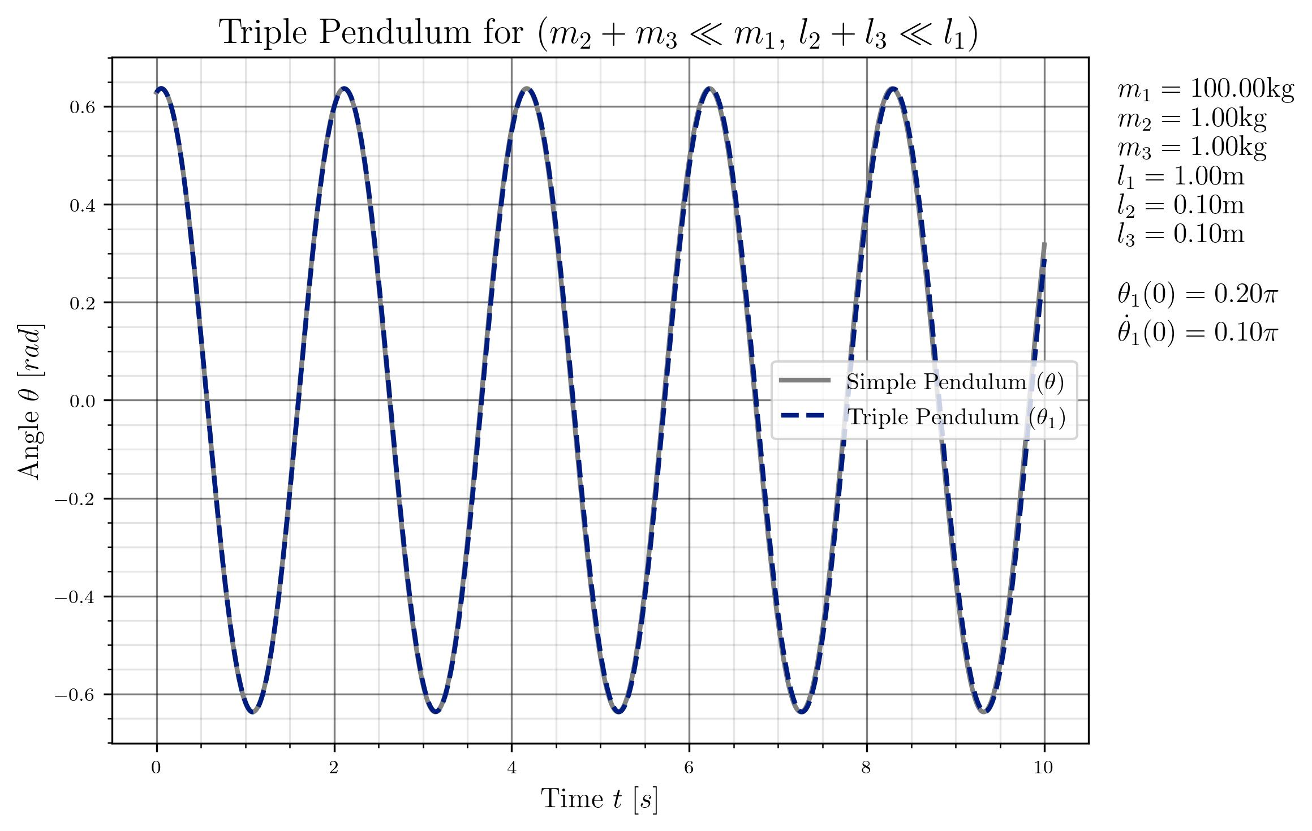
Results: The Simple Pendulum Approx.
$$\text{m}\text{1} \text{≫ }\text{m}\text{2 }\text{+} \text{m}\text{3}$$

Slide 10
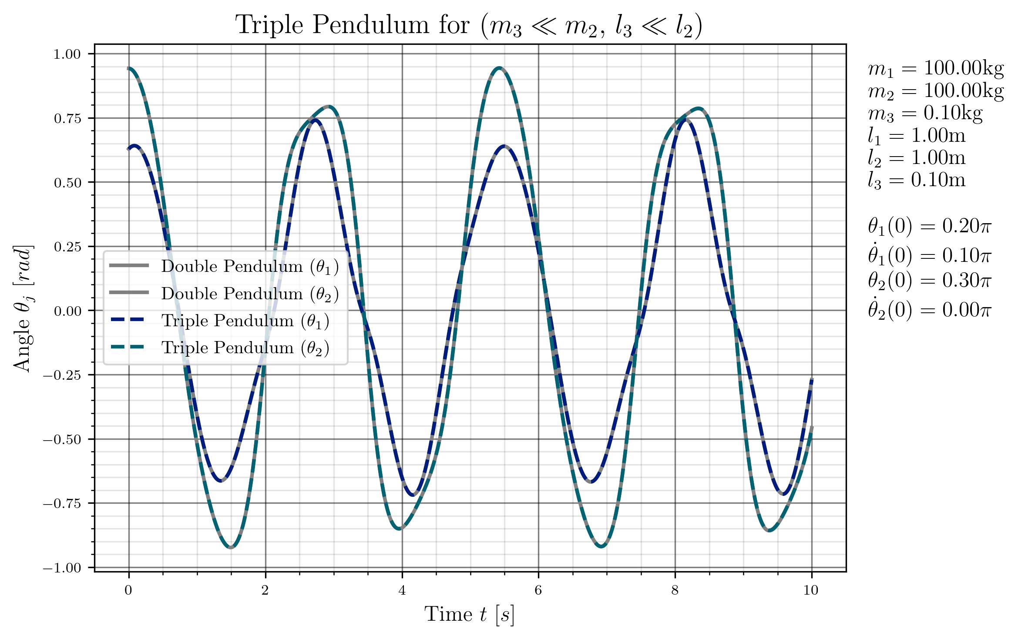

Results: The Double Pendulum Approx.
$$\text{m}\text{1} \text{+} \text{m}\text{2 }\text{≫ }\text{m}\text{3}$$

Slide 11

Results: Simulation Breakpoints
$$\text{m}\text{2 }\text{≫ }\text{m}\text{1} \text{+} \text{m}\text{3}$$

Slide 12


Results: $\text{Sensitivity} \text{to} \text{initial} \text{conditons}$
$$∆θ_{1}\left(0\right)={10}^{−4}π$$

Slide 13

Results: $\text{Sensitivity} \text{to} \text{Numerical} \text{Solver}$
Solver
Runge-Kutta 2. order
Runge-Kutta 4. order
Runge-Kutta 6. order

Slide 14
Thank you for your attention!
Reference:
[1] https://www.researchgate.net/figure/The-simple-triple-pendulum_fig4_341399839 [accessed 4 Feb 2025]

