Slide 1
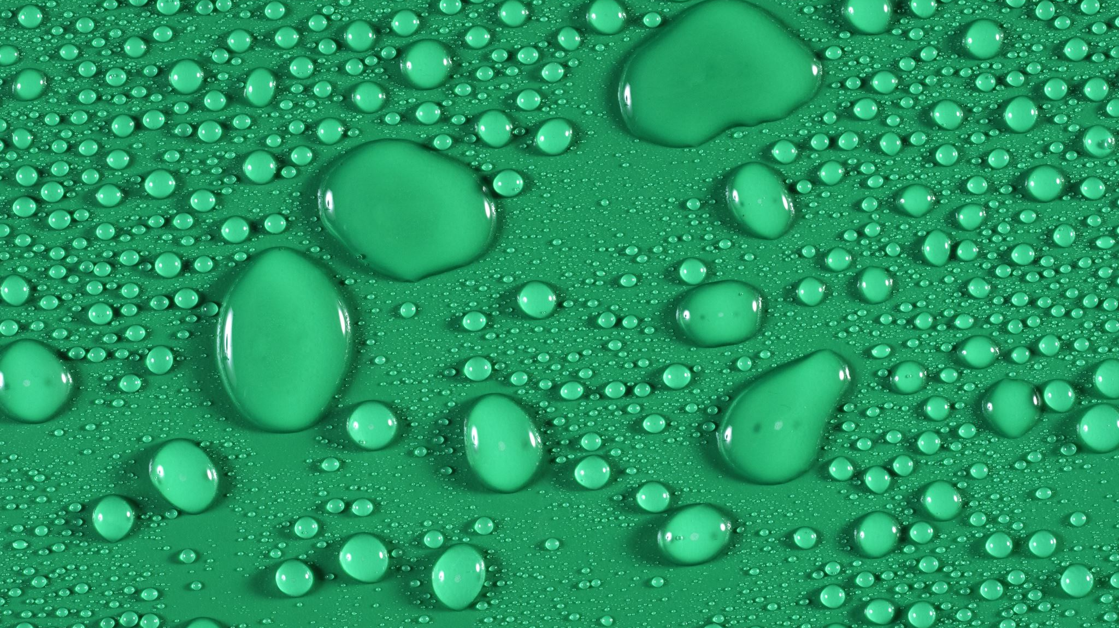
Droplets on Cylindrical PMMA Surfaces
Noah J. R.

Slide 2
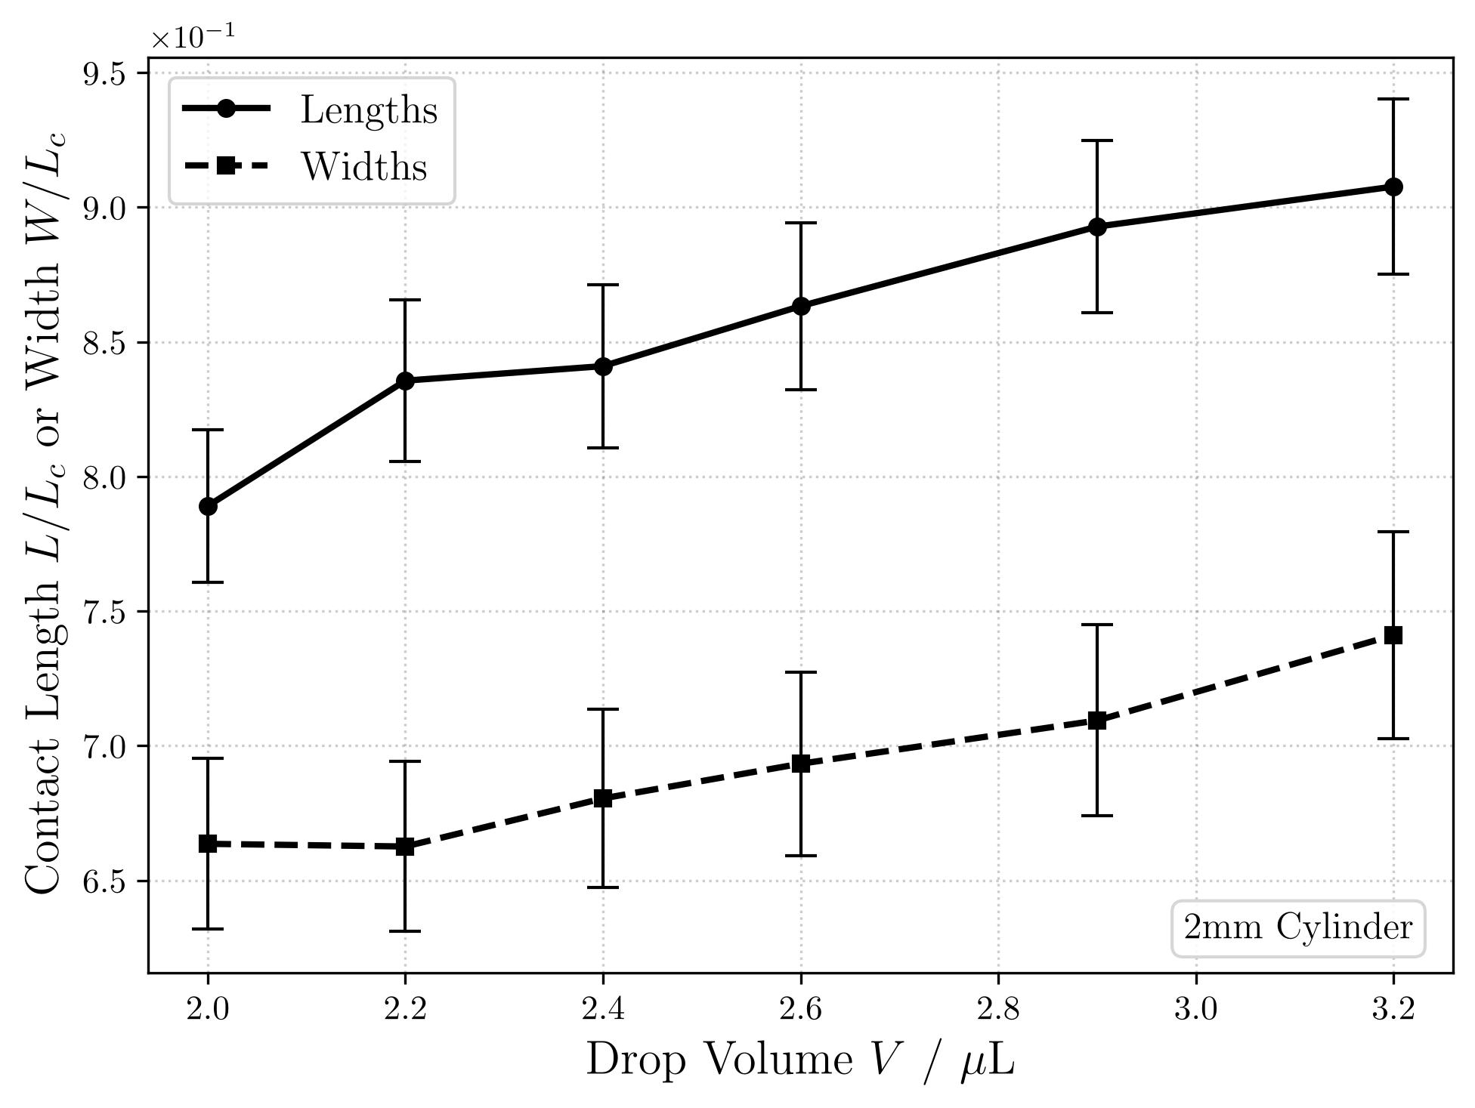
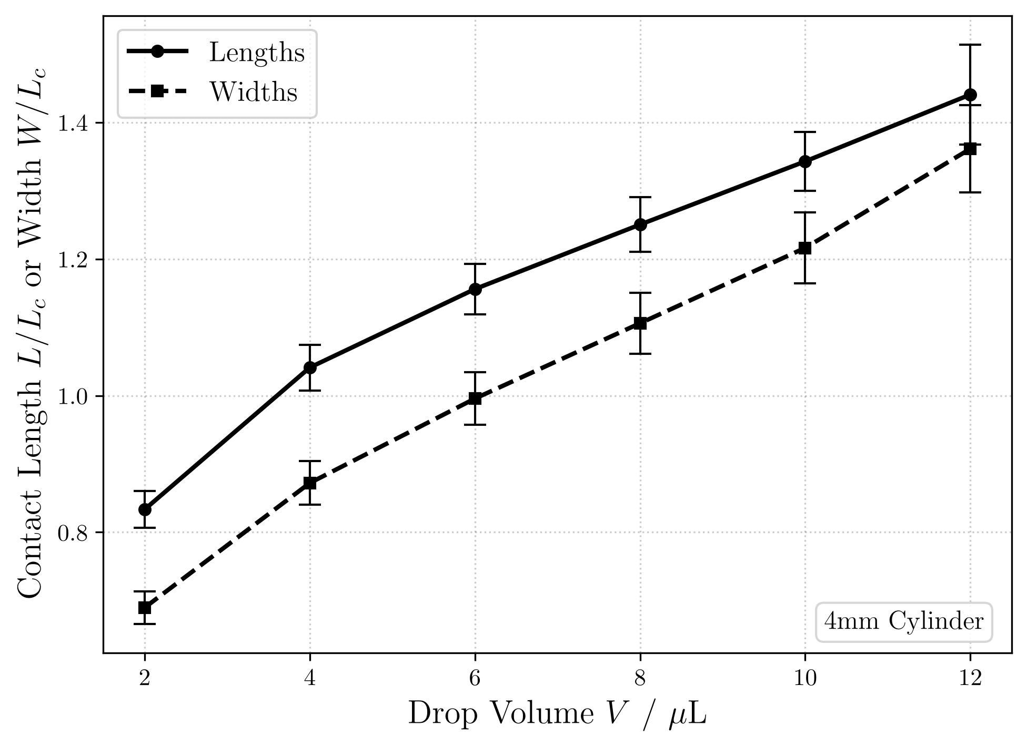
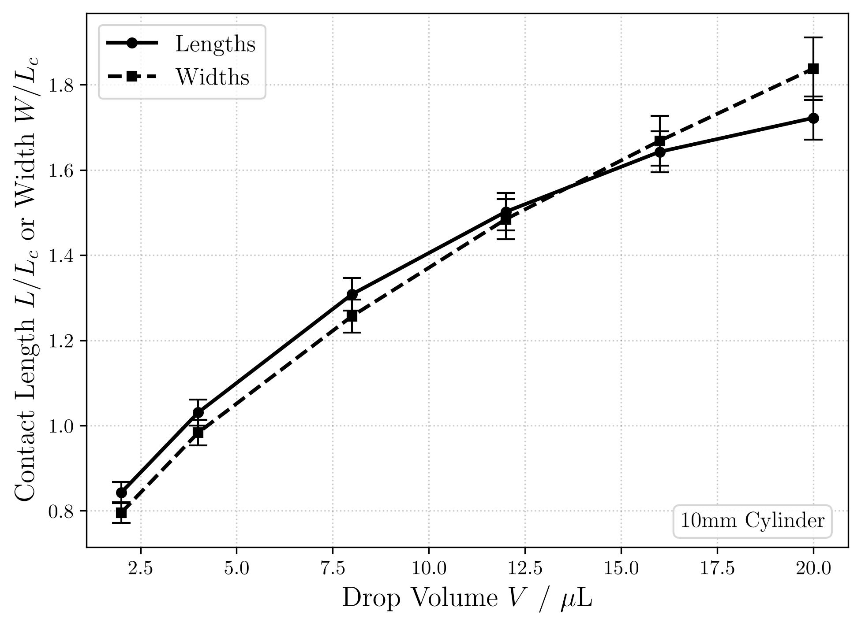
Contact Lengths (Refresher)
2mm PMMA
4mm PMMA
10mm PMMA

Slide 3
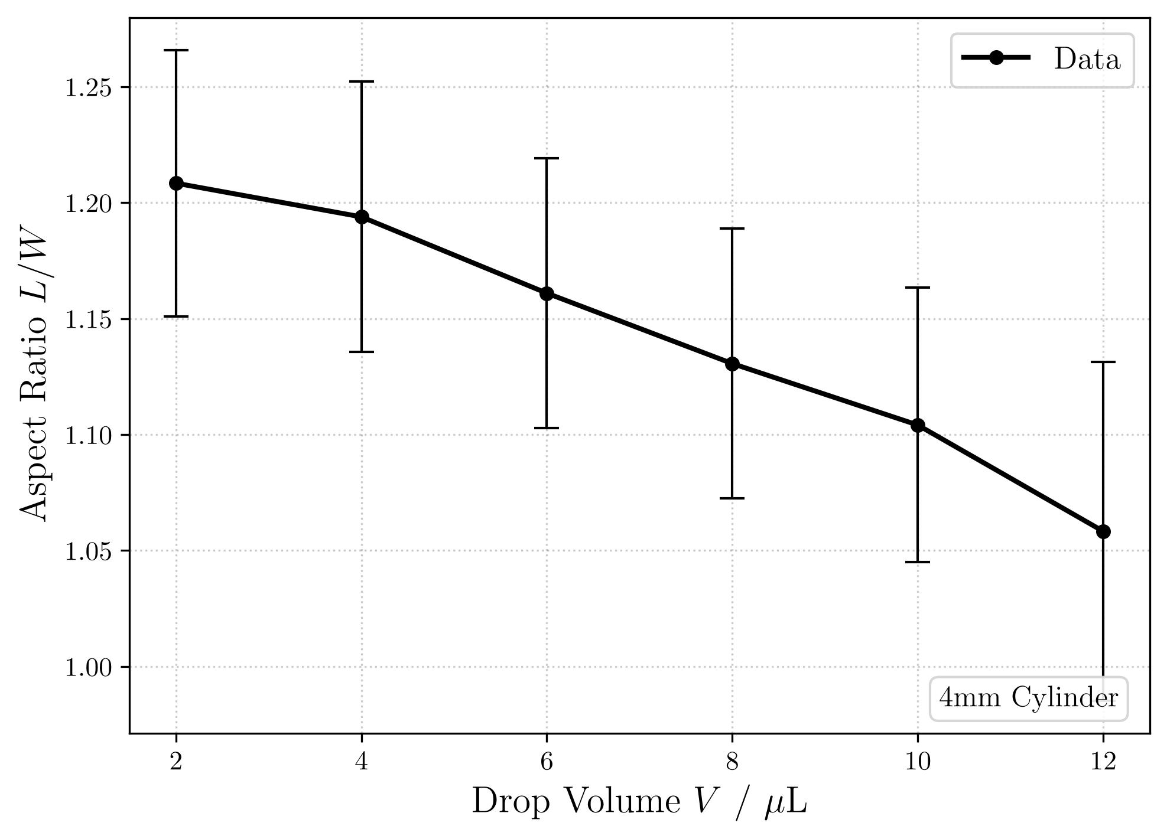
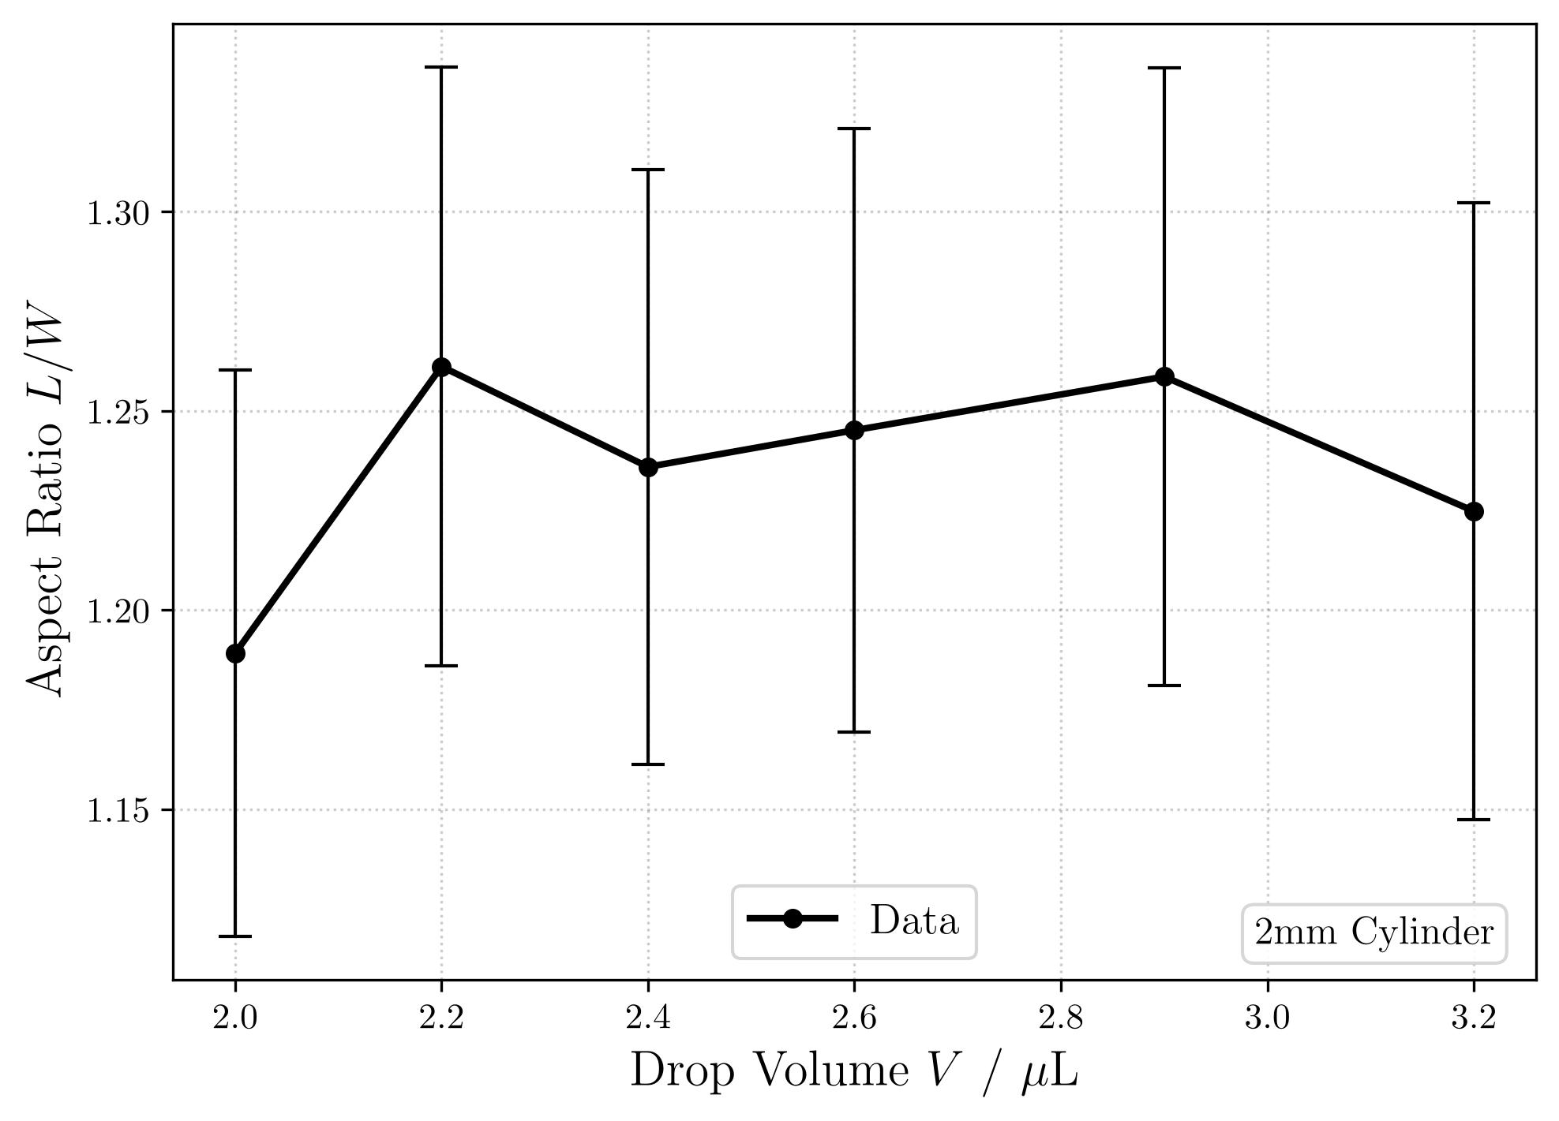
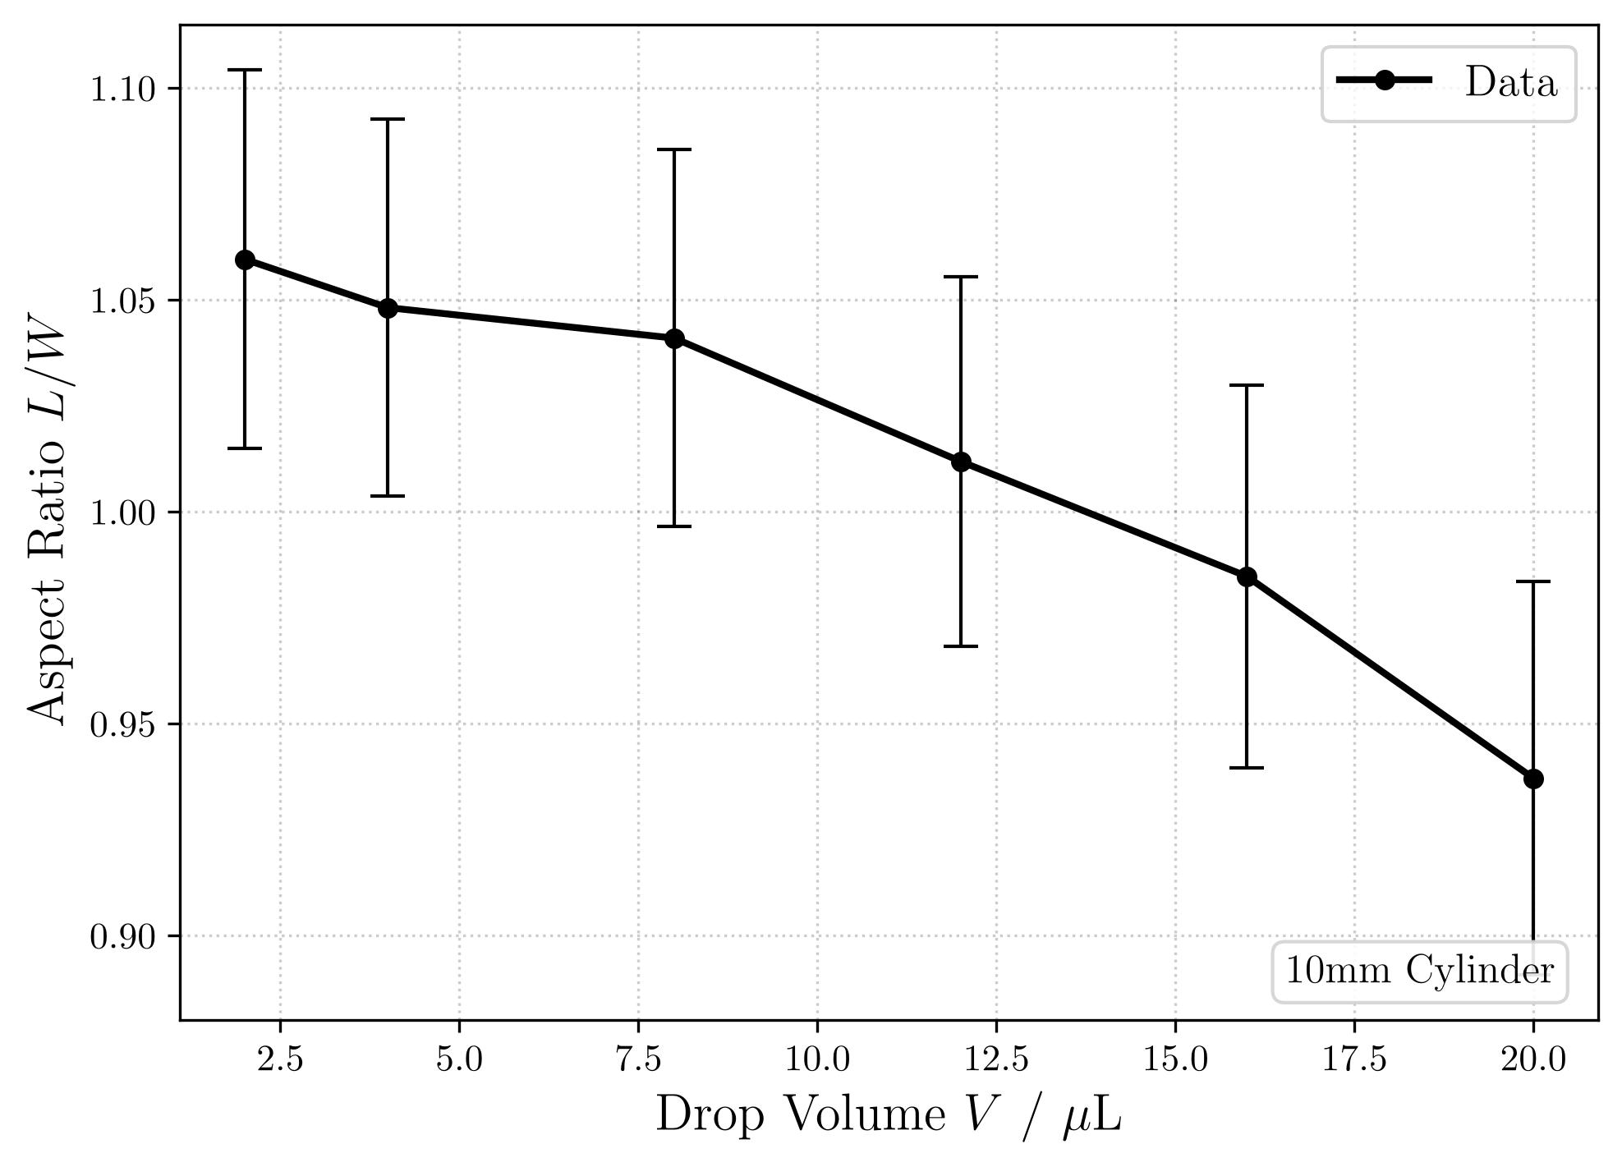
Aspect Ratios (Refresher)
2mm PMMA
4mm PMMA
10mm PMMA

Slide 4

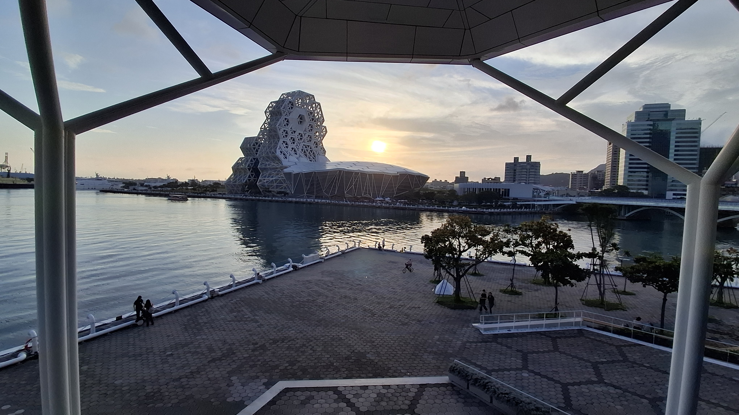
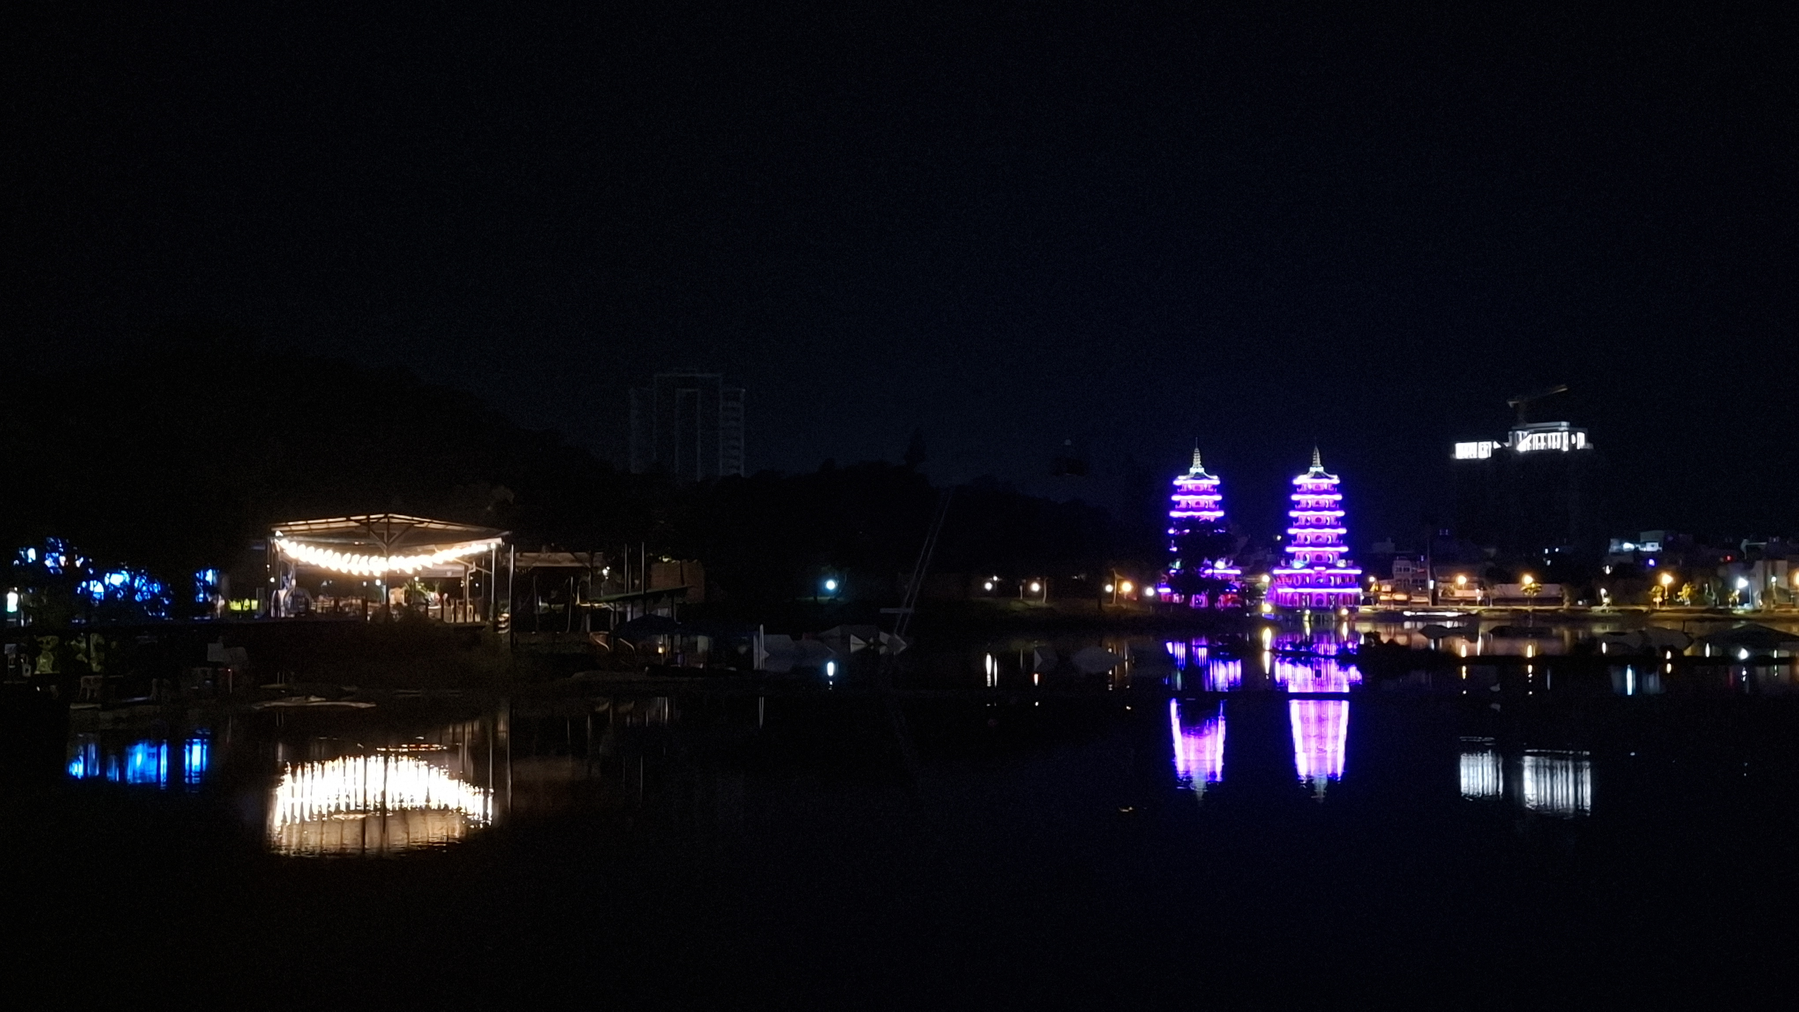
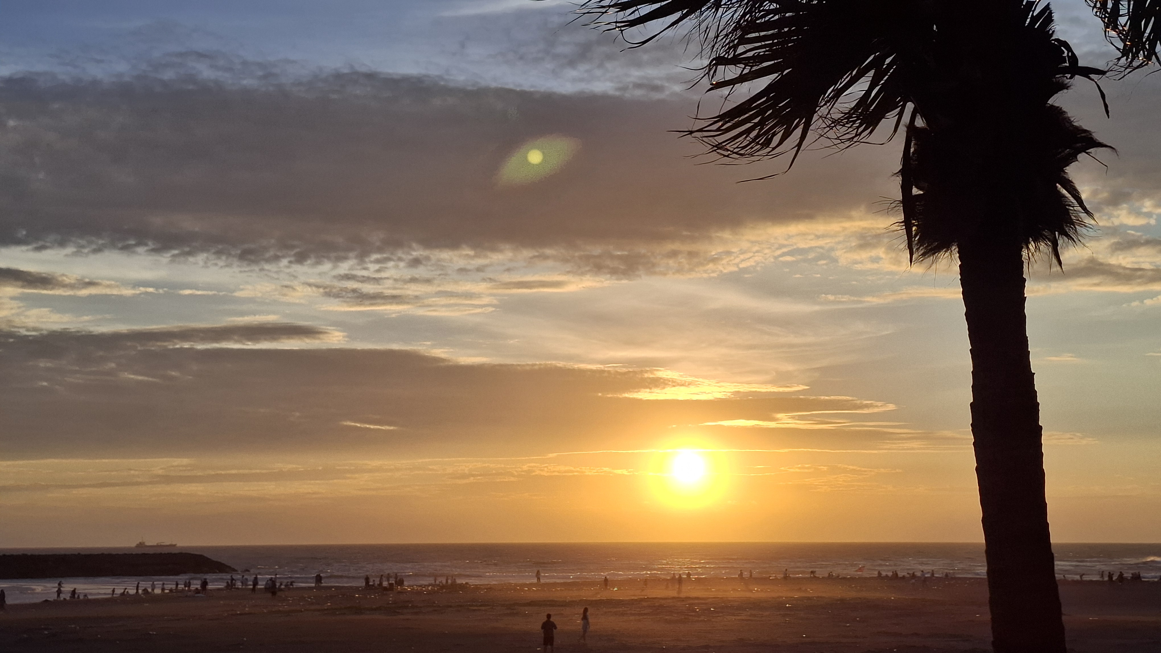
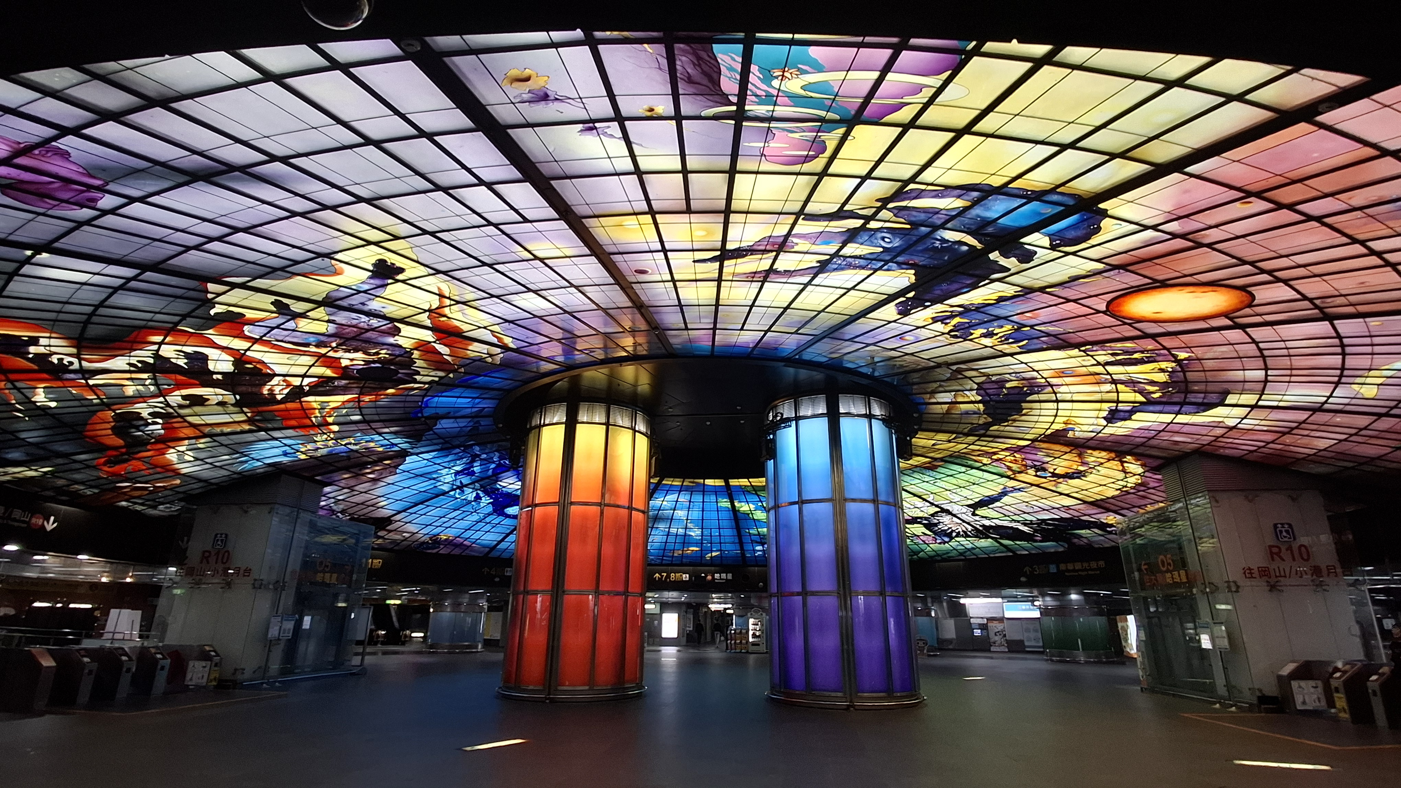
Kaohsiung

Slide 5


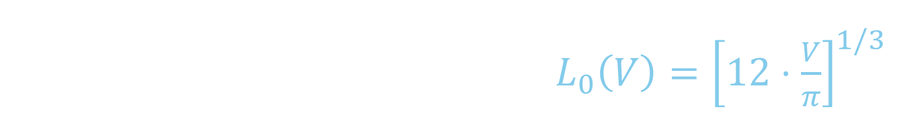
Comparing Volume with Contact Length
„Assume the Droplet describes a perfect half sphere.“
Half-Sphere Diameter: $L_{0}\left(V\right)={\left[12⋅\frac{V}{π}\right]}^{1/3}$
$L>L_{0}$ → „rounded droplet“
$L<L_{0}$ → „flattened droplet“

Slide 6
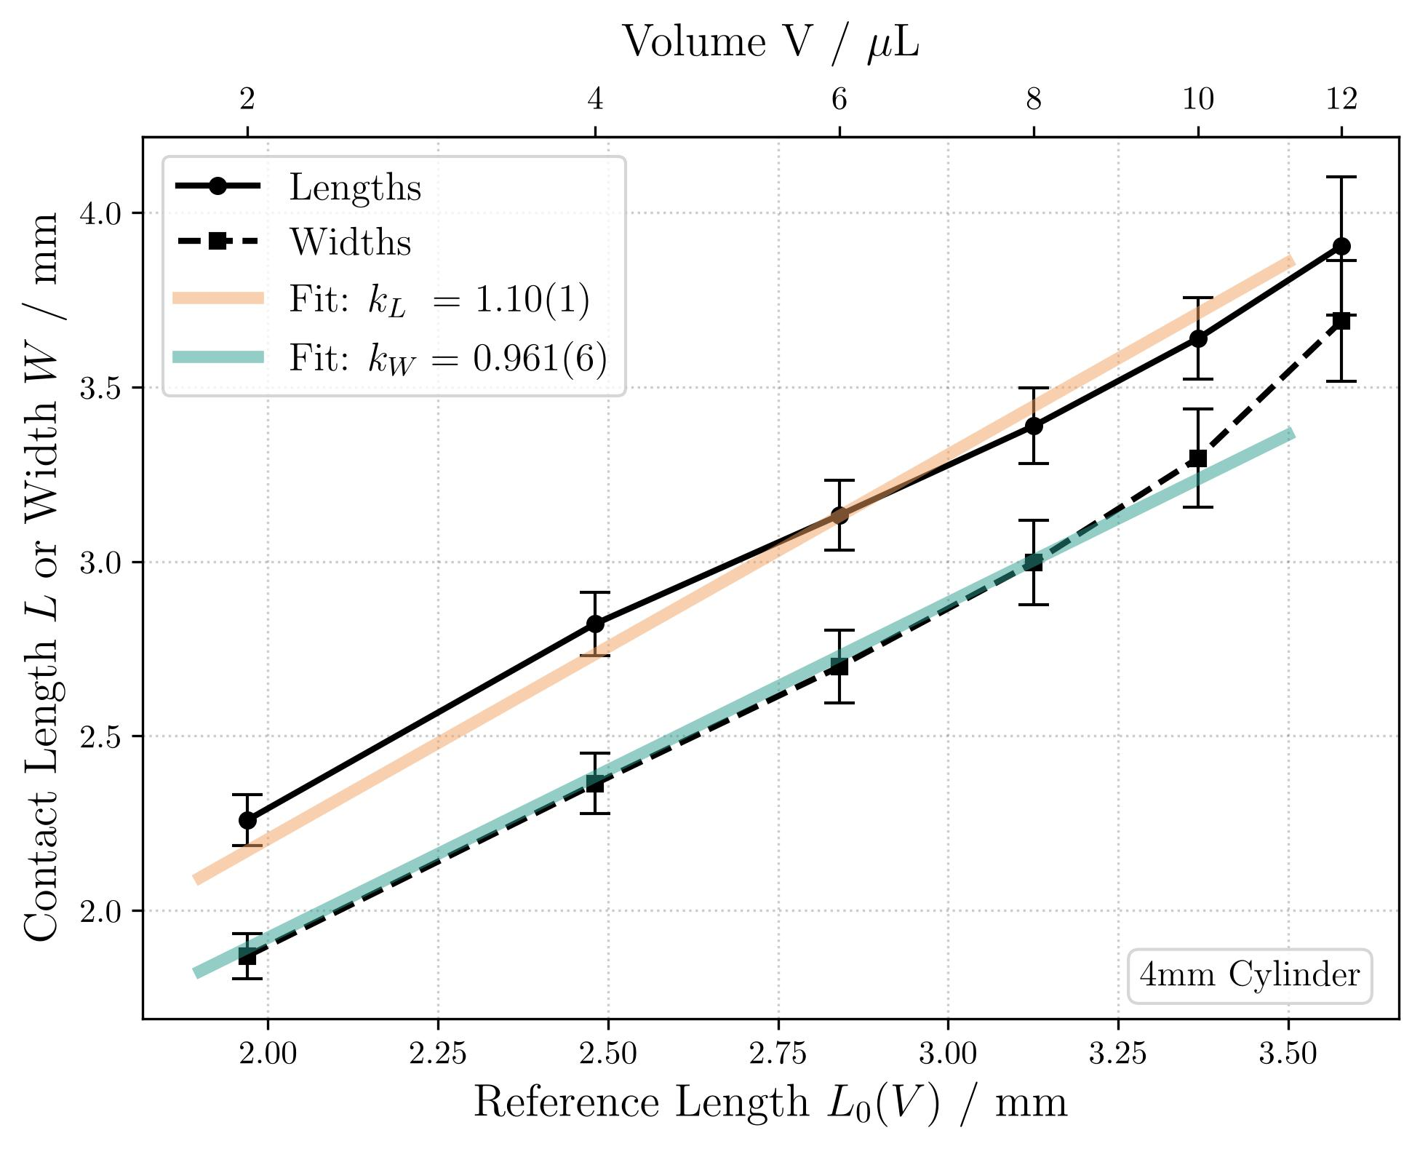
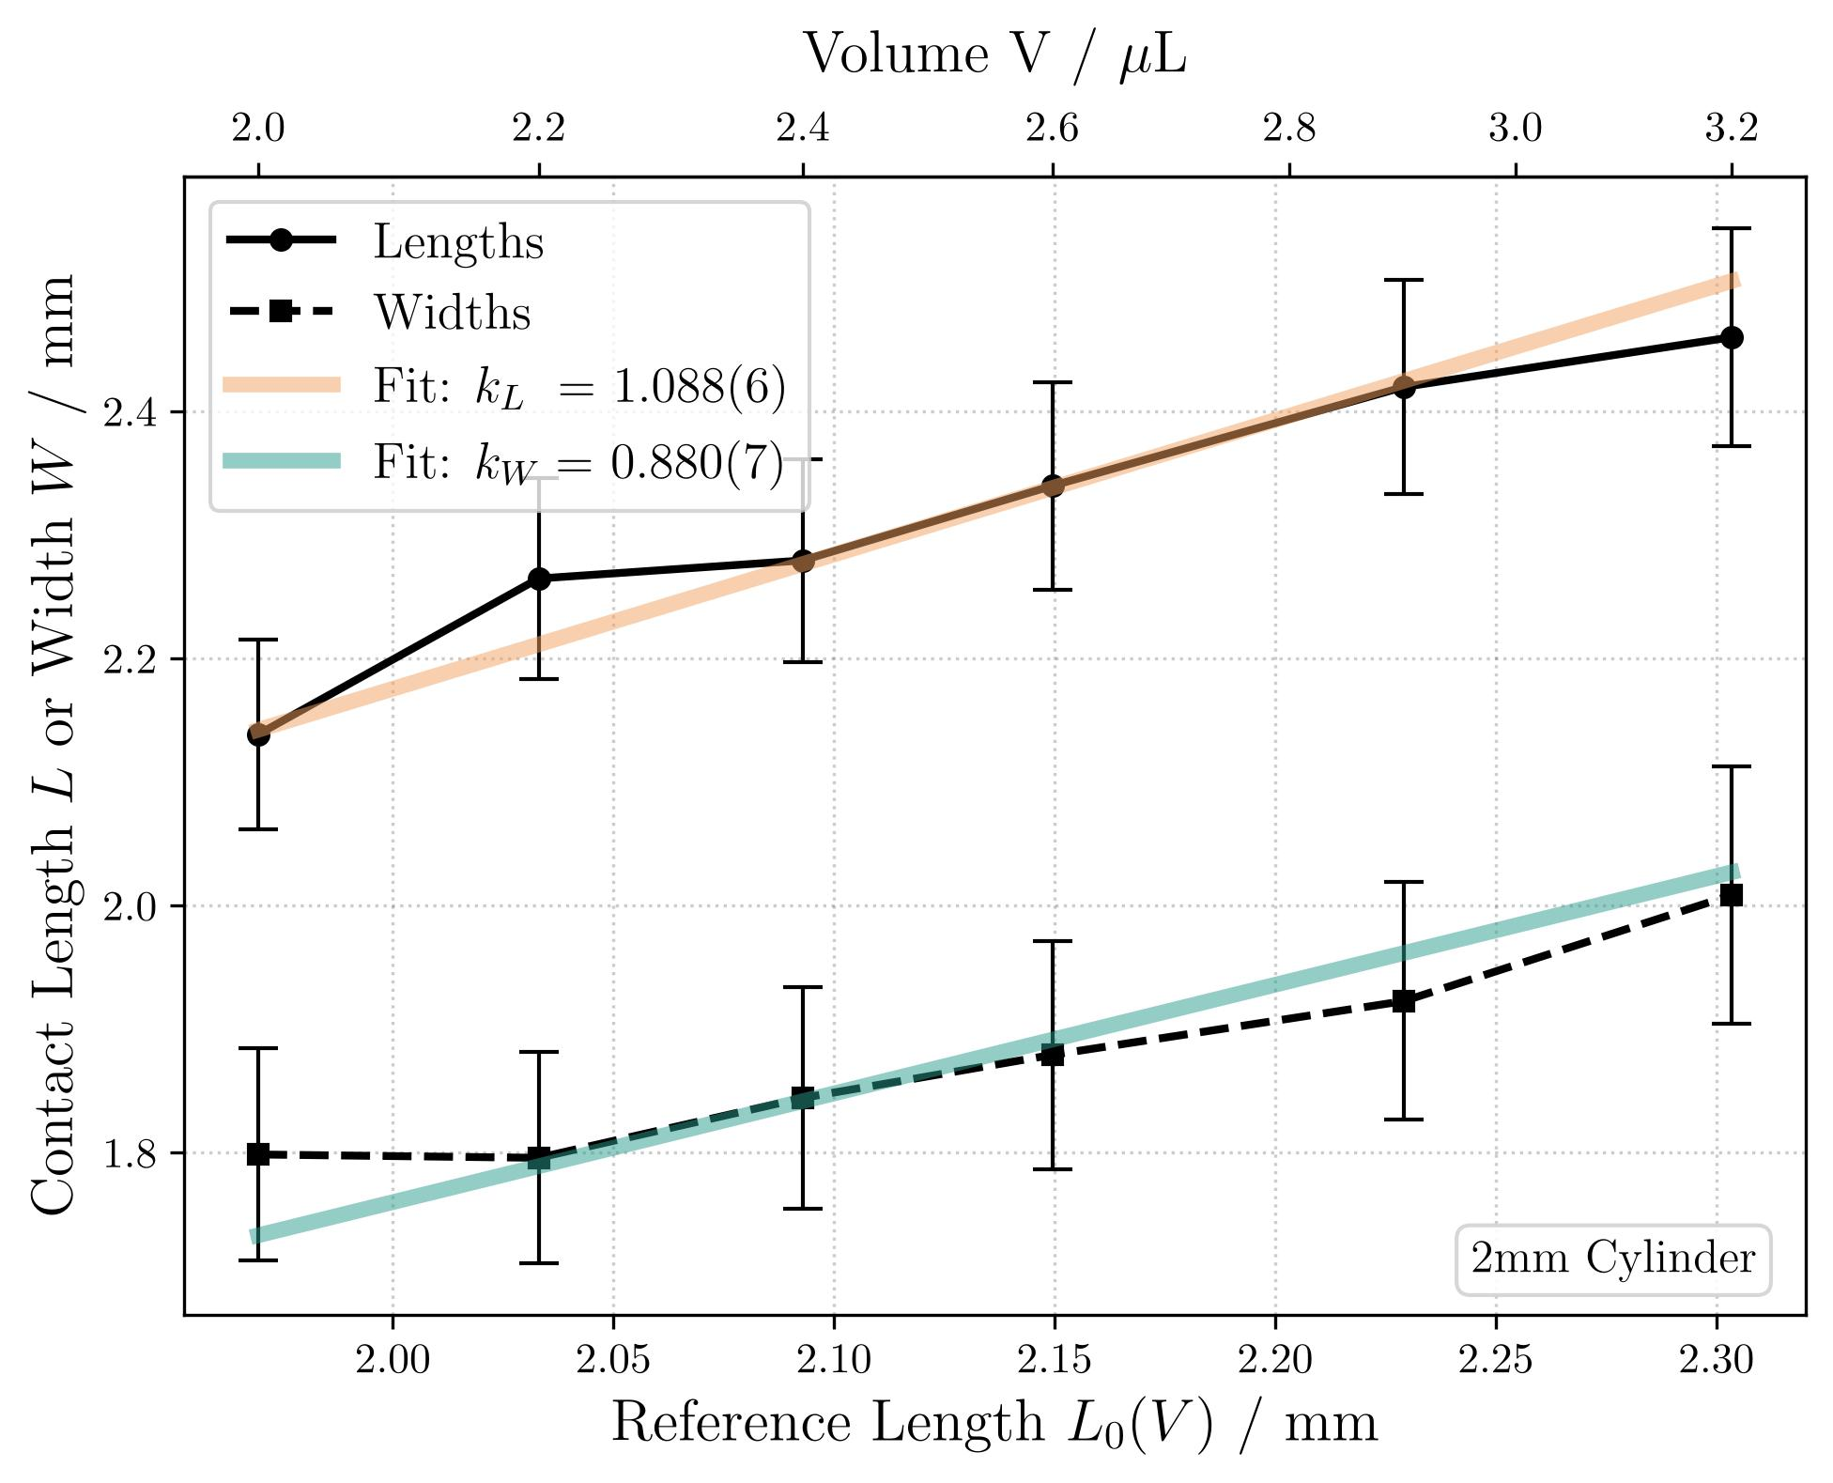
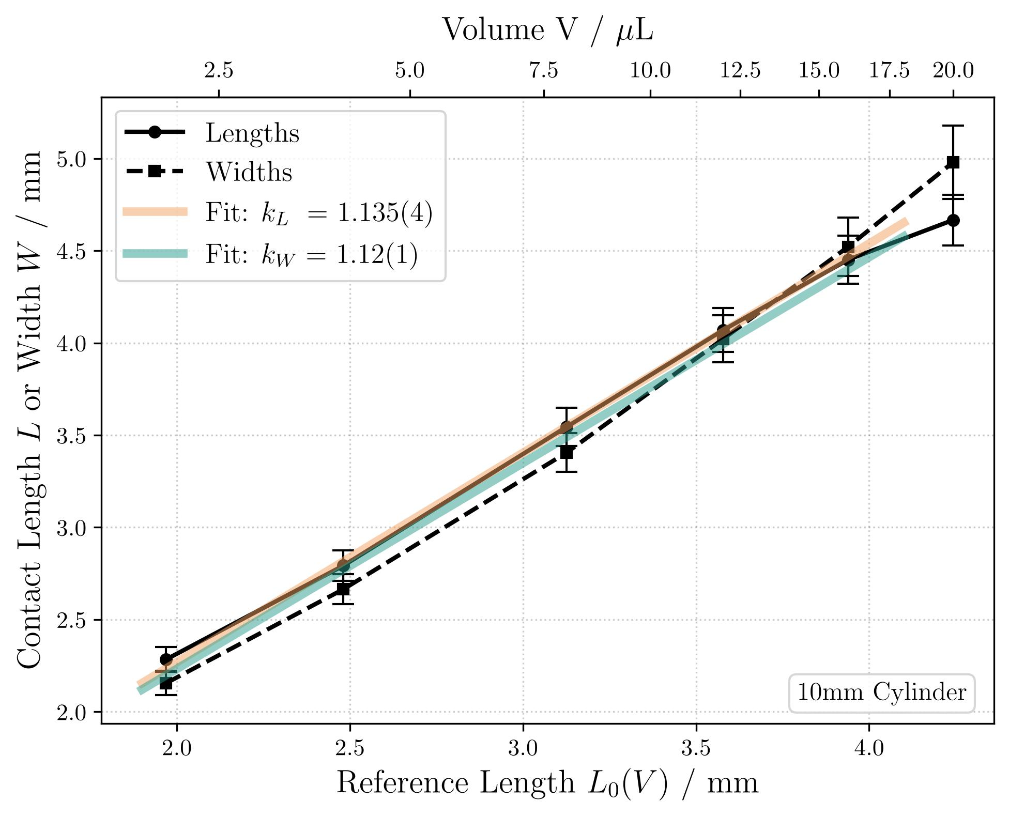
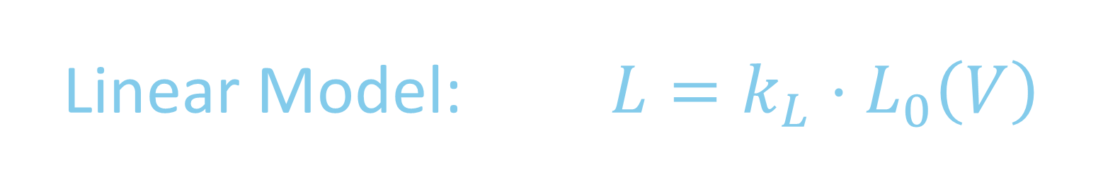

Linear Model: $L=k_{L}⋅L_{0}\left(V\right)$
2mm PMMA
4mm PMMA
10mm PMMA
Model fits with high flexibility! $(χ^{2}≪1)$

Slide 7
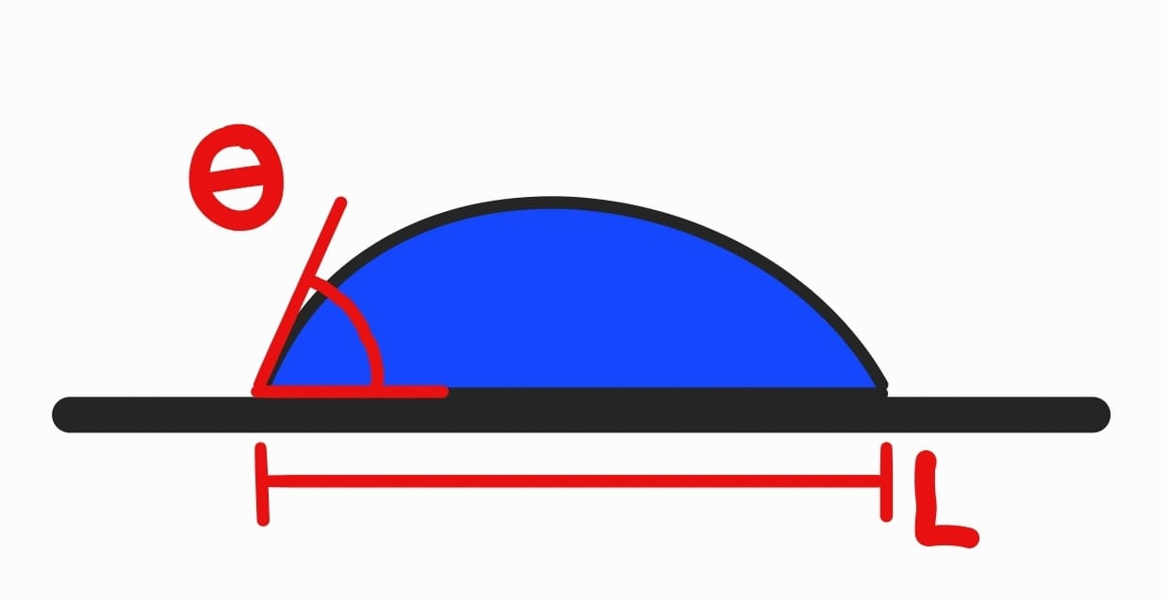
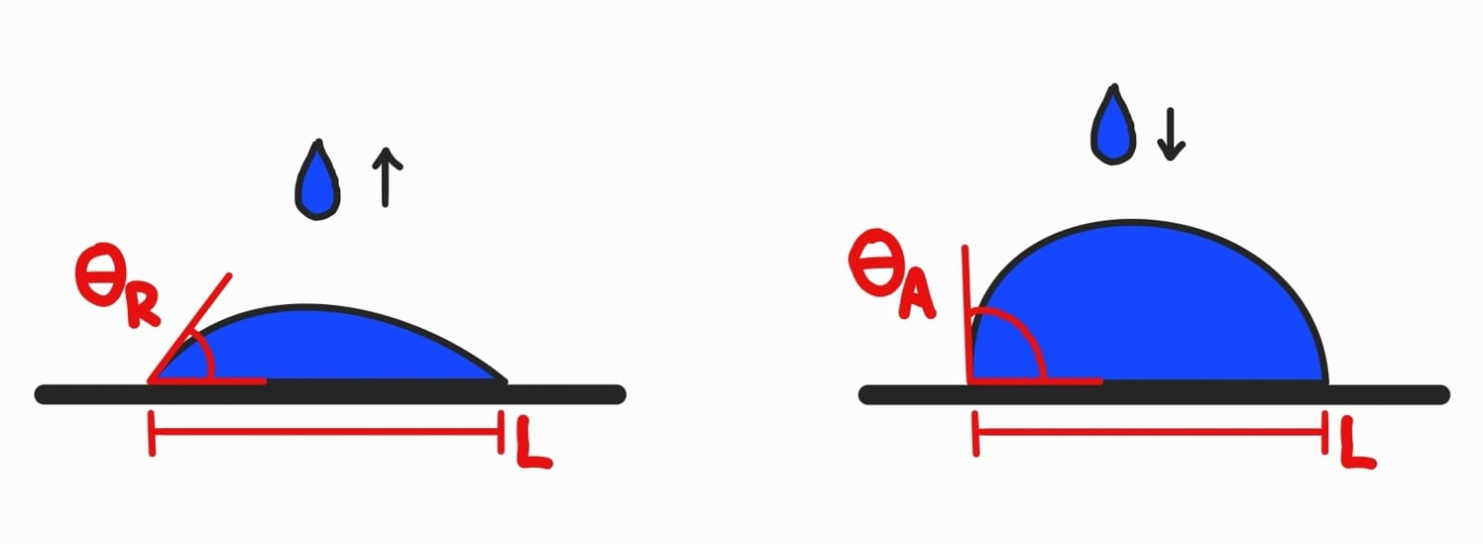
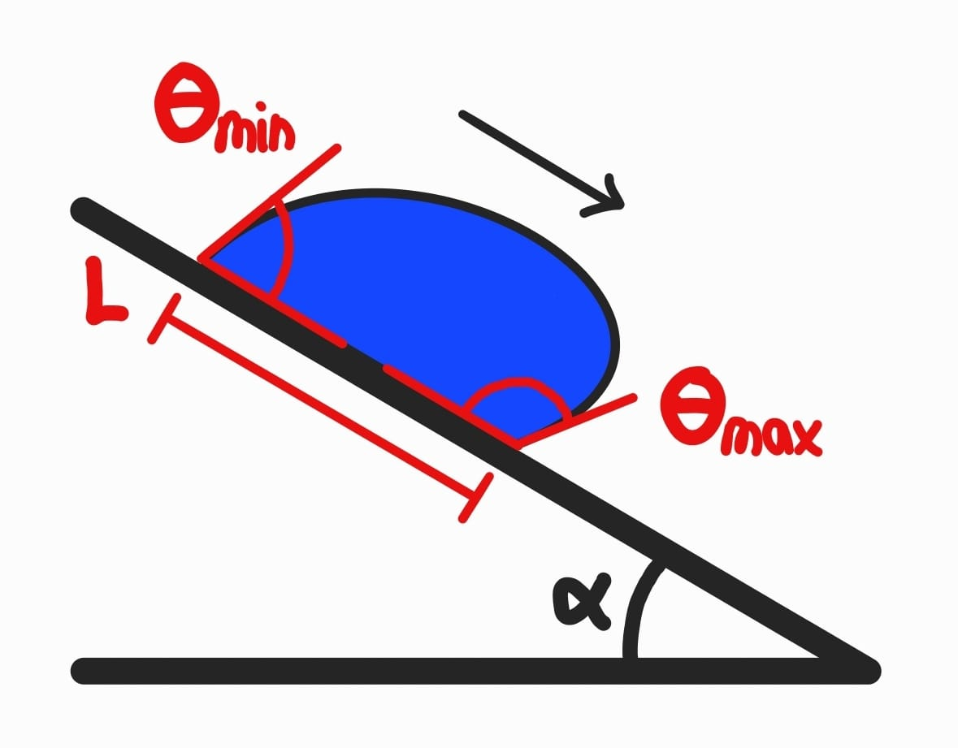
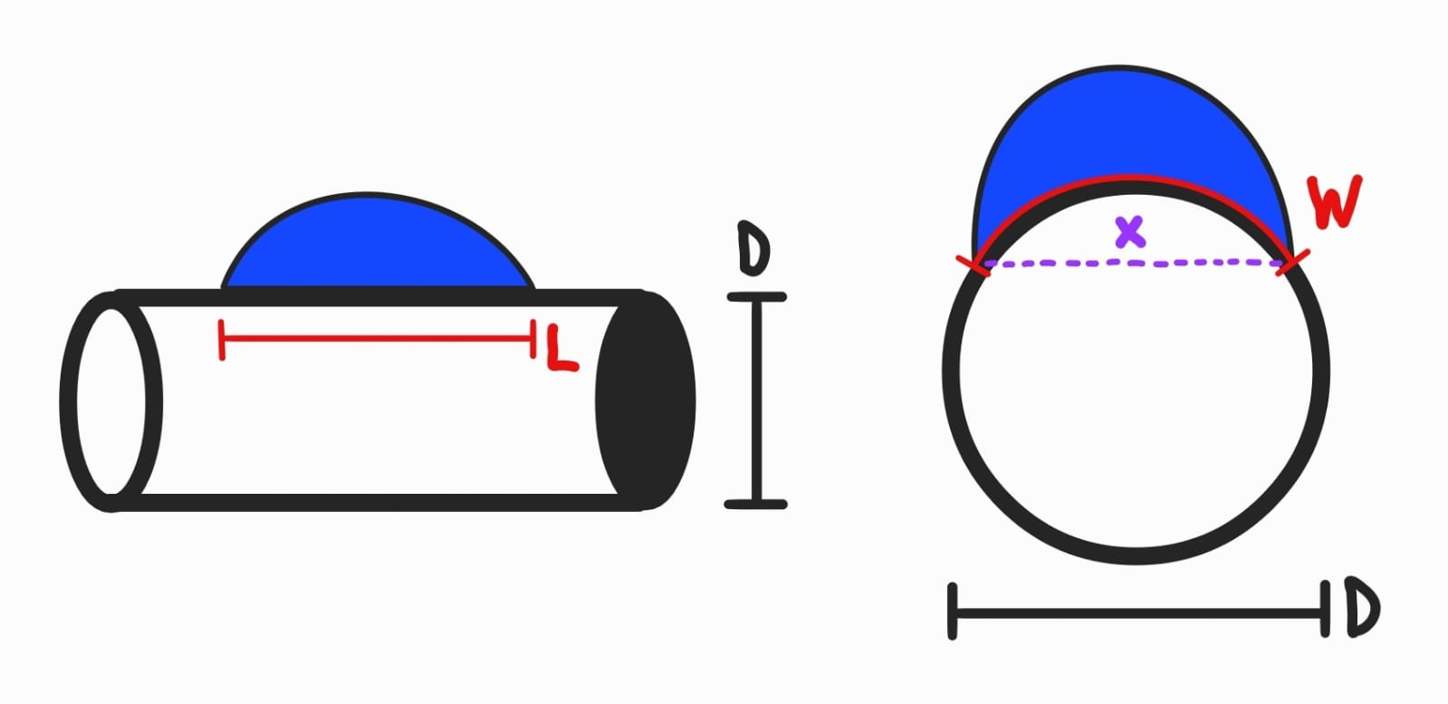
Report Preparations

