Slide 1

Droplets on Cylindrical PMMA Surfaces
Noah J. R.

Slide 2
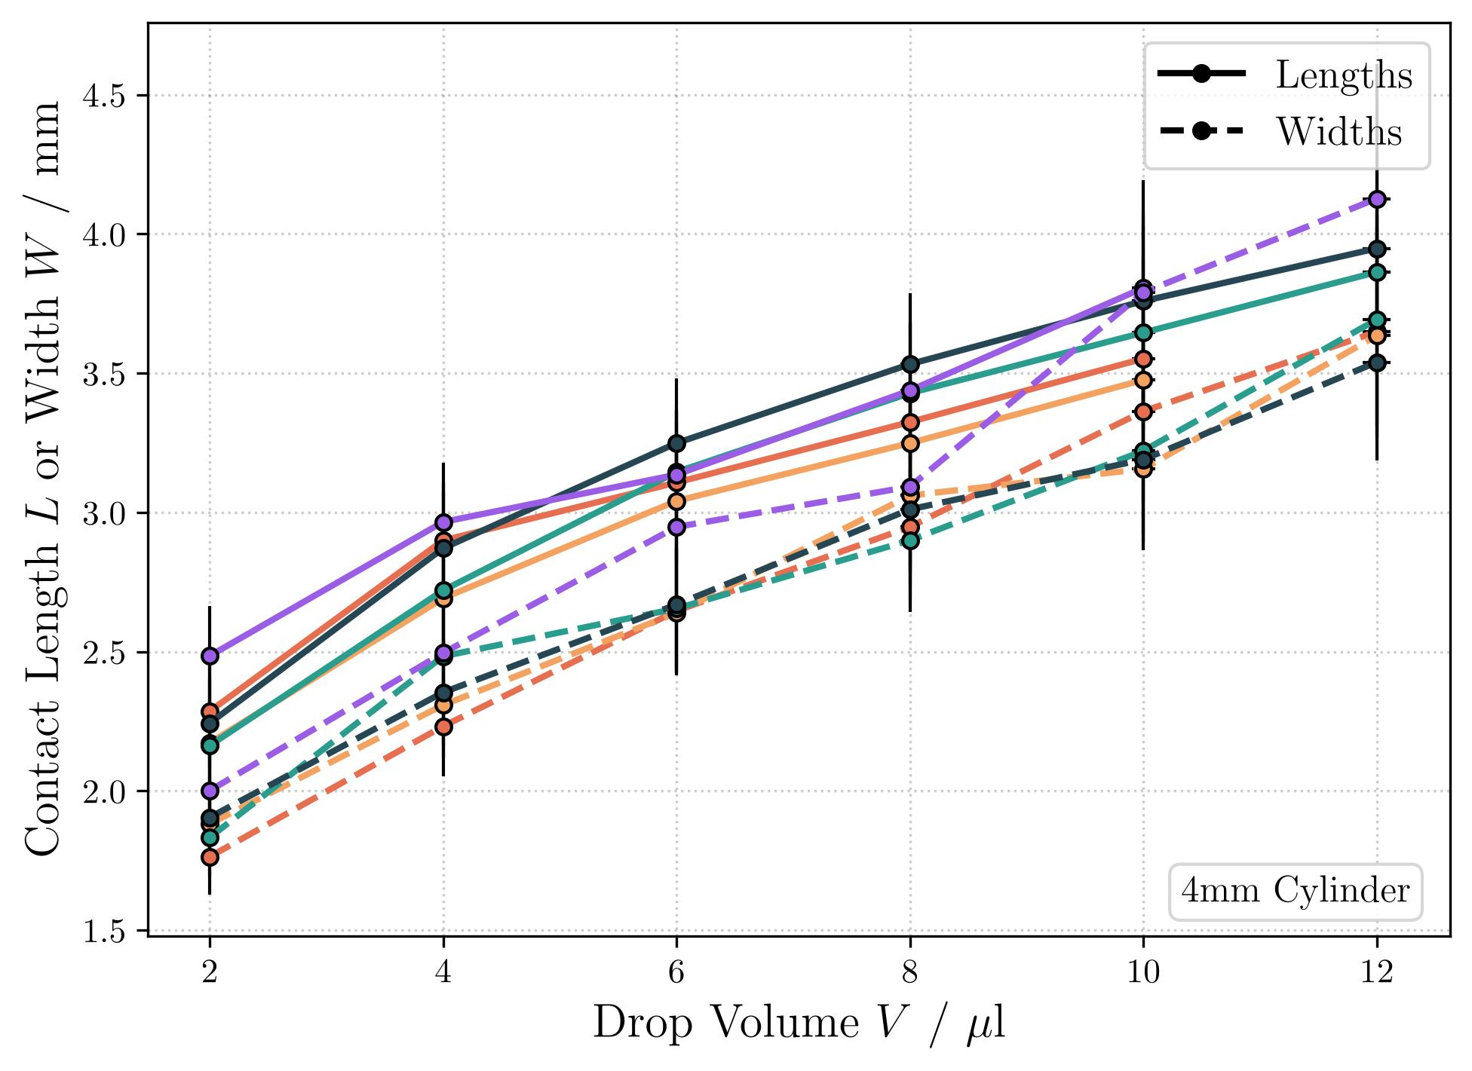
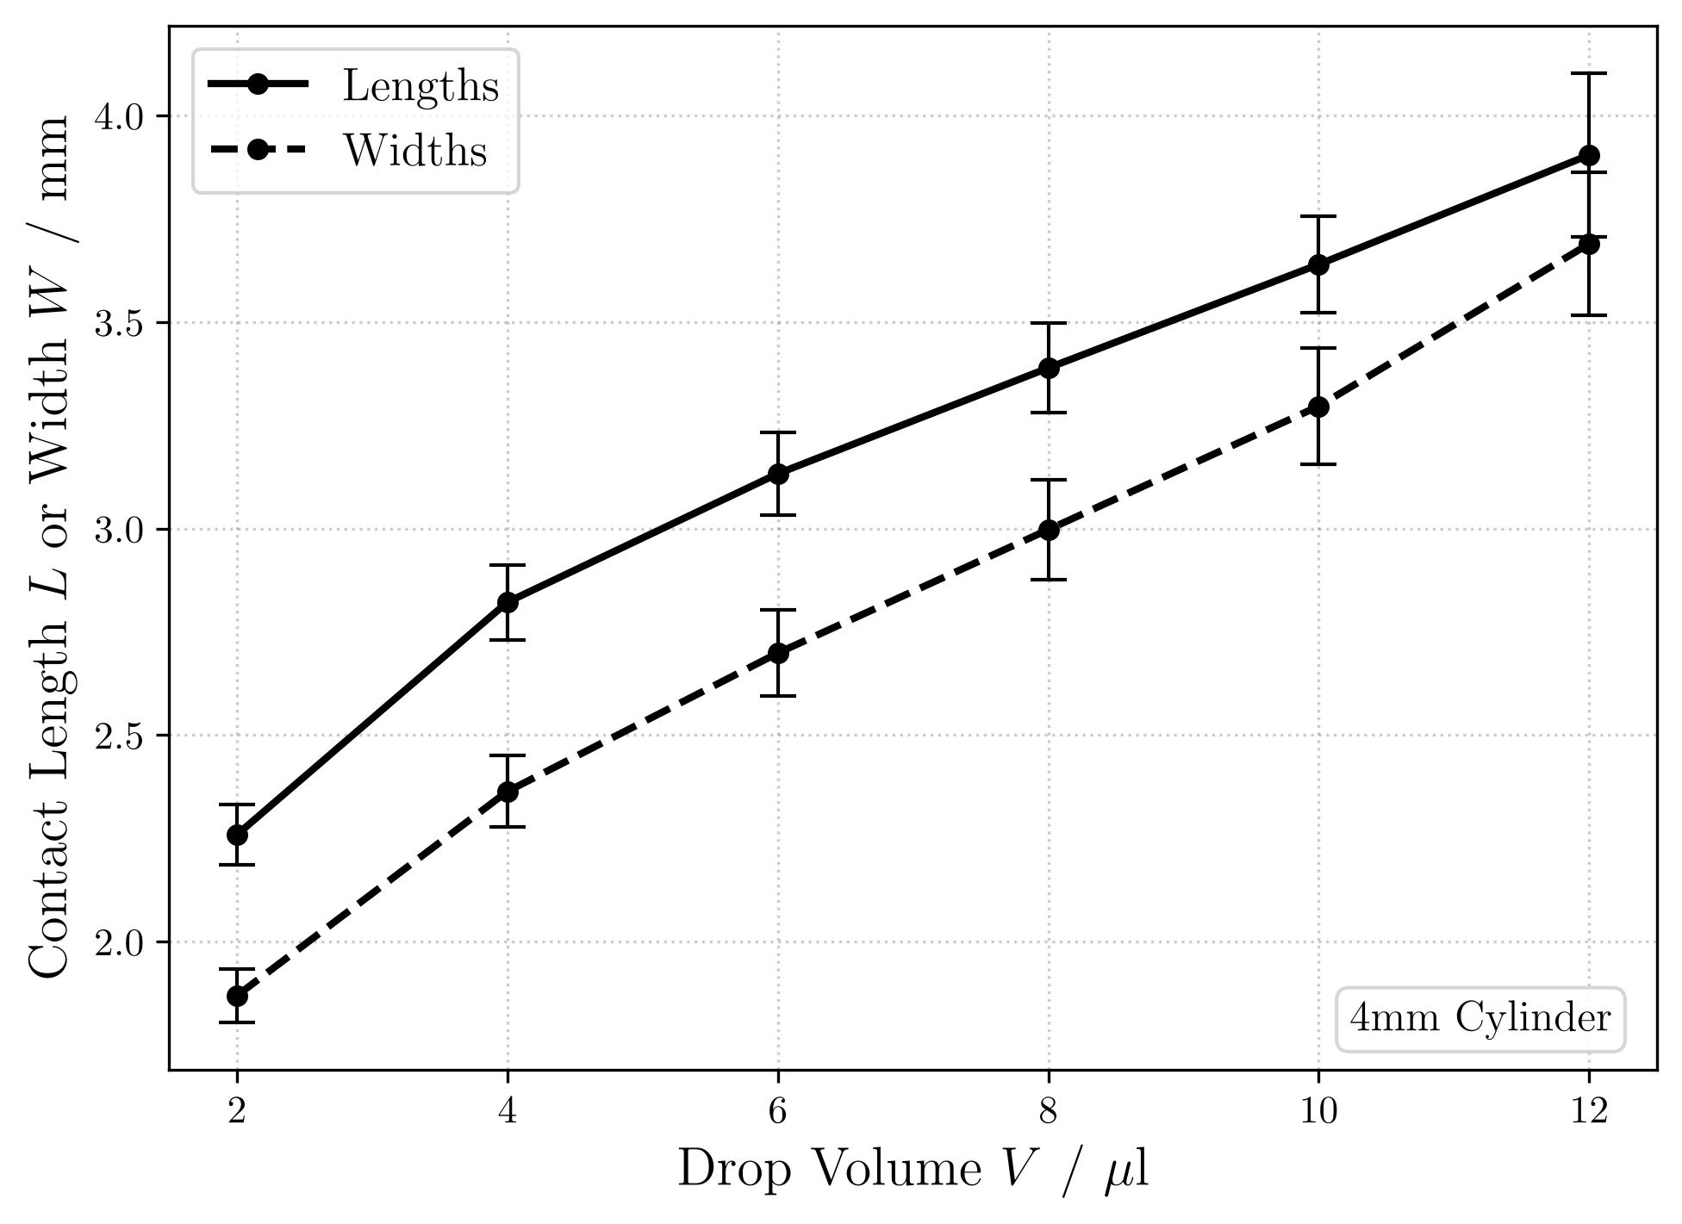
Contact Length Measurement (4mm)

Slide 3
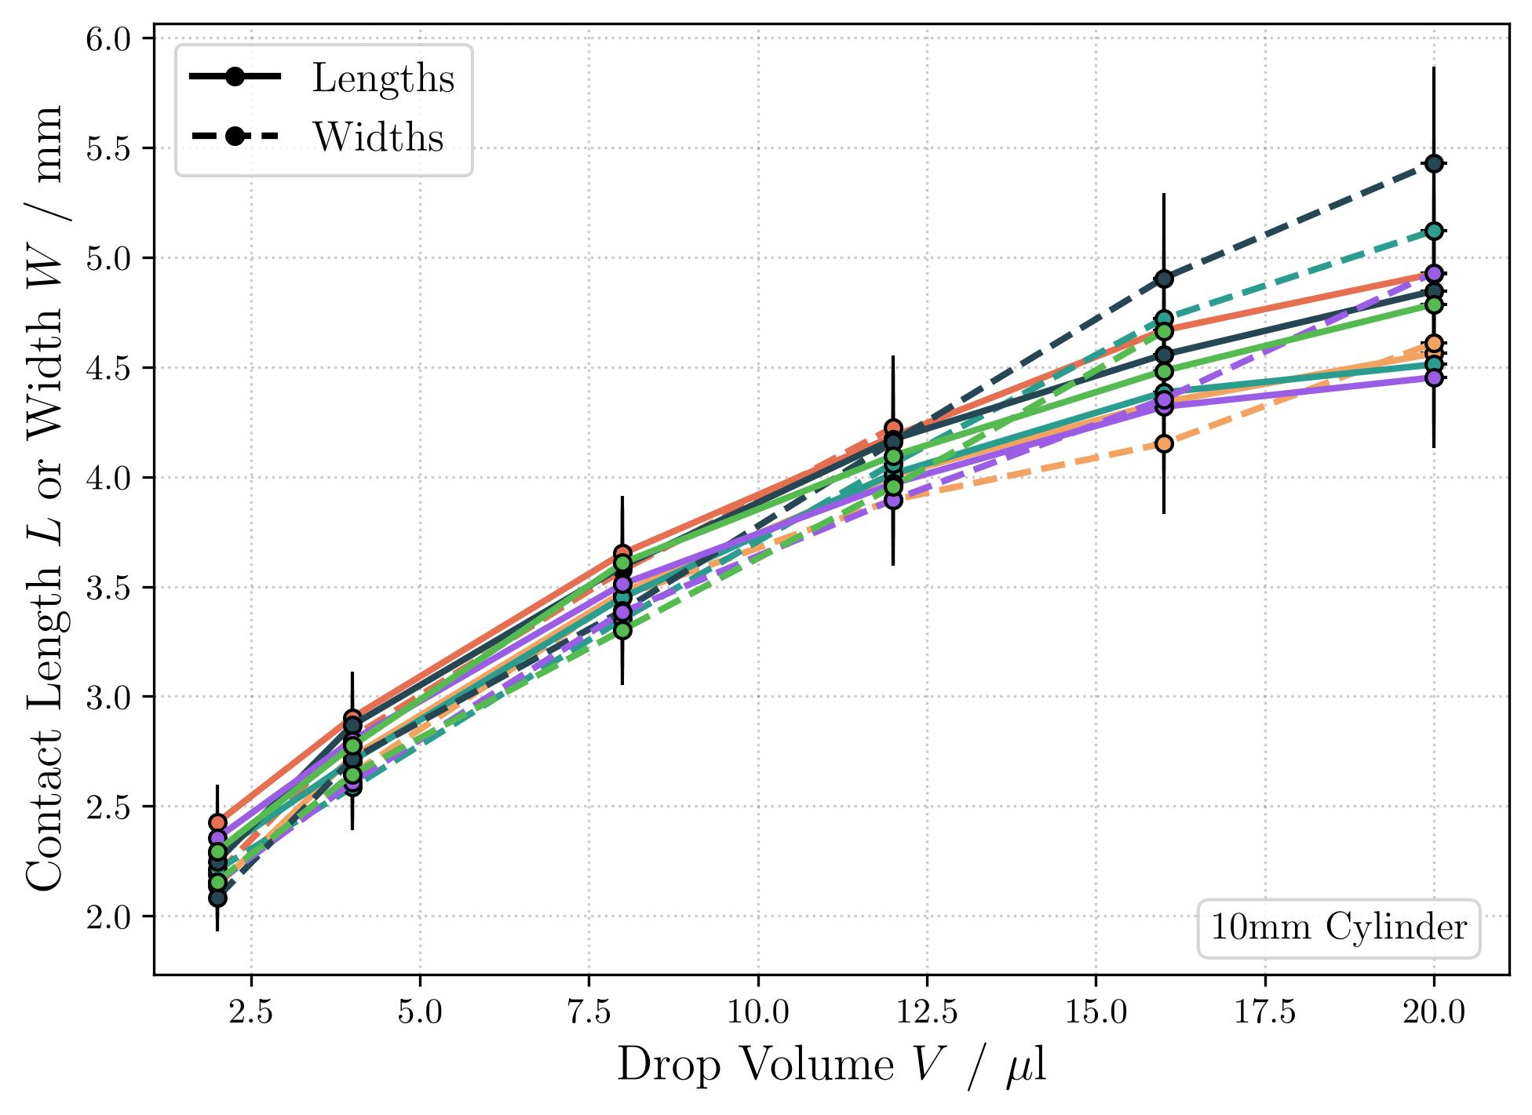
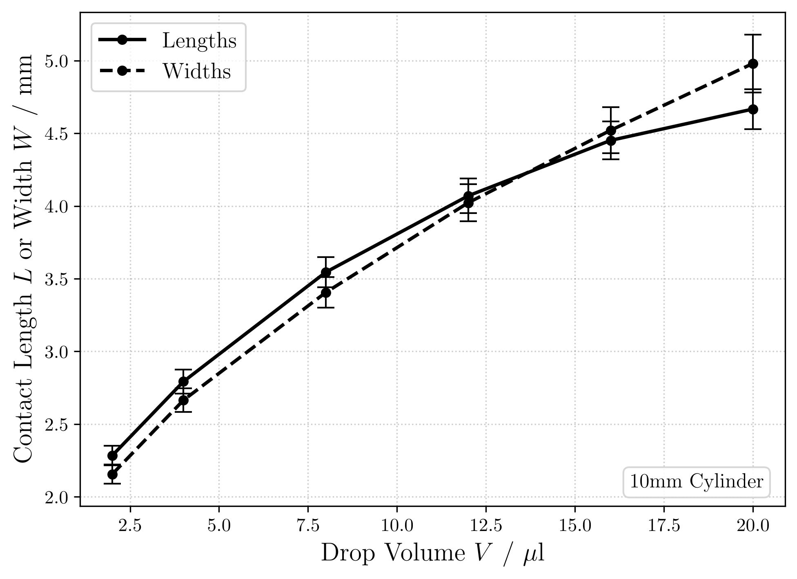
Contact Length Measurement (10mm)

Slide 4
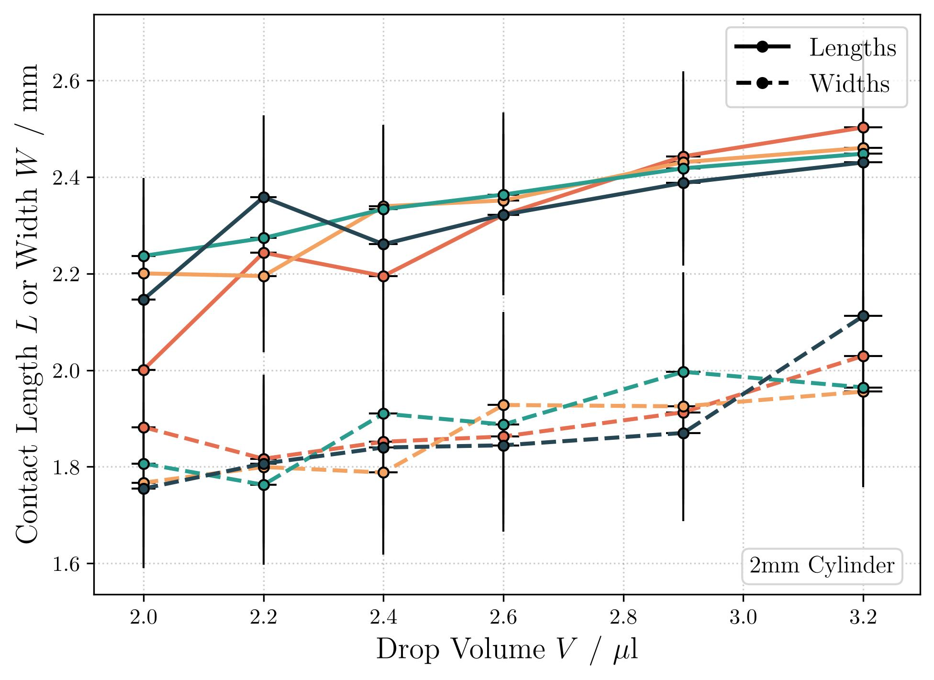
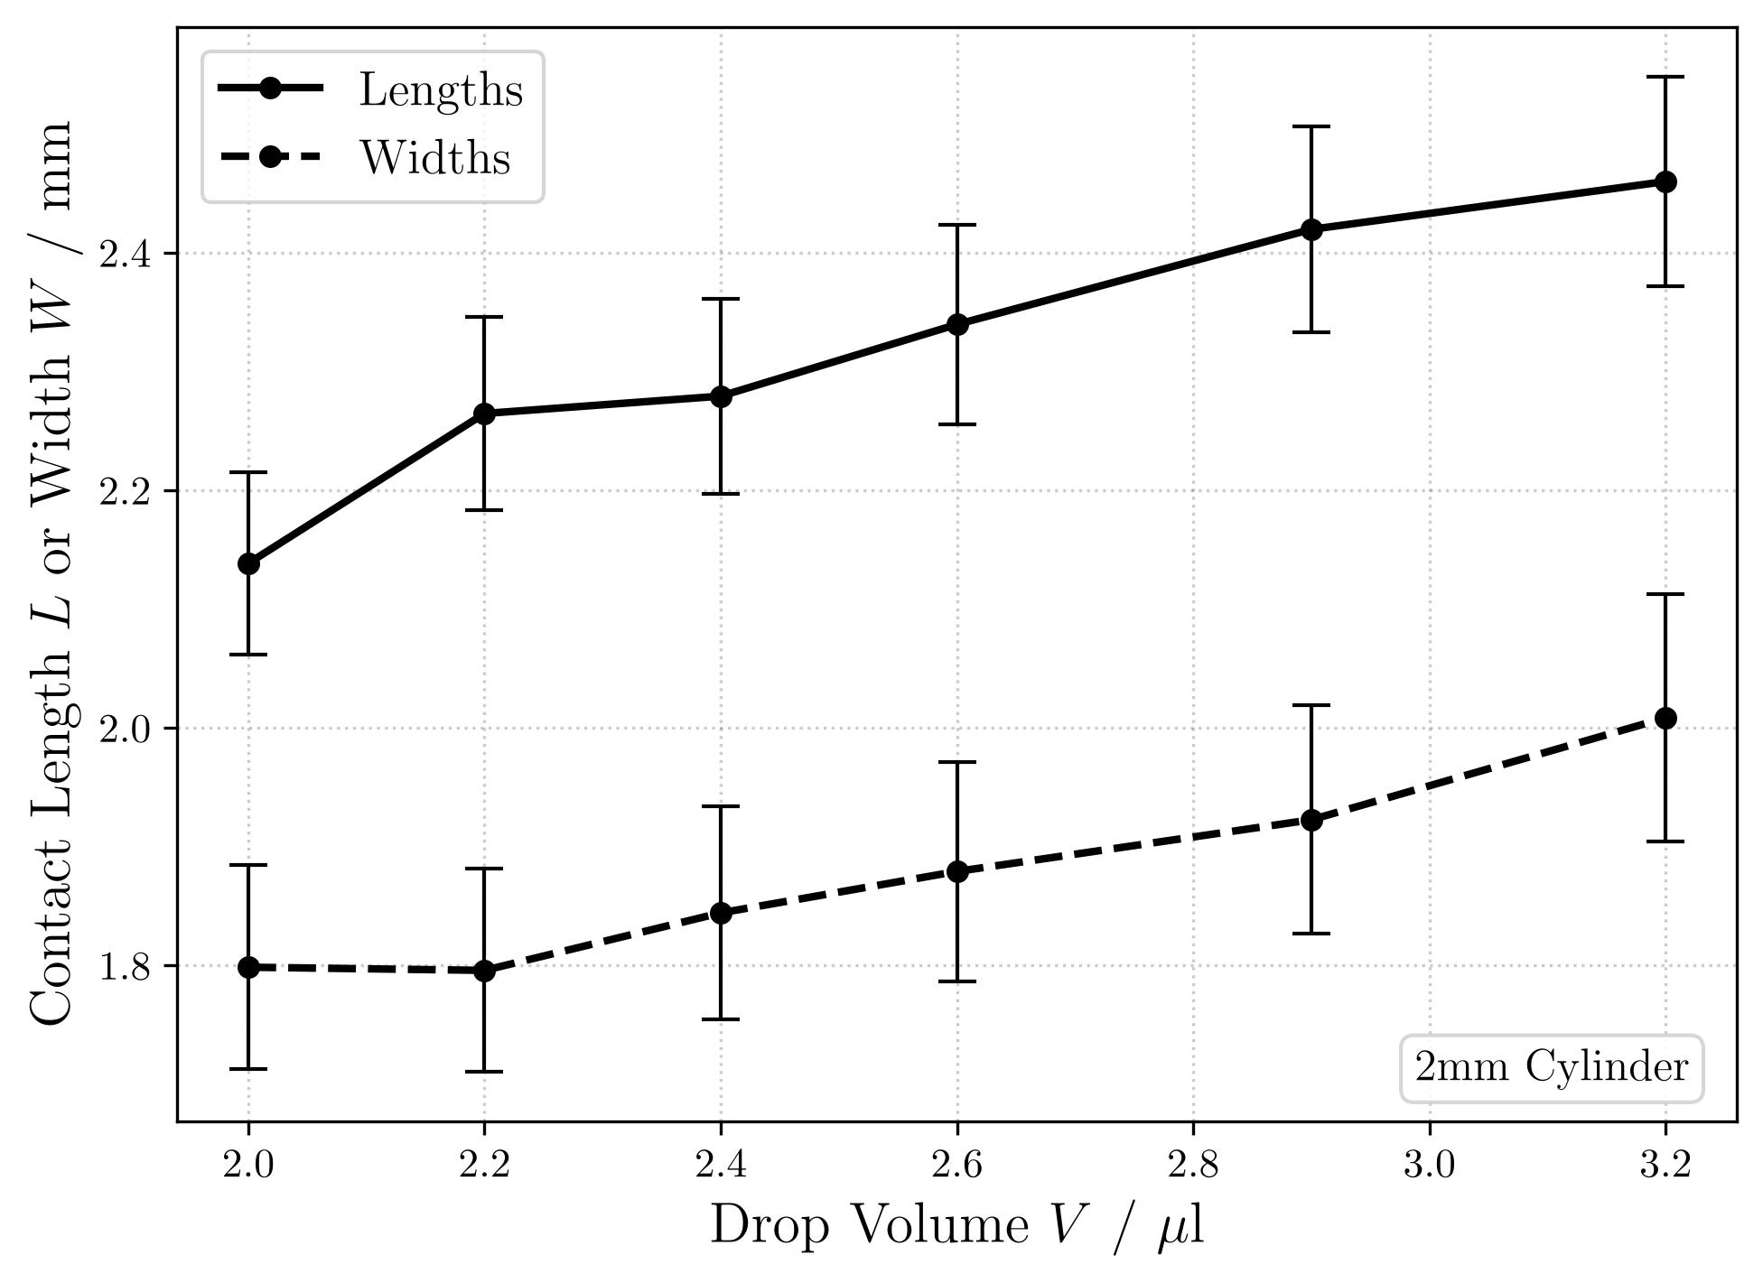
Contact Length Measurement (2mm)

Slide 5
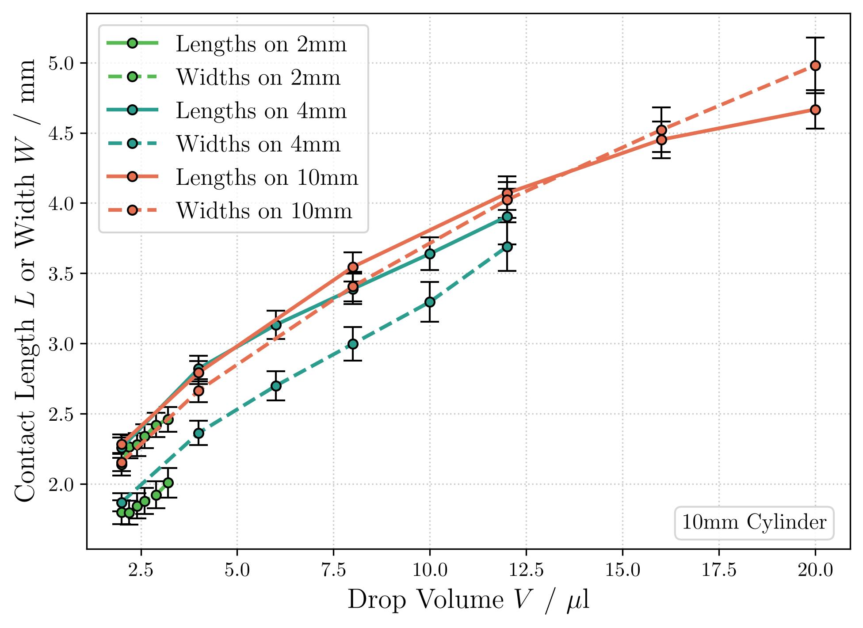
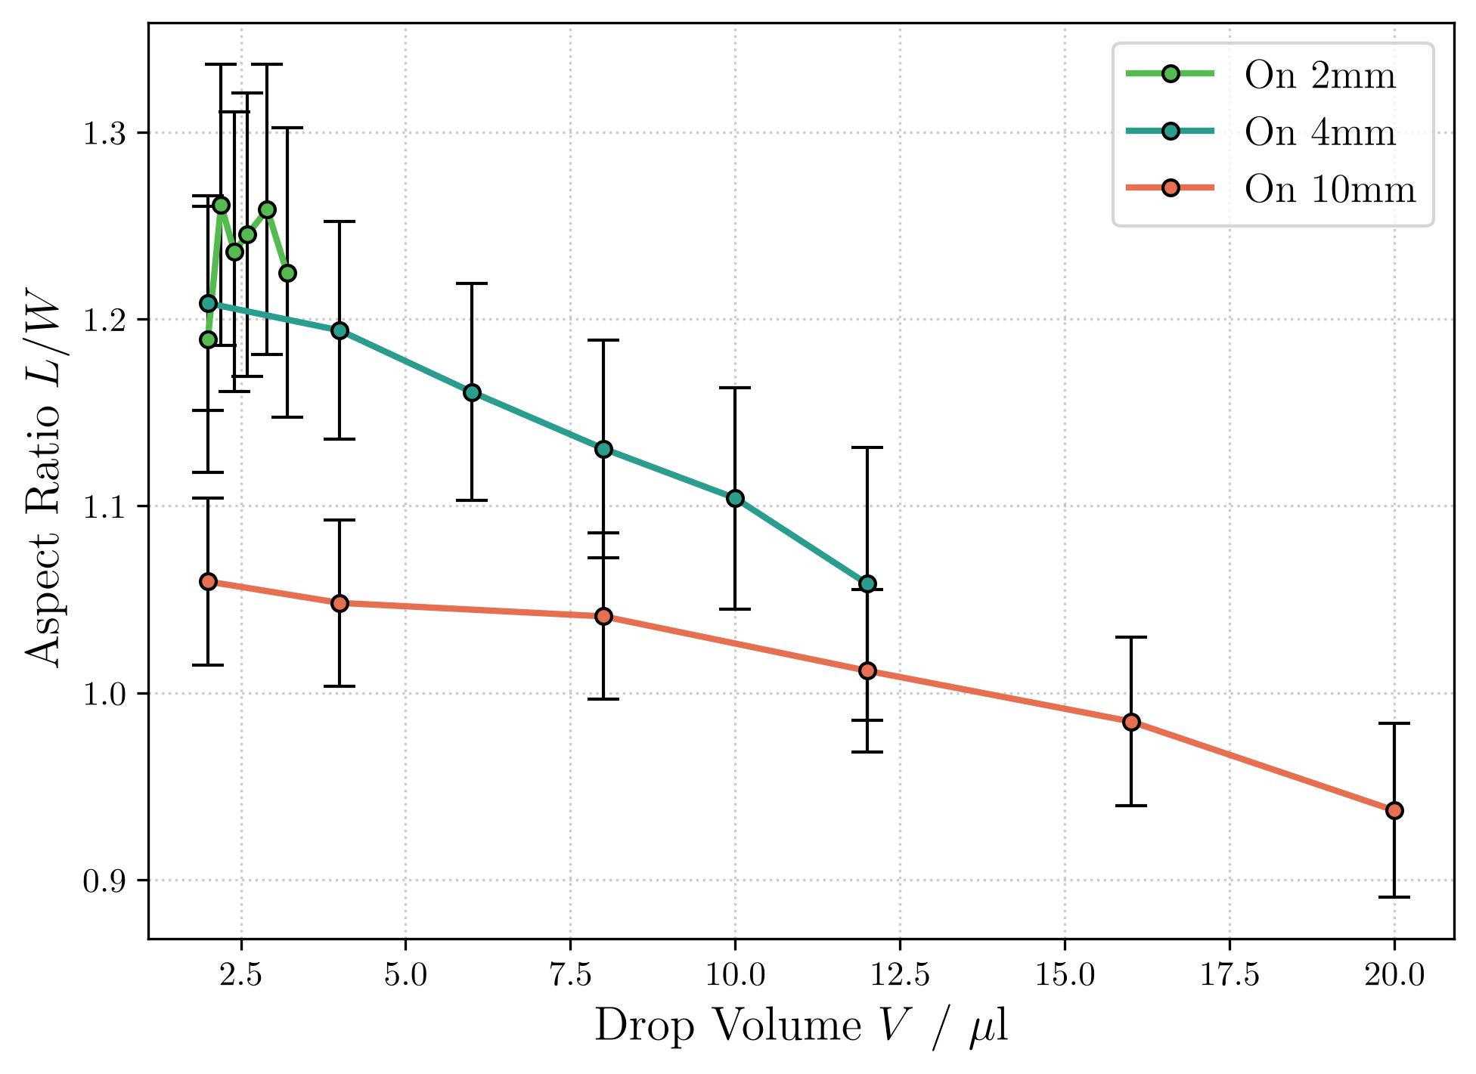
Comparison

Slide 6

How to compare D = 2mm / 4mm / 10mm
Normalizazion
Contact Lengths: L → L / D
Contact Widths: W → W / D
Droplet Volume: V → V / ($πD^{2}$)
If Adhesion Force was independent of scale,
Then all cylinders should behave the same after normalization.

Slide 7
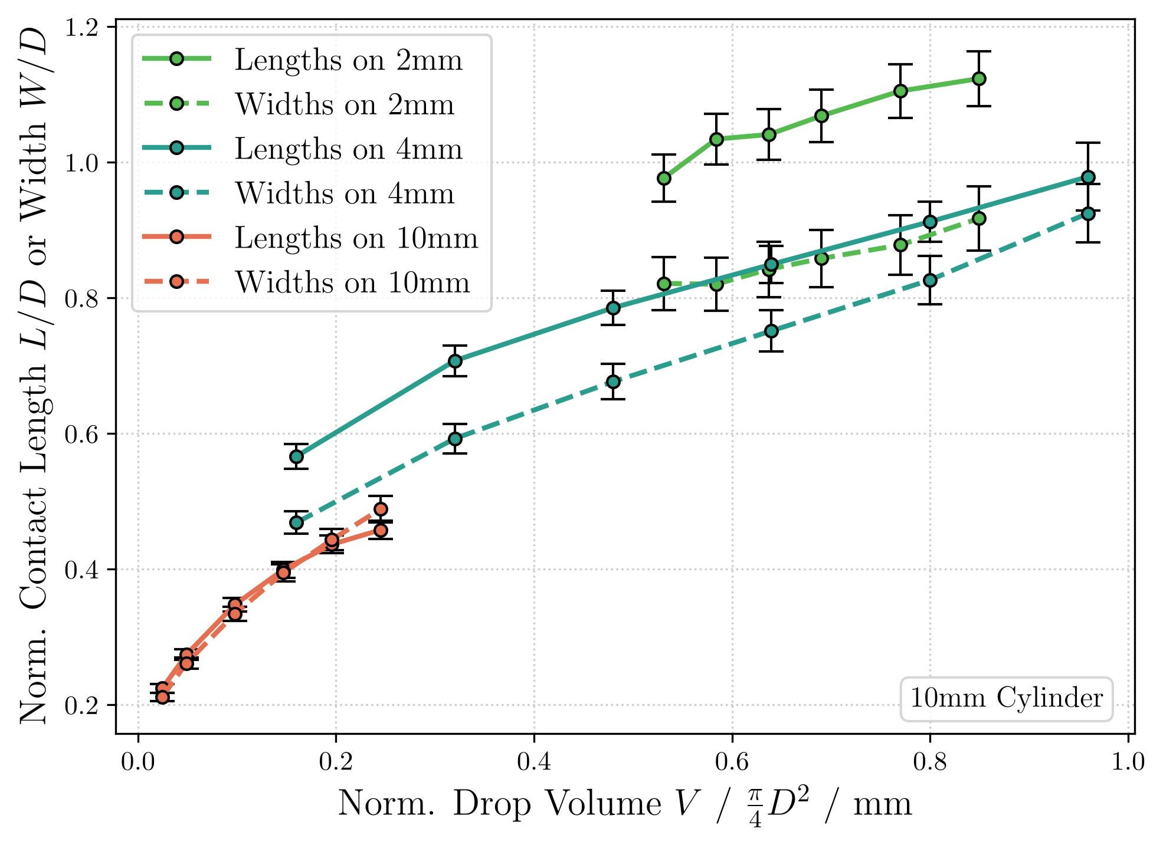
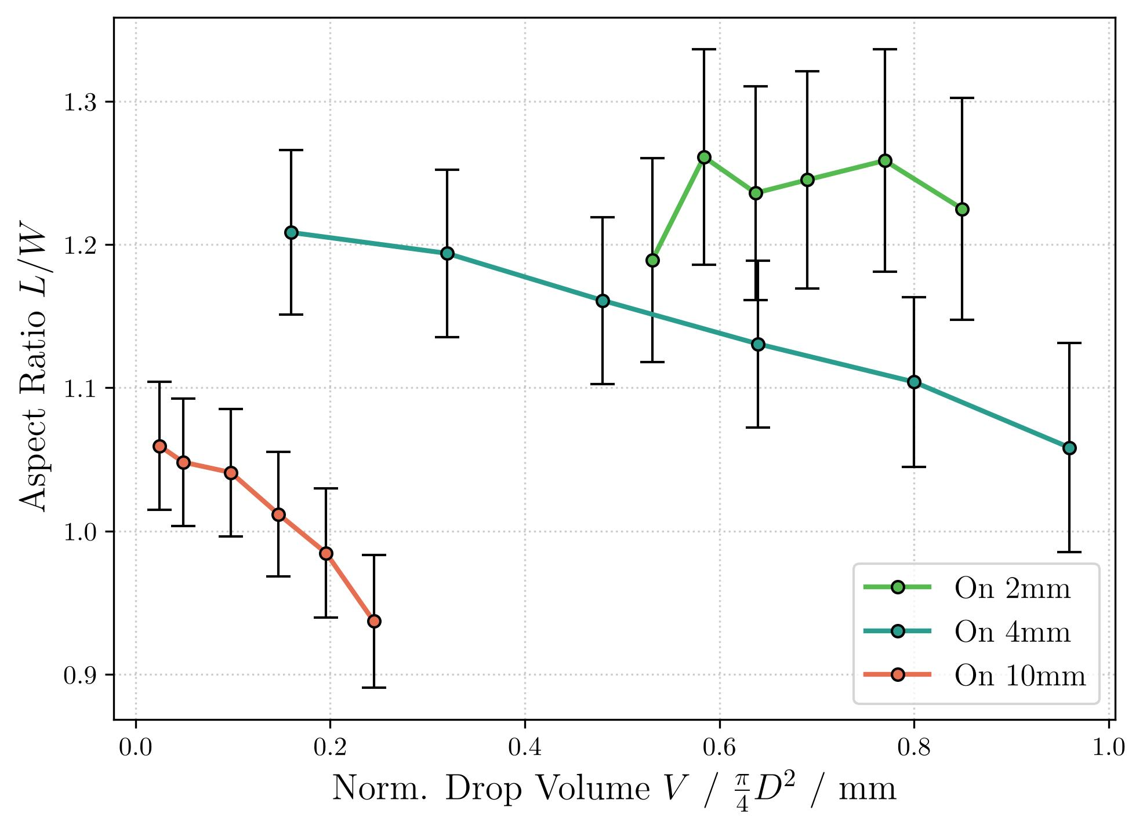
Comparison (Normalized)
Not quite the case!

