Slide 1
Musclehub: A/B Test
By Koen Lijffijt-de Vogel

Slide 2
Table of Contents
Introduction
The A/B test
The dataset
Results
Qualitative data
Recommendation

Slide 3
Introduction
Musclehub
Membership process:
Take a fitness test with a personal trainer.
Fill out an application for the gym.
Send in their payment for their first month’s membership.
Does the fitness test intimidate some prospective members?

Slide 4
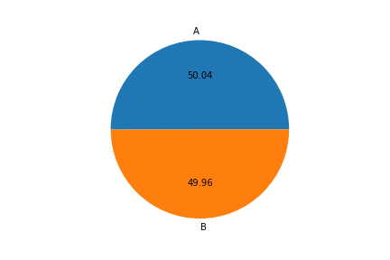
The A/B Test
Experiment started: 7-1-2017
Number of visitors: 5004
Group A: 2504
Group B: 2500

Slide 5
The Dataset
Musclehub’s database:
Name (first and last)
Email
Gender
Date of visit
Fitness test date
Application date
Purchase date
Will be used to compare groups

Slide 6
The Dataset - The Funnel
Visit
Application
Membership
Place where group A gets the fitness test.

Slide 7
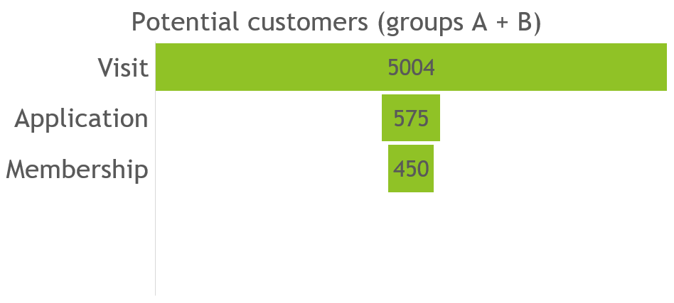
The Dataset – The Funnel
(11.49% of visits)
(8.99% of visits)

Slide 8
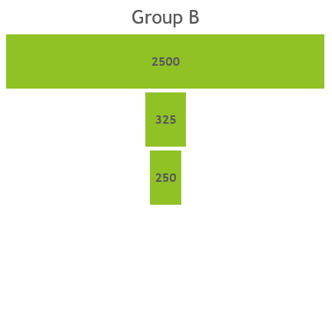
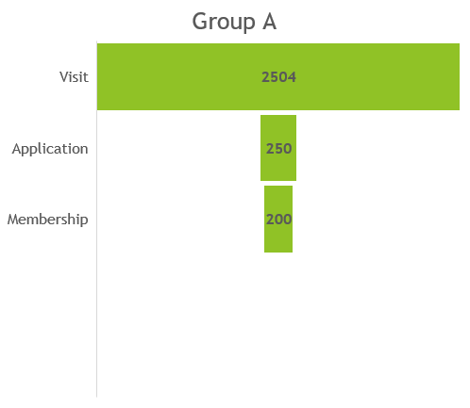
The Dataset – Groups Compared

Slide 9
Results – Hypotheses
Three hypotheses:
There is no significant difference in the number of applications that were picked up between group A and group B.
There is no significant difference in the number of people who picked up an application, as well as a membership, between group A and Group B.
There is no significant difference in the number of people who picked up a membership between group A and group B.

Slide 10

Results – Hypotheses
Application as part of visit.
Membership as part of application.
Membership as part of visit.

Slide 11
Results – Test
What test to use?
Are membership purchase and participation in the fitness test related?
Is there a difference between categorical variables in the same population?
Groups A and B are independent.
Chi² Test
Confidence level of 95% (0.05)

Slide 12
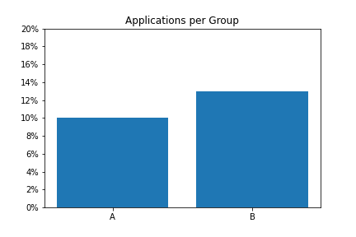
Results – Hypothesis 1
P-value: 0.00096
P-value < 0.05
Rejected
There is a statistically significant association between the two variables.

Slide 13
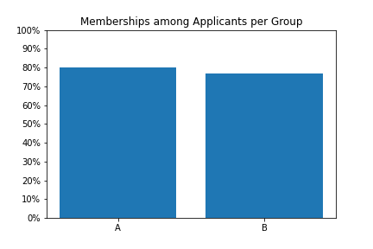
Results – Hypothesis 2
P-value: 0.43259
P-value > 0.05
Not Rejected
There is no statistically significant association between the two variables.

Slide 14
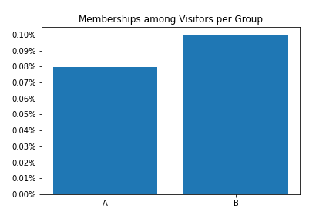
Results – Hypothesis 3
P-value: 0.01472
P-value < 0.05
Rejected
There is a statistically significant association between the two variables.

Slide 15
Qualitative data
Two out of four interviewed did not take the fitness test:
One mentioned Musclehub making him/her “feel welcome” specifically after another gym made him/her take a fitness test.
One expressed aprecciation for not being forced into a fitness test after this had happened at another gym. However, s/he did not sign due to “the weight machines [having] all those sweat stains on them”.

Slide 16
Qualitative data
Two out of four mentioned taking the fitness test.
one “regretted it”.
one found it to be “super helpful” and mentioned that s/he “had to sign up and keep coming back” after taking it.

Slide 17
Recommendation
There is a significant association between people not taking a fitness test and signing up for a membership.
However, qualitative data has shown that there are people who appreciate the test.
Further research based on the dataset:
Does gender play a role in the appreciation of a fitness test?

