Slide 1
Quality assessment of RNAseq data in .fastq files
Practical Bioinformatics for Biologists
Koen Meijer
Emma Gerrits
02-02-2018
https://github.com/EmmaGerrits/project_pbfb

Slide 2
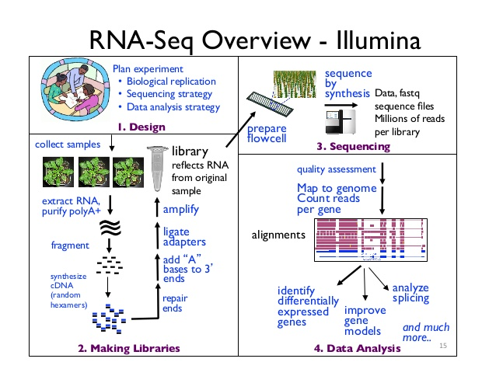

Slide 3
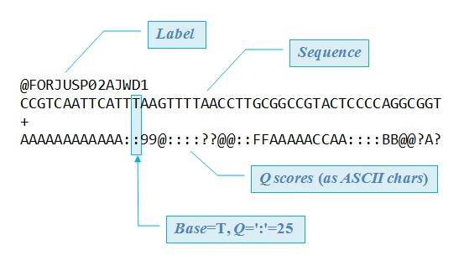
.fastq file
Storage of data generated in next-gen sequencing experiments
Contains information about
the sequence, and the quality
Score for each base
The format is not standardized
https://www.drive5.com/usearch/manual/fastq_files.html

Slide 4
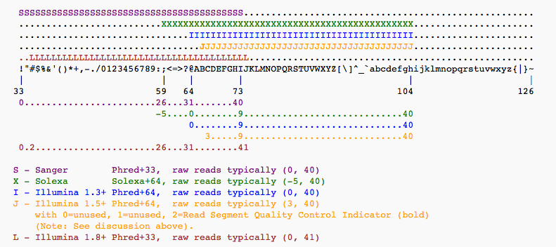

Quality scores
Encoded in ASCII characters
Multiple standards

Slide 5
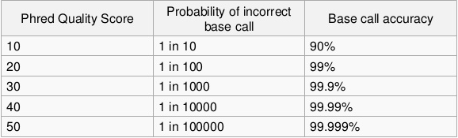
Phred quality score
All standards for quality coding use Phred
Phred scores indicate the probability of an incorrect base call generated in a sequencing experiment
Logarithmic scale

Slide 6






Goal Tools
Determine the format used to encode the quality scores
Determine the quality of the sequencing → probability of errors
Ubuntu
jEdit
Shell
Python
R
Peregrine

Slide 7
Dataset
NCBI >> GEO
SRA toolkit via terminal
Zebrafish microglia transcriptome SRR4242432
Illumina HiSeq 2500
$ fastq-dump.2.8.2 SRR4242432
$ head -n 40 SRR4242432.fastq > test_SRR4242432.fastq

Slide 8
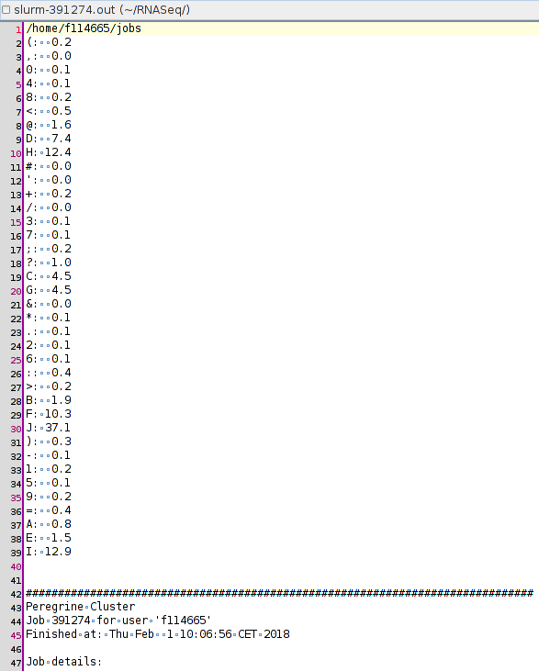
Find FASTQ quality standard
for loop that isolates quality score
Lines, and lists each quality score
character in the .fastq file
Illumina 1.8+ was identified as the
encoding standard in this file
In hindsight, the use of Peregrine was
unnecessary

Slide 9
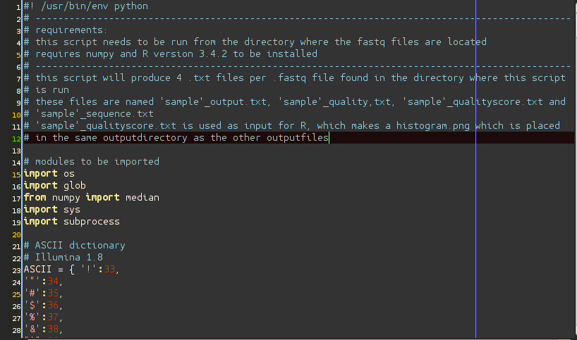
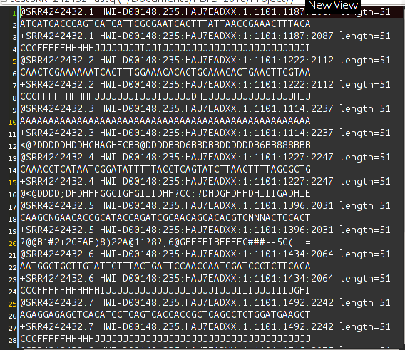
Input
FASTQ file
Our script

Slide 10
Script
Run the script from the directory where your .fastq files are stored
Import modules
Dictionary of ASCII quality encoding
Opens each .fastq file in the directory from where the script is run
Displays how many .fastq files are found and their names.
emma@emma-laptop-2:~/Documents/PBfB_2018/Project$ ./project_pbfb.py
1 FASTQ file(s) found.
The following files will be analyzed:
testSRR4242432.fastq
Press Enter to continue...

Slide 11
Script
For each file: output directory + output files
Sample name
Sequence information
Quality information
Graph made in R
...
...
...
----------------------------------------------
Output saved to /home/emma/Documents/PBfB_2018/Project/SRR4242432_outputfiles

Slide 12
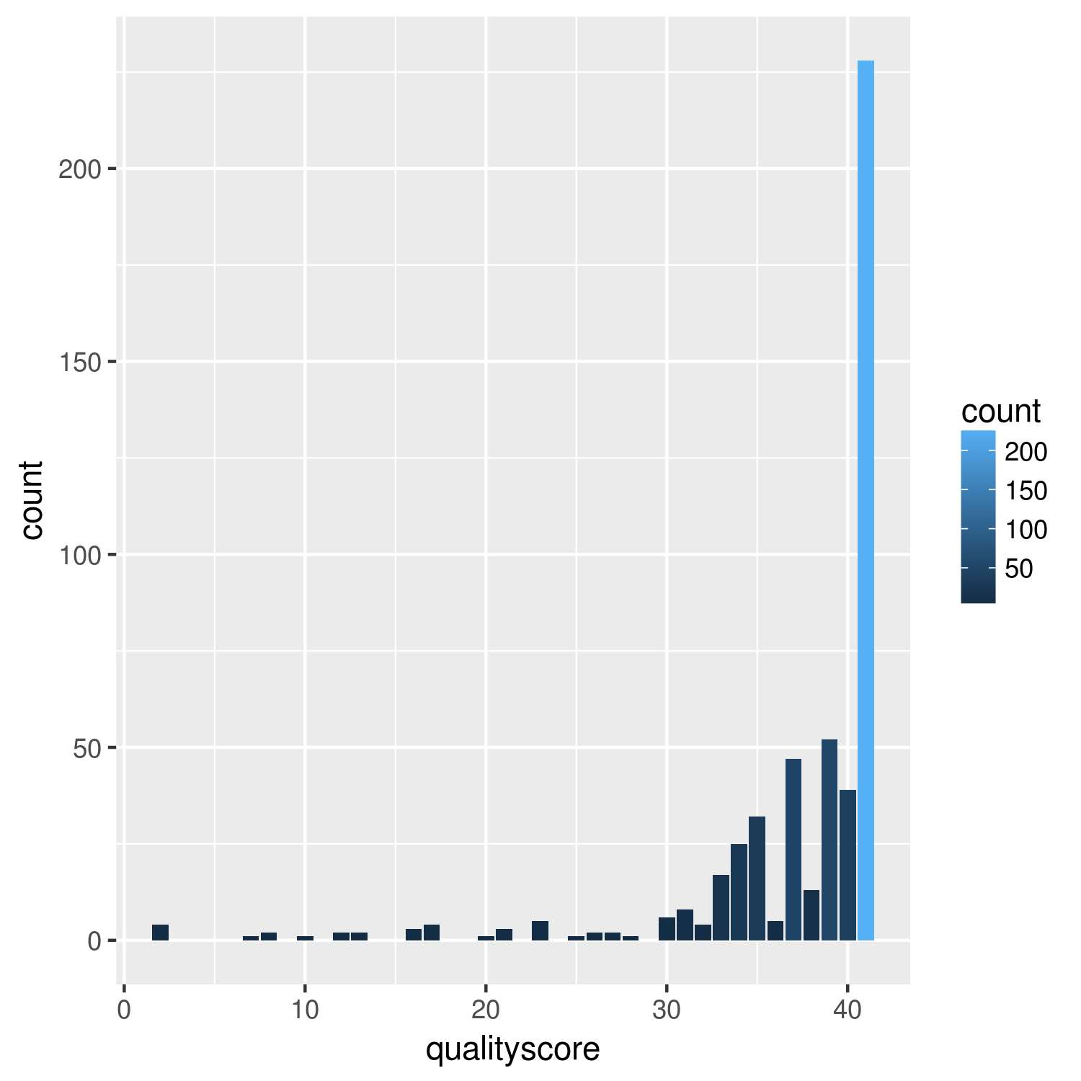
Output
Test of a 3.4 GB .fastq file in peregrine → up to 20 GB memory
Test file output:
emma@emma-laptop-2:~/Documents/PBfB_2018/Project/SRR4242432_outputfiles$ ls
SRR4242432_histogram.R SRR4242432_qualityscores.png SRR4242432_quality.txt
SRR4242432_output SRR4242432_qualityscore.txt SRR4242432_sequence.txt

Slide 13
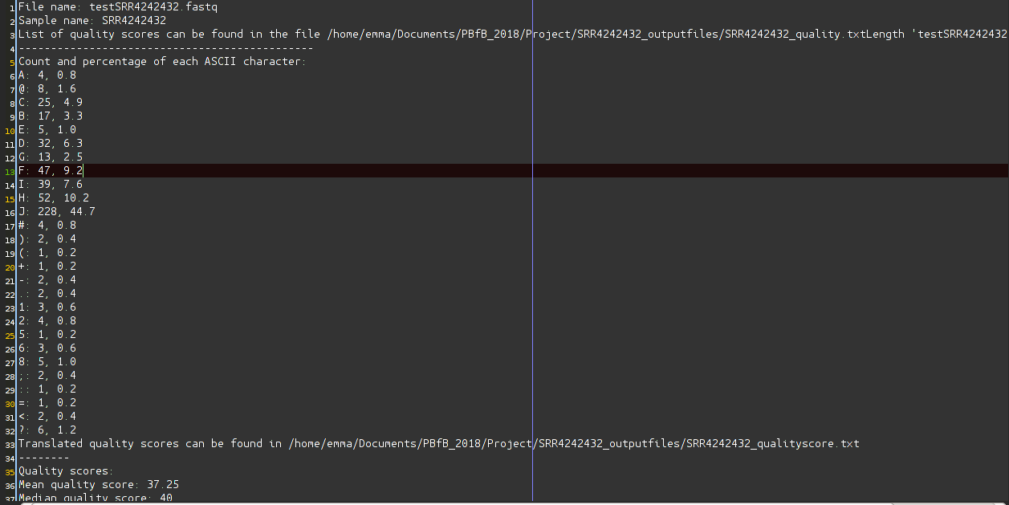
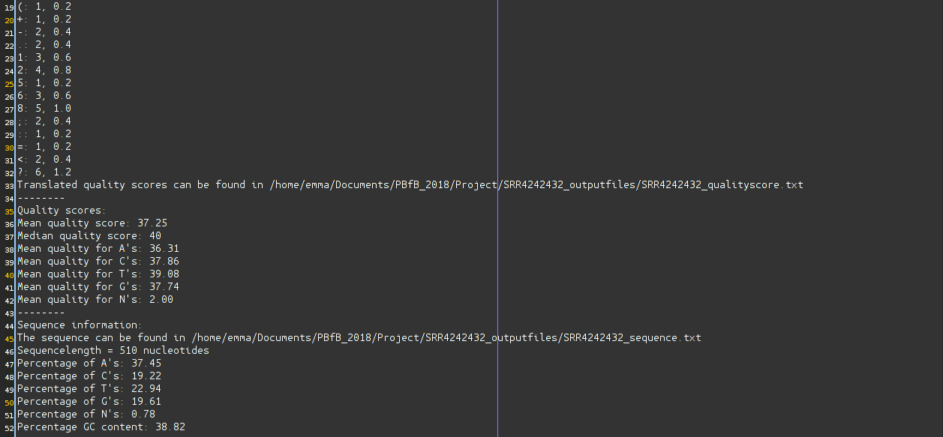
Output

Slide 14
Conclusion
Determined the standard used for encoding the quality scores
Python script capable of processing multiple aspects of a FASTQ file at once
Realized that Python is not the most efficient method for processing large data files
FastQC is more efficient in running the operations on large files
https://github.com/EmmaGerrits/project_pbfb

