Slide 1

Shri Vaishnav Vidyapeeth Vishwavidyalaya Shri Vaishnav Institute of Information and Technology (SVIIT)
Dept. of Computer Science Engineering
7th Sem, Session (2021-2025)
Major Project
Siftly - Site Comparison Engine
Guided By:-
Prof. Virendra Dani
Presented By :-
Avani Pansare(21100BTCSAII09403)
Mruthunjay Parmar (21100BTCSAII09431)
Divyanshu Khatri (21100BTCSAII09412)
Shivam Chouhan (21100BTCSAII09443)

Slide 2
Outline
Introduction
Overall Description
Implemantation
Testing

Slide 3
Introduction
Siftly, a product comparison engine designed to assist consumers in evaluating deals across various e-commerce platforms.
Requirements are prioritized using a numerical system, with higher numbers indicating higher priority. It is assumed that higher-level requirements inherently carry the priorities defined for their detailed counterparts unless explicitly stated otherwise.
Siftly aims to streamline the online shopping experience by aggregating and comparing product data from multiple e-commerce platforms.
The software enhances user decision-making by providing transparent, unbiased information specific to user preferences

Slide 4
Overall Description : Product perspective
Siftly is a new, self-contained product developed to enhance the online shopping experience by providing users with easy access to product comparisons and deals.
Summary of Major Functions: This includes a high-level outline of the key features and functions that Siftly must perform.
Searching for products across multiple platforms.
Comparing prices and product features
Filtering results based on user preferences (e.g., price range, brand).
Viewing historical price trends for products.
Receiving alerts for price drops or new offers.

Slide 5
External Interface Requirements : User Interfaces
GUI Standards & Style Guides: The interface will follow modern UI/UX standards, including a clean, minimalistic design with intuitive navigation. The colour palette and typography will align with Siftly's brand guidelines, focusing on user-friendliness and accessibility.
Screen Layout & Constraints: Each page will have a consistent layout with a header (navigation bar), a content area displaying products, and a footer. Filters, search bars, and sorting options will be placed in side panels or at the top for easy access.
Standard Buttons & Functions: Common elements like a "Help" button, "Contact Us," and "Profile" options will be accessible on every screen. Buttons for filtering, sorting, and comparing prizes will have standard, easy-to-understand labels and icons.
Keyboard Shortcuts & Navigation: Navigation will support keyboard shortcuts for accessibility, such as using arrow keys to scroll through items or "Enter" to select a prize for comparison.
Error Message Display Standards: Errors will be displayed as pop-ups or inline messages with clear guidance on what went wrong and how users can resolve issues.

Slide 6
Hardware & Software Interfaces
For Siftly, the connections to other hardware components are as follows:
Supported Devices: Web browsers (desktop, mobile), mobile devices (iOS, Android).
Data Interactions: HTTP/HTTPS requests for fetching and aggregating prize data from external APIs.
Control Interactions: User interactions via mouse, keyboard, and touch inputs to filter and sort prizes.
Server Communication: REST APIs for backend data processing; cloud-based servers (e.g., AWS, GCP) handle storage and requests.
Protocols: HTTPS for secure communication between the client, server, and external prize data sources.

Slide 7
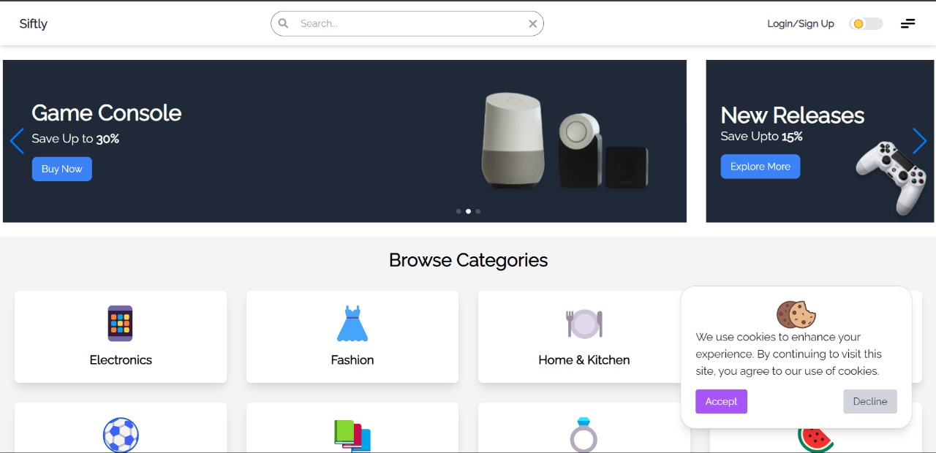
Implementation

Slide 8
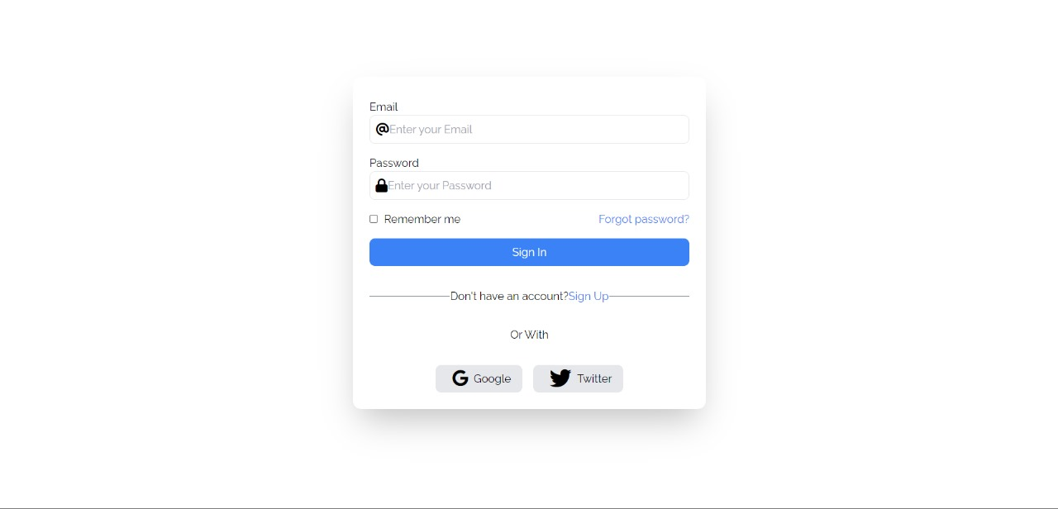
Implementation

Slide 9
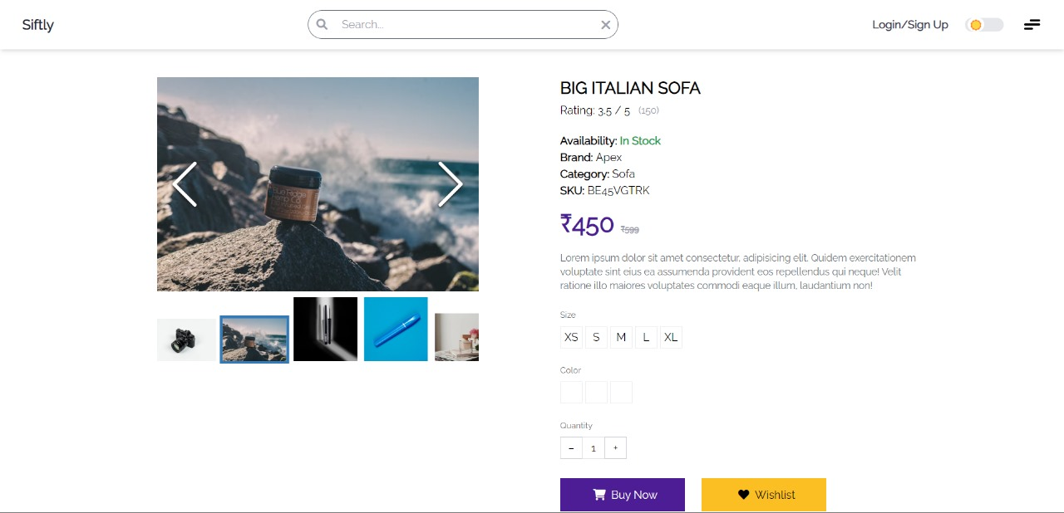
Implementation

Slide 10
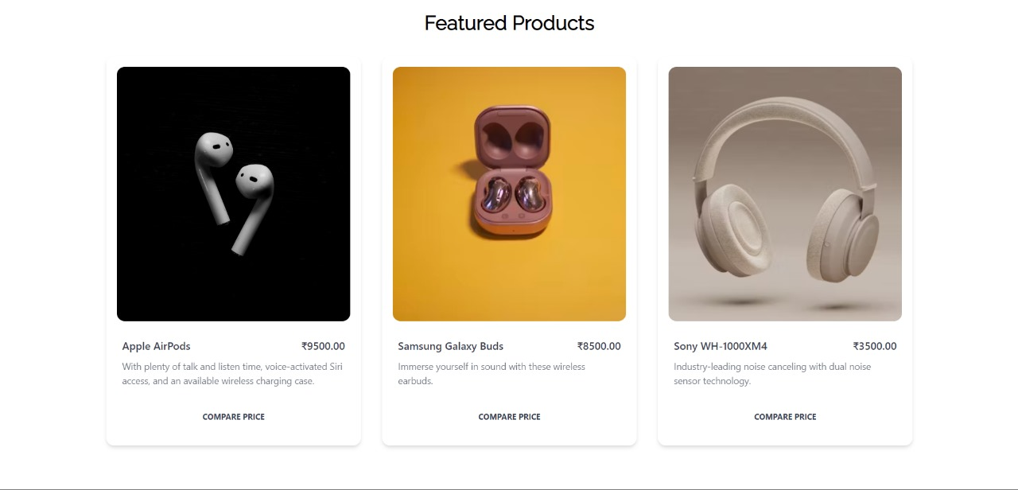
Implementation

Slide 11
Implementation

Slide 12
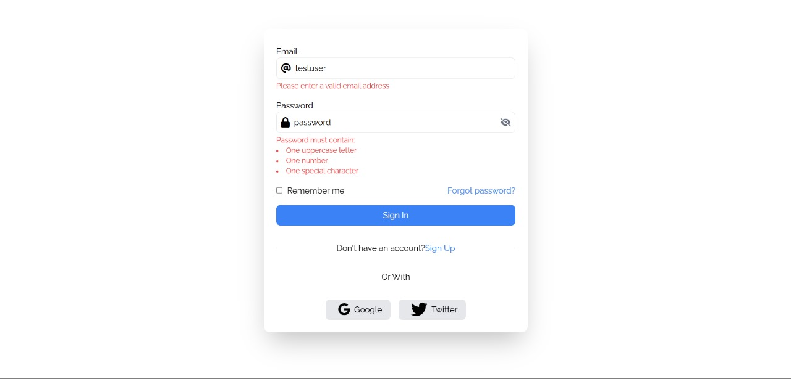
Login Testing

Slide 13
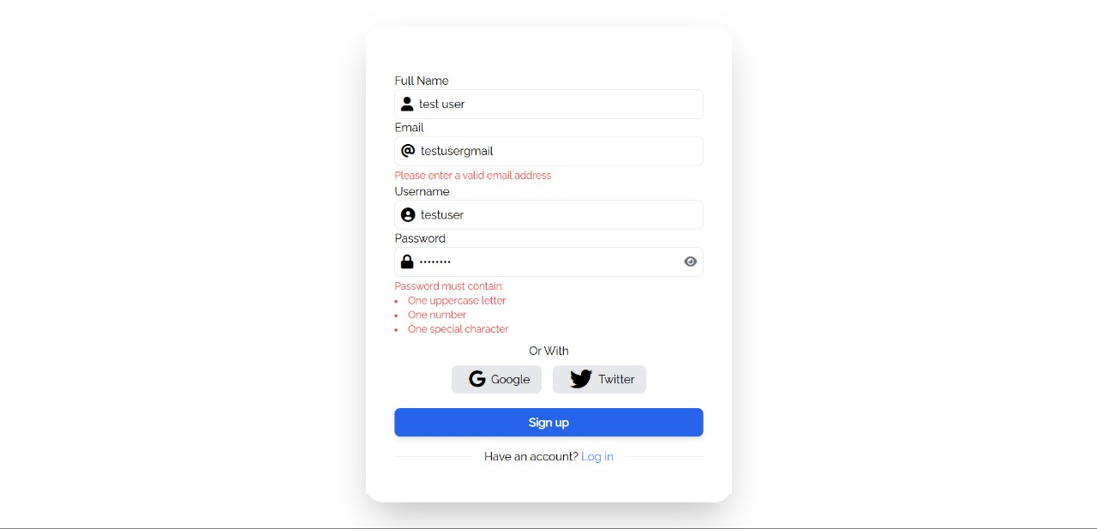
Login Testing

Slide 14
Thank You

