Slide 1
Karma’s Choice 2022 Growth Plan
By: Kofoworola Ogutuga

Slide 2
.. Executive Summary ..
An analysis and recommendations for Karma’s Choice as the company plans its 2022 strategy. Focus is on how customer experience, employee engagement, and market positioning can reach a 16% increase in revenue.
Customers rate the brand highly overall, but finding items is the weakest point. Employees are only moderately engaged, lowest being pride and retention. The brand is stronger than competitors on staff satisfaction, but weaker on product and loyalty. Employee engagement is worth funding because better employee experience lines up with better customer score.
My main recommendation is to keep the people advantage and fix the store layout. Karma’s Choice ROI will show up mostly through better retention, store layout, employee engagement, product availability, and more repeat visits rather than an immediate jump in average spend.
I reviewed 3 data sources to understand what is happening across the business.
  CX shows 27,174 customer responses from receipt surveys
  EX shows 80 employee responses from email surveys
  MX shows how Karma’s Choice compares to 9 competitors in the market
  CX is based on a 5-point Likert scale plus transaction dollars.
  EX and MX use top-box style competitive scores.
  I looked for patterns between satisfaction, behavior, and spending to find the strongest growth opportunities.
I used these 3 datasets to answer three questions:
  Is employee engagement a smart investment? Yes
  Was the store layout and self-checkout investment effective? Yes, needs more
  What else can improve retention and financial growth? ...

Slide 3
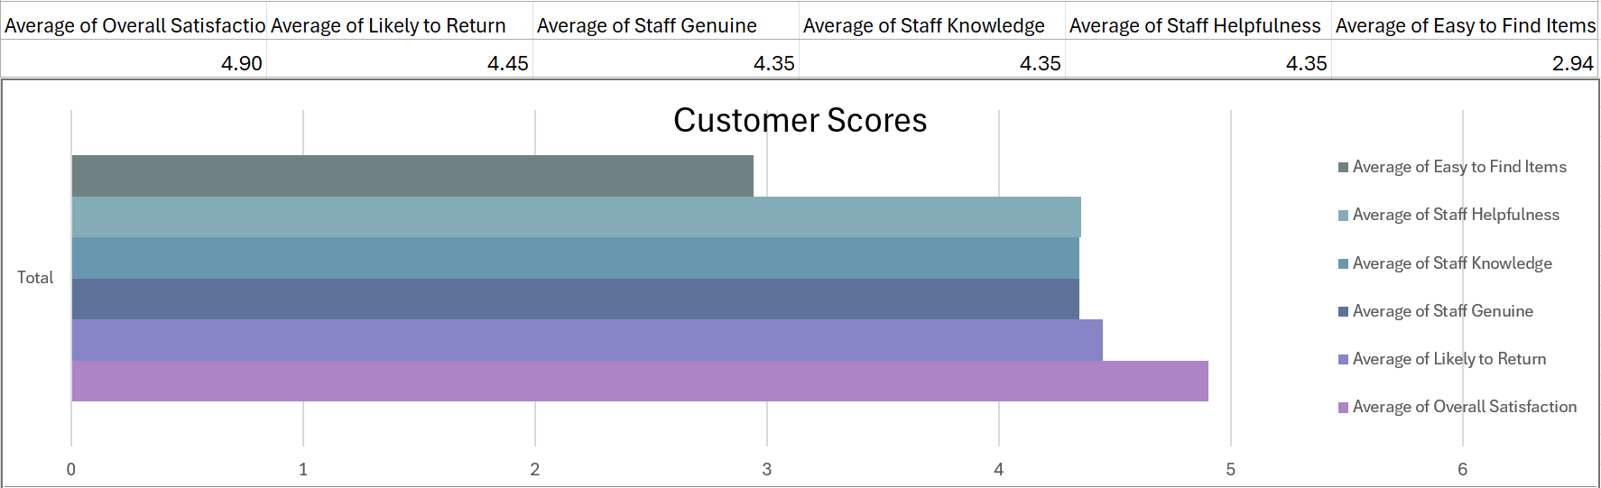
.. Customer Experience ..
The customer experience data shows that Karma’s Choice performs strongly overall, but the one major issue Is Item findability. This tells me that customers like the service, but the shopping around the store is what's creating the problem.
  Overall satisfaction is very high at 4.90 / 5
  Likelihood to return is also strong at 4.45 / 5
  Staff related scores are strong at 4.35 / 5 in genuine, knowledgeable, and helpful service
  The weakest score is easy to find items at 2.94 / 5

Slide 4
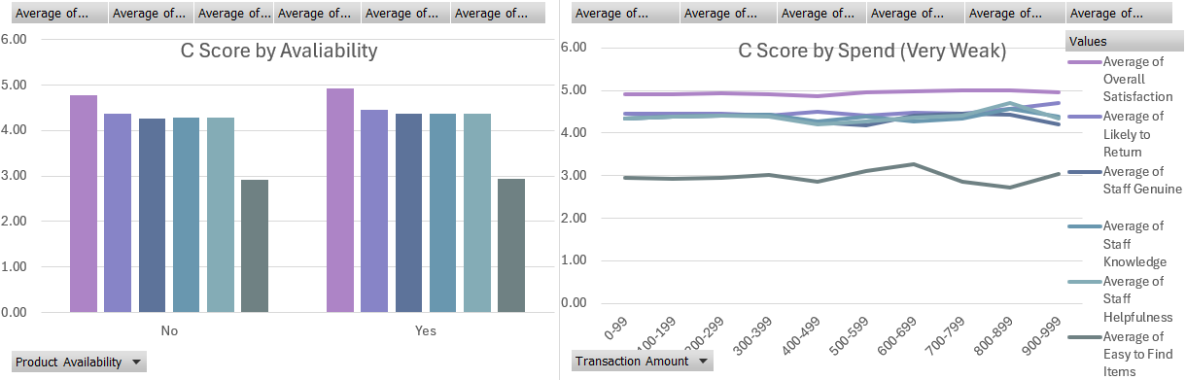
.. What Drives Spend & Retention ..
Improving experience increases financial performance.
My analysis shows that average transaction amount is $71.65 and that spends connection to satisfaction scores is very low. My view is that employee engagement can support revenue, but the biggest effect is indirect. Employee engagement helps protect service quality and customer retention. It does not automatically raise average spend on its own. Customers are more likely to spend and return when they're happier about the store, and the thing currently holding back Karma's choice is its item findability and availability. Improving product availability and item findability is needed to get that ROI.
  Customers who feel better about the store are more likely to return
  Customers with better return intent also show stronger overall satisfaction
  Return intent and satisfaction is stronger when product are available.

Slide 5
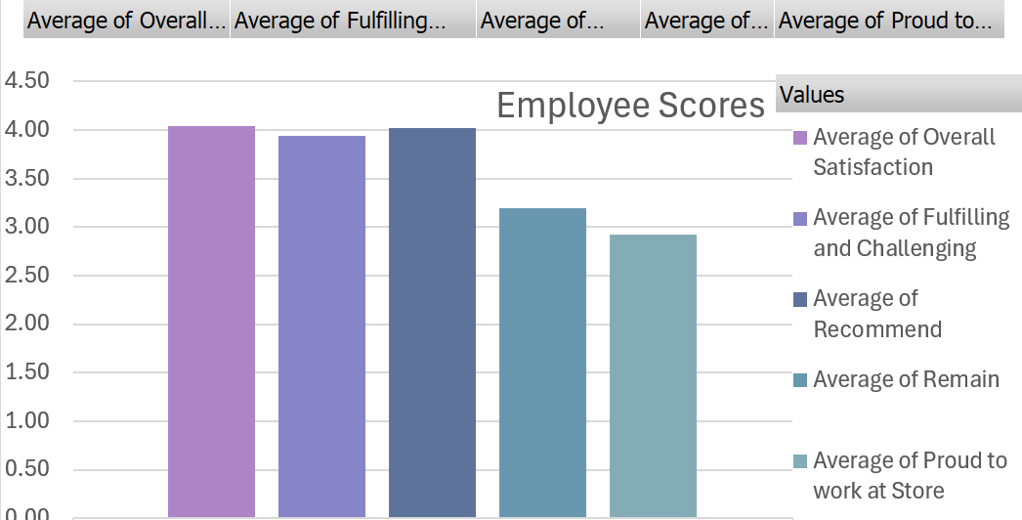
.. Employee Engagement & ROI ..
Is Employee Engagement Worth the Investment?​ Yes
I do think employee engagement is a promising investment. Employees directly influence the customer experience at every step of the store visit. Stores with stronger employee participation show higher average customer spend. Customers with the highest likelihood to return spend about $71.91, while the lowest loyalty group spends about $54.60 on average. That tells me engagement supports retention and repeat buying, even if it does not create an instant jump in spend. My view is that employee engagement is a medium to long-term ROI play, not a quick win by itself.
Despite customer reviews, the EX-data shows good satisfaction, but weak emotional attachment. Karma’s Choice should build on its employees' engagement more, especially in its weakest areas of pride and retention.
​
  Overall employee satisfaction: 4.04 / 5 ​
  Recommend the store as a workplace: 4.03 / 5 ​
  Remain at the store: 3.20 / 5 ​
  Proud to work at the store: 2.93 / 5 ​
  Average participation rate is 59.7%, which suggests engagement can improve

Slide 6
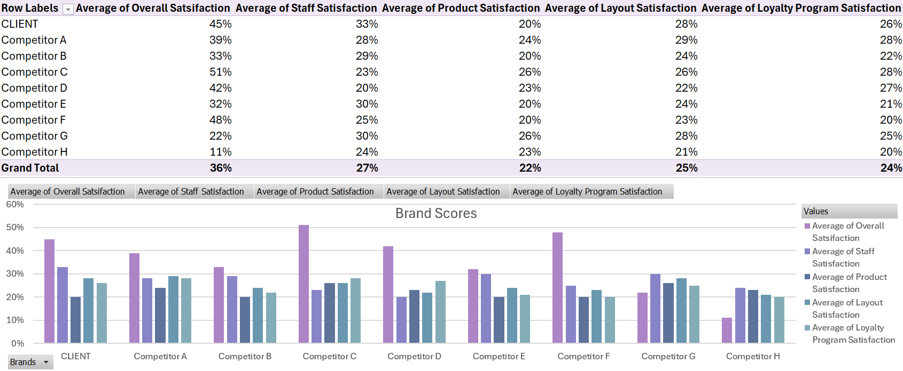
Market Position
Against competitors, Karma’s Choice is strongest on staff, weaker on product and loyalty. This tells me that Karma’s Choice is winning on the human side with it's people advantage, but where their competitors are winning is where growth is needed. Product satisfaction and Loyalty program satisfaction needs to be improved.
My market research analysis shows a mixed competitive position.
  3rd - Overall satisfaction: 45%
  1st - Staff satisfaction: 33%
  Tied Last - Product satisfaction: 20%
  Tied 2nd - Layout satisfaction: 28%
  4th - Loyalty program satisfaction: 26%

Slide 7
.. Layout, Self-Checkout, and Retention ..​
​
Was layout and self-checkout a bad investment? Self-checkout No, Layout Needs More.​
​
I do not think the layout and self-checkout investment was a bad idea. However, the data does not show that it solved the main customer problem of 2.94/5 Easy to Find Items. Customers still want a smoother shopping experience. The issue is not the investment itself, but how it was implemented. The store may be easier in some ways, but not necessarily more intuitive. Self-checkout has helped but it doesn't fix every frustration. If customers still struggle to find items or get help, retention still falls. My view is that the layout investment should be improved further. My recommendation is to keep self-checkout, but improve signage, aisles, and floor support so customers can find what they need faster.
.. Customer Journey Opportunities ..
Are there any other opportunities to drive higher retention, and financial growth?​ Yes
The biggest opportunity for customer Journey is improving the 2.94/5 item findability. Improving the store layout will greatly help the business. CX Survey results show the customers are more likely to return and spend more when they have a higher satisfaction rate, and item findability is holding back the satisfaction scores greatly.
A less important opportunity is improving product availability, customers that said yes to available products had slightly higher satisfaction scores across all questions. However, the boost in satisfaction scores are quite small.
Which would be the same for the last opportunity: improving employee engagements. Despite the investment in Employee Engagement, employees are still less satisfied than customers. While customers scored a 4.9/5 in overall satisfaction, employees scored a 4.04/5. Investing even more in Employee Engagement would improve the satisfaction score, but It may not be worth it. Employees are still doing a great job, despite the lower overall satisfaction. What's really needs fixing is the store layout.

Slide 8
.. The 2022 Growth Strategy ..
To support 16% revenue growth and improve retention , Karma’s Choice should focus on 4 priorities:
  Main Priority 1: Improve the customer journey - Make items easier to find and up product Satisfaction. Clearer signage, better aisle logic, and cleaner layout.
  Priority 2: Improve product availability - fewer out-of-stocks, better replenishment, stronger shelf execution.
  Priority 3: Invest more in employees - Improve engagement, recognition, scheduling fairness, Support training. Make employees more prepared, confident, and happy to be there.
  Minor Priority 4: Strengthen loyalty program - improve loyalty value, personalized offers, and post-purchase retention tactics
.. Closing ..
Engaged employees, smoother shopping, more available products, and better loyalty program = better retention and will drive stronger revenue. Karma’s Choice should use these recommendations and collect the same data again at the end of 2022.
In conclusion, Karma’s Choice should keep investing in employee engagement and use its strong people interactions and service potential to see its ROI in 2022. The brand can turn that service strength into higher retention and financial growth, by Improving the customer journey.

