Slide 1


Is Enough Being Done?
The Issue Of High Crime In Some Toronto Neighbourhoods
---------------------------------------------------------------------------------------------------------------------------------------------
By: Kofoworola Ogutuga

Slide 2
Introduction
Objective
Analysis of High-Crime Neighbourhoods
  Neighbourhoods with Highest Crime Number
  Initiatives and Interventions in High-Crime Neighbourhoods
  Neighbourhood Crime Number Over The Years​
  Crime Rate Per 100,000 vs. Neighbourhood Population 2024​
  Defining High vs. Low Crime Rates ​
Recommendations & Conclusion
- Table Of Contents -

Slide 3
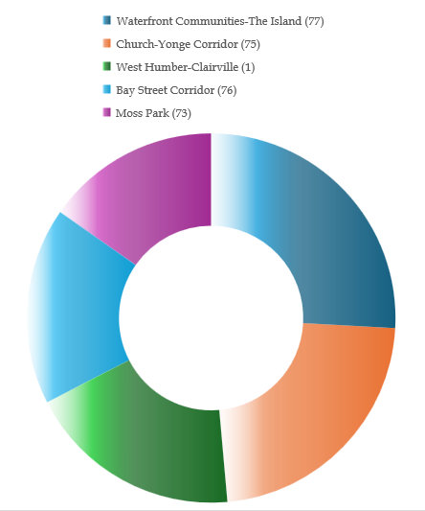
- An Evidence Based Assessment Using City Of Toronto Open Data -
Introduction
This presentation explores the distribution and trends of crime across Toronto’s neighbourhoods, focusing on areas with the highest incident counts. By analyzing open data from the City of Toronto, I have identified key trends, compared crime rates relative to population, and examined the impact of existing neighbourhood initiatives. Although the City of Toronto has implemented many safety measures, my findings show that additional targeted interventions are necessary and needed, especially in areas near George Brown’s St. James Campus, because I plan to move closer to there.
​Overview of crime distribution across neighbourhoods. ​
Examination of yearly trends and per capita crime rates. ​
Evaluation of current municipal interventions. ​
Preliminary conclusion: More targeted actions is needed.
- W e l c o m e -

Slide 4
- Data Used from City of Toronto’s Open Data: “Major Crime Indicators” -
Is Enough Being Done About Toronto Neighbourhoods
With The Highest Number Of Crimes?​
I’ve examined which neighbourhoods have the highest amount of crime /crime rate and the factors contributing it, how crime rates change over time, both in absolute terms and relative to population, and the effectiveness of current safety initiatives and whether they are sufficient in reducing incidents.
- PRESENTATIONS OBJECTIVE -

Slide 5
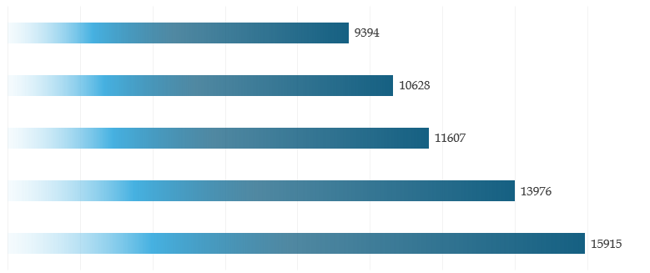
- 1 -
Neighbourhoods with Highest Total Crime Number

Slide 6
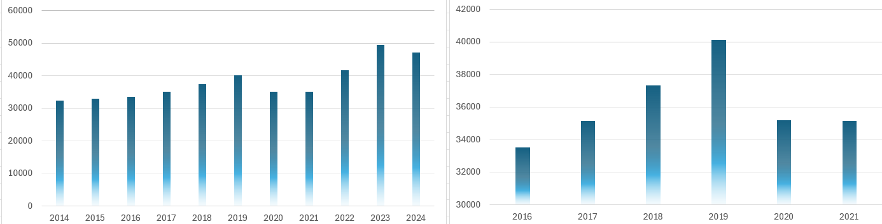
- 3 -
Initiatives and Interventions in High-Crime Neighbourhoods
The City of Toronto has implemented several initiatives to combat crime in it most affected neighbourhoods.
Data from the Major Crime Indicators reflects periods during which these initiatives were launched, allowing me to relate intervention timing with changes in crime trends.
Despite these efforts, temporary results, some area continued to experience elevated crime rates. Thats why there still a need for additional or more targeted measures.
Initiatives Like:
Supervised Consumption Sites (SCS) in Moss Park and Church-Yonge Corridor
FOCUS Toronto on West Humber-Clairsville
Summer Safety Initiative and Neighbourhood Officers Program
Violence Reduction Program (VRP) in Toronto Community Housing

Slide 7
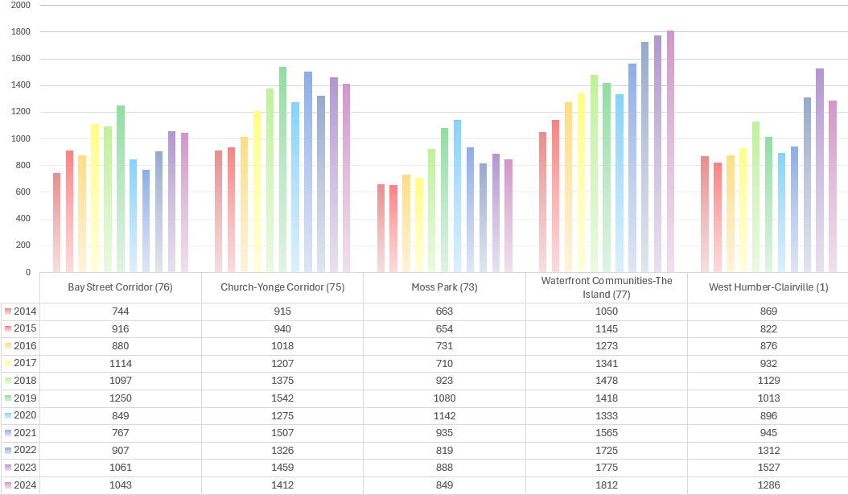
- 2 -
Neighbourhood Crime Number Over The Years
Notice The Drop During Covid And The Raise In Moss Park

Slide 8
- 4 -
Crime Rate Per 100,000 vs. Neighbourhood Population 2024
To understanding the impact of crime on local communities, I analyzed the 2024 crime counts relative to the 2024 population in each neighbourhood. By normalizing the data, we calculated the number of crimes per 100,000 residents. This gives a clearer “per person” view of the problem, rather than relying solely on absolute numbers.
Waterfront Communities-The Island: | Church-Yonge Corridor: | West Humber-Clairville: | Bay Street Corridor: | Moss Park:
Crime Count = 1,812 Population = 65,900 Crime Rate = (1,812 / 65,900) × 100,000 Crime Rate ≈ 2,751.70 crimes per 100,000 | Crime Count = 1,412 Population = 31,340 Crime Rate = (1,412 / 31,340) × 100,000 Crime Rate ≈ 4,506.43 crimes | Crime Count = 1,286 Population = 33,310 Crime Rate = (1,286 / 33,310) × 100,000 Crime Rate ≈ 3,860.00 crimes | Crime Count = 1,043 Population = 25,800 Crime Rate = (1,043 / 25,800) × 100,000 Crime Rate ≈ 4,039.53 crimes | Crime Count = 849 Population = 20,500 Crime Rate = (849 / 20,500) × 100,000 Crime Rate ≈ 4,141.46 crimes

Slide 9
- 5 -
Defining High vs. Low Crime Rates
In order to determine which areas urgently need for intervention, I compare the crime rates against a benchmark. For this analysis, we use 4,000 crimes per 100,000 residents as an initial benchmark. Neighbourhoods with crime rates above this threshold are considered to have high crime rates. Those below are categorized as moderate, though still requiring monitoring.
Interpretation of The Results (2024)
Waterfront Communities-The Island: ~2,751.70 crimes per 100,000 | Church-Yonge Corridor: ~4,506.43 crimes per 100,000 | West Humber-Clairville: ~3,860.00 crimes per 100,000 | Bay Street Corridor: ~4,039.53 crimes per 100,000 | Moss Park: ~4,141.46 crimes per 100,000
Interpretation: Way below the 4,000 benchmark, has a relatively lower risk on a per capita basis. | Interpretation: Exceeds the benchmark, highlighting it as a high-risk area. | Interpretation: Just below the threshold but still deserves attention. | Interpretation: Slightly above the threshold, indicating elevated risk. | Interpretation: Clearly above the benchmark, indicating an urgent need for targeted interventions.

Slide 10
- What Must Be Done -
These recommendations will enhance public safety in high-crime neighbourhoods and create safer trusting environments:
Increase Targeted Community Policing: Focus more resources on areas with persistently high per capita crime rates.
Invest in Infrastructure: Improved lighting, public spaces, and community centers is known for deterring crime.
Enhance Community Engagement: More regular public reporting and support community-based safety initiatives.
Conduct Ongoing Evaluations: Use continuous data monitoring combined with community feedback to adapt and refine interventions over time.
In Conclusion
To conclude, our study indicates that while the City of Toronto has made notable efforts to tackle crime in its most affected neighbourhoods, significant challenges remain. The persistent high crime rates, particularly when viewed on a per capita basis, emphasize the need for more nuanced and targeted interventions. This analysis serves as a call to action for policymakers, law enforcement, and communities alike to work together for enhanced public safety.
- R E C O M M E N D A T I O N -

Slide 11

Thank You For Reading
------------------------------------------------------------------------------------------------------------------------------
This Evidence Based Assessment Using City Of Toronto Open Data

