Slide 1
Codecademy
By: Ethan Tran

Slide 2
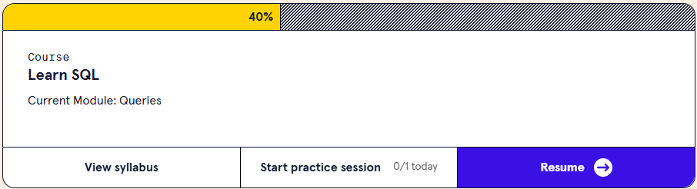
Day 1 10/28/24
I learned about Structured Query Language (SQL), which helps manage and work with data in relational databases that use tables. I got familiar with basic data types like INTEGER and TEXT, and important SQL commands such as CREATE TABLE for making new tables, INSERT INTO for adding data, SELECT for retrieving data, UPDATE for changing existing data, DELETE FROM for removing data, and ALTER TABLE for changing table structures. I also studied rules called constraints, like PRIMARY KEY and NOT NULL, to keep data accurate. By practicing with SQLite, I gained skills to work with databases effectively, helping me make better decisions based on data.

Slide 3
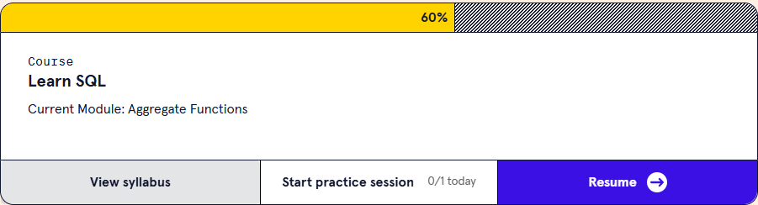
Day 2 10/29/24
In the SQL, I learned how to use functions like SUM(), AVG(), COUNT(), MIN(), and MAX() to perform calculations on data sets within a database. These functions let me quickly summarize large amounts of data—like calculating total sales, finding average values, counting entries, or identifying minimum and maximum values in a dataset. I also learned to use the GROUP BY clause to apply these functions to specific groups of data, and the HAVING clause to filter results based on aggregate conditions. Overall, these tools help me derive clear and useful insights from complex datasets.

Slide 4
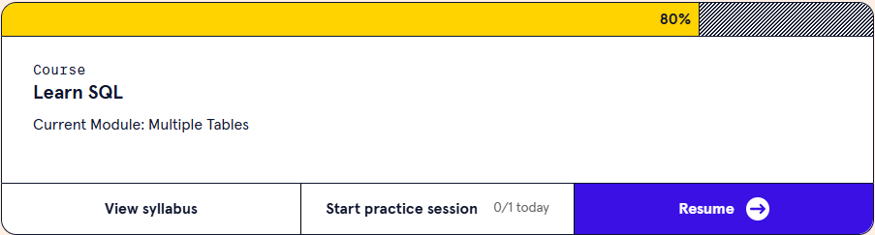
Day 3 10/30/24
In the SQL, I learned how to combine data from different tables using various types of joins, like INNER JOIN, LEFT JOIN, RIGHT JOIN, and FULL OUTER JOIN. Each join type helps link tables based on common keys, allowing me to pull in related data across multiple tables. I also learned about subqueries, which let me nest queries to access data indirectly, and I explored UNION and UNION ALL, which combine results from separate queries into one dataset. These techniques give me a lot more flexibility for working with complex, interconnected data, making it easier to analyze information across different tables in a database.

Slide 5
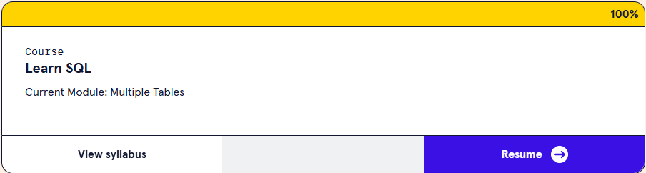
Day 4 10/31/24
I learned how to use aggregate functions with conditional logic by combining them with CASE WHEN statements. This lets me create more detailed summaries, like calculating totals based on specific conditions within groups. I also used DISTINCT to count unique entries in certain categories and learned about window functions like ROW_NUMBER() and RANK(), which allow me to perform calculations across defined "windows" or sections of data without grouping everything together. On top of that, I got into performance considerations, like indexing and query optimization, to keep my aggregate queries efficient, especially when working with large datasets.

Slide 6
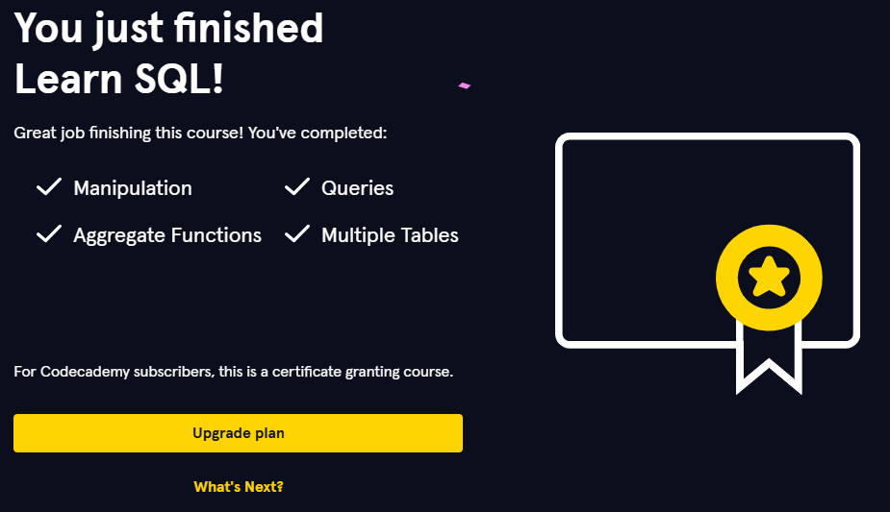
certificate

Slide 7
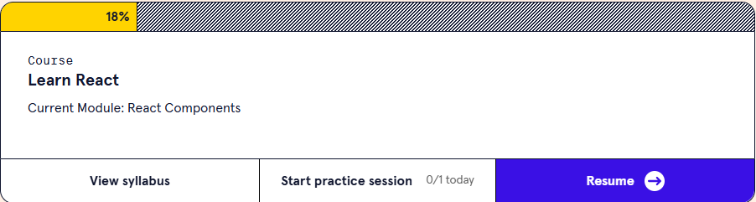
BONUS: REACT 10/31/24
In React, I learned about creating reusable UI elements, or "components," which are the building blocks of any React application. React components are JavaScript functions or classes that return JSX—a syntax extension that looks like HTML but works in JavaScript—defining how a part of the UI should appear. I learned how to structure an app by building small, focused components that handle one specific function, making them easier to maintain and reuse. Components can be "functional" or "class-based," and they can also accept "props" (short for properties) to display dynamic data or handle user input. Understanding components helped me see how React apps are structured and how data flows through them, making the development process more organized and scalable.

Slide 8
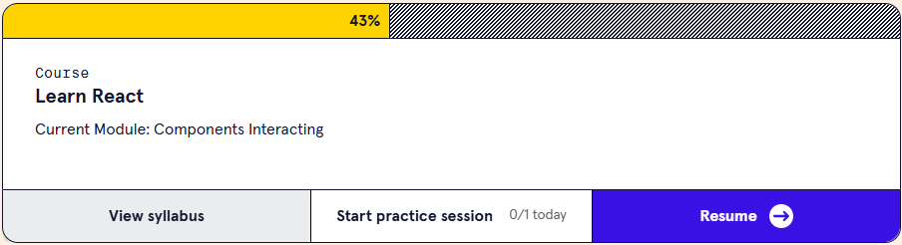
BONUS: REACT 11/01/24
In React, I learned how different components in a React app communicate and share data. This involves passing data from a parent component to its child components using "props," which act as a way for parent components to send information down the component tree. I also learned about "lifting state up," where state is managed in a common parent component and shared among children, allowing them to synchronize based on shared data. Additionally, I explored callback functions, which enable child components to send information back to their parent components. These techniques allow components to interact dynamically, making React apps more interactive and responsive to user actions.

Slide 9
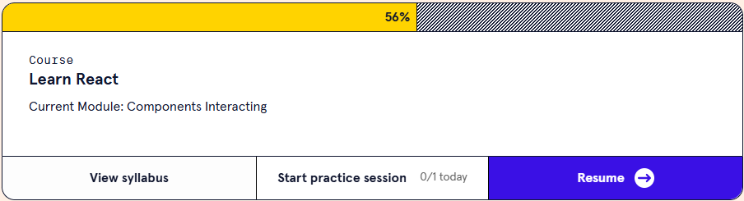
BONUS: REACT 11/01/24
I learned about using context to manage and share state globally across multiple levels of the component tree without manually passing props through each level. The Context API in React allows me to create a centralized state that can be accessed by any component, making it easier to manage data for components that aren’t directly related. I explored controlled and uncontrolled components as well—controlled components manage their state through React, while uncontrolled components use the DOM directly. This unit also covered the basics of React hooks like useState and useEffect, which allow function components to handle state and lifecycle events, making them even more powerful and interactive. Altogether, these methods streamline how data and behavior flow through an app, making it easier to handle complex interactions across various components.

Slide 10
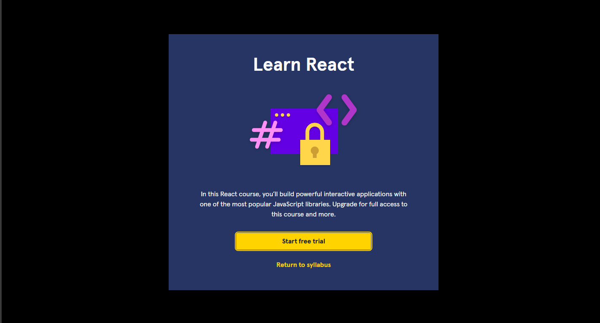
BONUS: REACT Got pay walled

