Slide 1

ORCA GCN
Citation Trust
Presenting:
Almog Raz
Yuval Kogan
Advisors:
Dr. Renata Avros
Prof. Zeev Volkovich
Braude College of Engineering - Spring 2026
Project Code: 26-2-R-10
Final Project - Phase A

Slide 2
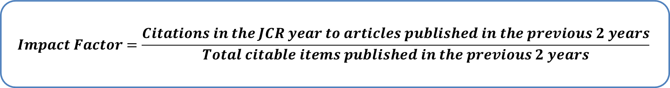
The Status Quo - Journal Impact Factor
Journal of Applied Science
Journal Impact Factor is the five-star rating method of science – one number, the average citations a journal earns, that directly affects hiring, funding, and prestige.
★★★★★
IMPACT FACTOR
14.2
avg. citations / paper
2-year window
50+ years as default
the one number scientists trusts
$$Impact Factor=\frac{Citations in the JCR year to articles published in the previous 2 years}{Total citable items published in the previous 2 years}$$
Notes:
think of the last time you booked a hotel or bought something online. You did not read every review - you glanced at the star rating and trusted it. Academia has the exact same shortcut. It is called the Impact Factor. Every journal gets one number - basically the average times its papers get cited - and that number decides who gets hired, who gets funded, and which research the world pays attention to. It is the five-star rating of science, and for fifty years it has been the number everyone trusts, an overall comfortable numbered grading to look at. So hold one question for the next fifteen minutes: what happens when the star rating can be faked?

Slide 3



The Problem with Impact Factor
Context Blindness
Systematic Manipulation
Dimensionality Flaws
Treats all citations equally
Vulnerable to coordinated citation rings
Ignores critical metadata
Notes:
Context Blindness: every citation adds exactly +1 regardless of semantic relevance, field distance, or citation context.
Systematic Manipulation: citation cartels (journals mutually over-citing each other in closed loops) are invisible to a flat count.
No temporal awareness: a burst of 50 citations in one week looks identical to 50 organic citations over three years.
Dimensionality loss: the academic landscape is a rich heterogeneous graph, but IF collapses it to a single scalar.
No verification layer: 'filler' citations (used to pad reference lists) carry the same weight as foundational cross-field references.

Slide 4

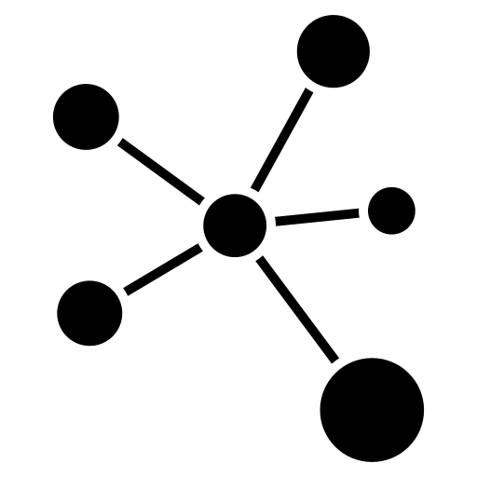
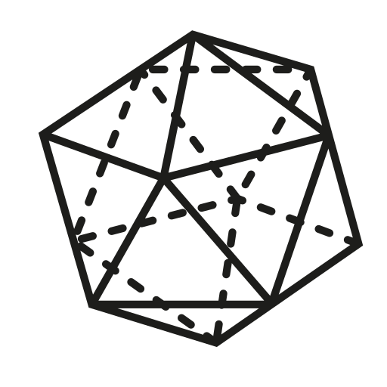
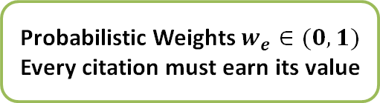
The Solution: Curvature-Aware Impact Factor (CAIF)
Trust Weighted
Structurally Secure
Multi-Modal Dimensions
Probabilistic Weights $w_{e}∈(0, 1)$ Every citation must earn its value
Neutralize citation rings by mapping the topology
4D feature vector – analyzing Geometry, Network Flows, Timestamps, and Text Semantics
Notes:
Trust-weighted counting: each citation edge receives a continuous score w between 0 and 1 instead of a binary +1.
Four independent signals: ORC graph geometry, GCN neural embeddings, temporal plausibility, and NLP semantic similarity each audit the citation from a different angle.
Cartel detection via curvature: citation rings produce distinctively negative Ollivier-Ricci curvature, a geometric signature traditional metrics cannot observe.
Field normalization (NCAIF): raw scores are adjusted by field-wide citation averages so biology and physics journals can be compared fairly.
Statistical validation: a Z-score against a null model confirms the result is not an artifact of network size or citation age distribution.

Slide 5




System Architecture Overview
Data Collection
Feature Profiling
Trust Calculation
Final Score
Phase 1: Ingestion
Phase 2: Extraction
Phase 3: Audit
Phase 4: Validation
Notes:
Single entry point: a journal name plus a citation window triggers an HTTP query to the OpenAlex REST API.
Heterogeneous graph: raw JSON is converted into typed nodes (Papers, Authors, Journals) and typed edges (cites, authored-by, published-in).
Parallel fan-out: the graph is broadcast as four simultaneous streams to the ORC, GCN, Temporal, and NLP extractors in Phase 2.
Feature fusion: the four per-edge scores are concatenated into a single multi-modal vector that the Citation Trust Head processes in Phase 3.
Validated output: Phase 4 aggregates trust weights into a raw CAIF score, normalizes it, and gates publication on a Z-score test against a null model.

Slide 6
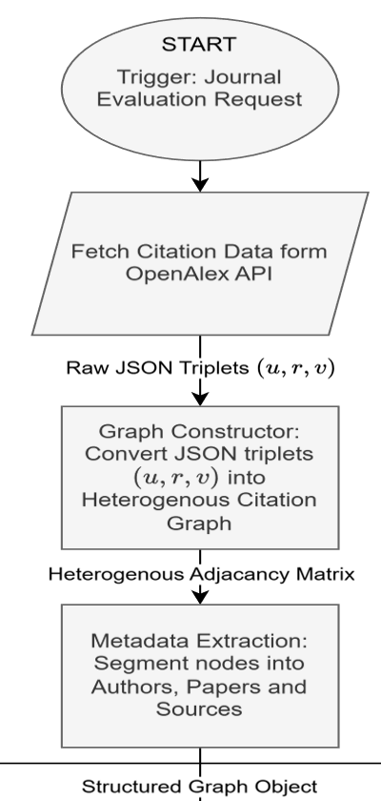
Phase 1: Data Acquisition & Pre-processing
Goal: Turn a single journal request into a typed citation graph, broadcast as four parallel streams
query the journal's papers and their citations, rebuild them as typed (Source Node,Relationship Type, Target Node) triplets in a heterogeneous graph, then sort nodes by type and split each paper's details into four streams.
Notes:
Now the solution — it runs in four phases, and we build them up one at a time. Phase one is plumbing, but important plumbing. Follow the diagram left to right. We start with one request: a journal name, a year window, a research field. That goes to OpenAlex — a giant open database of papers — and pulls back the raw material: every paper, its authors, its journal, and every citation between them, as JSON. The Graph Constructor turns that into a graph with three kinds of nodes — papers, authors, journals — joined by typed edges like cites and authored-by. Finally, Metadata Extraction fans the graph out into four parallel streams: the network's wiring, its starting features, its timestamps, and its abstract text. Hold onto those four colored streams — in the next phase each one gets analyzed independently. One request in; a rich, typed citation network out.

Slide 7
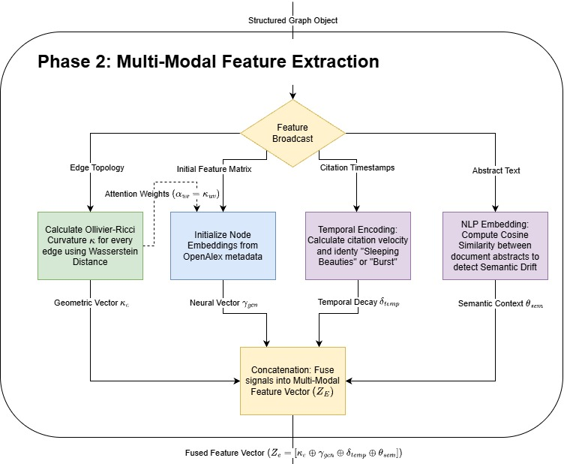
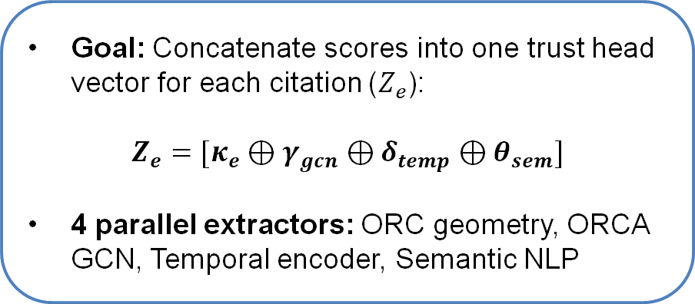
Phase 2: Multi-Modal Feature Extraction
Goal: Concatenate scores into one trust head vector for each citation ($Z_{e}$):
$$Z_{e}=[κ_{e}⊕γ_{gcn}⊕δ_{temp}⊕θ_{sem}]$$
4 parallel extractors: ORC geometry, ORCA GCN, Temporal encoder, Semantic NLP
Notes:
Phase two is where the intelligence lives. Remember those four streams? Each now feeds its own specialist, and they all run in parallel — four independent reads on every single citation. The first is geometry, and it is the heart of the project. For each citation we look at the neighborhood: if the two papers share many common connections, the citation sits in a tight, healthy cluster — trustworthy. If they share almost none, it is a lonely bridge between unrelated worlds — a red flag. The second is a neural network that checks whether the papers' learned profiles genuinely match. The third checks timing — is the citation even chronologically possible, or part of a suspicious burst? The fourth reads the actual abstracts and asks whether the two papers are even about the same thing. Four questions — geometry, network, time, meaning — and we staple the four answers into one vector per citation. That vector is what the next phase judges.
$Z_{e}=[κ_{e}⊕γ_{gcn}⊕δ_{temp}⊕θ_{sem}]$

Slide 8
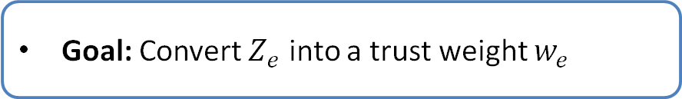
Phase 3: Neural Audit Mechanism
Goal: Convert $Z_{e}$ into a trust weight $w_{e}$
Notes:
Input: the four-dimensional feature vector assembled in Phase 2, one per citation edge.
Architecture: a single learned linear layer followed by a sigmoid activation, intentionally lightweight and interpretable.
Output: a trust weight w in [0, 1]; values near 1 indicate a clean, structurally coherent citation; values near 0 flag manipulation.
Interpretability: after training, the learned coefficients directly reveal which signal the model found most predictive of citation quality.
Bounded by design: the sigmoid guarantees no citation ever receives a negative weight or a weight above 1, regardless of input magnitude.

Slide 9
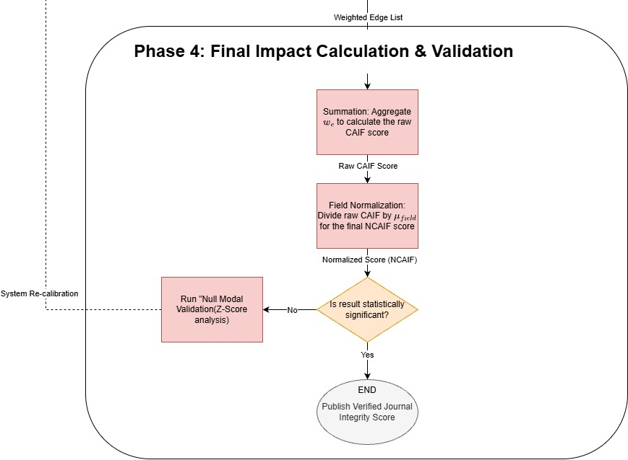
Phase 4: Impact Calculation & Validation
Goal: Normalize citation quality for fair cross disciplinary comparison
Calculates a trust weighted sum and normalizes against the field wide average
Notes:
Trust-weighted CAIF sum: replaces the traditional raw count with the sum of all incoming trust weights divided by the number of published papers.
Field normalization: a per-field, per-year normalization factor is multiplied directly into each edge weight, separating citation quantity, quality, and field comparability into three auditable components.
Null model baseline: hundreds of degree-preserving random graph shuffles generate a baseline distribution of CAIF scores for the same journal.
Z-score decision gate: the journal's real NCAIF must exceed the null distribution by a statistically significant margin to be published.
Flagging vs. publishing: journals that do not clear the Z-score threshold are flagged for potential structural manipulation rather than receiving a published score.

Slide 10
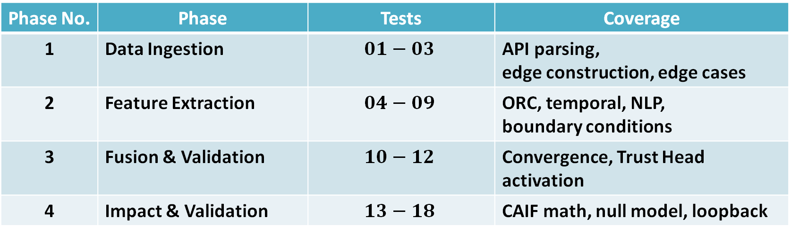
Testing Plan: Methodology Overview
18 tests total across 4 pipeline phases
Phase No. | Phase | Tests | Coverage
1 | Data Ingestion | $$01−03$$ | API parsing, edge construction, edge cases
2 | Feature Extraction | $$04−09$$ | ORC, temporal, NLP, boundary conditions
3 | Fusion & Validation | $$10−12$$ | Convergence, Trust Head activation
4 | Impact & Validation | $$13−18$$ | CAIF math, null model, loopback
Notes:
18 tests total: distributed across all four pipeline phases from data ingestion through null model validation.
Phase-scoped isolation: each module is tested independently before integration, so failures are immediately localized.
Boundary conditions: explicit tests for zero-citation papers, chronologically impossible timestamps, and extreme feature values (magnitude 9999) that could cause overflow or NaN.
Math correctness vs. robustness: half the tests verify numerical outputs match expected values; the other half verify the system degrades gracefully under invalid or malformed input.
Decision logic tested explicitly: the Z-score rejection gate and re-calibration loopback are both exercised as first-class test scenarios.

Slide 11
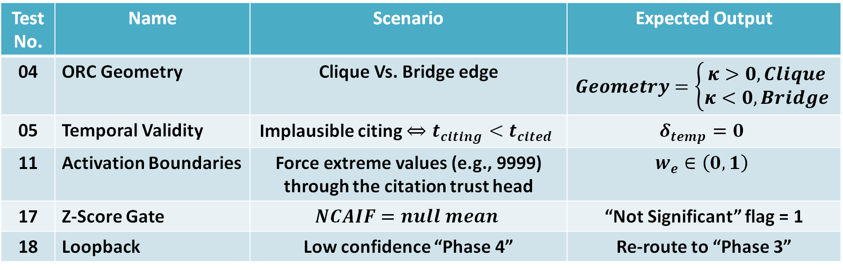
Testing Plan: Key Validation Scenarios
Test No. | Name | Scenario | Expected Output
04 | ORC Geometry | Clique Vs. Bridge edge | $$Geometry=\left\{\begin{aligned}κ>0, Clique \\ κ<0, Bridge\end{aligned}\right.$$
05 | Temporal Validity | Implausible citing $⇔t_{citing}<t_{cited}$ | $$δ_{temp}=0$$
11 | Activation Boundaries | Force extreme values (e.g., 9999) through the citation trust head | $$w_{e}∈\left(0,1\right)$$
17 | Z-Score Gate | $$NCAIF=null mean$$ | “Not Significant” flag = 1
18 | Loopback | Low confidence “Phase 4” | Re-route to “Phase 3”
Notes:
Test 04 (ORC correctness): run curvature on a perfect clique and a single bridge edge; clique must return positive curvature, bridge must return negative.
Test 05 (temporal impossibility): feed a citation where the citing paper predates the cited paper; the temporal encoder must output a penalty score of exactly 0.
Test 11 (sigmoid bounds): force extreme vectors (magnitude +/- 9999) through the Trust Head; output must remain strictly inside [0, 1].
Test 17 (Z-score gate): set NCAIF exactly on the null distribution mean; the decision gate must correctly classify this as not statistically significant.
Test 18 (re-calibration loopback): force a low-confidence Phase 4 output; verify the system routes back to Phase 3 for a second pass rather than publishing an unreliable score.

Slide 12
Project Challenges & Complexities
→
CHALLENGE
HOW WE SOLVED IT
Messy real-world data - deeply nested JSON, missing abstracts.
Defensive parsing - the pipeline degrades gracefully instead of crashing on a gap.
→
CHALLENGE
HOW WE SOLVED IT
Curvature is expensive - Wasserstein distance per edge scales quadratically.
Batched computation secures the feasibility of the graph geometry at full scale.
→
HOW WE SOLVED IT
CHALLENGE
No ground-truth "trust" labels exist for any citation.
Weak supervision - proxy labels drawn from known manipulation patterns.
Notes:
No honest engineering talk is complete without the parts that fought back — and these were the fun ones. Three stand out. First, real-world data is messy. OpenAlex JSON is deeply nested and full of holes — some papers simply have no abstract. So we built the pipeline to degrade gracefully: a missing field bends the system, it never breaks it. Second, the geometry is expensive. That curvature signal relies on the Wasserstein distance — optimal transport — computed for every citation edge, and the cost scales quadratically. We tamed it with batched computation so it stays tractable on large graphs. Third, the deepest one: there is no answer key. Nobody has labeled which citations are trustworthy, so we cannot train the usual way. We use weak supervision — proxy labels drawn from known manipulation patterns like cartels and self-citation loops. Every one of these was a design decision, not a dead end.

Slide 13
Conclusion
→
TRADITIONAL IF
CAIF — TRUST-WEIGHTED
+1
0 → 1
per citation – no questions asked
per citation – each one earns its respective weight
Build the graph → read each citation four ways → score its trust → sum, normalize, and statistically validate.
flat · countable · gameable
flat · countable · gameable
geometry · network · time · meaning
Notes:
No honest engineering talk is complete without the parts that fought back — and these were the fun ones. Three stand out. First, real-world data is messy. OpenAlex JSON is deeply nested and full of holes — some papers simply have no abstract. So we built the pipeline to degrade gracefully: a missing field bends the system, it never breaks it. Second, the geometry is expensive. That curvature signal relies on the Wasserstein distance — optimal transport — computed for every citation edge, and the cost scales quadratically. We tamed it with batched computation so it stays tractable on large graphs. Third, the deepest one: there is no answer key. Nobody has labeled which citations are trustworthy, so we cannot train the usual way. We use weak supervision — proxy labels drawn from known manipulation patterns like cartels and self-citation loops. Every one of these was a design decision, not a dead end.

Slide 14
ORCA GCN Citation Trust
Thank You!
Questions?
Notes:
Special thanks - Thank you to Prof. Zeev Volkovich & Dr. Renata Avros for their guidance

