Slide 1
Crop production analysis using tableau
BATCH 8
Guided By: Srinivas reddy sir
(Associate Professor)
CHAREEKA REDDY(17RH1A1211)
KOGANTI SAI SNEHITHA(17RH1A1225)
SINGAM SUJANI(17RH1A1253)

Slide 2
CONTENTS :
INTRODUCTION
ABSTRACT
EXISTING SYSTEMS
TECHNOLOGIES
WHY TABLEAU?
SAMPLE DATASET
STEPS FOR DATA ANALYSIS
INDIVISUAL WORK SHEETS ANALYSIS
FINAL DASHBOARD
CONCLUSION

Slide 3
INTRODUCTION
OVERVIEW :
From ancient period, agriculture is considered as the main and the foremost culture practiced in India.
The greenish goods produced in the land which have been taken by the creature leads to a healthy and welfare life.
Since the invention of new innovative technologies and techniques the agriculture field is slowly degrading.
Cultivating techniques the seasonal climatic conditions are also being changed against the fundamental assets like soil, water and air which lead to insecurity of food.
By analyzing all these issues and problems like weather, temperature and several factors, there is no proper solution and technologies to overcome the situation faced by us.

Slide 4
ABSTRACT
Farming currently accounts for about one percent of agriculture land worldwide.
Farming should not use chemical fertilizers, pesticides, herbicides. It requires more natural alternatives (vegetable wastes) and improve soil fertility.
To produce non-toxic food and control person diseases. How data mining done with tableau tool applying algorithm to improve product.
This project is divided into three sections:
(i) Data Collection (ii) Data filtering(iii)Data visualization.

Slide 5
Existing Systems :
Crop Selection and Crop Yield Prediction
Weather Forecasting
Smart Irrigation System

Slide 6
TECHNOLOGIES
TABLEAU TOOL
This tool produces interactive data visualization software products focused on business intelligence. Tool can see and understand the data. Analyze and Explore data in seconds just drag and drop trends. Import the data like spread sheet, csv file format etc.
PYTHON

Slide 7
WHY TABLEAU ?
There are a variety of tools available for one to derive relevant conclusions out of raw data.
Once such technique is visualization, which reveals insights out of the data, allows visual data analysis and enables quicker decision-making. ‘Tableau’ is one such Business intelligence and data visualization tool.
It is very popular and intuitive to use.

Slide 8
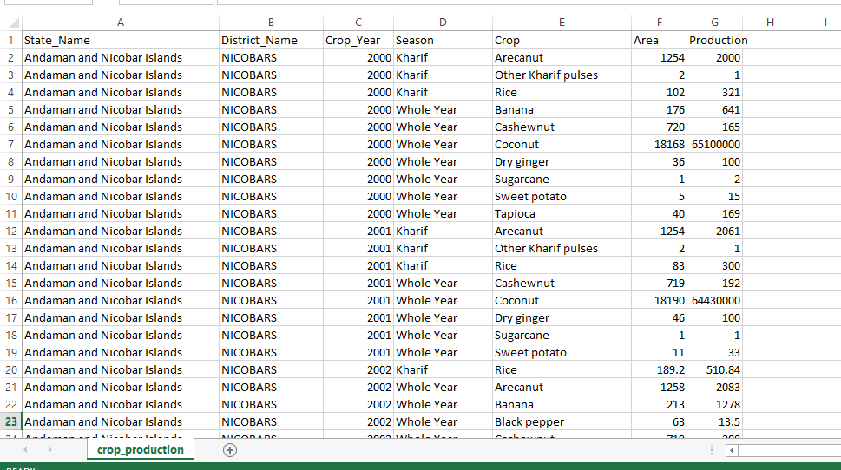
SAMPLE DATASET

Slide 9
STEPS FOR DATA ANALYSIS IN TABLEAU:
Loading the data set
Preparing the work sheets
Creating the Dashboard

Slide 10
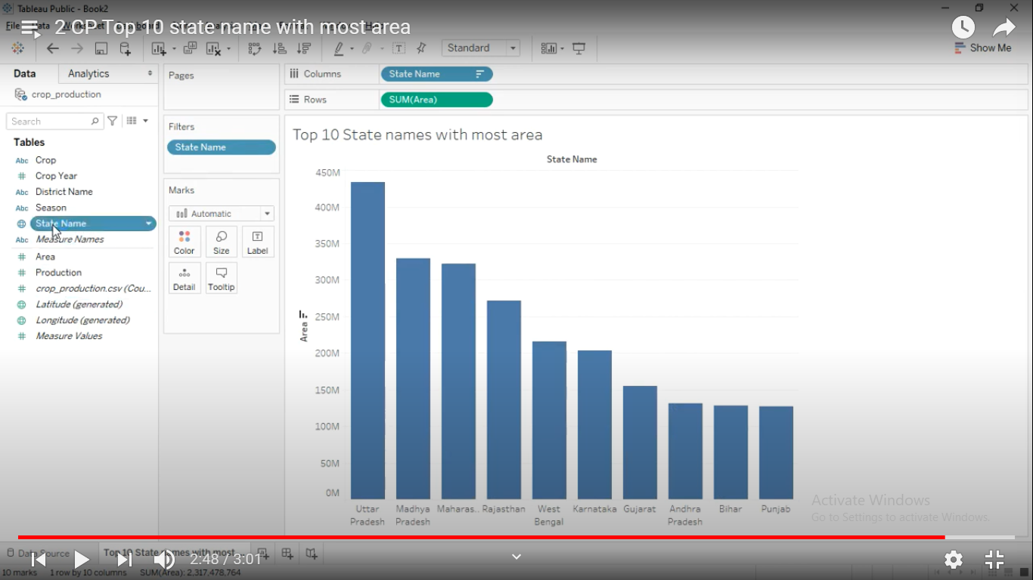
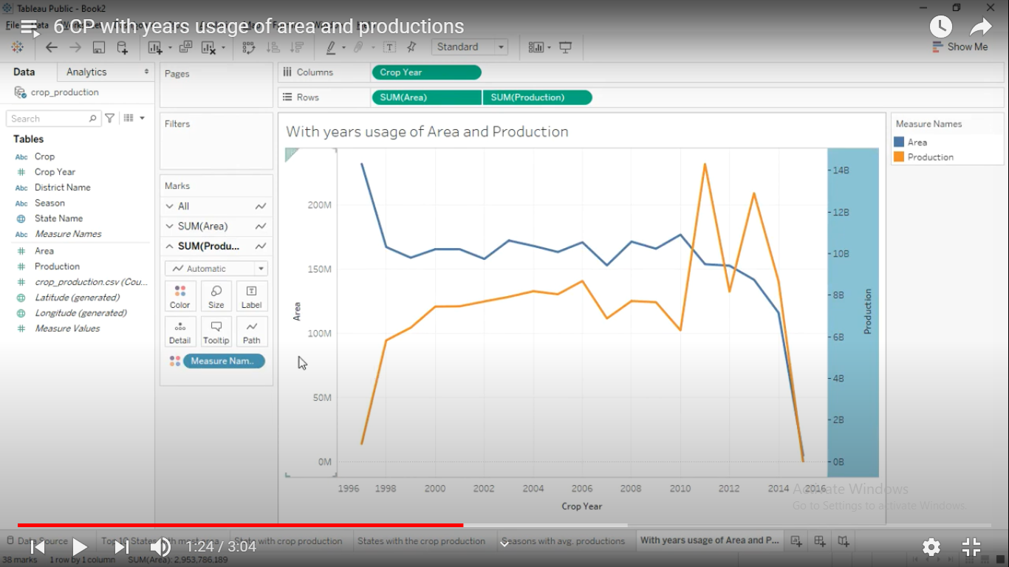
TOP 10 STATE NAMES WITH MOST AREA
WITH YEARS USAGE OF AREA AND PRODUCTION
INDIVISUAL WORKSHEET ANALYSIS

Slide 11
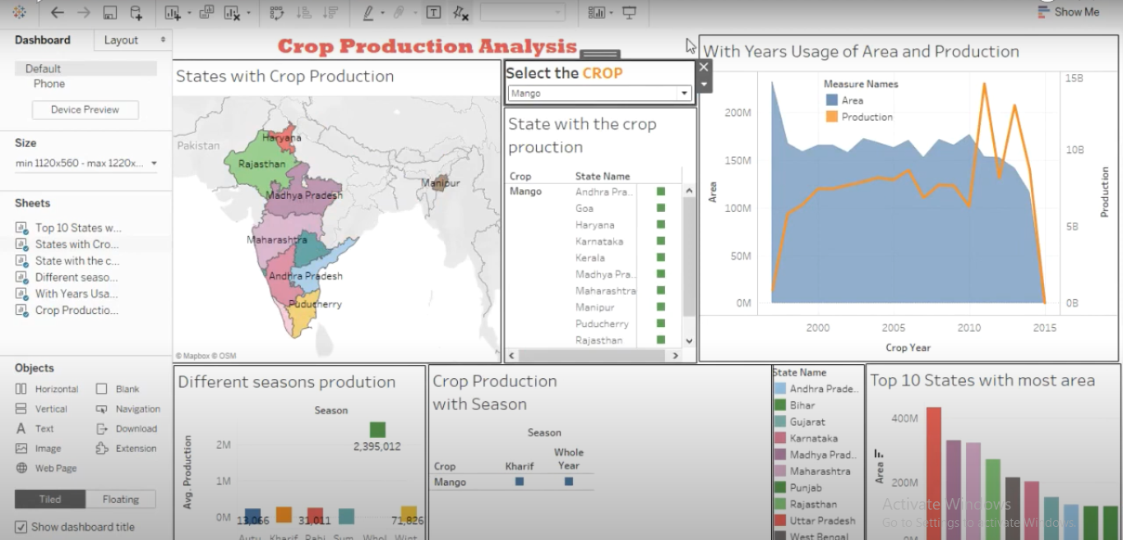
FINAL DASH BOARD OF CROP PRODUCTION ANALYSIS

Slide 12
CONCLUSION:
A large body of data is available in every field, and a huge push towards extracting insights from it is being made by individuals and corporations in order to make data-based decisions.
Crop yield prediction is still remaining as a challenging issue for farmers. The aim of this project is to propose and implement a rule based system to predict the crop yield production from the collection of past data.
Crop production analysis will help in increase the production and overcoming the problems, by increasing the yield

Slide 13
THANK YOU

