Slide 1
😷
THE UNEVEN PANDEMIC
Scale & Speed A Population-Adjusted Look at Global COVID-19 Spread
By Burabari Gift Kogbara
AnalystLab Africa Data Analytics Internship · Week 4: Data Visualization & Dashboarding

Slide 2
Dataset Overview
Primary Source
Enrichment Source
Coverage
Grain
Johns Hopkins CSSE COVID-19 time series
(Confirmed & Deaths, global)
World Bank population data
(SP.POP.TOTL, 2021 reference year)
~200 countries/regions
Jan 22, 2020 – Mar 9, 2023
Country + Date
(collapsed from province-level rows)
What the data represents
Business questions this dashboard answers
Daily cumulative confirmed cases and deaths per country, merged with each country's total population to enable fair, size-adjusted comparison.
Which countries were truly hit hardest, once population size is accounted for?
Which countries' outbreaks escalated fastest?
How concentrated is global death toll among a handful of countries?
AnalystLab Africa · Data Analytics Internship · Week 4
2

Slide 3
Business Problem
Raw case counts are misleading.
Headlines and dashboards built purely on totals over-represent large countries and under-represent smaller, harder-hit ones. Decision-makers need to know: adjusted for population, who was actually hit hardest and how fast did it happen?
Why this matters
Resource allocation and public health messaging based on raw totals can misdirect attention away from small nations facing proportionally severe outbreaks.
Understanding speed-to-outbreak (not just scale) helps distinguish geographic proximity effects from genuine policy failures.
A concentrated view of severity (which countries drove global deaths) is essential for retrospective policy evaluation.
AnalystLab Africa · Data Analytics Internship · Week 4
3

Slide 4
KPIs Defined
Total Confirmed / Total Deaths
Global CFR
Global cumulative totals as of the latest reporting date
Case Fatality Rate Deaths ÷ Confirmed, worldwide
Cases per 100k
Peak Daily New Cases (+ per 100k)
Confirmed cases normalized by population the core "fair comparison" metric
The single worst reporting day, in absolute and population-adjusted terms
Days to First 1,000 Cases
Daily Growth Rate %
How quickly each country's outbreak reached four figures
Day-over-day % change in cumulative cases momentum, not just volume
AnalystLab Africa · Data Analytics Internship · Week 4
4

Slide 5
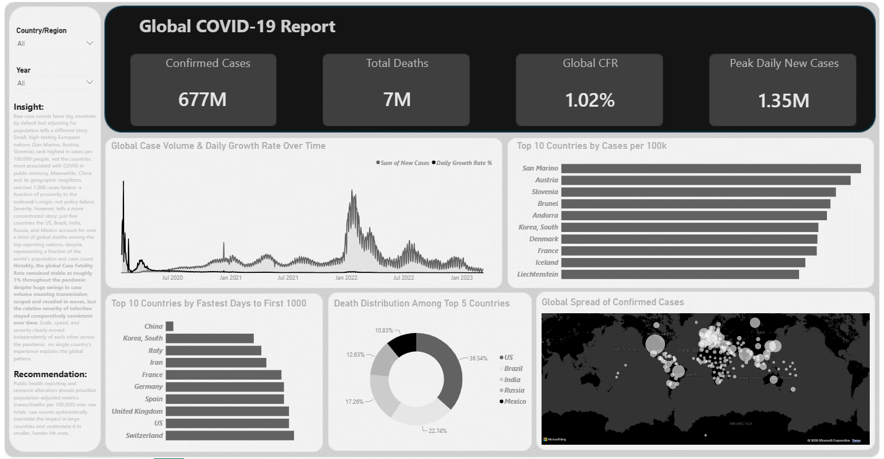
Dashboard: Scale & Speed
AnalystLab Africa · Data Analytics Internship · Week 4
5

Slide 6
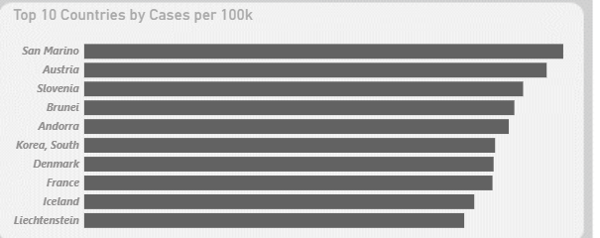
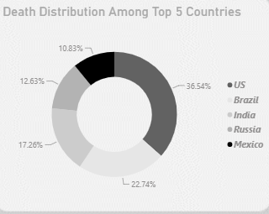
Highlight: Adjusting for Population Changes the Ranking
San Marino, Austria, and Slovenia not the US, India, or Brazil top the per-capita ranking. Meanwhile, just 5 countries (US, Brazil, India, Russia, Mexico) account for over a third of deaths among top-reporting nations, showing severity is far more concentrated than case volume.
AnalystLab Africa · Data Analytics Internship · Week 4
6

Slide 7
Key Insights
Population context reverses the story
Raw case counts favor big countries by default. Adjusted per 100,000 people, small high-testing European nations rank highest — not the countries most associated with COVID in public memory.
Speed reflects geography, not policy
China and its neighbors reached 1,000 cases fastest a function of proximity to the outbreak's origin, not a policy failure.
Severity is concentrated, not distributed
Just five countries US, Brazil, India, Russia, Mexico account for over a third of deaths among top-reporting nations, despite representing a fraction of global population and case count.
CFR stayed stable while volume swung wildly
Global Case Fatality Rate held near 1% throughout, even as case volume surged and receded across multiple waves severity per infection stayed consistent even as transmission didn't.
AnalystLab Africa · Data Analytics Internship · Week 4
7

Slide 8
Recommendations
1
Prioritize population-adjusted metrics (cases/deaths per 100,000) over raw totals in public health reporting and resource allocation raw counts systematically overstate impact in large countries and understate it in smaller, harder-hit ones.
2
Treat "days to outbreak" metrics with geographic context proximity to an outbreak's origin should not be conflated with the strength or weakness of a country's response.
3
Monitor CFR as a stability indicator a rising CFR alongside falling case volume would signal deteriorating care capacity, worth flagging early in future outbreaks.
AnalystLab Africa · Data Analytics Internship · Week 4
8

Slide 9
Challenges Faced
Locale-based date parsing errors
JHU's M/D/YY date format initially failed to parse; fixed by explicitly setting US locale during type conversion rather than relying on system defaults.
Cross-source country name mismatches
~25 countries had different names between JHU and World Bank data (e.g., "US" vs. "United States", "Congo (Kinshasa)" vs. "Congo, Dem. Rep.") resolved via manual value mapping.
Flawed DAX from row-context bugs
An initial "New Cases" formula produced impossible results (100M+ single-day cases) due to province-level rows breaking country-date matching; fixed by aggregating to one row per country/date before recalculating.
Context transition in nested CALCULATE()
A "days to peak" measure returned negative values due to CALCULATE() inside FILTER() collapsing filter context; resolved using ALLEXCEPT() to correctly scope calculations per country.
AnalystLab Africa · Data Analytics Internship · Week 4
9

Slide 10
Conclusion
Scale, speed, and severity moved independently of each other across the pandemic no single country's experience explains the global pattern.
Raw totals tell a story dominated by population size. Once adjusted, a very different set of countries emerges as truly hardest-hit. This distinction isn't academic it directly shapes how resources, attention, and policy should be allocated in future public health crises.
Thank you.
#AnalystLabAfrica · Week 4 Capstone Dashboard
AnalystLab Africa · Data Analytics Internship · Week 4
10

