Slide 1
Bank Marketing Case Study
Understanding Term Deposit Subscription Behavior
AnalystLab Africa Week 5 Business Analytics Case Study

Slide 2
Problem Statement
Why do some customers subscribe to term deposits while others do not and which customer groups are more likely to respond positively to marketing campaigns?
Why it matters: Undirected marketing outreach is costly and inefficient. Understanding which customers are most likely to convert allows the bank to shift from a one-size-fits-all campaign to a targeted strategy improving conversion rates while reducing wasted contact effort.

Slide 3
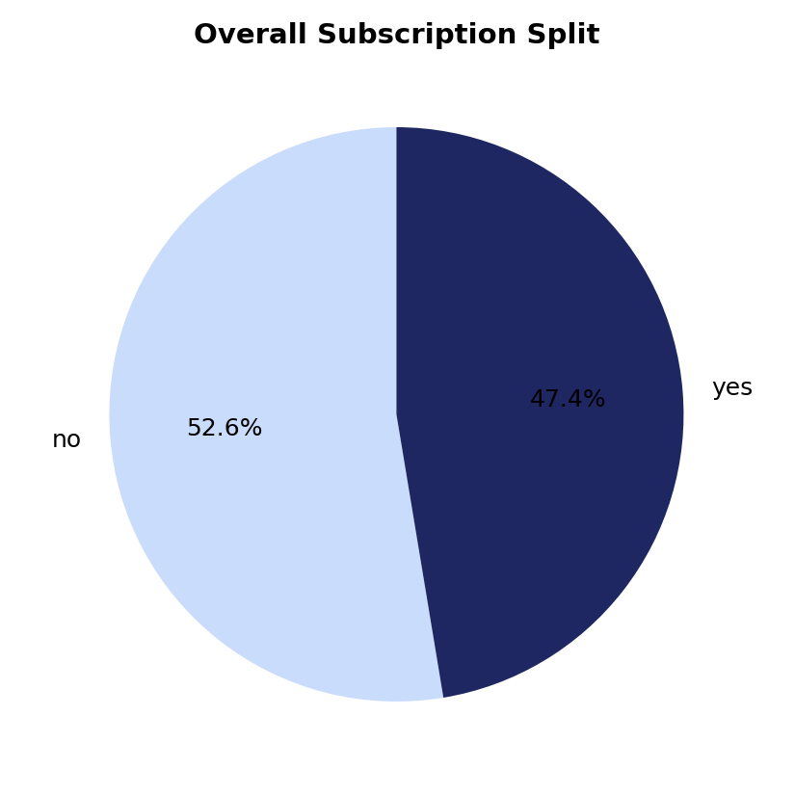
Dataset Overview
11,162
17
47.4%
0
Customer contacts
Columns
Subscribed (yes)
Missing values
Key columns
Demographics: age, job, marital status, education
Financial: account balance, loans, credit default
Campaign: contact method, duration, day/month
Target: deposit (subscribed: yes/no)

Slide 4
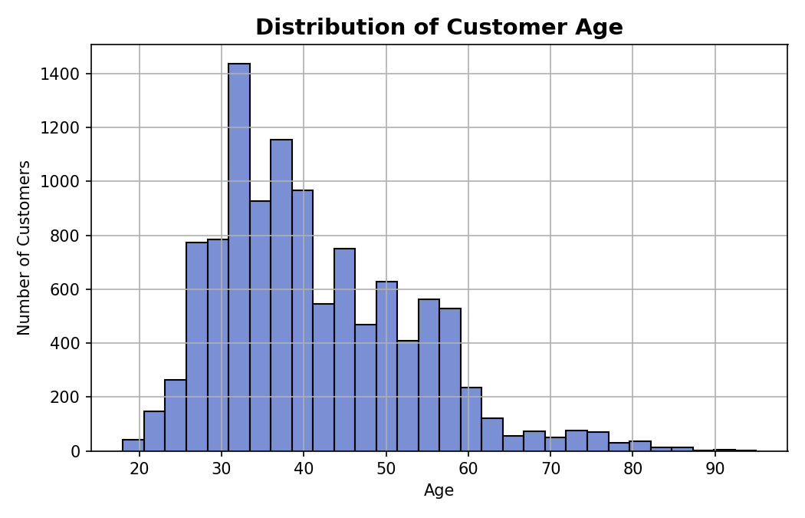
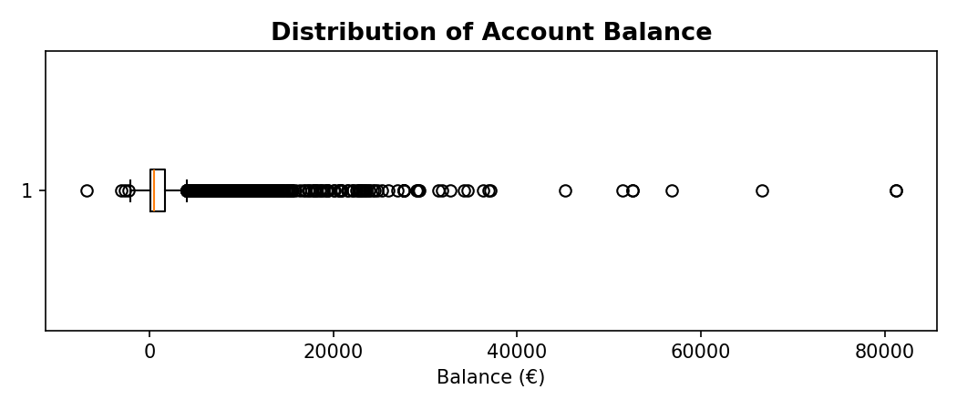
Distributions: Age & Balance
Balance is heavily right-skewed: median ≈ €550, but a small number of high-balance outliers pull the mean to €1,528.

Slide 5
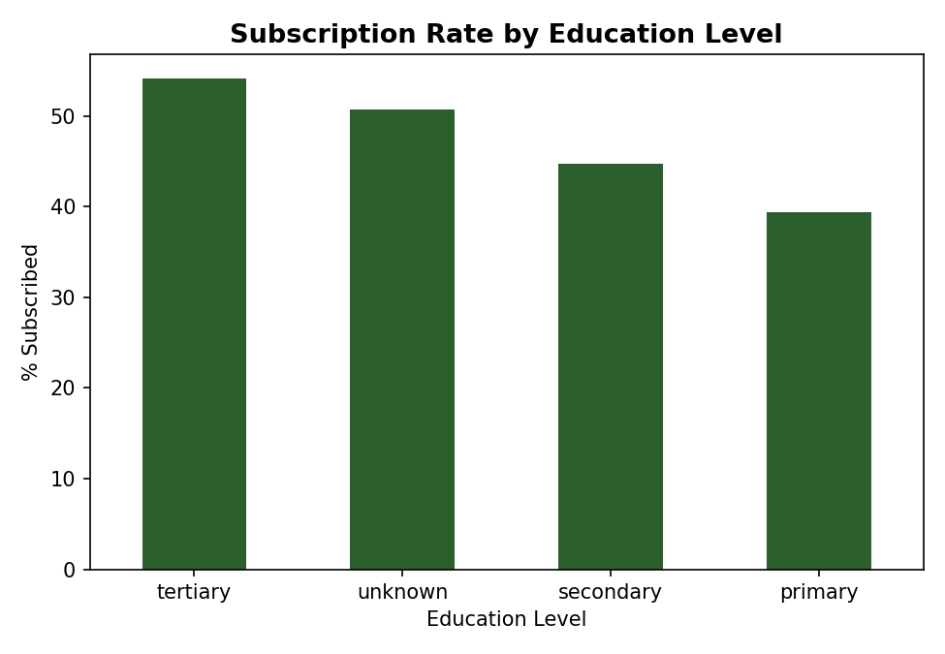
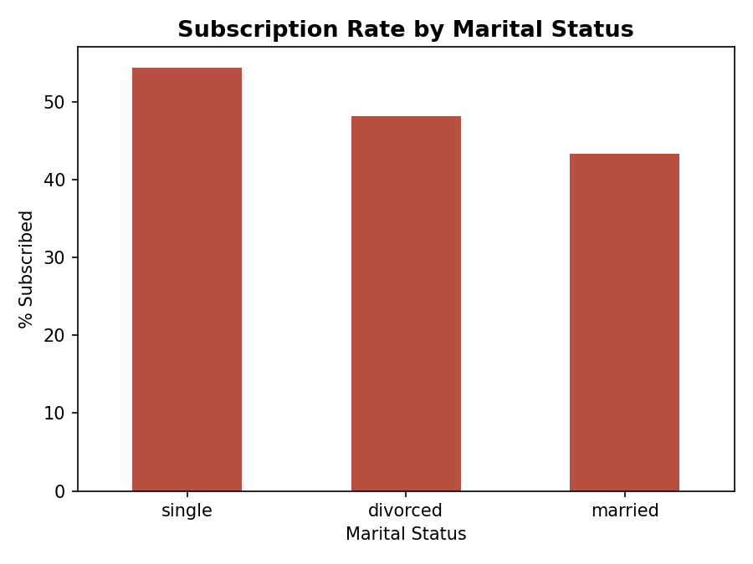
Who Responds Best? Education & Marital Status

Slide 6
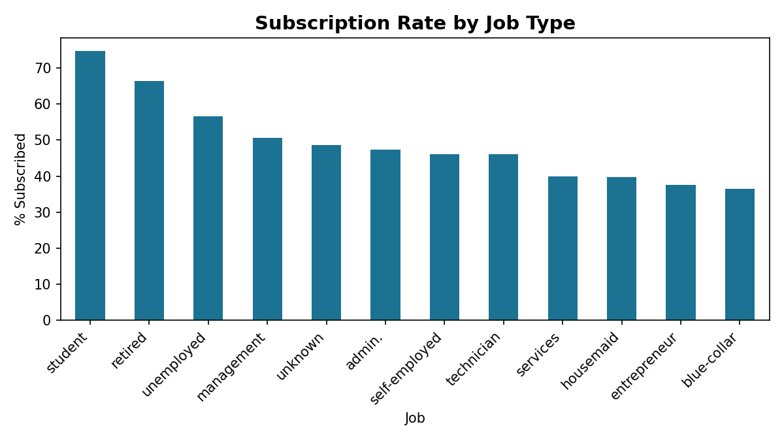
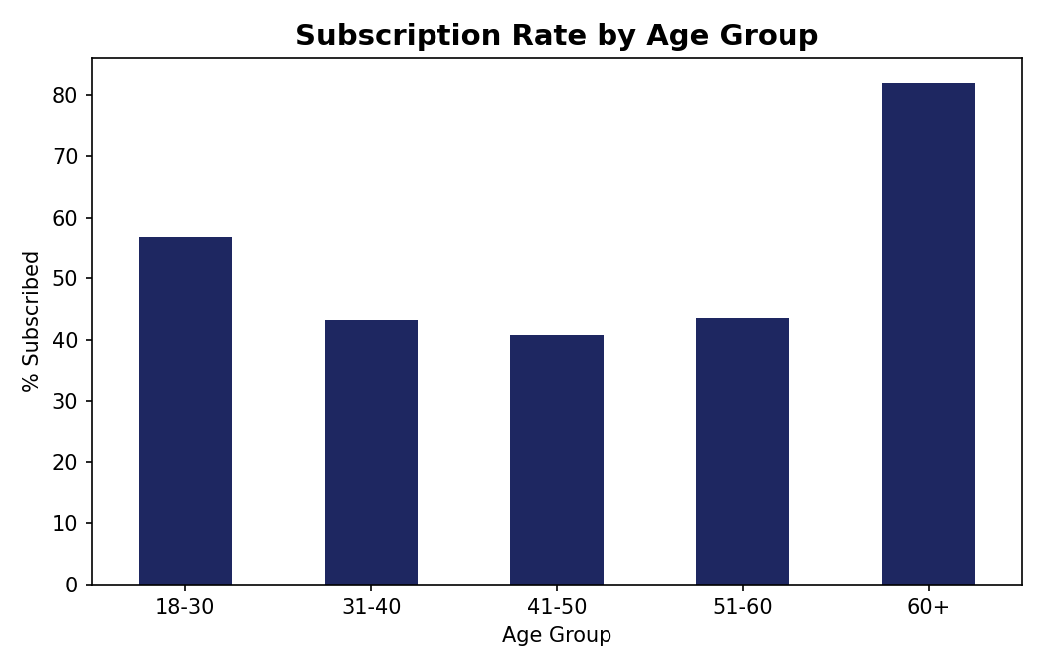
Who Responds Best? Job & Age

Slide 7
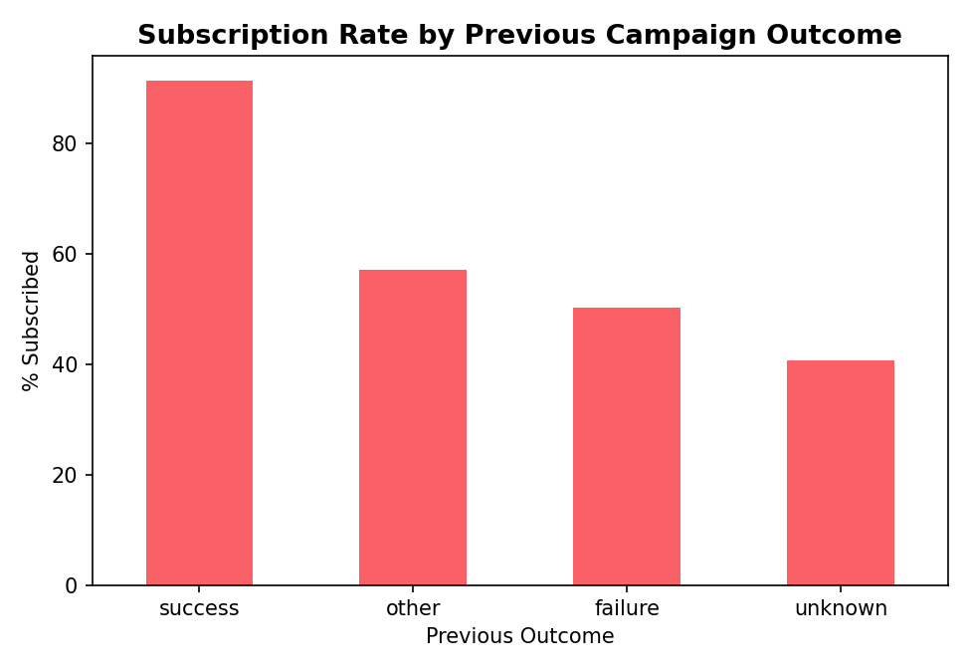
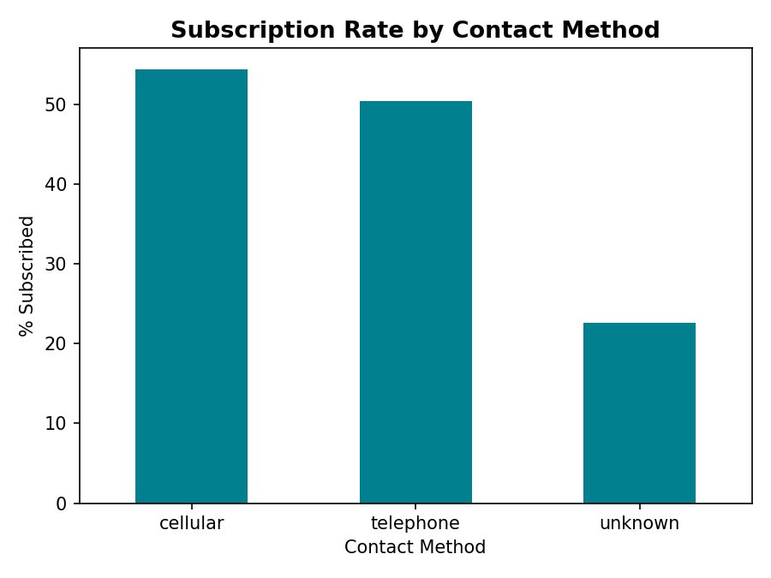
The Strongest Signal: Prior Success & Contact Method

Slide 8
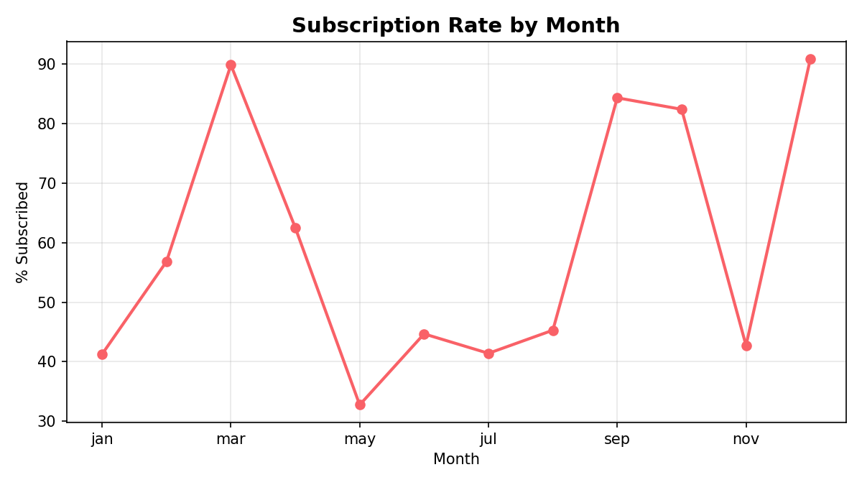
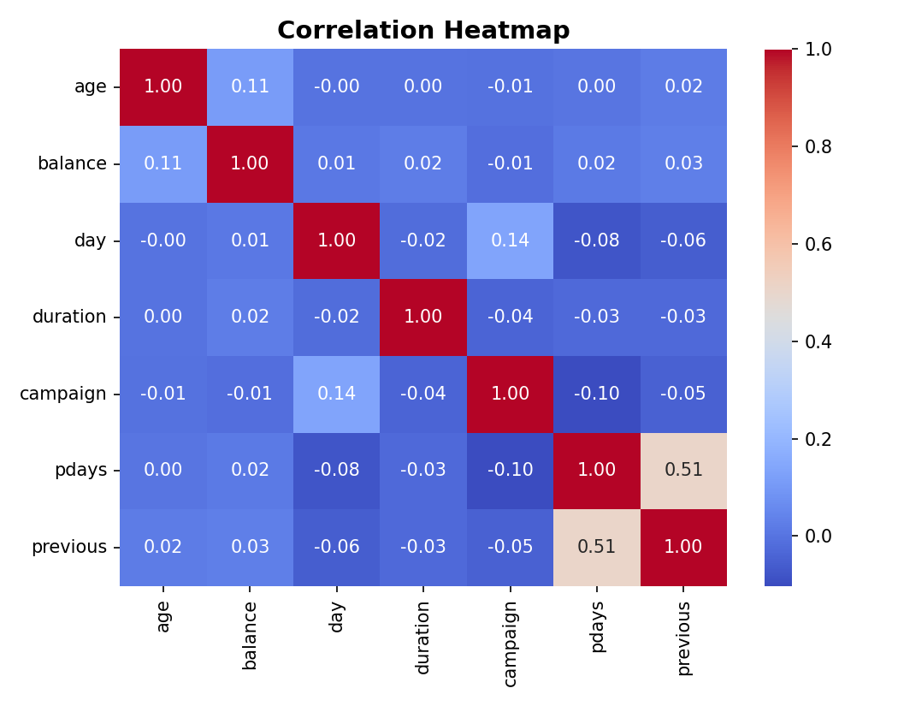
Timing & Numeric Relationships

Slide 9
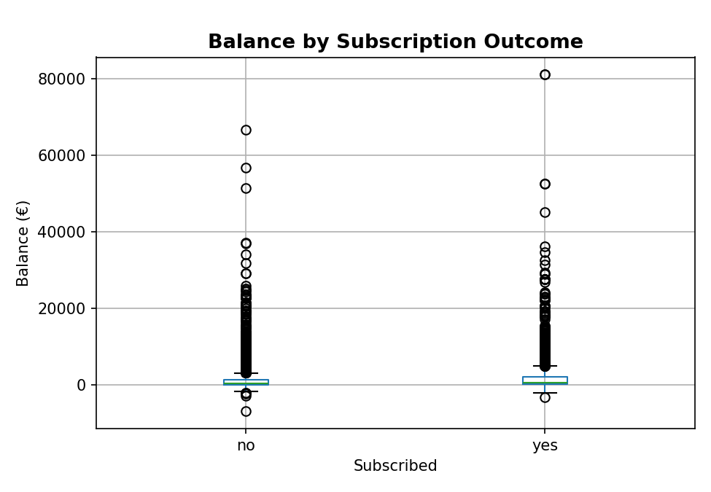
Balance Predicts Subscription
Median balance: €733 for subscribers vs €414 for non-subscribers nearly double.

Slide 10
Major Findings
Prior success predicts future success
Age is U-shaped
Customers who subscribed before convert again at ~91% vs ~41% for never-contacted customers.
60+ (~82%) and 18-30 (~57%) subscribe far more than working-age adults 31-50 (~41-43%).
Job type is a strong signal
Contact method matters
Students (~75%) and retirees (~65%) subscribe much more than blue-collar/entrepreneurs (~36-38%).
Cellular/telephone convert at ~50-54% vs only ~23% for unrecorded ("unknown") contacts.
Balance predicts conversion
May overloaded, underperformed
Subscribers hold nearly double the median balance of non-subscribers (€733 vs €414).
25% of all contacts happened in May, which had the lowest conversion rate (~33%).

Slide 11
Recommendations
1
Prioritize re-engaging customers with previous campaign success (~91% conversion)
2
Shift marketing focus toward students, retirees, and single customers
3
Reduce reliance on unrecorded contact methods — shift toward cellular/telephone
4
Reconsider campaign timing and volume, especially around May
5
Use account balance as a pre-screening signal for outreach prioritization

Slide 12
Conclusion
Term deposit subscription is driven primarily by a customer's life stage, financial standing, and prior relationship with the bank not by campaign volume alone.
By prioritizing previously successful customers, focusing on the most receptive segments, improving contact reliability, and rebalancing campaign timing, the bank has a clear, data-backed path to higher conversion at lower cost.
AnalystLab Africa Data Analytics Internship Program

