Slide 1
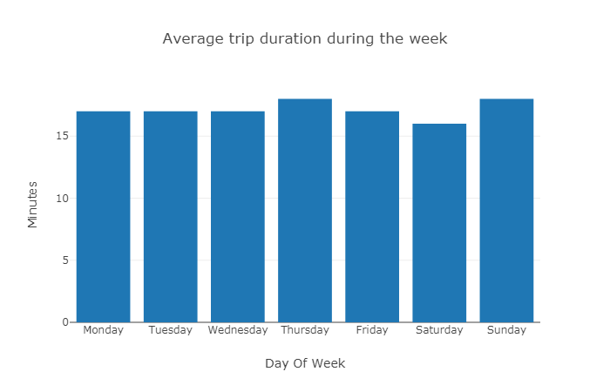
Diagram 1

Slide 2
Average trip duration doesn’t really change through Monday to Friday with ~17 minutes.
Exception is Thursday when clients take trips a little bit longer approximately by 1 minute.
Weekend have both the minimal trip duration (Saturday) and one of the maximum (Sunday), which is on the same level as on Thursday.

Slide 3
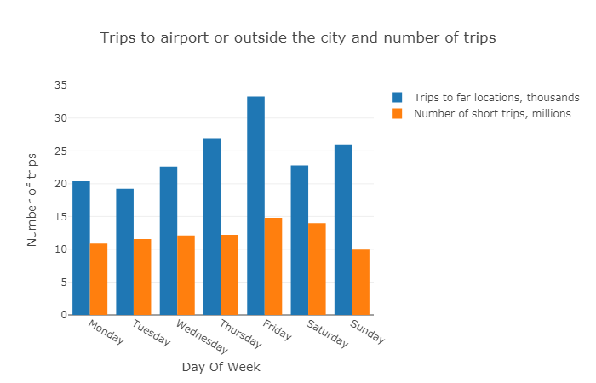
Diagram 2

Slide 4
Why do people on Thursday tend to take a ride little longer on opposite to Saturday? Shouldn’t it be different?
Diagram 2 could share with us some useful information.
Thursday and Sunday probably have the same longest average ride (18 min) due to the 2nd and 3rd places in number of trips to faraway places, in addition there is the minimum of short rides in Sunday.
Saturday has average quantity of long-distance trips and above average number of short rides. That is the reason of 16 minutes average trip duration.
There is significant difference from the rest of the days in terms of far rides on Friday. Unfortunately, the count of short trips is significant too, so average ride lasts only 17 minutes.

Slide 5
First of all, ‘Unknown’ borough in dataset is probably a location outside of New York.
The goal was to compare trip fares between different boroughs in New York, so ‘Unknown’ should be ignored.
I thought it was important to not forget about a return trip. So not only trip from Manhattan to Bronx was counted, but also a way back.

Slide 6
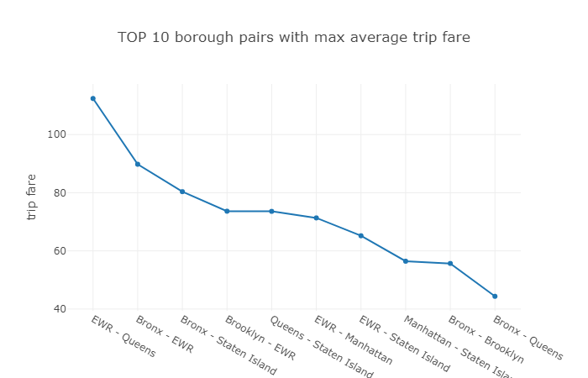
Diagram 3
These pairs have expensive trips between each other because airport(EWR), Staten Island and Bronx are located far from the city center.
The highest trip fare in June 2018 is average trip fare from EWR to Queens.

Slide 7
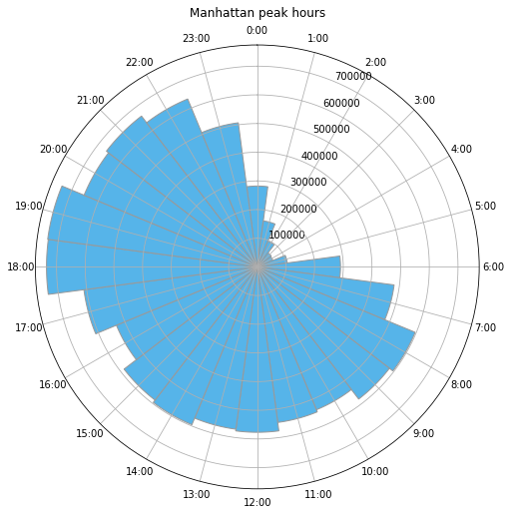
Evening peak hours in Manhattan are 18:00, 19:00, 20:00, 21:00, 22:00.
Diagram 4

