Slide 1
STUDENT PERFORMANCE
Aashish Porwal (160116737084)
K.Aditya(160116737085)

Slide 2
ABSTRACT
Student performance is an essential part in higher learning institutions. This is because one of criteria for a high quality institution is based on its excellent record of academic achievemets.
Almost every college has their own management system to manage the student records and keep an eye on their progress but coming to students point of view it is becoming difficult for them to predict their results at the end of the course so our project aims at providing the overall predictable performance at the end of the course based on different social , sports and academic attributes using Neural Network.
Therefore, a systematical review on predicting student performance is proposed to improve students achievements. The main objective of this to provide an overview on the datamining techniques and Machine Learning techniques that have been used to predict students performance.
Language used: Python

Slide 3
INTRODUCTION
Having spent the past few months studying quite a bit about data mining and statistical inference, I wanted a more serious and challenging task than simply working and re-working the examples that many books and blogs make use of.
My objective was to build a model that would predict whether or not a student would fail the math course that was being tracked. I focused on failure rates as I believed that metric to be more valuable in terms of flagging struggling students who may need more help.

Slide 4
How Well Are You Progressing?
Problem statement!!!!!

Slide 5
Features
Sex, Age,School,Address
Studytime,failures,schoolsup
Activities,Internet,HigherEducation
Absence,Health,FreeTime.
Taken from ML Repository

Slide 6
HARDWARE AND SOFTWARE REQUIREMENTS
HARDWARE REQUIREMENTS:
1.WINDOWS REQUIREMENTS:
Microsoft Windows (32-bit or 64-bit)
3 GB RAM minimum
2 GB available disk space.

Slide 7
SOFTWARE REQUIREMENTS:
PYTHON 3.7

Slide 8
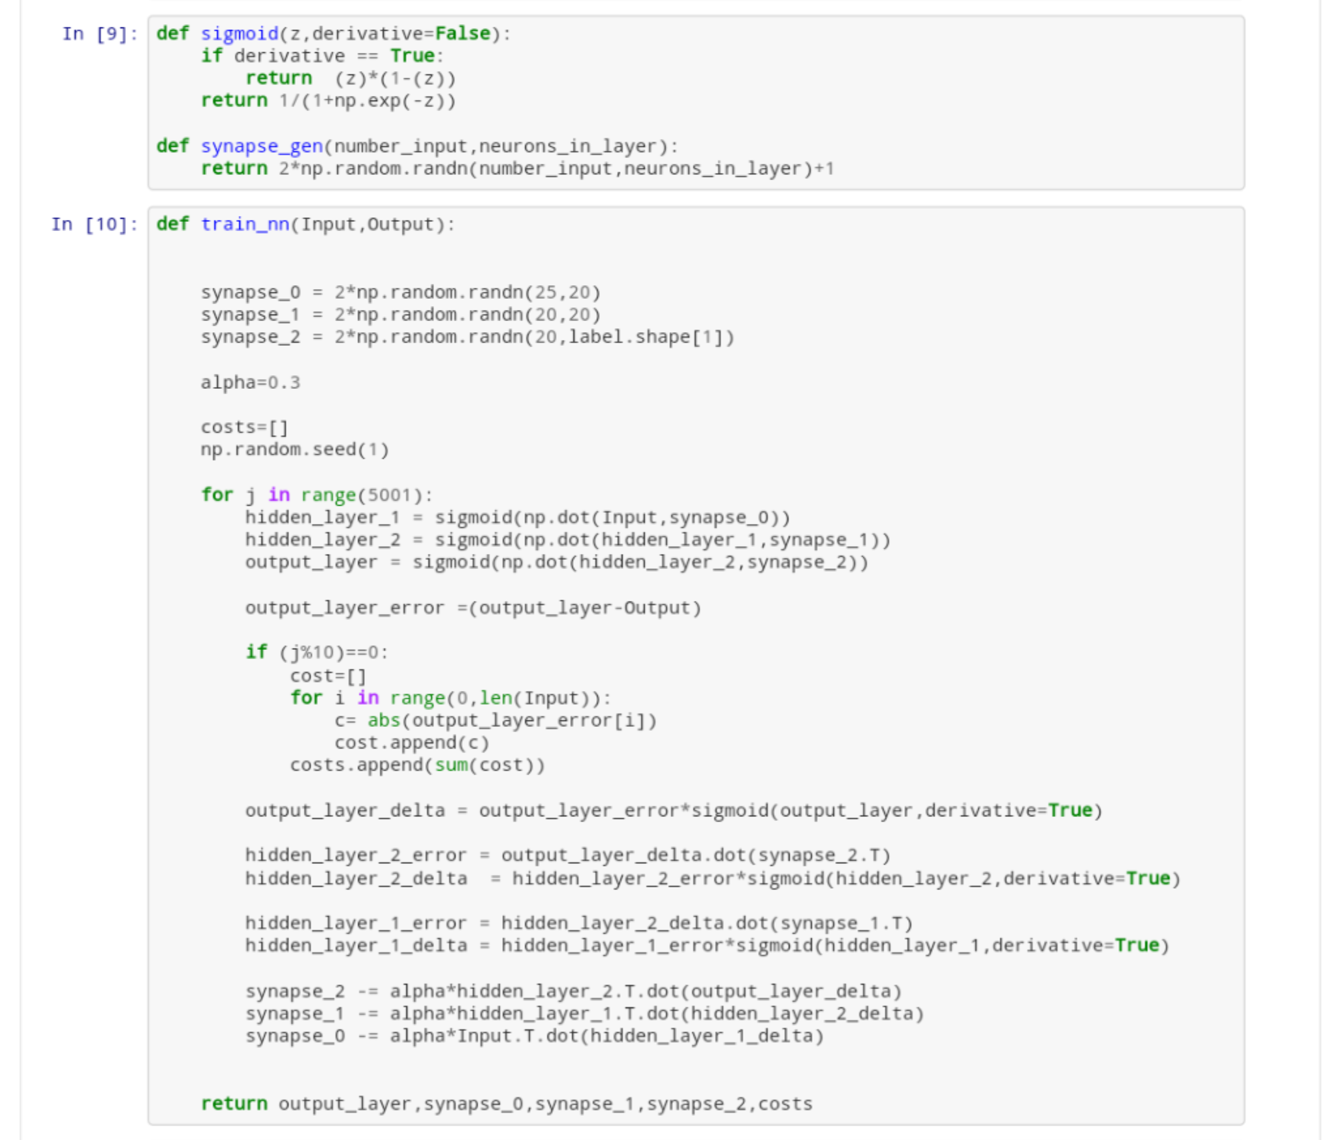
System Design and Implementation
Load the .CSV files into a dataframe.
Preprocessing the data-data cleaning,label encoder, test train and predict
Pipeline-to transfer the data
Confusion matrix
Predict the output

Slide 9
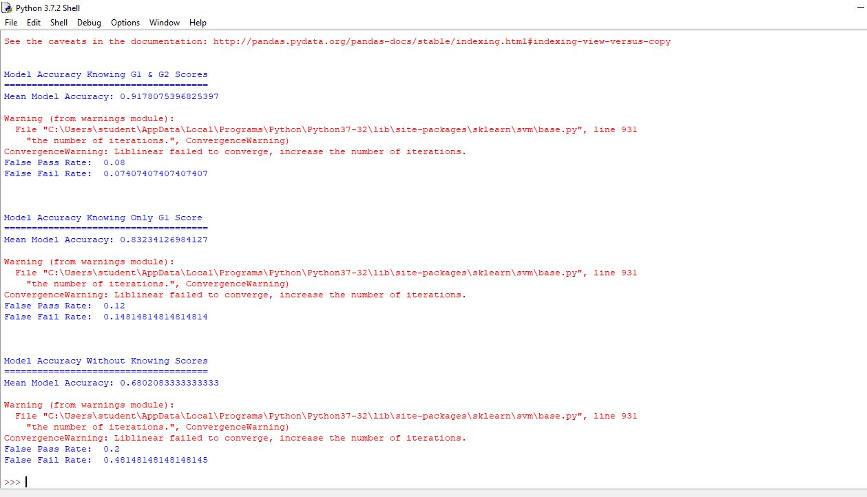
Results

Slide 10
Conclusion and Future Scope
If we increase the metrics and size of the data, the believability is increased and it can be used in production.

Slide 11
Bibilography
mlrepository
http://www3.dsi.uminho.pt/pcortez/student.pdf

Slide 12
THANK YOU

