Slide 1

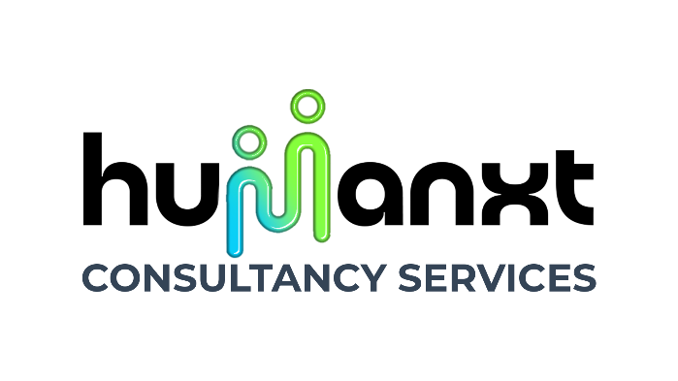

HUMANXT
THE NEXT-GEN HR

Slide 2
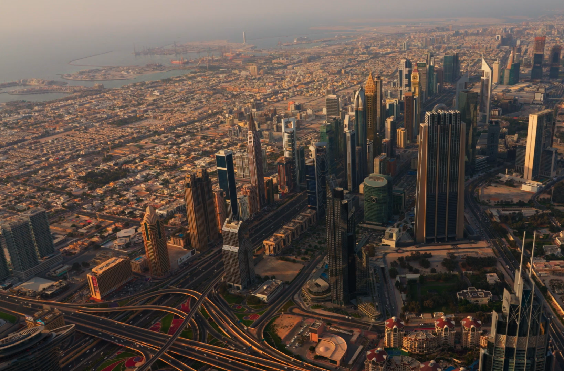
At Humanxt, we are dedicated to empowering organizations by placing people at the core of our mission. Started as a freelance company back in 2013, we gradually established in 2020, we are a premier human resources and organizational development consultancy based in Dubai, United Arab Emirates, with a global presence across India & the GCC. Our goal is to foster thriving workplaces where talent flourishes, driving sustainable success for businesses and their people.
About Us

Slide 3

Enabling the Enablers
Who we are
We are a dynamic team of HR strategists, organizational psychologists, talent management experts, and culture architects committed to redefining the employee experience. With deep expertise in human capital strategy, leadership development, and workplace transformation, we partner with organizations of all sizes—from innovative startups to global enterprises—to unlock the full potential of their workforce.

Slide 4

Our Services
At Humanxt, we empower organizations by blending people expertise with next-gen HR technology. Our services span talent acquisition & assessments, employee onboarding & verification, HR policy & compliance, payroll outsourcing, and AI-driven people analytics. From building future-ready job architectures to streamlining HR operations, we help businesses unlock human potential and achieve lasting growth.
1
2
3
AI-Driven People Analytics & Insights
Talent Acquisition and Assessment Services in UAE and Gulf
Employee Onboarding and Verification Services in UAE
In the modern business landscape, data is no longer just a support tool—it’s a strategic driver. At Humanxt, we bring the power of artificial intelligence to human resources with our cutting-edge AI-driven HR analytics services in UAE.
Finding the right talent is more than just filling roles—it’s about building a team that drives your business forward. At Humanxt, our talent acquisition services in UAE are designed to do exactly that.
At HUMANXT, we simplify and strengthen the way businesses welcome and verify new employees with our employee onboarding UAE and background verification Dubai services.

Slide 5
Our Services
At Humanxt, we empower organizations by blending people expertise with next-gen HR technology. Our services span talent acquisition & assessments, employee onboarding & verification, HR policy & compliance, payroll outsourcing, and AI-driven people analytics. From building future-ready job architectures to streamlining HR operations, we help businesses unlock human potential and achieve lasting growth.
4
5
6
Career Development and Personal Branding in UAE
HR Policy Development and Compliance Services in UAE & GCC
Payroll Services & HR Outsourcing in UAE and Gulf
Our career development and personal branding services in the UAE and Gulf region deliver exceptional value by combining expertise, technology, and local insight.
Our HR policy development and compliance services in UAE and across the GCC region are designed to help your business stay legally sound, strategically agile, and operationally efficient.
Managing payroll and HR operations in today’s fast-changing business world can be complex and time-consuming. At Humanxt, we help simplify this process with our payroll services in UAE and full-scale HR outsourcing solutions in Dubai and the Gulf.

Slide 6
Our Services
At Humanxt, we empower organizations by blending people expertise with next-gen HR technology. Our services span talent acquisition & assessments, employee onboarding & verification, HR policy & compliance, payroll outsourcing, and AI-driven people analytics. From building future-ready job architectures to streamlining HR operations, we help businesses unlock human potential and achieve lasting growth.
7
8
Comprehensive HR Technology and Operations Management
Job Architecture & Role Optimization Services in UAE & Gulf
Our cloud-based HR technology solutions in UAE are designed to streamline workflows, improve data access, and support scalable business operations across the Gulf.
A clear job structure is the foundation of an efficient, motivated, and high-performing workforce. At Humanxt, we help organizations bring structure, clarity, and purpose to every role through our job architecture and role optimization services in UAE and across the Gulf.

Slide 7

Why Us
Our Strengths
1
Human + Tech Advantage We bring the perfect balance of empathy and innovation. Our team blends decades of HR expertise with advanced AI-driven analytics to provide insights that go beyond the obvious—helping organizations hire smarter, retain talent longer, and foster a culture of growth.
2
End-to-End HR Solutions Whether you need talent acquisition, employee assessments, onboarding, payroll outsourcing, or HR policy development, Humanxt provides everything under one umbrella. This eliminates the hassle of dealing with multiple vendors, saving time and resources while ensuring consistency across your HR operations.
3
Seamless Integration We believe technology should make work simpler, not more complicated. That’s why our systems and services are designed to integrate smoothly with your existing HR platforms. This ensures faster adoption, minimal disruptions, and maximum efficiency in daily operations.

Slide 8
Why Us
Our Strengths
4
Global Standards, Local Expertise Operating across the UAE and India, we understand the nuances of different labor laws, compliance frameworks, and cultural contexts. Our solutions are rooted in international HR best practices while being tailored to meet local regulations—giving you the best of both worlds.
5
Scalable & Future-Ready Your business today won’t look the same tomorrow—and neither should your HR approach. Humanxt solutions are flexible and scalable, adapting to the evolving needs of startups, SMEs, and large enterprises alike. We future-proof your workforce strategies so you’re always ahead of the curve.
6
Trusted Partner in People Growth At Humanxt, we don’t just provide services—we build relationships. Our mission is to unlock the full potential of your workforce, strengthen organizational culture, and empower individuals to thrive. With us, you gain a strategic HR partner invested in your long-term success.

Slide 9
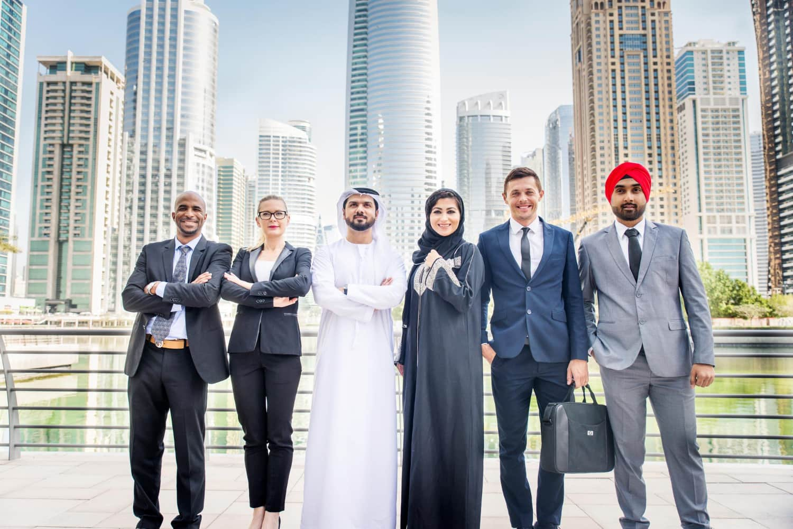

Our
Standing
1
The team at Humanxt delivered exactly what our HR department needed. Their AI-driven insights helped us uncover workforce patterns that directly improved our retention and employee engagement strategy.
Sarah Al Mansoori
HR Director
1
Thanks to HumanXT, we built a compliant and scalable HR structure that supported our rapid business growth. Their role design, onboarding solutions, and continuous support were tailored perfectly to our evolving needs.
Neha Kapoor
People Operations Manager
What I appreciated most was their proactive mindset. HumanXT didn't just provide dashboards—they interpreted the data, suggested solutions, and helped us act fast. Their people analytics service is among the best I’ve seen.
Imran Hussain Shaikh
Senior HR Consultant
1

Slide 10
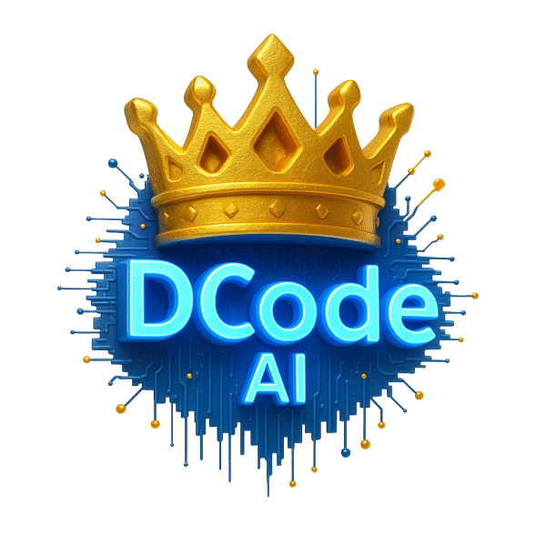
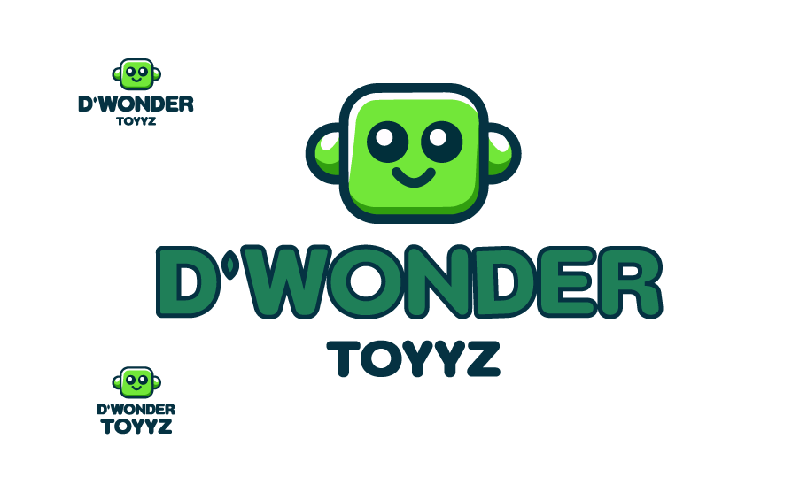

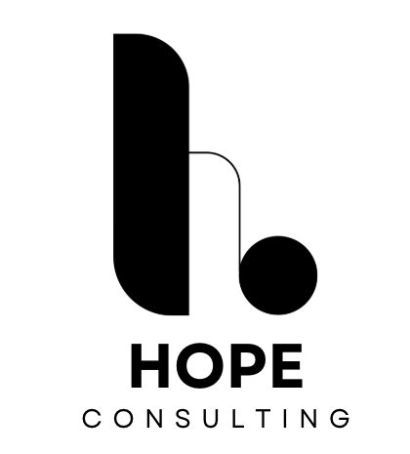
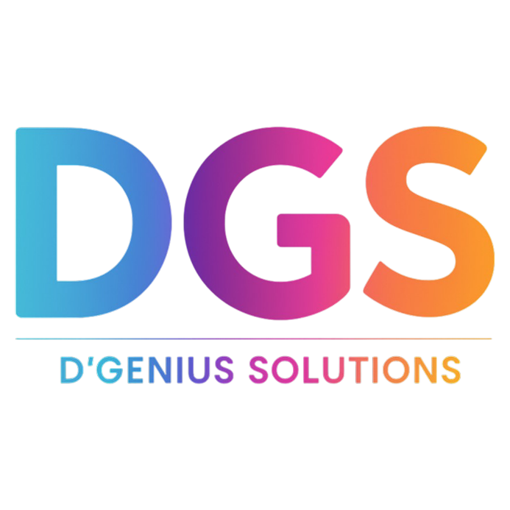

Our
Clients

Slide 11

At Humanxt, our future outlook is to redefine the world of work by blending AI-driven insights with human-centered strategies. We are committed to building scalable, inclusive, and future-ready HR solutions that not only help businesses adapt to change but also empower individuals to thrive, innovate, and grow in an ever-evolving global landscape.
Future
Outlook

Slide 12
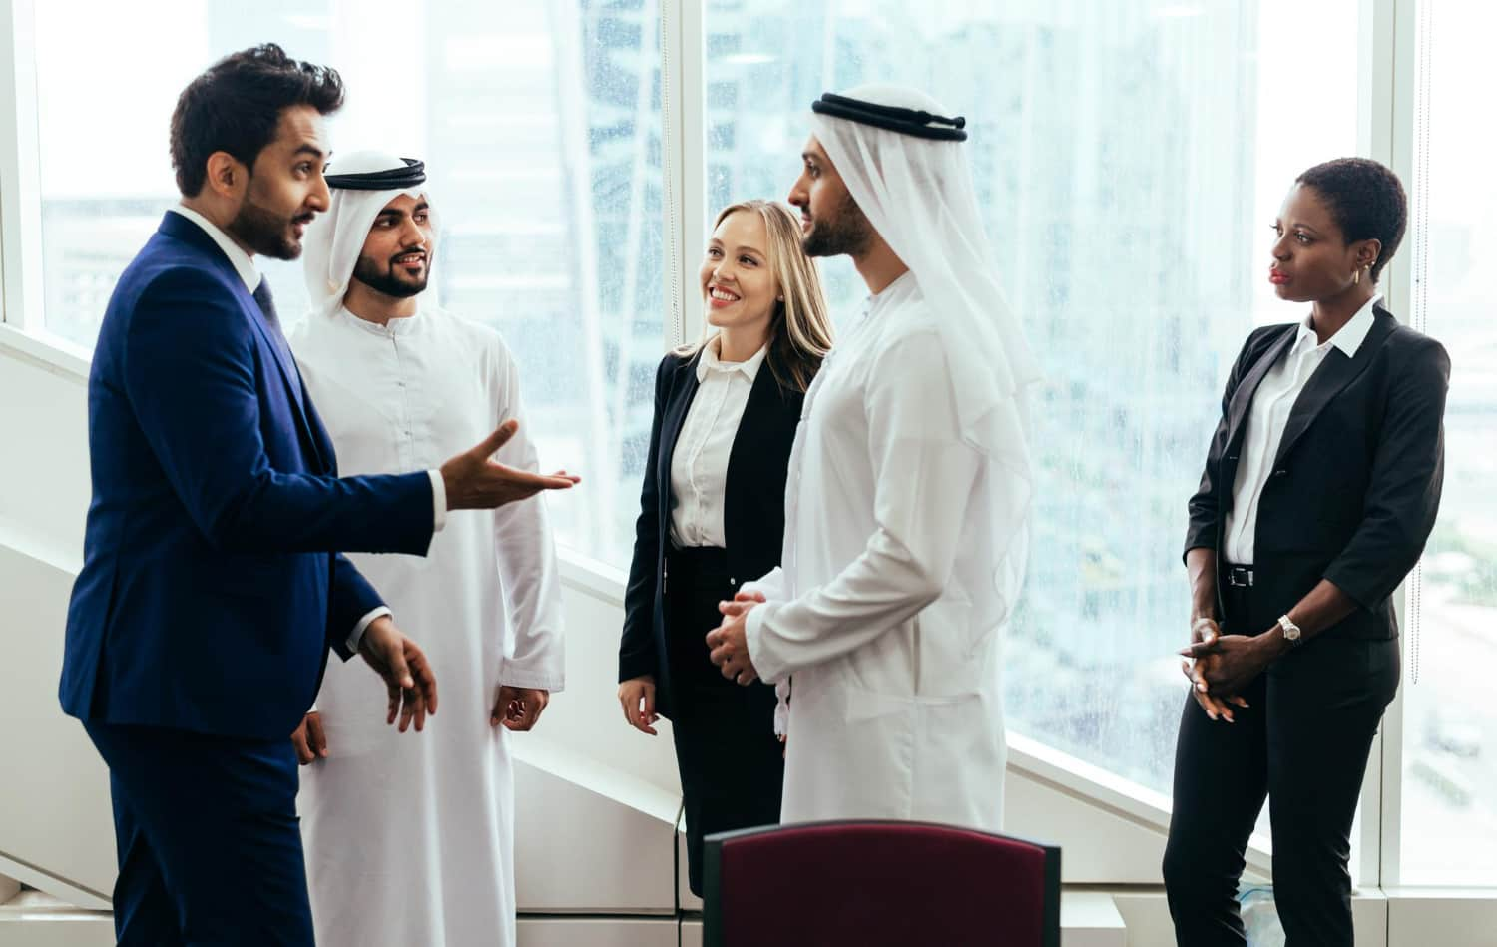
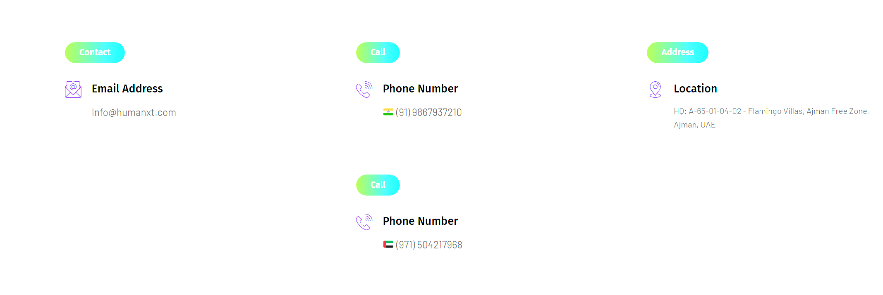
Let’s
Connect
Contact
Us

