Slide 1


Slide 2
Education
What is Bitcoin & Blockchain
The game-theoretical incentive system
The Metanet and how to use it
How to program onChain applications

Slide 3
The Metanet
Bitcoin Beyond Just Payments

Slide 4
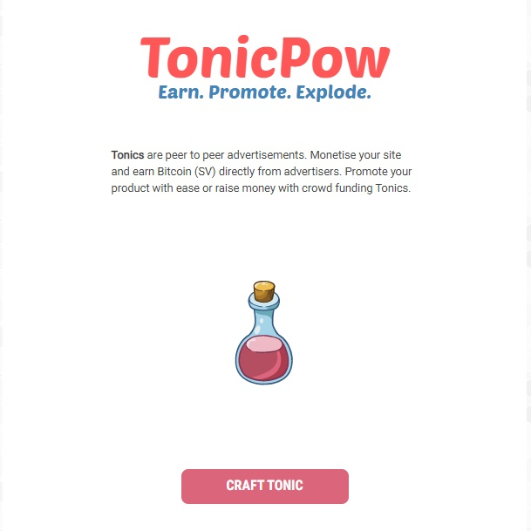
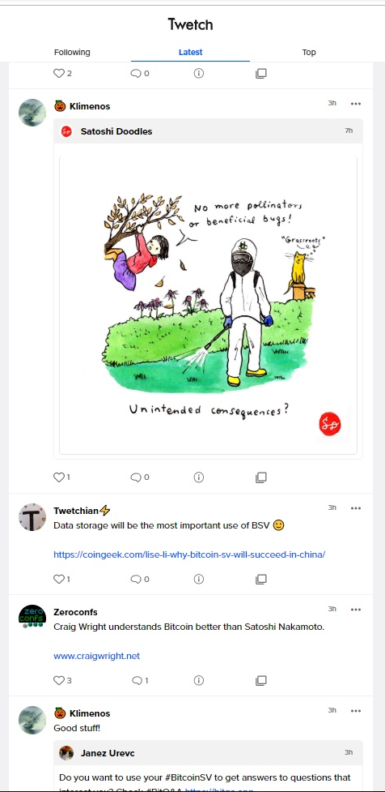

Scalable and Stable protocols attract hundreds of applications. Now we can program and surf on Bitcoin.
Metanet
Apps

Slide 5
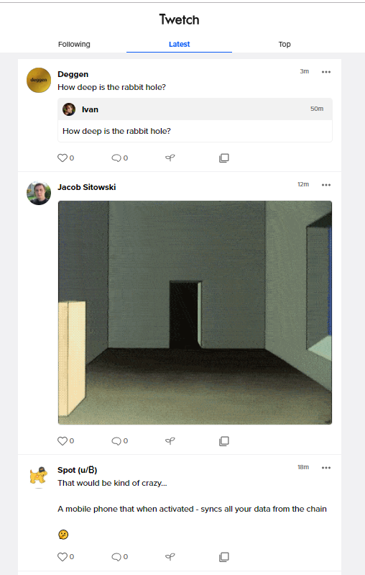
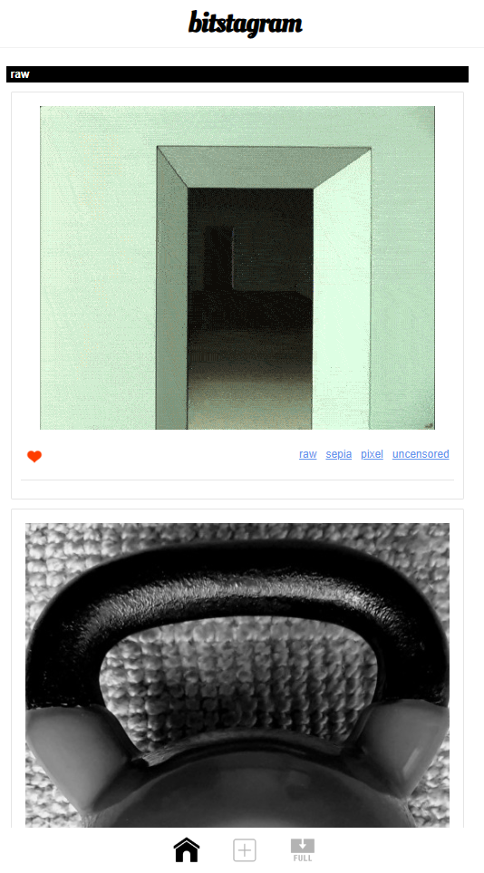

Slide 6
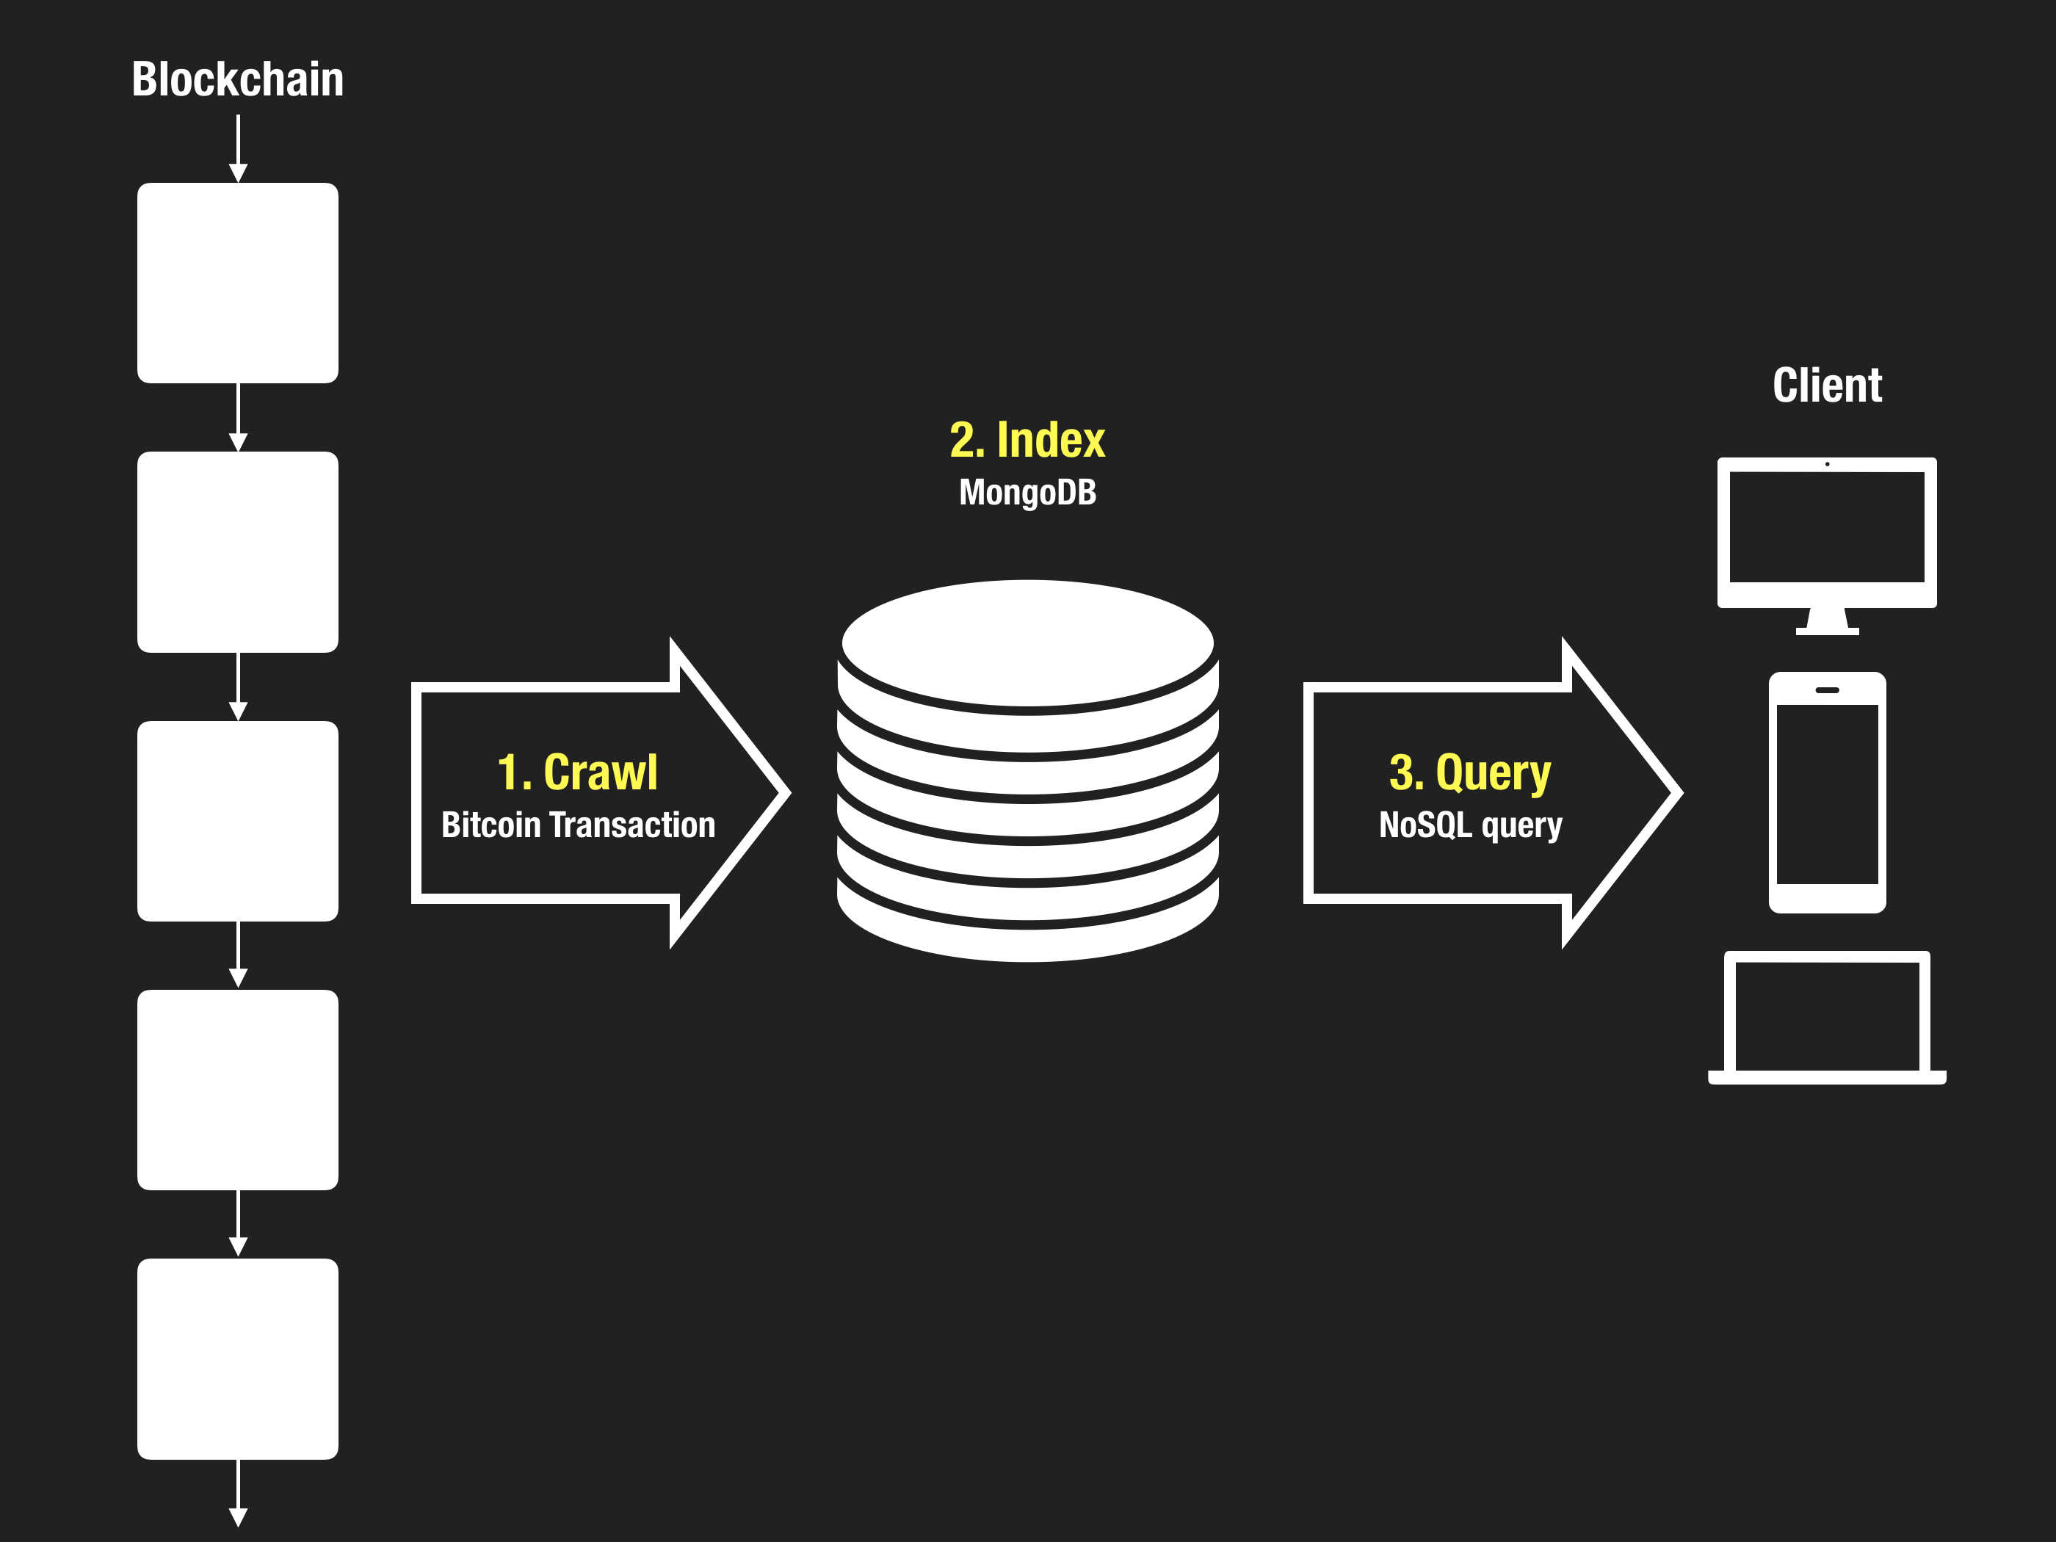
How to use blockchain as database
https://docs.bitdb.network/docs/intro_v3

Slide 7
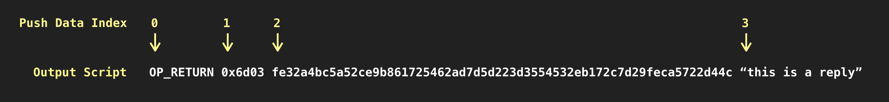
OP_Returns
Upload data to the chain
https://docs.bitdb.network/docs/intro_v3

Slide 8
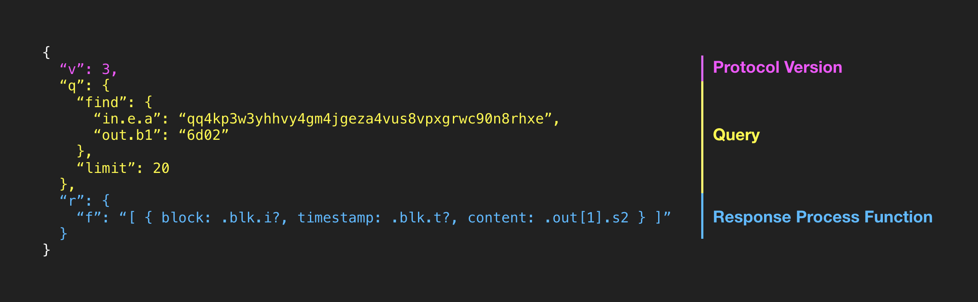
BitDB Queries
Find your data onChain
https://docs.bitdb.network/docs/intro_v3

Slide 9

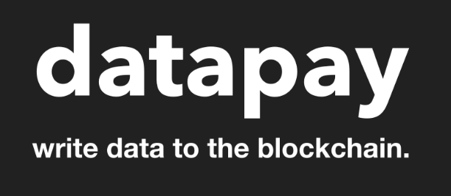

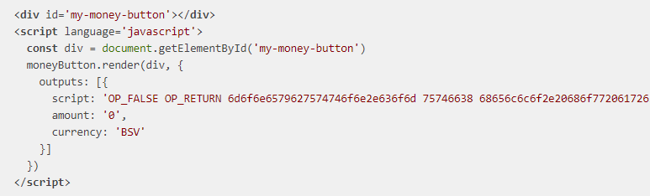
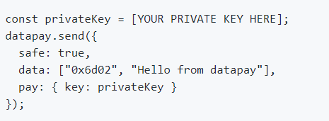
Uploading Data

Slide 10
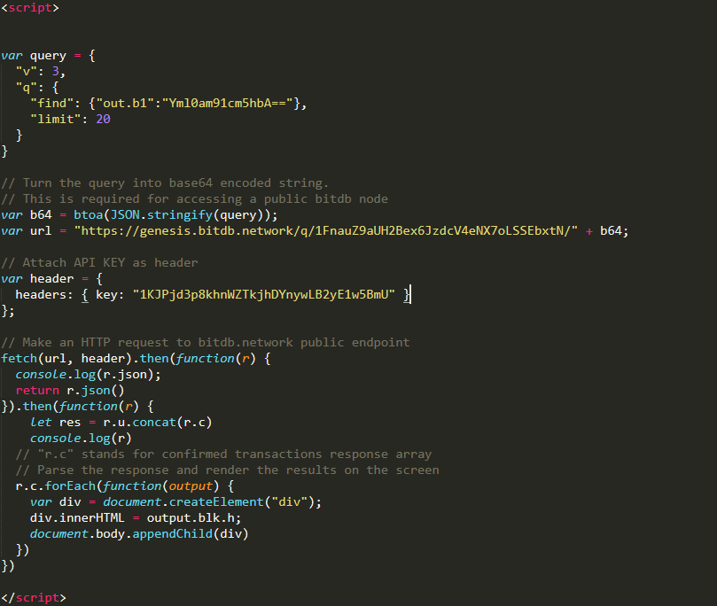
Real World Example
Data Query

Slide 11
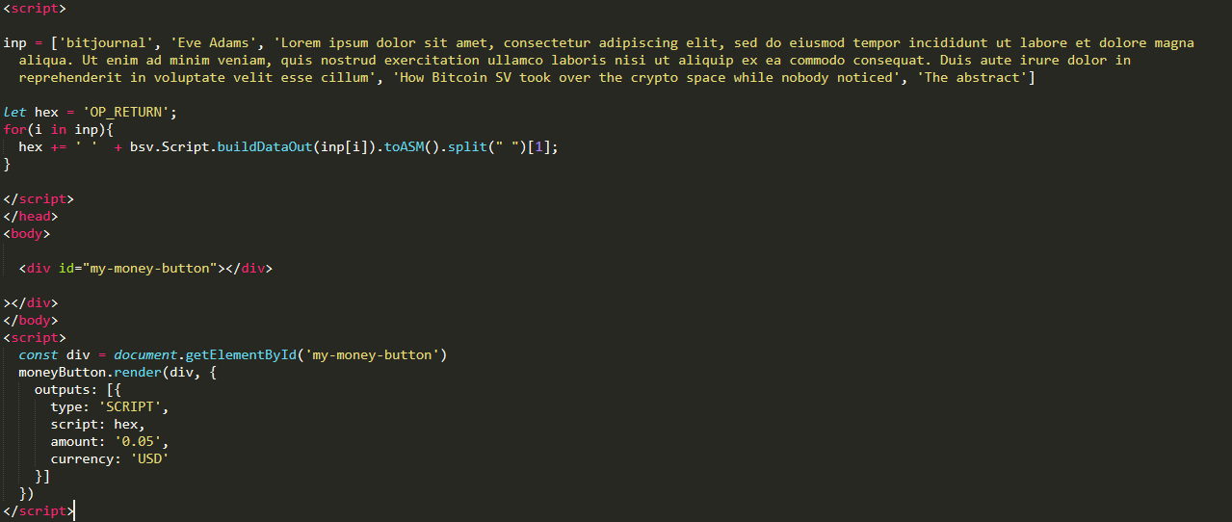
Real World Example
Data Upload

Slide 12
