Slide 1
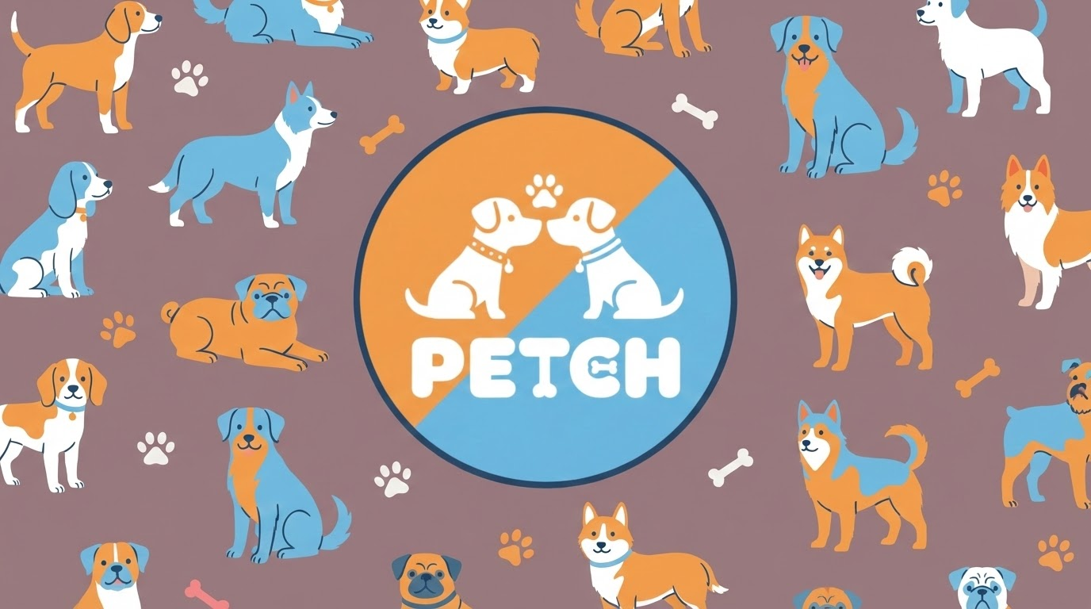
Sergio Bailén
Gerald maltsev

Slide 2
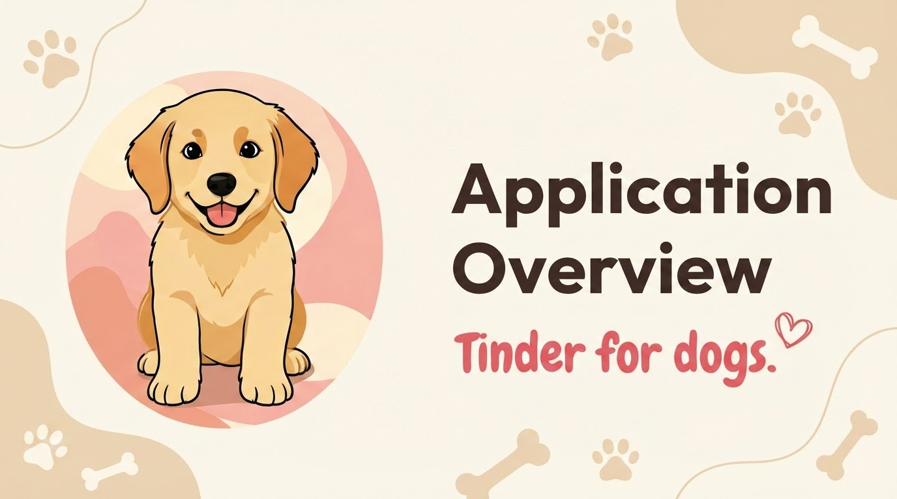

Slide 3

Logo and Eslogan
Eslogan: "Love at first bark"

Slide 4
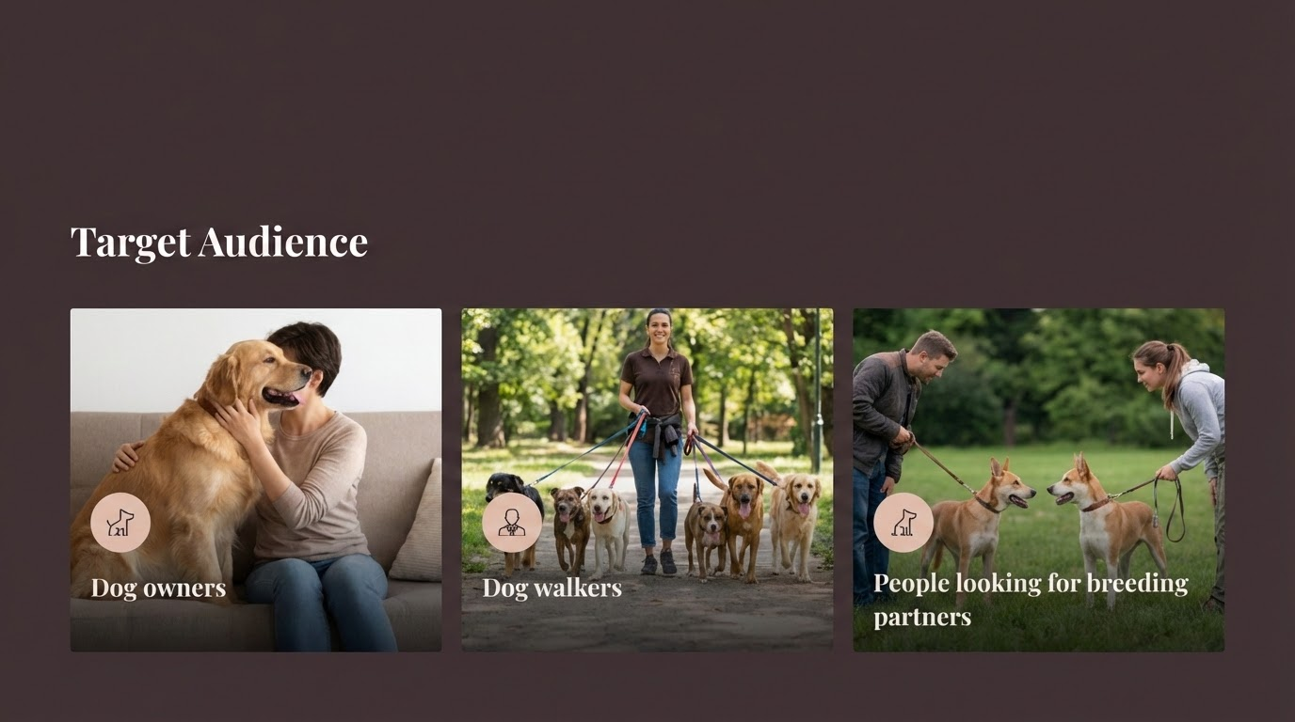

Slide 5
Description and Goals
Socialize dogs
Find walking companions
Build a community
To reduce anxiety and behavioral problems.
Help owners find walking companions in their neighborhood.
Create a local community of dog lovers.

Slide 6
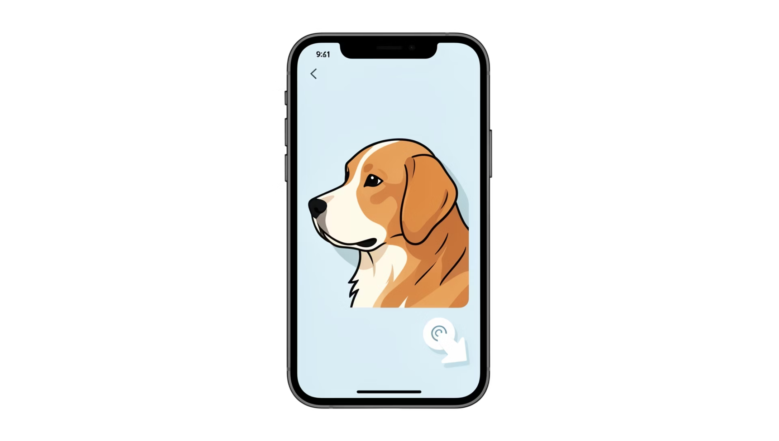
App Features
Swiping Zone
Swipe right for a "Woof" (Like) or left for a "Grrr" (Pass).

Slide 7
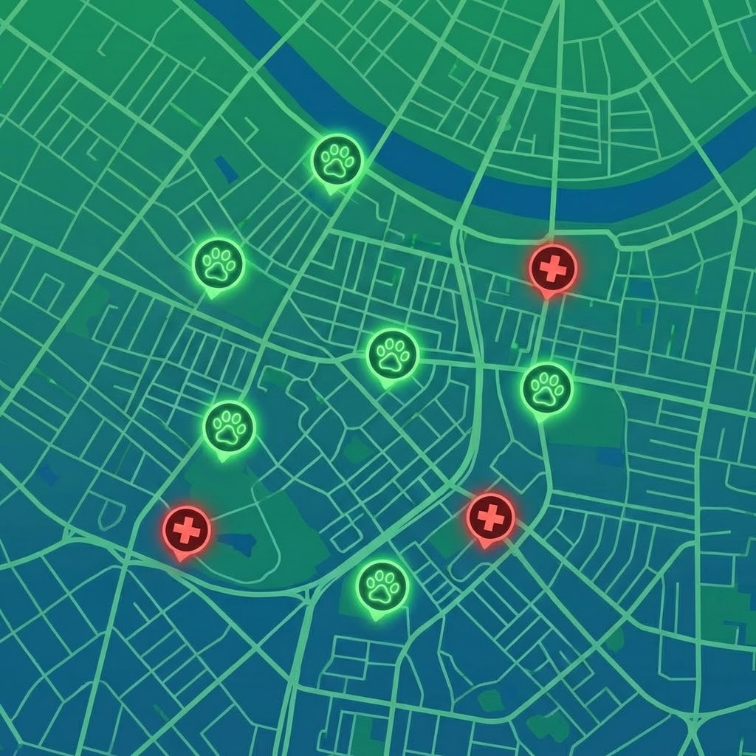
More Features
1
2
Owner Chat
Petch Map
Unlocks only when there is a "Match".
Highlights nearby dog-friendly parks and 24/7 emergency vets.

Slide 8


