Slide 1
(A)
O₂
OER
Mn^{II}
fast
Mn^{II}
H₂O
k₁
non-
RDS
E₁⁰: c.a. 0.35 V
k₁
Another
intermediate
k_{1r}
k_{1r}
Mn^{III}_{485 nm}
Another
intermediate
k_{2r}
Mn^{III}
fast
k_{2r}
k₂
Mn^{III}_{520 nm}
k₂
RDS
RDS
OER

Slide 2
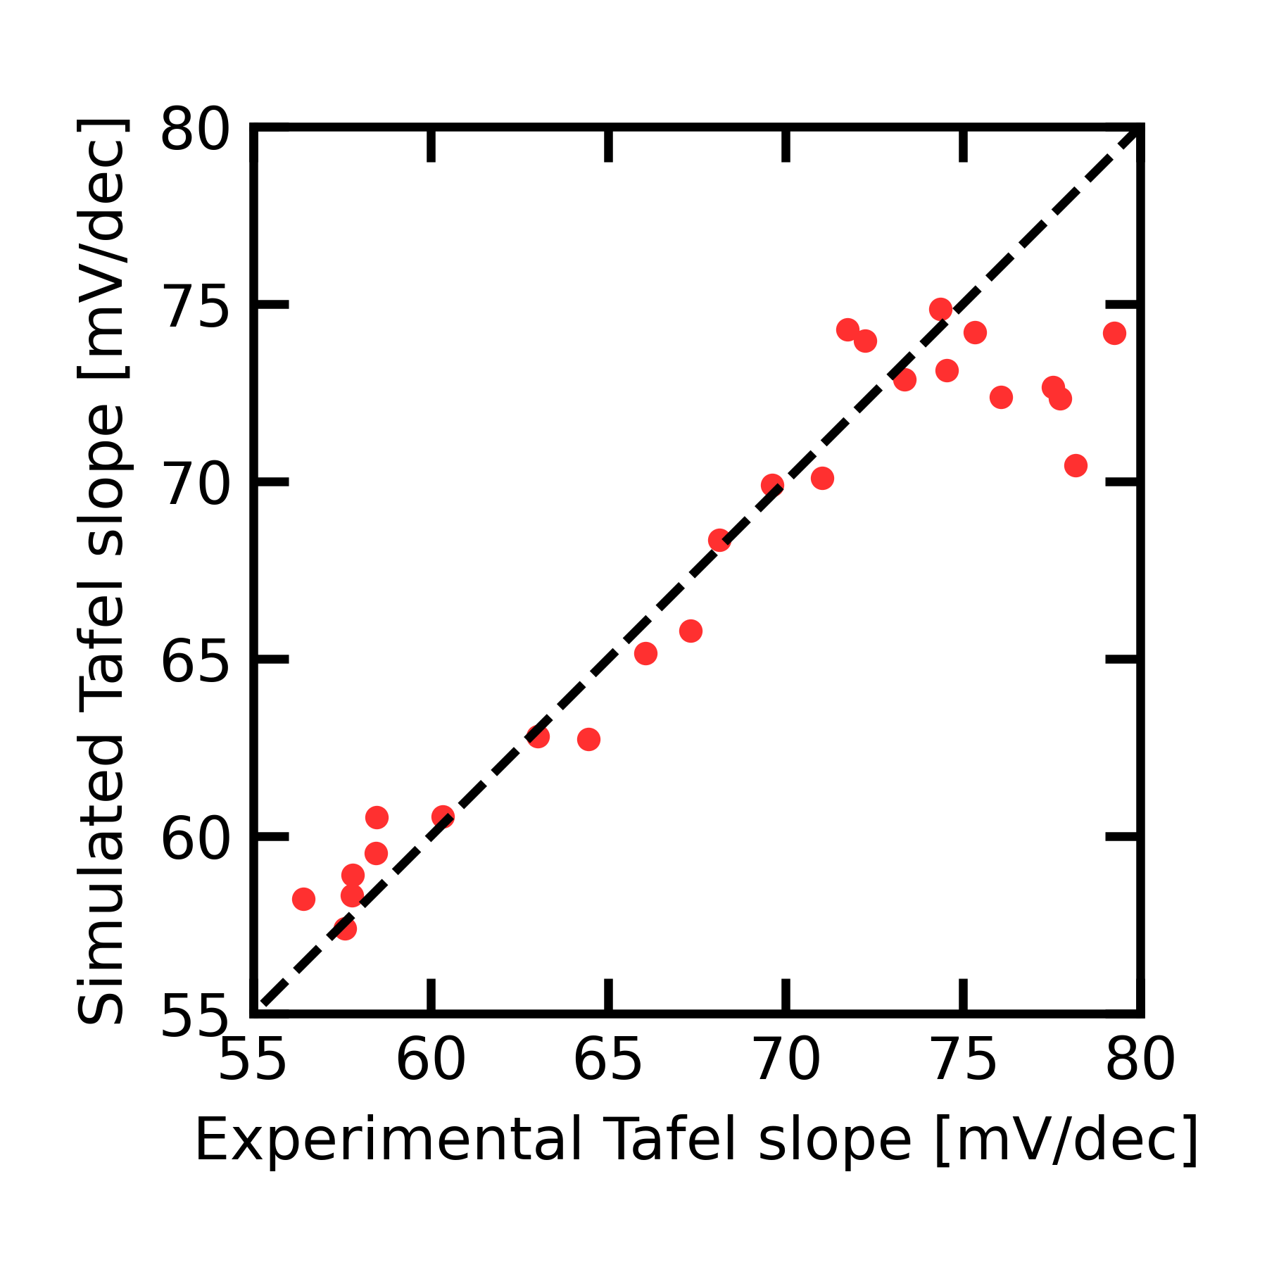
(A)
O₂
H₂O
fast
Mn^{II}
k₁
E₁⁰: c.a. 0.35 V
Another
intermediate
k_{1r}
(A)
Mn^{III}_{485 nm}
O₂
Redox process A
k_{2r}
fast
Mn^{II}
E₁ ≈ 0.35 V
(B)
fast
H₂O
k₂
Mn^{III}_{520 nm}
k_{1r}
k₁
RDS
Mn^{IV}
Mn^{III}
k_{2r}
k₂
RDS
E₂ ≈ 0.85 V
fast
Mn^{III}_{520 nm}

Slide 3
O₂
Fast
Mn^{II}
Redox process A
H₂O
E₁ ≈ 0.35 V
k_{1r}
k₁
Mn^{IV}
Mn^{III}
k_{2r}
k₂
RDS
E₂ ≈ 0.9 V

