Slide 1
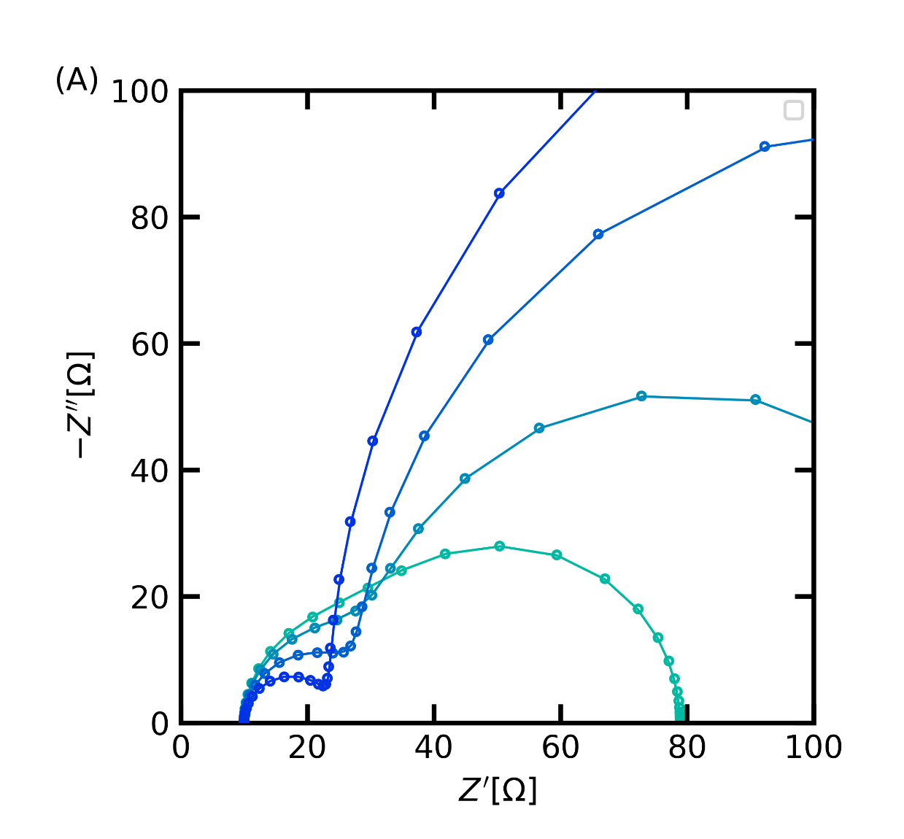
H₂
H⁺
H⁺
H_{ad}

Slide 2
C_{dl}
R_{sol}
R_{ct2}
R_{ct1}
C_{dl}
C_{ads}
R_{sol}
Z_{F} (KM)

Slide 3
H⁺
H₂
H_{ad}
H_{ad}
e⁻

