Slide 1
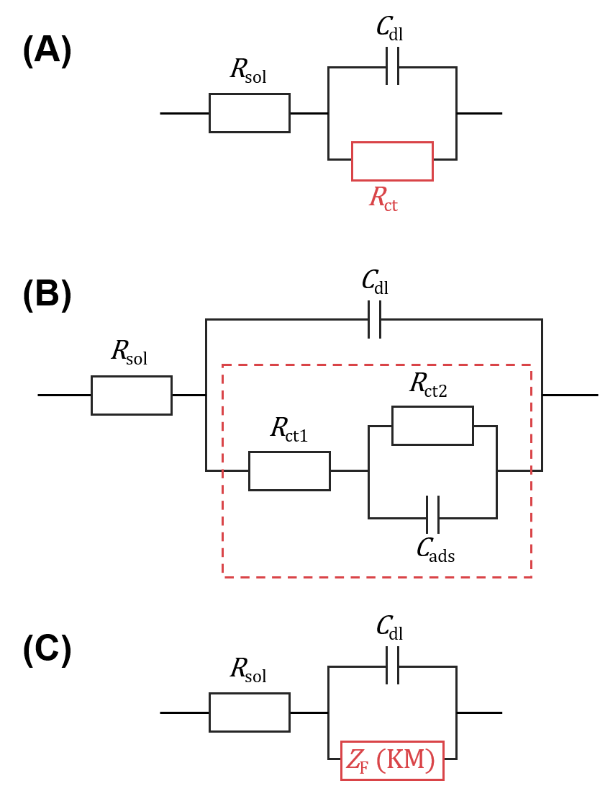
C_{dl}
(A)
R_{sol}
R_{ct}
(B)
C_{dl}
R_{sol}
R_{ct2}
R_{ct1}
C_{ads}
C_{dl}
(C)
R_{sol}
Z_{F} (KM)

Slide 2
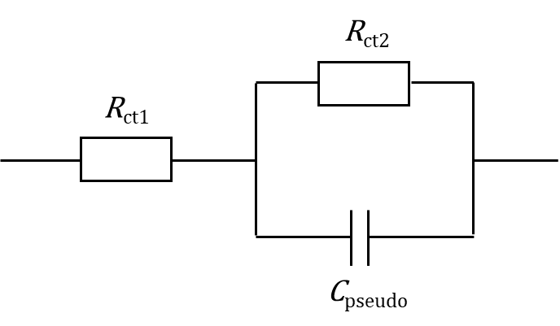

R_{ct2}
R_{ct1}
C_{ads.}

Slide 3
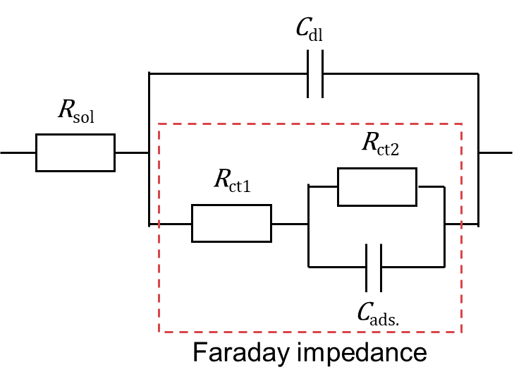
C_{dl}
R_{sol}
R_{ct2}
R_{ct1}
C_{ads.}
Faraday impedance

Slide 4
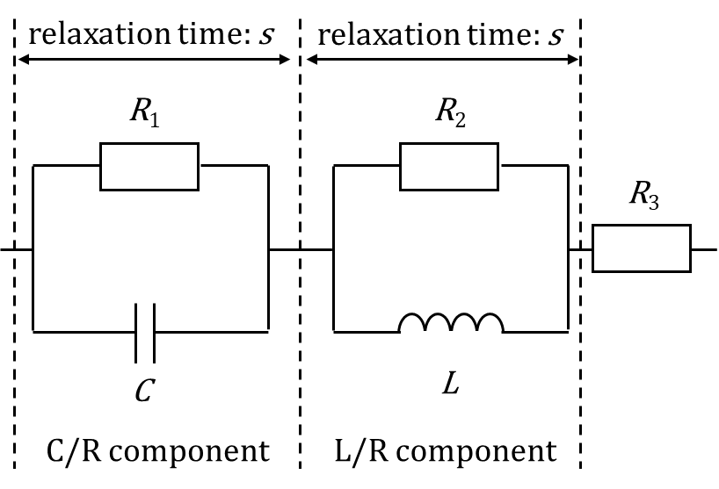
relaxation time: s
relaxation time: s
R₁
R₂
R₃
C
L
C/R component
L/R component

Slide 5
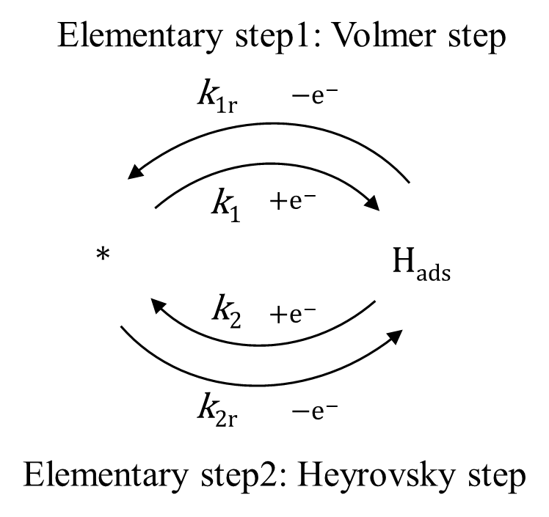
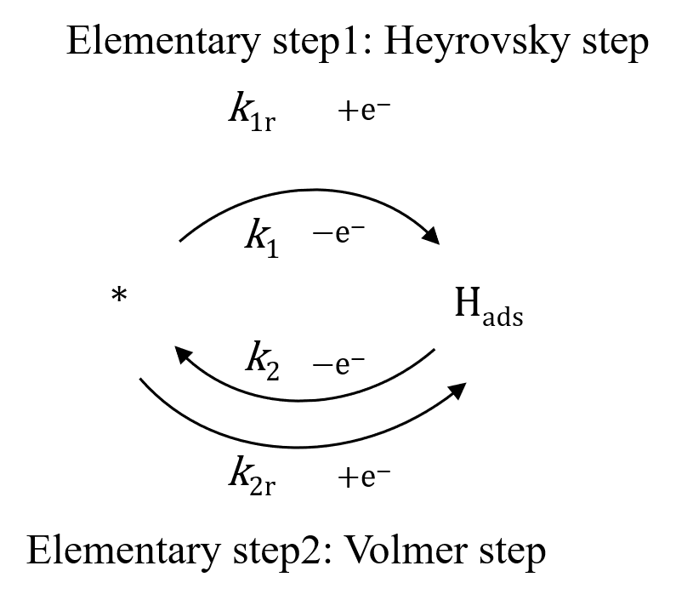

*
Elementary step1: Heyrovsky step
Volmer
step
fast
k₁
k_{1r}
+e⁻
k_{1r}
fast
k_{2r}
k₁
−e⁻
H_{2, ads}
H_{ads}
*
H_{ads}
k₂
$θ_{H_{2}}=0$
k₂
−e⁻
Heyrovsky step
k_{2r}
+e⁻
Elementary step2: Volmer step

Slide 6

Volmer
step
*
k₁
+H⁺, e⁻
fast
k_{1r}
−H⁺, e⁻
The original
reaction mechanism
fast
k_{2r}
+H⁺, e⁻
H_{2, ads}
H_{ads}
$θ_{H_{2}}=0$
k₂
+H⁺, e⁻
Heyrovsky step
Elementary step1
k_{1r}
−e⁻
k₁
+e⁻
Reaction network
*
H_{ads}
k₂
+e⁻
k_{2r}
−e⁻
Elementary step2

Slide 7
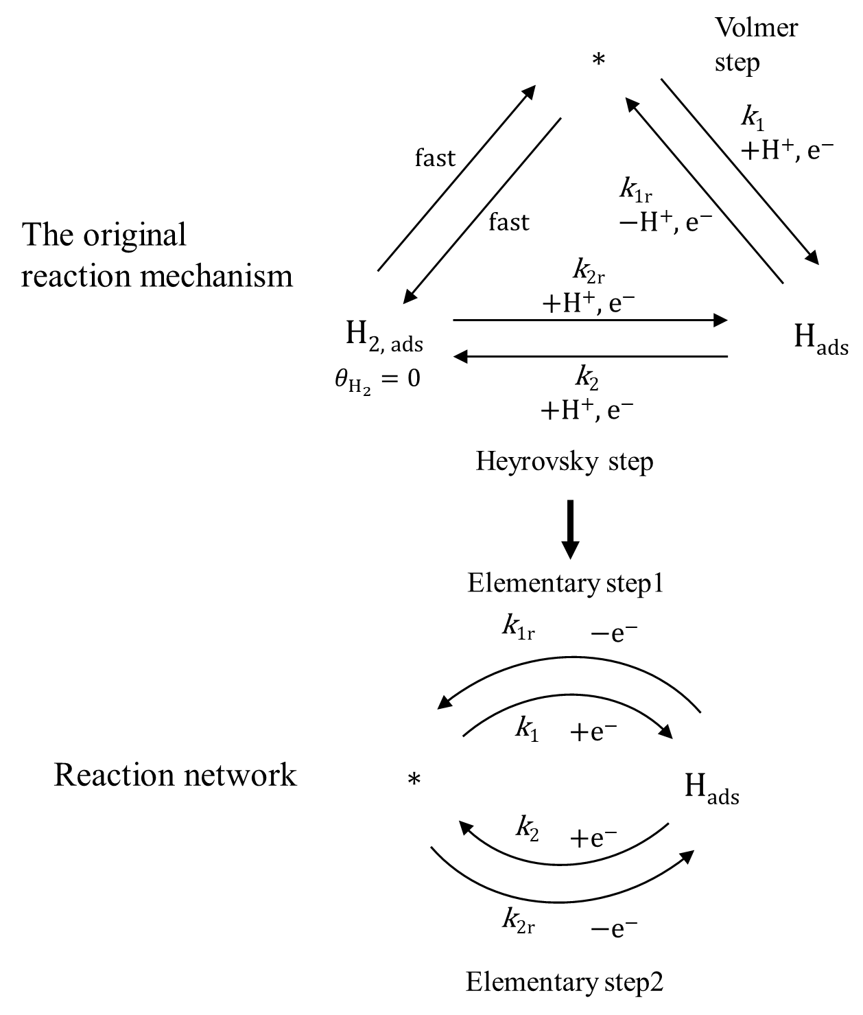

Slide 10
E
t
Δt
E = E₀
E = E₁
E = E₂
θ_{SS}(E)
θ(t₁+ Δt)
Real E
θ
θ(t₁)
Step E
θ = A exp(-kt) + θ₀
t
t₁
t₁+Δt
Δt
t
t

Slide 11
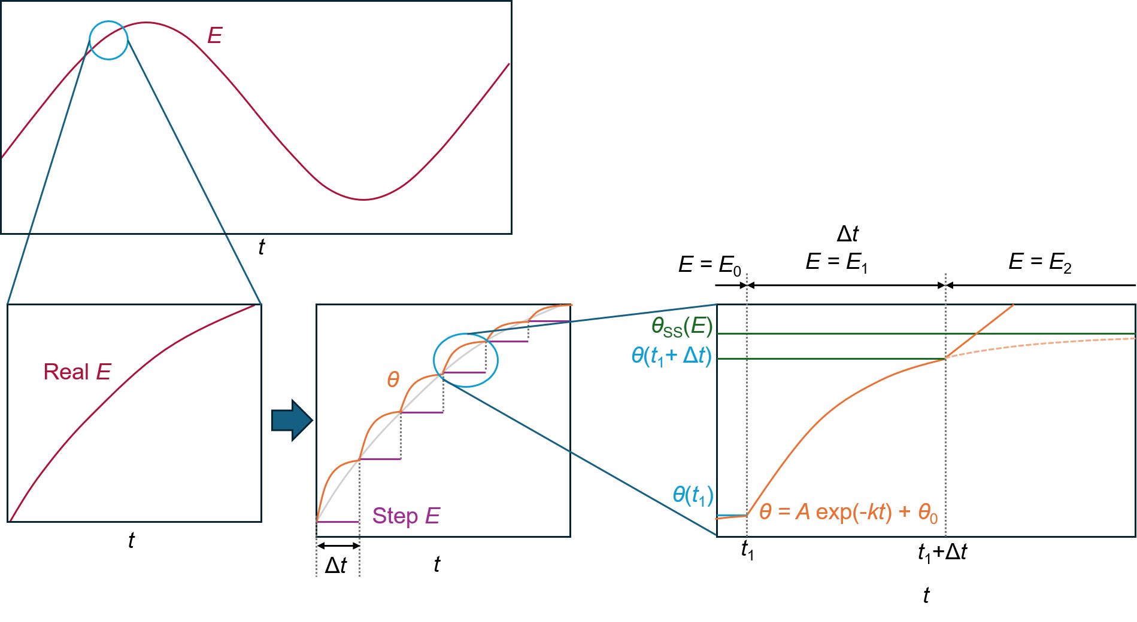

Slide 12
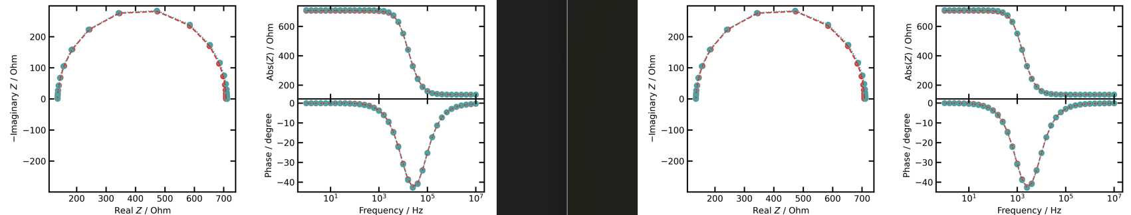
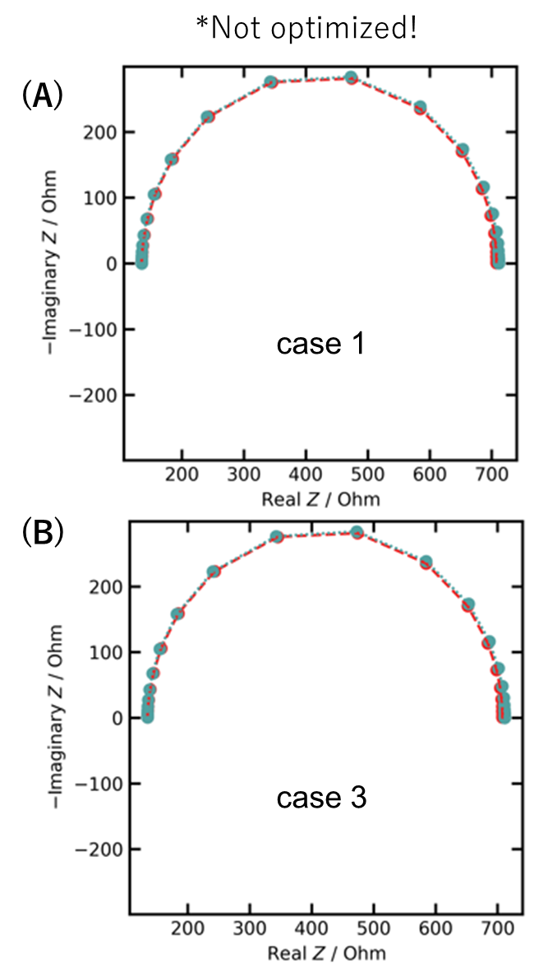
*Not optimized!
(A)
case 1
(B)
case 3

Slide 13
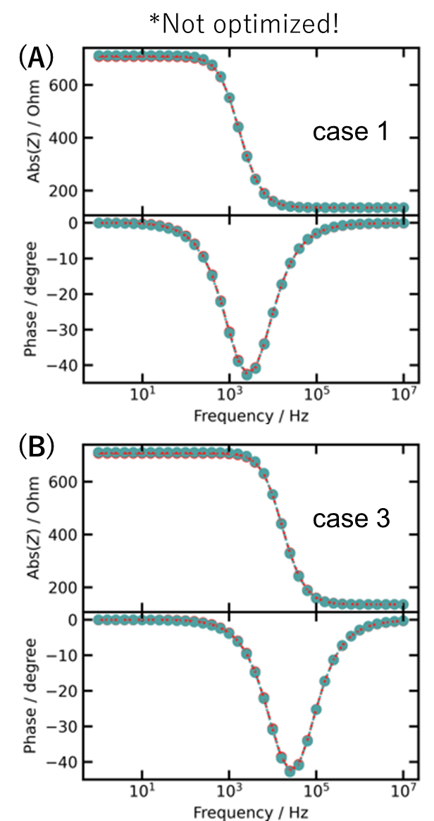
*Not optimized!
(A)
case 1
k₁⁰ and k₂⁰: ×10
(B)
k₁⁰ and k₂⁰: ×10
Γ: × 1/10

Slide 14
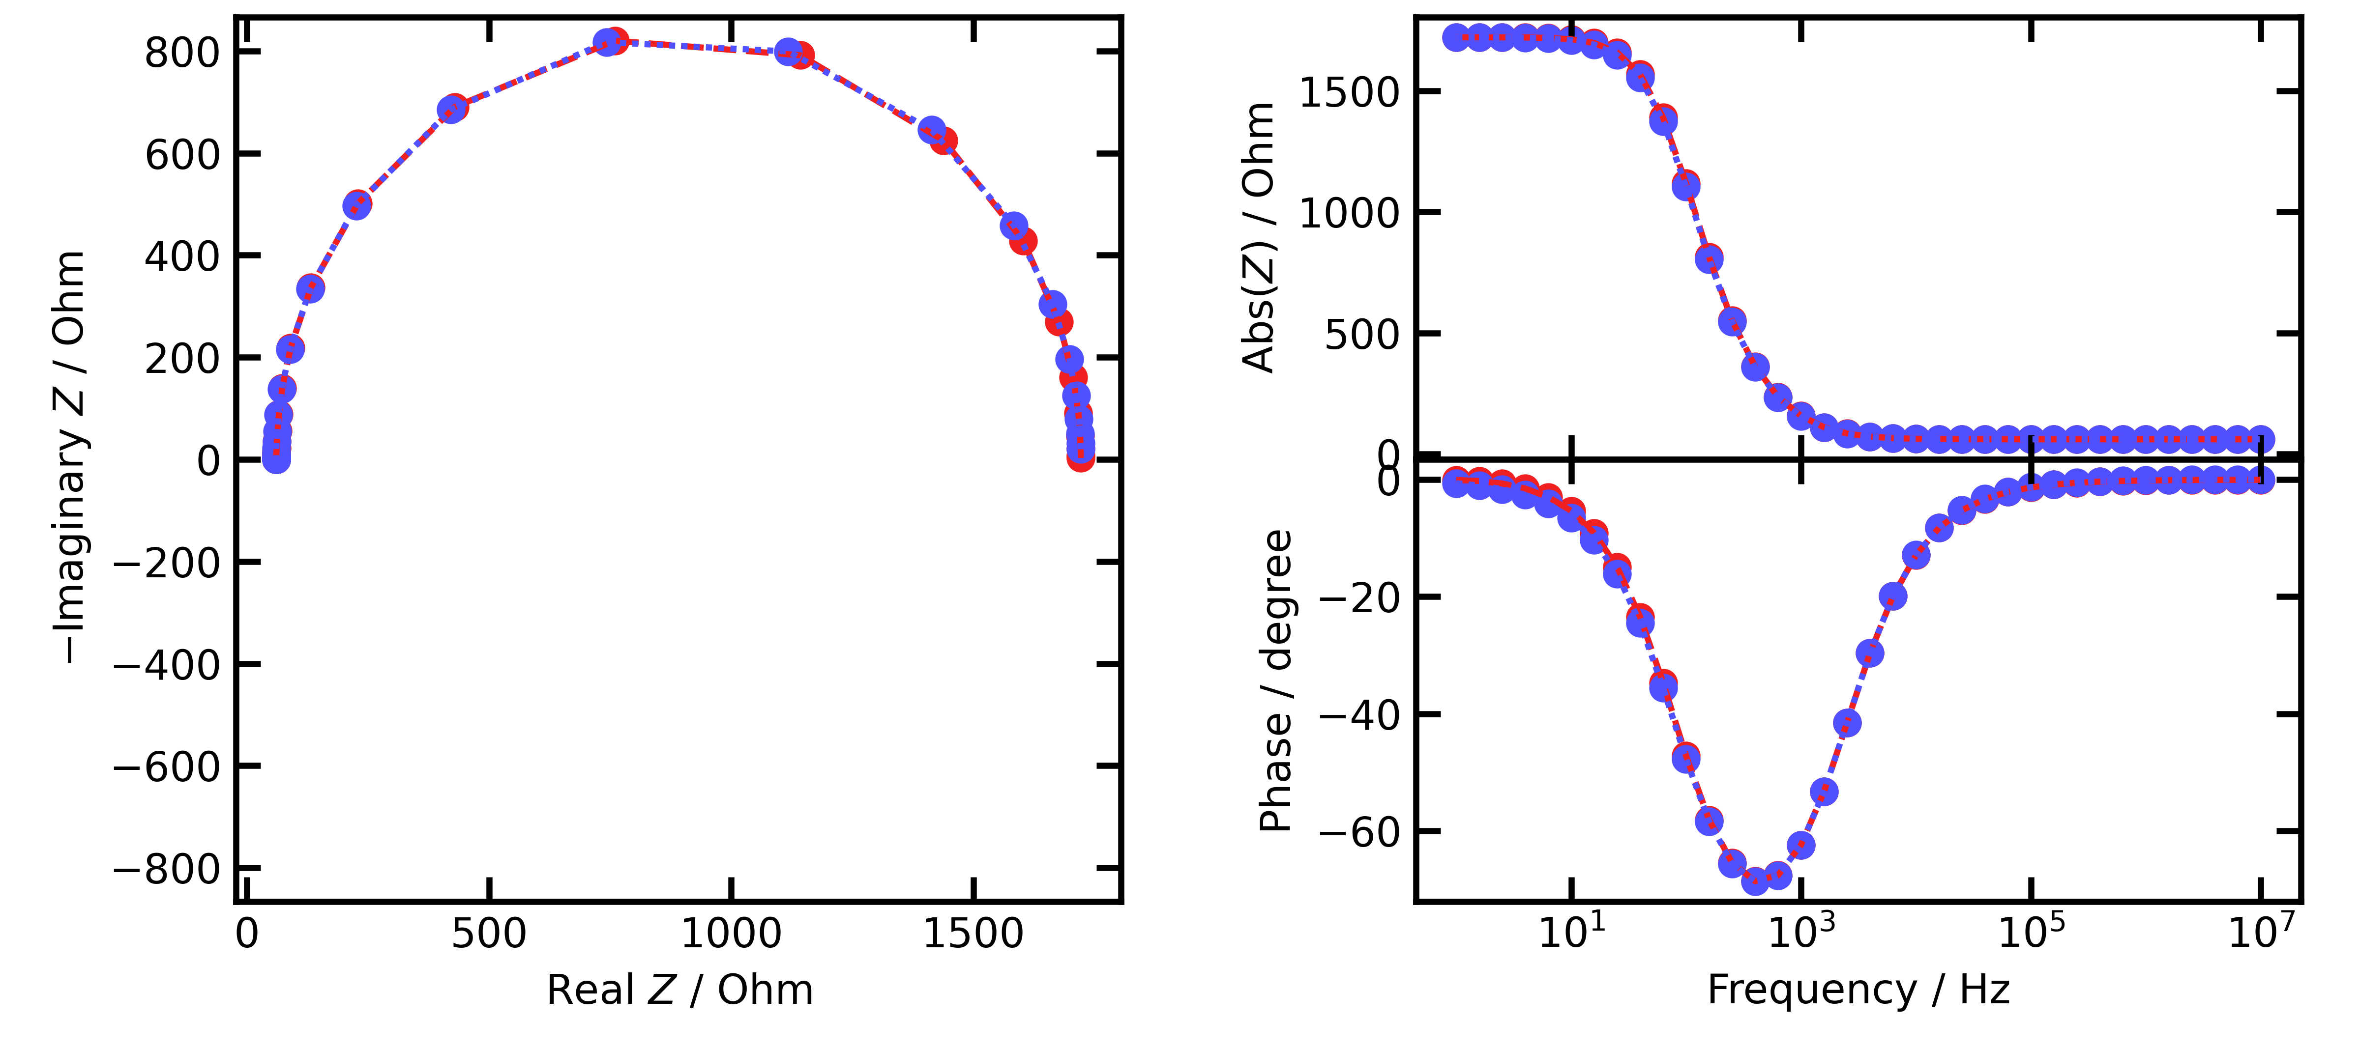
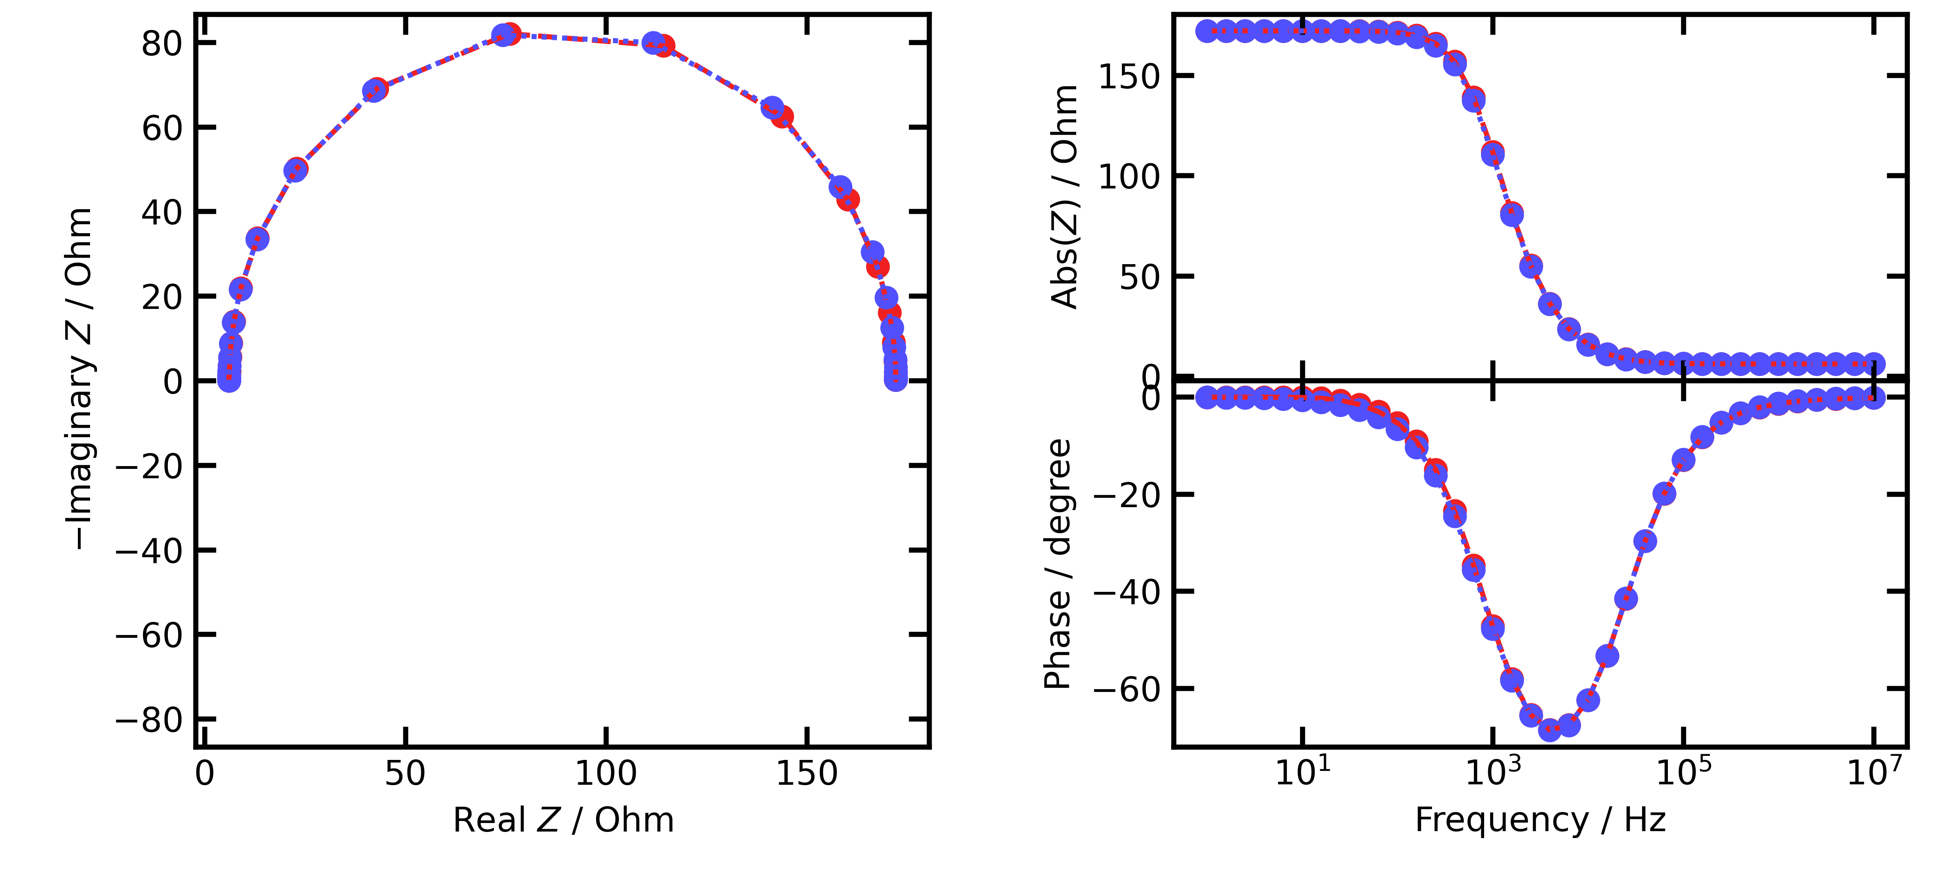
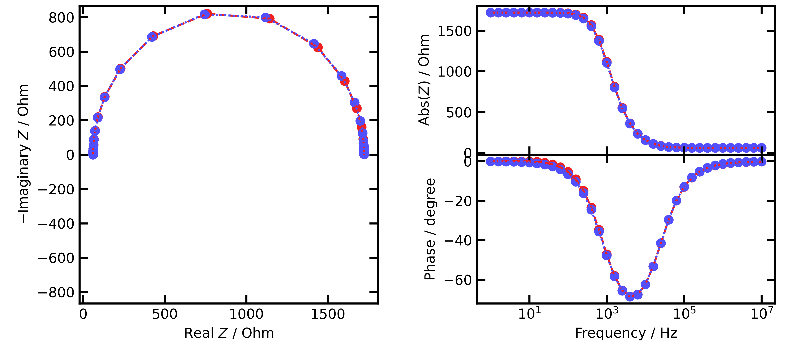
(A)
(A)
Case 1:
Standard
Case 1:
Standard
(B)
(B)
Case 2:
k₁⁰ and k₂⁰: ×10
Case 2:
k₁⁰ and k₂⁰: ×10
(C)
(C)
Case 3:
k₁⁰ and k₂⁰: ×10
Γ: × 1/10
Case 3:
k₁⁰ and k₂⁰: ×10
Γ: × 1/10

Slide 15
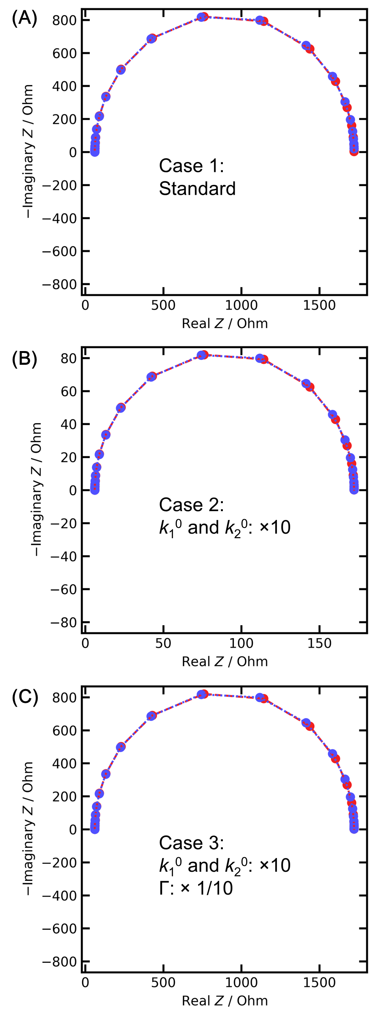
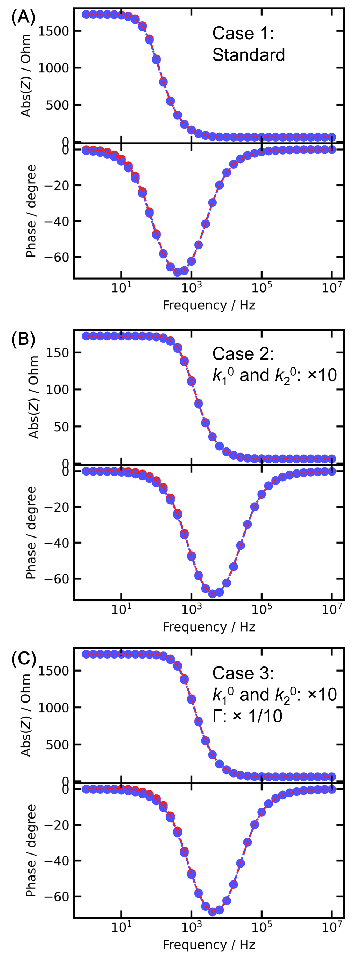

Slide 16
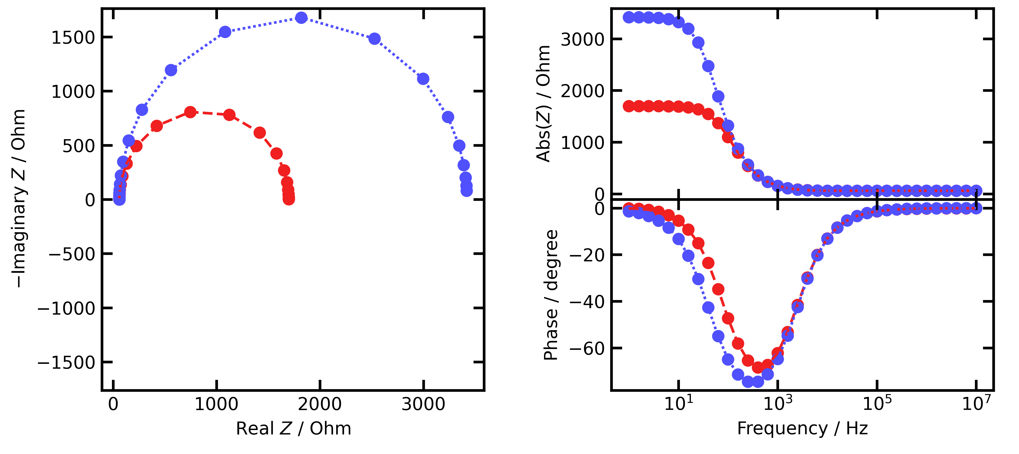
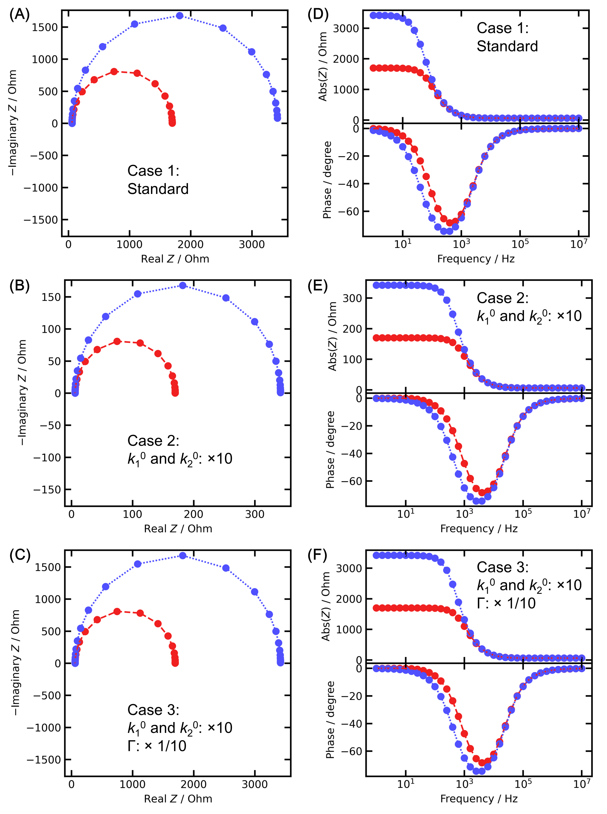
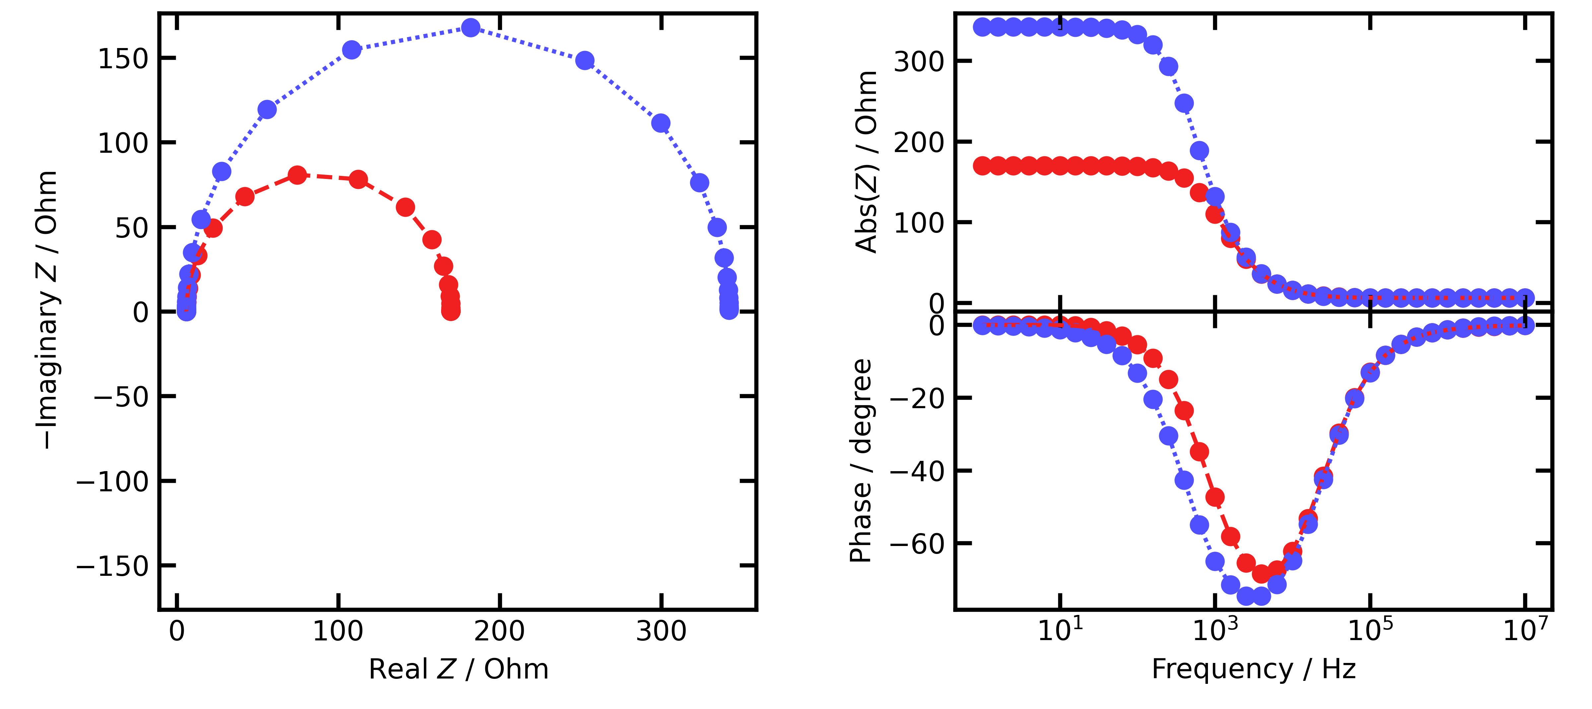

(A)
(D)
Case 1:
Standard
Case 1:
Standard
(B)
(E)
Case 2:
k₁⁰ and k₂⁰: ×10
Case 2:
k₁⁰ and k₂⁰: ×10
(C)
(F)
Case 3:
k₁⁰ and k₂⁰: ×10
Γ: × 1/10
Case 3:
k₁⁰ and k₂⁰: ×10
Γ: × 1/10

Slide 17
RN1, 0V, 10mV
下部2140px

Slide 18
RN2, 0V, 10mV
下部2140px

Slide 19
RN3, 0V, 10mV
下部2140px

Slide 23
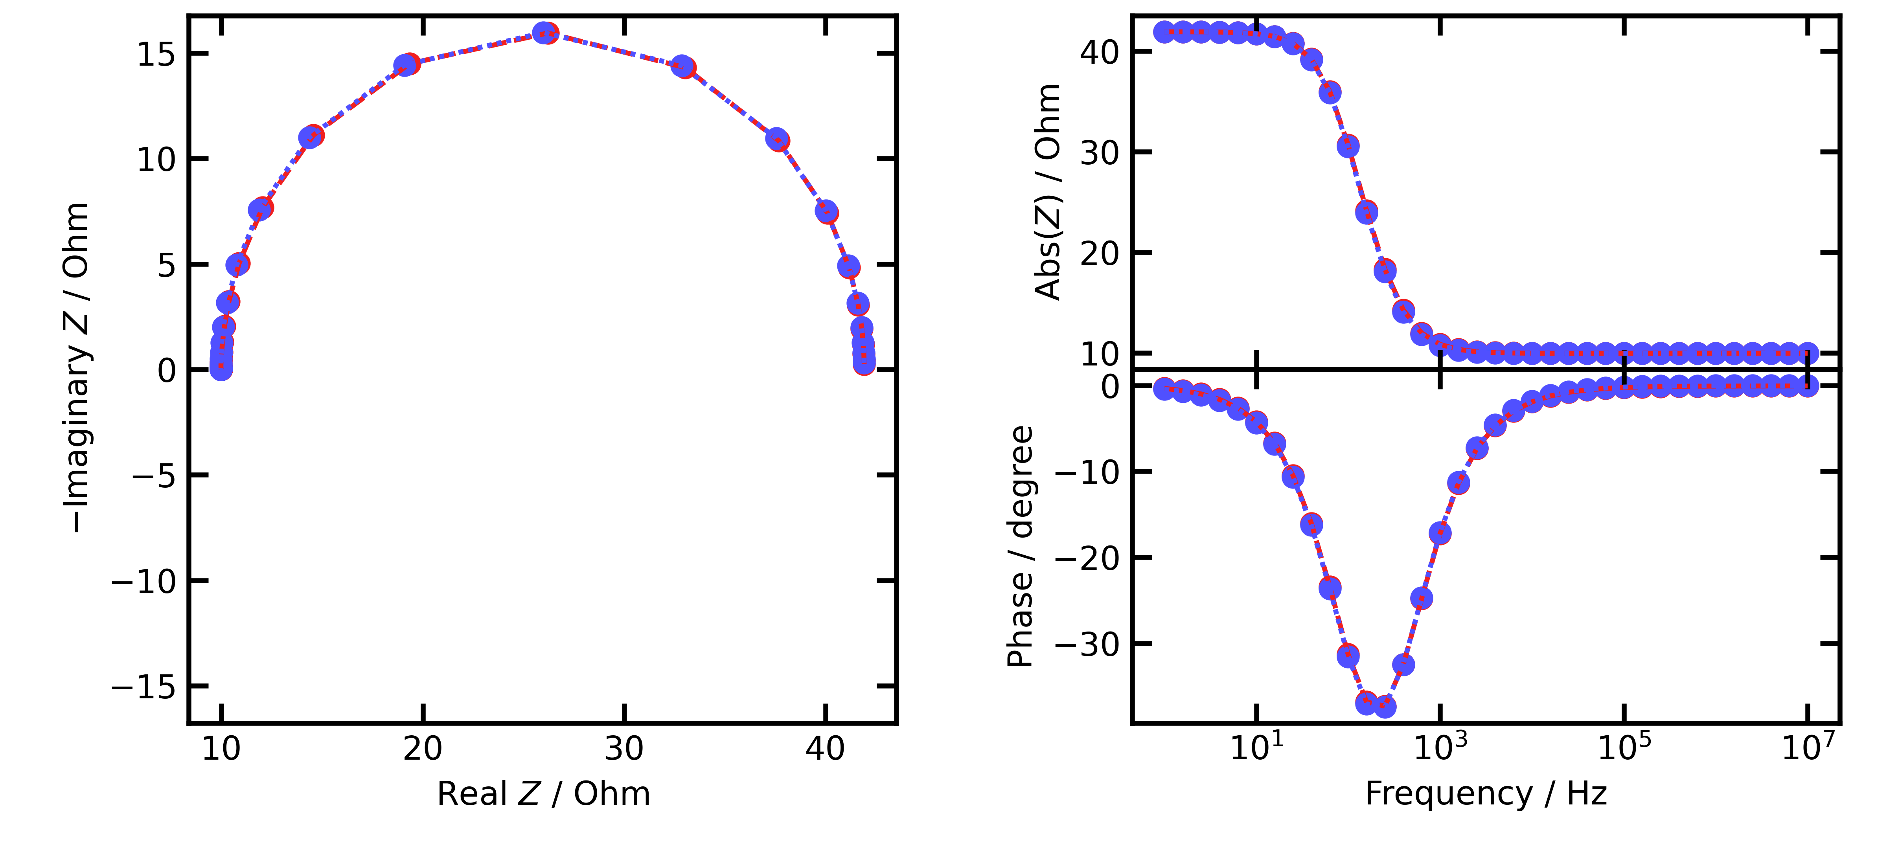
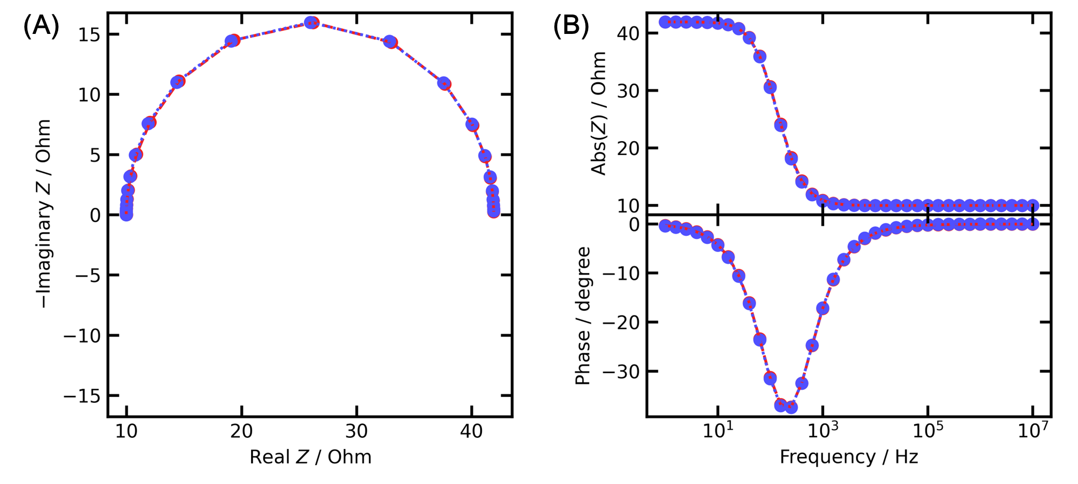
RN1, 0.1V, 10mV
下部2140px
(A)
(B)

Slide 24
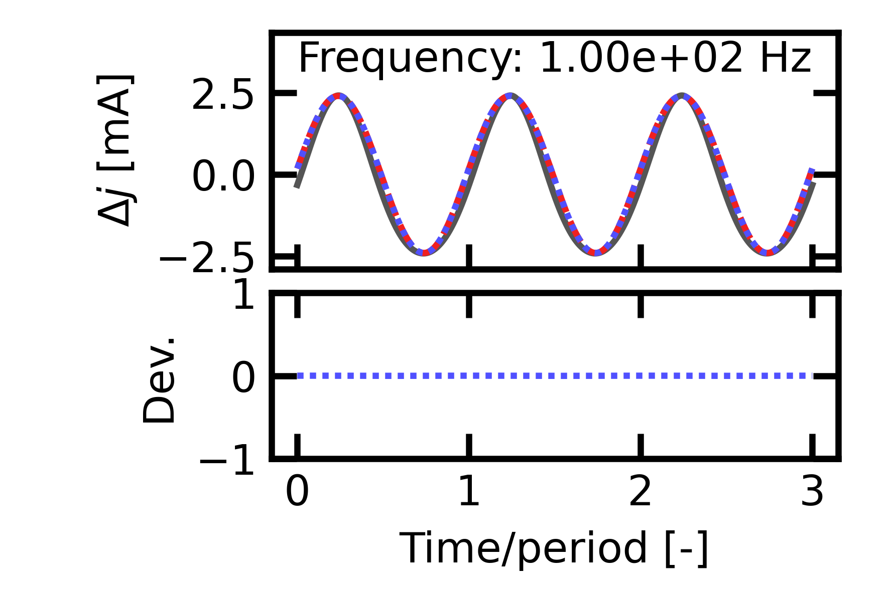
RN1, 0.1V, 10mV

