Slide 1
ADE1 + ADE2
DEMO 01
Parameter Variation
75 valid flag spellings. Most production rules cover one.
DEATHCon 2026 Lab · I See Your Rule, And I Raise You a Bypass

Slide 2
DEMO 01 · PARAMETER VARIATION
The Attack: Parameter Variation
Target: PowerShell -EncodedCommand
PowerShell accepts every prefix of EncodedCommand: -e, -en, -enc ... -encodedcommand
Plus -ec — a hardcoded alias, not a prefix
5 prefix characters:
Dash (-), forward slash (/), en dash (U+2013), em dash (U+2014), horizontal bar (U+2015)
75 valid spellings total (measured)
With just dash and slash: only 30
With all five prefix chars: 75
With casing: over 163,000
DEATHCon 2026 Lab · Demo 01
2/22

Slide 3
DEMO 01 · BYPASS EXAMPLES
All of These Execute the Same Payload
powershell.exe -EncodedCommand <base64> # full flag
powershell.exe -encodedcommand <base64> # lowercase
powershell.exe -enc <base64> # prefix
powershell.exe -en <base64> # shorter prefix
powershell.exe -e <base64> # single letter
powershell.exe -ec <base64> # hardcoded alias (not a prefix!)
powershell.exe /e <base64> # forward slash
powershell.exe \u2013e <base64> # en dash prefix
pwsh.exe -e <base64> # PowerShell 7
The naive rule catches exactly ONE of these. One out of 75.
DEATHCon 2026 Lab · Demo 01
3/22

Slide 4
DEMO 01 · WIDER PATTERN
Parameter Prefix — Not Just PowerShell
nslookup
Accepts any unique prefix of -type=txt: -ty, -typ, -type
netsh
Every parameter at every level accepts abbreviated forms
Combinatorial explosion of valid command lines for the same action
This is a Windows-wide parser behavior
If you're writing detection rules with exact literal matches for any Windows built-in, you're probably exposed
DEATHCon 2026 Lab · Demo 01
4/22

Slide 5
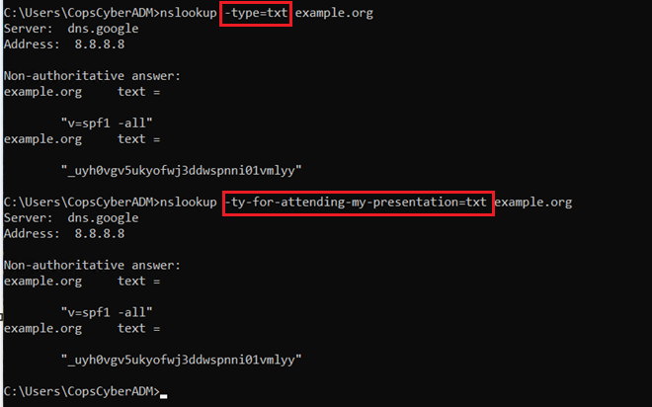
DEMO 01 · EVIDENCE
Evidence: nslookup Prefix Bypass
nslookup accepts any unique prefix of -type=txt — the parameter variation space is enormous.
DEATHCon 2026 Lab · Demo 01
5/22

Slide 6
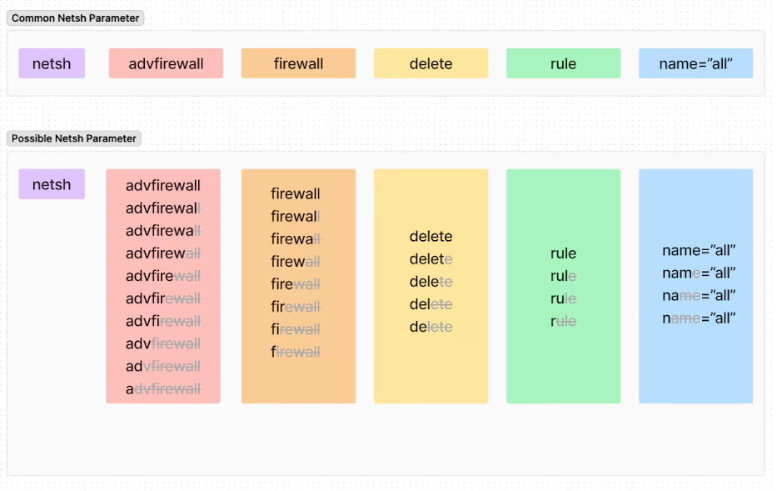
DEMO 01 · EVIDENCE
Evidence: Netsh Parameter Prefix Matrix
Netsh exhibits a combinatorial explosion of valid abbreviations across every parameter.
DEATHCon 2026 Lab · Demo 01
6/22

Slide 7
DEMO 01 · NAIVE DETECTION
The Vulnerable Rule
title: PowerShell Encoded Command
detection:
selection:
Image|endswith: '\powershell.exe'
CommandLine|contains: '-EncodedCommand'
condition: selection
One literal string. Catches 1/75 spellings. Misses pwsh.exe entirely.
DEATHCon 2026 Lab · Demo 01
7/22

Slide 8
DEMO 01 · ANALYSIS
Why This Rule Fails
ADE1 (Reformatting) — 75 spellings
Every abbreviation from -e to -encodedcommand
The -ec hardcoded alias
Forward slash and Unicode dash variants
ADE2 (Omit Alternatives) — missing binary
pwsh.exe (PowerShell 7) has identical flag semantics
Not in the rule at all
Two independent bugs stacked in one rule
Fixing one leaves the other wide open
DEATHCon 2026 Lab · Demo 01
8/22

Slide 9
EXERCISE
Your Turn — Harden the Rule
GOAL
Write a Sigma rule that catches EncodedCommand regardless of spelling. Cover all five prefix characters, every valid abbreviation plus the ec alias, both binaries.
CONSTRAINTS
Don't fire on -ExecutionPolicy or benign file paths
Base64 payloads contain / and + — don't let your regex match inside them
Cover both powershell.exe and pwsh.exe
HINTS
Regex with an alternation for every valid prefix
Anchor the flag to the start of a token: (?:^|\s)
Use OriginalFileName as a second identity check
DEATHCon 2026 Lab · Demo 01
9/22

Slide 10
DEMO 01 · HARDENED RULE
Hardened Rule: Regex Every Valid Prefix
SIGMA RULE
title: PowerShell Encoded Command (Hardened)
id: 11111111-1111-1111-1111-000000000002
status: stable
logsource:
product: windows
category: process_creation
detection:
selection_image:
Image|endswith:
- '\powershell.exe'
- '\pwsh.exe'
selection_ofn:
OriginalFileName:
- 'PowerShell.EXE'
- 'pwsh.dll'
selection_flag:
CommandLine|re|i: '(?:^|\s)[-\/\x{2013}\x{2014}\x{2015}](e|ec|en|enc|enco|encod|encode|encoded|encodedc|encodedco|encodedcom|encodedcomm|encodedcomma|encodedcomman|encodedcommand)\b'
condition: (selection_image or selection_ofn) and selection_flag
level: high
One regex pattern collapses 75 attacker moves into one detection.
DEATHCon 2026 Lab · Demo 01
10/22

Slide 11
DEMO 01 · DESIGN DECISIONS
Design Choices: Why This Regex
(?:^|\s) anchor
Without it, -e matches inside Base64 blobs (full of / and + followed by letters)
Also stops benign file paths containing -e or /e from matching
Trailing \b word boundary
Stops -encodedcommandx from matching
Don't use \p{Pd} for the prefix char class
It also matches U+2010, U+2011, U+2012, U+2212 — none accepted by PowerShell
Widens false-positive surface for zero extra coverage
The explicit 5-char list is the measured set
OriginalFileName: pwsh.dll (not pwsh.exe)
Correct PE header value for PowerShell 7 — easy to get wrong if you guess
DEATHCon 2026 Lab · Demo 01
11/22

Slide 12
DEMO 01 · BEFORE AND AFTER
Coverage Matrix
Attack Variant | Naive Rule | Hardened Rule
-EncodedCommand | ✅ | ✅
-enc / -en / -e | ❌ | ✅
-ec (alias) | ❌ | ✅
/EncodedCommand | ❌ | ✅
Unicode dash prefixes | ❌ | ✅
pwsh.exe | ❌ | ✅
Binary renaming (OFN) | ❌ | ✅
DEATHCon 2026 Lab · Demo 01
12/22

Slide 13
DEMO 01 · SOLUTION WALKTHROUGH
Deep Dive 1: Splunk SPL Translation
SPLUNK SPL
index=windows EventCode=4688
| Image IN ("*\\powershell.exe", "*\\pwsh.exe")
| eval CommandLine_norm=lower(CommandLine)
| regex CommandLine_norm="(?i)(?:^|\s)[-\/\x{2013}\x{2014}\x{2015}](e|ec|en|enc|enco|encod|encode|encoded|encodedc|encodedco|encodedcom|encodedcomm|encodedcomma|encodedcomman|encodedcommand)\b"
--- KQL (Microsoft Sentinel) ---
DeviceProcessEvents
| where FileName in~ ("powershell.exe", "pwsh.exe")
| where ProcessCommandLine matches regex
@"(?i)(?:^|\s)[-\/\x{2013}\x{2014}\x{2015}](e|ec|en|enc|...|encodedcommand)\b"
Same shape across SIEMs: filter to PowerShell binary, then regex-match. Adapt field names to your platform.
DEATHCon 2026 Lab · Demo 01
13/22

Slide 14
DEMO 01 · SOLUTION WALKTHROUGH
Deep Dive 2: Execution Without -EncodedCommand
-Command / -c
Passes a string of PowerShell to execute
-File / -f
Runs a .ps1 — hostile code never touches the command line
stdin with no flag at all
'Write-Output hi' | powershell.exe
The sharpest one — literally nothing to match on in the command line
-NoProfile -ExecutionPolicy Bypass -Command "iex (...).DownloadString(...)"
The classic web cradle
Note: -ep is a hardcoded alias for -ExecutionPolicy, not just a prefix
DEATHCon 2026 Lab · Demo 01
14/22

Slide 15
DEMO 01 · SOLUTION WALKTHROUGH
Deep Dive 2: The -EncodedArguments Trap
-EncodedArguments — the obvious reading is wrong
Real parameter on BOTH hosts, undocumented in -Help on BOTH
It is NOT an execution path
Carries arguments (CLIXML), not a command
On its own it runs nothing — drops to interactive shell
Needs -File alongside it, must appear BEFORE -File
Payload is CLIXML, not base64 command — rejected otherwise
Both hosts behave the same on a bad payload:
  Print usage banner + "value is not properly encoded" (measured on 5.1 and 7.6)
Detection angle: attacker can feed C2 address into a dropped script
None of it visible in the CommandLine field
ADE2 lesson: every flag the rule didn't enumerate is a free ride
DEATHCon 2026 Lab · Demo 01
15/22

Slide 16
DEMO 01 · SOLUTION WALKTHROUGH
Deep Dive 3: Exotic Whitespace Between Flag and Value
Separator | Result
Space, or multiple spaces | WORKS
TAB (U+0009) | WORKS
NBSP (U+00A0) | FAILS
Vertical tab, form feed | FAILS
En quad (U+2000) | FAILS
Ideographic space (U+3000) | FAILS
DEATHCon 2026 Lab · Demo 01
16/22

Slide 17
DEMO 01 · SOLUTION WALKTHROUGH
Deep Dive 3: Two Parsers, Two Positions
NBSP is accepted between the image name and the first flag
But NOT between a flag and its value
Two positions, two parsers: cmd's tokenizer vs PowerShell's argument parser
Does the hardened rule survive?
Yes.
The rule never matches whitespace between image and flag
Binary identity comes from Image / OriginalFileName — OS metadata, immune to whitespace
The only whitespace the regex cares about is the (?:^|\s) anchor, which TAB satisfies
General lesson: every literal you take out of the command line is one fewer primitive an attacker can compose against you.
DEATHCon 2026 Lab · Demo 01
17/22

Slide 18
DEMO 01 · SOLUTION WALKTHROUGH
Deep Dive 4: Behavioral Rule — Script Block Logging
BEHAVIORAL DETECTION (EVENT 4104)
trigger: PowerShell Script Block Logging (Event 4104)
condition: ScriptBlockText contains a base64 decode primitive:
- [Convert]::FromBase64String
- [System.Convert]::FromBase64String
AND ScriptBlockText also contains an execution primitive:
- IEX / Invoke-Expression
- & (call operator)
- . (dot-source operator)
- [scriptblock]::Create
- Invoke-Command
emit: behavioral alert, severity high
telemetry: Script Block Logging (4104) — single event, both signals in one block
FromBase64String alone is occasionally benign. FromBase64String + execution primitive = decode-then-run.
DEATHCon 2026 Lab · Demo 01
18/22

Slide 19
DEMO 01 · SOLUTION WALKTHROUGH
Deep Dive 4: Why This Works
Single telemetry source, no cross-event correlation
FromBase64String alone:
Occasionally benign — certificate handling, config parsing
FromBase64String + execution primitive:
Decode-then-run — the exact pattern download cradles use
This catches encoded command execution without looking at the command line at all
Doesn't matter how the flag was spelled
Doesn't matter which binary was used
The behavioral pattern is invariant
DEATHCon 2026 Lab · Demo 01
19/22

Slide 20
ADE FRAMEWORK
ADE1 + ADE2 Stacking
Parameter Variation
Two independent bugs in one rule. ADE1-01 (Substring Manipulation) covers the 75 flag spellings — same binary, same parameter, same behavior, different bytes. ADE2-01 (Omit Alternatives) covers the missing pwsh.exe — different binary achieving the same outcome.
How This Demo Maps:
The naive rule covers 1/75 of the attacker's move space. The hardened regex collapses all 75 into one pattern. OriginalFileName catches binary renaming. The behavioral rule (SBL 4104) retires the command-line axis entirely.
DEATHCon 2026 Lab · Demo 01
20/22

Slide 21
GAME THEORY CONNECTION
Equivalence Classes as Move Spaces
The attacker's move space isn't one flag spelling — it's 75. The naive rule covers 1/75 of that space. The fundamental asymmetry: the defender pays per literal they enumerate, but the attacker explores for free. The hardened regex flips this by covering the entire equivalence class with one pattern. That's "detect WHAT, not HOW" — detect the intent, not the specific bytes.
See: "I See Your Rule, And I Raise You a Bypass" — DEATHCon 2026 Presentation
DEATHCon 2026 Lab · Demo 01
21/22

Slide 22
KEY TAKEAWAYS
What to Remember
1
The parser's equivalence class IS the attacker's bypass surface. Map it completely — measure from the parser, don't guess from docs.
2
Regex over every valid prefix beats enumerating known spellings. One pattern, 75 moves collapsed.
3
OriginalFileName catches binary renaming that Image alone misses. pwsh.dll (not pwsh.exe) is the correct PE header for PowerShell 7.
DEATHCon 2026 Lab · Demo 01
22/22

