Slide 1
I See Your Rule,
And I Raise You a Bypass
Adversarial & Game Theory Aspects of Detection Engineering

Slide 2
THE FRAME
The Thesis
Detection engineering is a
non-cooperative, repeated, imperfect-information game.
NON-COOPERATIVE
REPEATED
IMPERFECT INFO
no shared objective
no terminal state
no full visibility
3/28

Slide 3
PART I · THE GAME
Game Theory Introduction
The study of mathematical models of strategic interactions
Umbrella term for the science of rational decision making
Detection vs. evasion and defender vs. attacker are a game - and therefore, can be analyzed under Game Theory
4/28

Slide 4
PART I · THE GAME
The Move–Countermove Cycle
Four phases in an infinite game. Each is a rational best-response to the previous.
01
02
03
04
ADVERSARY ACTS
DEFENDER OBSERVES
COMMUNITY ADAPTS
ADVERSARY LEARNS
Adapts from public/private research. Deploys novel technique.
Detects via telemetry. Publishes learnings publicly.
Research community absorbs the pattern and disseminates.
Reads the public research. Engineers the next evasion.
4/28

Slide 5
PART I · THE GAME
The Learned Enemy
Adversaries can learn your defenses from the security research community.
THE COMMUNITY
Vendor blogs · Sigma rules on GitHub · MITRE ATT&CK · conference talks · red team write-ups · detection-as-code repos. All public, all studied.
THE REHEARSAL
Adversaries reverse-engineer signatures, test tools against common defenses, and adapt TTPs before ever touching your environment.
THE SILENCE
No prior recon observed. No probes of your detections. Evasion arrives fully formed on first contact — your telemetry simply goes quiet.
5/28

Slide 6
PART I · THE GAME
Chess vs. Poker
Why classical game theory gets detection engineering wrong out of the box.
♟ CHESS — PERFECT INFORMATION
🃏 POKER — IMPERFECT INFORMATION
• Both players see the full board
• Every action is observable
• Game tree is large but bounded
• Opponent's cards are hidden
• Actions reveal information selectively
• Bluffing is rational. Deception pays.
Detection engineering is poker. The practitioners who treat it like chess keep losing.
6/28

Slide 7
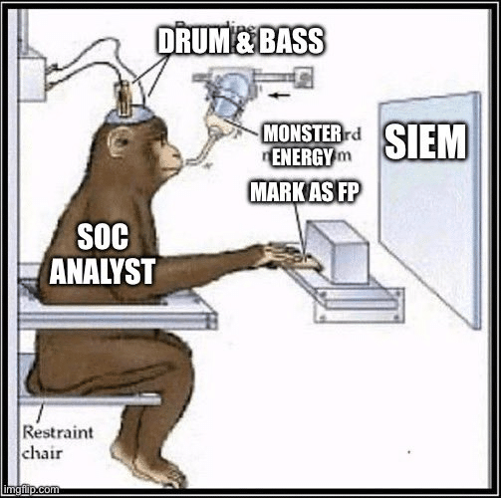
PART I · THE GAME
The Two Equilibria You're Already In
An equilibrium is a stable state where no player can improve their outcome by unilaterally changing their strategy.
EQUILIBRIUM #1 — FALSE/BENIGN POSITIVES
Your FP/BP rate will never be zero.
Defenders accept FPs/BPs because missing TPs is strictly worse. Attackers accept occasional detection because avoiding all alerts requires operationally crippling constraints.
Stable. Not optimal.
7/28

Slide 8
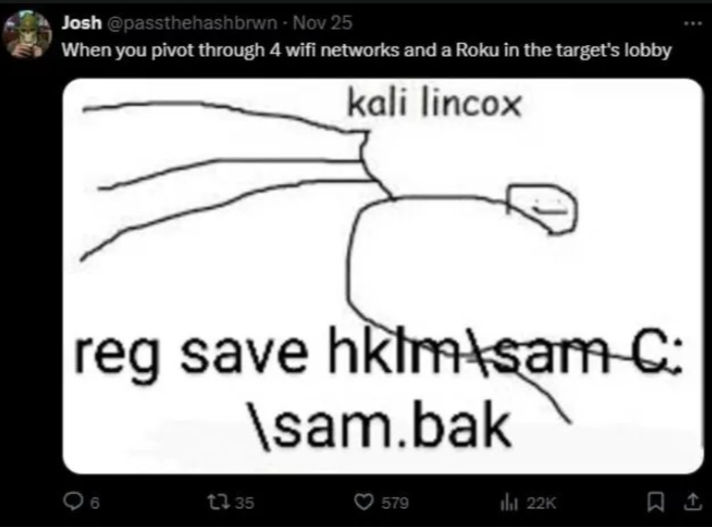
PART I · THE GAME
The Two Equilibria You're Already In
An equilibrium is a stable state where no player can improve their outcome by unilaterally changing their strategy.
EQUILIBRIUM #2 — SOPHISTICATION
Threats cluster in the middle.
LOW: commodity, easily detected. HIGH: nation-state, reserved for highest-value targets. MIDDLE: LOLBins, legitimate tool abuse — scales, slips past basic detections. This is where your threats live.
New detective capability shifts the equilibrium towards defenders.
7/28

Slide 9
PART II
The Economics of Detection
Both sides optimize, spend where the marginal leverage is highest.
8/28

Slide 10
PART II · ECONOMICS
The Two Cost Stacks
Both sides spend resources. The question is where each side gets the most marginal leverage.
ATTACKER COST STACK
DEFENDER COST STACK
› Recon & targeting
› Telemetry & storage
› Tooling
› Rule development
› Initial access
› Rule maintenance
› Persistence
› Alert triage
› Lateral movement
› False positives
› OpSec & cleanup
› Incident response
9/28

Slide 11
PART II · ECONOMICS
Shaping the Payoff Matrix
BEFORE
AFTER
Stealthy
Aggressive
Stealthy
Aggressive
Broad
−
+
→
Broad
+
++
Narrow
−−
+
Narrow
−
++
Three levers: RAISE attacker cost · LOWER defender cost · REDIRECT to surfaces you observe.
10/28

Slide 12
PART II · ECONOMICS
High-Leverage Detection — A Template
Four criteria: multiple techniques covered · hard to evade cheaply · high-value asset · cross-phase.
EXAMPLE: LSASS MEMORY ACCESS
TECHNIQUES COVERED
HARD TO EVADE
Credential dumping across Mimikatz, ProcDump, comsvcs, NtReadVirtualMemory, custom implants — all of them
Reading a protected process's memory IS the attack. You cannot randomize it away.
HIGH VALUE
CROSS-PHASE
Domain credentials = the blast radius of your entire authentication layer.
Fires on credential access but can be relevant for lateral movement prep, and persistence — one rule, three tactics.
11/28

Slide 13
PART II · ECONOMICS
Mixed Strategies → Portfolio Theory
Don't predict. Diversify.
MIXED STRATEGY
PORTFOLIO THEORY
REBALANCE
Pure strategy: always play Rock.
Mixed strategy: randomize - play each of Rock, Paper, Scissors with probability ⅓.
A diversified allocation over detections. You don't guess which stock wins. You don't guess which technique lands.
Shift weight toward techniques with higher marginal leverage - now, or in general.
COVERAGE BEFORE CERTAINTY
Several good-enough detections across multiple surfaces strictly dominate one perfect detection on one surface. The attacker would have to evade all of them at once — mathematically harder than evading any one.
12/28

Slide 14
PART II · ECONOMICS
Loud · Silent · Honey
LOUD
SILENT
HONEY
Alert immediately
Collect without alerting
Deliberately exposed bait
Analyst investigates. Adversary may learn you detected them.
Evidence preserved. Adversary unaware of detection.
Any interaction is malicious by construction.
WHEN TO USE
WHEN TO USE
WHEN TO USE
High confidence · Active defense · Low tolerance for dwell time
Long-horizon hunts · Forensic prep · APT tracking · OpSec preservation
Zero-FP by design · High-fidelity signal on intent
13/28

Slide 15
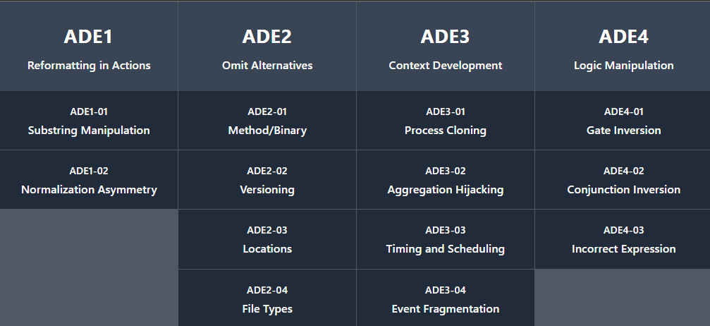
PART III
Adversarial Detection Engineering
The offensive practice of enumerating, reverse-engineering, and systematically bypassing detection rules.
14/28

Slide 16
PART III · ADE
Process Renaming
ATTACKER VIEW
The SOC is looking for mimikatz.exe. I'll just rename it to GoogleUpdate.exe and run it from %AppData%\Chrome.
DEFENDER'S COUNTER
Process Ancestry:
Hunt for legitimate-looking processes with the wrong parent and path. svchost.exe parented by powershell.exe or explorer.exe NOT from System32 is highly suspicious.
Command Line:
A renamed tool often still uses its unique command-line flags — check the source code.
15/28

Slide 17
PART III · ADE
Windows Subsystem for Linux
ATTACKER VIEW
I will use WSL for payload staging on the host machine. This is not detectable on the network side since WSL and Windows are using two different stacks, and generates esoteric process telemetry.
DEFENDER'S COUNTER
Monitor dllhost.exe file writes in unusual locations:
Any file operation that is performed from a WSL instance that affects the Windows host (i.e, using Linux pwsh to download a remote file and stage it locally) will generate a file operation event log where the initiating process is dllhost.exe
19/28

Slide 18
PART III · ADE
Command Aliasing
Attacker:
SOC looks for PowerShell IEX. I rename IEX with set-alias x iex. Now my command line says "x" — never the string they search for.
DEFENDER'S COUNTER
Aliasing detection:
detect set-alias usage in PowerShell context, especially when the target is a sensitive cmdlet (IEX, Invoke-Expression, etc).
19/28

Slide 19
PART III · ADE
Parameter Variation
ATTACKER VIEW
SOC searches for PowerShell hidden windows using "WindowStyle Hidden". I'll just use "w 1" — same effect, different string.
DEFENDER'S COUNTER
Enumerate full parameter space:
PowerShell EncodedCommand can be invoked via at least 28 different flag variations.
Both - and /:
Parameters in many processes can be written with either dash or slash. Many rules check only one of them.
Source-code level review:
When writing a rule, read the tool's source to understand all parsing branches.
19/28

Slide 20
PART III · ADE
Detect WHAT Attackers Must Do, Not HOW
HOW · RANDOMIZABLE
WHAT · INVARIANT
Specific implementations — interchangeable.
PsExec · WMI · SSH · PowerShell remoting
Obfuscation · Cobalt Strike · Sliver · custom C2
Scheduled task · service · registry key
Behaviors the attacker MUST perform.
RECON:
unusual enumeration, query spikes
PERSISTENCE:
scheduled tasks, services, autoruns
ESCALATION:
credential access and/or dumping
OBJECTIVES:
data access, exfil, encryption
The attacker can swap tools in a day. The behavior is the key artifact.
22/28

Slide 21
PART III · ADE
RDP — A Worked Example
Many specific techniques. One underlying behavioral pattern.
TECHNIQUE CLOUD — ALL FUNGIBLE
THE INVARIANT
Metasploit - reg.exe - WMI - PowerShell - VBS - .NET - PSExec - WinRM - PSRemoting
“fDenyTSConnections” set to 0
A behavioral detection at this level catches every technique on the left — including the ones not yet written.
23/28

Slide 22
PART III · ADE
Concentrate Where You Have the Advantage
Accept initial-access loss. Dominate post-exploitation.
Recon
Initial
Access
Execution
Persistence
Priv.
Esc
Lateral
Movement
Objectives
← attacker's advantage
defender's advantage — invest here →
THE RECOMMENDATION
Assume breach. Instrument the interior aggressively. React fast when you see movement.
24/28

Slide 23
PART IV
Strategic Close
So what do I do now?
8/28

Slide 24
PART IV · STRATEGIC CLOSE
Monday Morning Checklist
Four questions to test your current strategic posture. Take them to your team this week.
01
Can you label every detection as LOUD, SILENT, or HONEY?
02
Can you name the specific Nash equilibrium your program is sitting in?
03
Is your detection portfolio diversified across multiple surfaces per tactic?
04
What fraction of your detection budget sits in post-exploitation?
If you cannot answer any of these — that's the work to prioritize.
25/28

Slide 25
PART IV · STRATEGIC CLOSE
Five Things to Take Home
01
Detection engineering is a non-cooperative, repeated, imperfect-information game.
02
The goal is to shape the payoff matrix. Not to win every hand.
03
Coverage before certainty. Behavior before signature. Portfolio before prediction.
04
Run LOUD, SILENT, and HONEY detections deliberately — and build the vocabulary your SOC lacks.
05
Concentrate post-exploitation. That's where the defender's structural advantage lives.
26/28

Slide 26
RESOURCES
Further Reading
ADE FRAMEWORK
A DANCE OF RED AND BLUE
adeframework.org
Daniel Koifman · 2026
Open taxonomy of detection logic bugs.
Game-theoretic foundation for detection engineering. Chapter 4 is the source of much of this lecture.
MOVE AND COUNTERMOVE
SPECTEROPS RESEARCH
detect.fyi · January 2026
posts.specterops.io
Daniel's article-form treatment of the move-countermove cycle.
Start with "On Detection: From Tactical to Functional" series.
DETECT FYI
DETECTION ENGINEERING WEEKLY
detect.fyi
detectionengineering.net
Practitioner-grade detection engineering articles.
Newsletter by Zack Allen (Datadog).
27/28

Slide 27
Thank you!

