Slide 1
Overview of PL/SQL
Definition:
PL/SQL, the Oracle procedural extension of SQL, is a portable, high-performance transaction-processing language.
PL/SQL combines the data-manipulating power of SQL with the processing power of procedural languages.

Slide 2
Advantage of PL/SQL
Advantages :
Tight Integration with SQL
PL/SQL is tightly integrated with SQL, the most widely used database manipulation language.
High Performance
PL/SQL lets you send a block of statements to the database, significantly reducing traffic between the application and the database.
High Productivity
PL/SQL has many features that save designing and debugging time, and it is the same in all environments.

Slide 3
Advantage of PL/SQL
Advantages:
Portability
You can run PL/SQL applications on any operating system and platform where Oracle Database runs.
Scalability
PL/SQL stored subprograms increase scalability by centralizing application processing on the database server.
The shared memory facilities of the shared server let Oracle Database support thousands of concurrent users on a single node.

Slide 4
Advantage of PL/SQL
Advantages :
Manageability
PL/SQL stored subprograms increase manageability because you can maintain only one copy of a subprogram, on the database server, rather than one copy on each client system.
Any number of applications can use the subprograms, and you can change the subprograms without affecting the applications that invoke them.
Support for Object-Oriented Programming
PL/SQL allows defining object types that can be used in object-oriented designs.

Slide 5
Main Features of PL/SQL
Features:
Error Handling
Blocks
Variables and Constants
Subprograms
Packages
Triggers
Control Statements
Processing a Query Result Set One Row at a Time

Slide 6
PL/SQL Block
<< label >> (optional)
DECLARE -- Declarative part (optional)
-- Declarations of local types, variables, & subprograms
BEGIN -- Executable part (required)
-- Statements (which can use items declared in declarative part)
[EXCEPTION -- Exception-handling part (optional)
-- Exception handlers for exceptions (errors) raised in executable part] END;

Slide 7
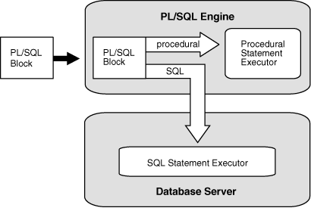
Architecture of PL/SQL

Slide 8
PL/SQL – Variable Decleration
Definition:
A variable declaration always specifies the name and data type of the variable.
DECLARE
part_number NUMBER(6); -- SQL data type
part_name VARCHAR2(20); -- SQL data type
in_stock BOOLEAN; -- PL/SQL-only data type
part_price NUMBER(6,2); -- SQL data type
part_description VARCHAR2(50); -- SQL data type
BEGIN
NULL;
END;
/

Slide 9
PL/SQL – Variable Decleration
Constant Declarations:
DECLARE
credit_limit CONSTANT REAL := 5000.00; -- SQL data type
max_days_in_year CONSTANT INTEGER := 366; -- SQL data type
urban_legend CONSTANT BOOLEAN := FALSE; -- PL/SQL-only data type
BEGIN
NULL;
END;
/

Slide 10
PL/SQL – Variable Decleration
Declaring Variable of Same Type as Column:
Syntax:
variable_name table_name.column_name%TYPE;
Example:
DECLARE
surname employees.last_name%TYPE;
BEGIN
DBMS_OUTPUT.PUT_LINE('surname=' || surname);
END;
/

