Slide 1
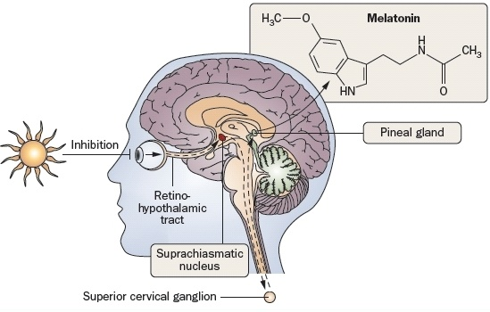
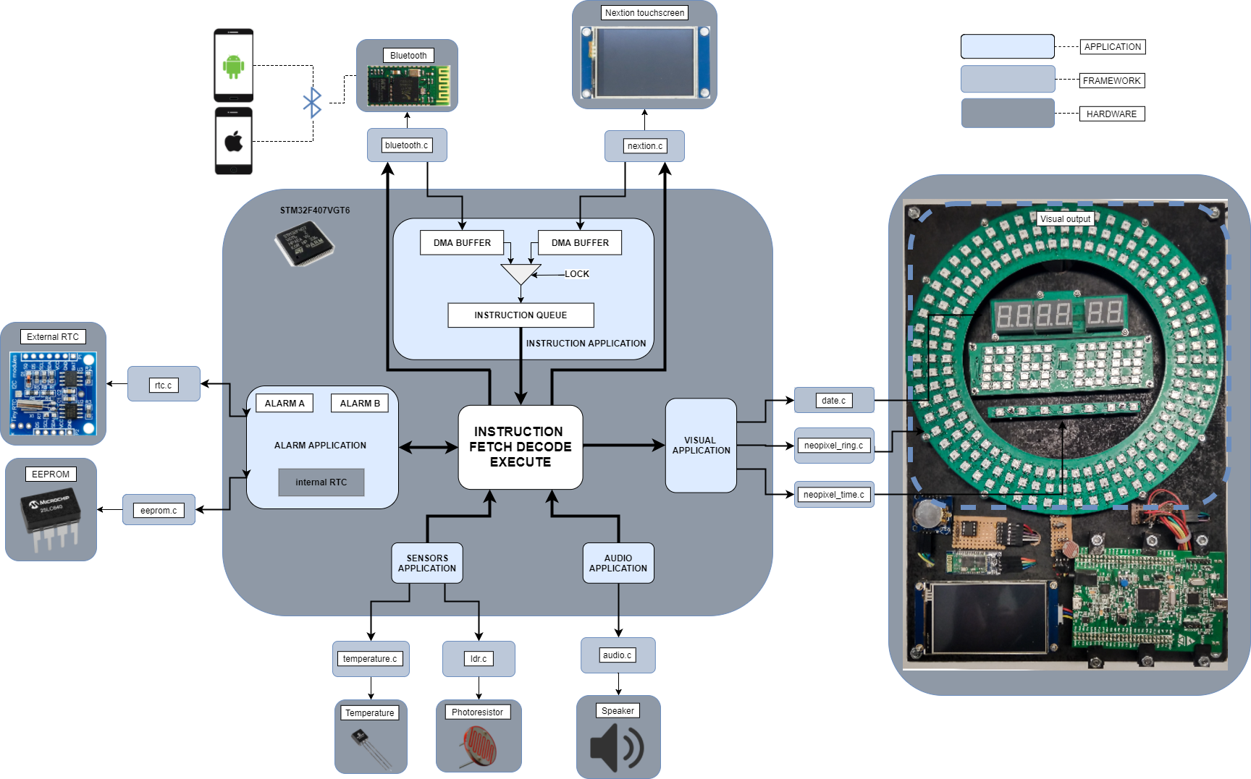
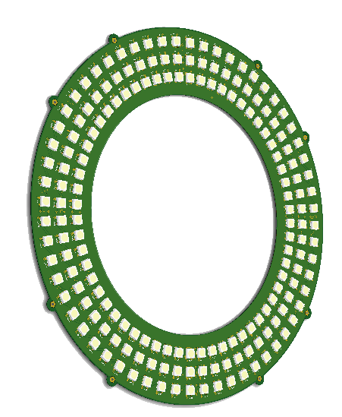
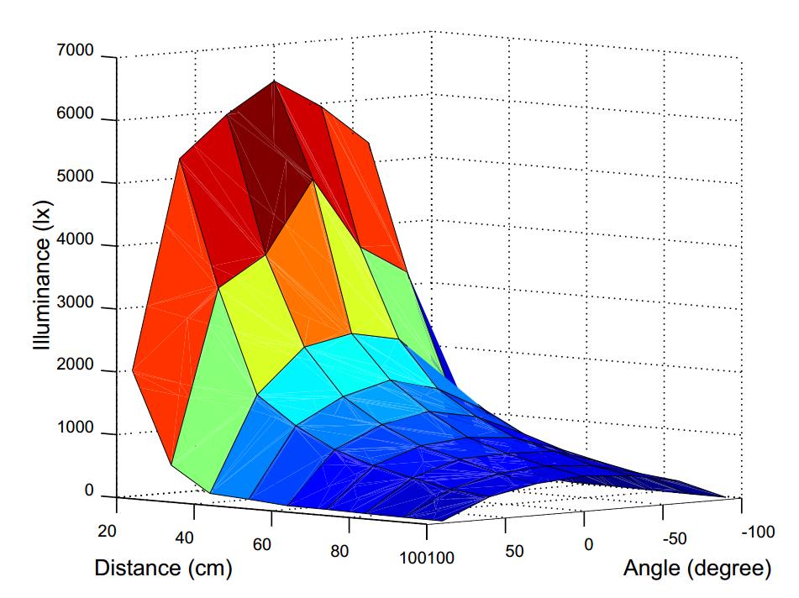
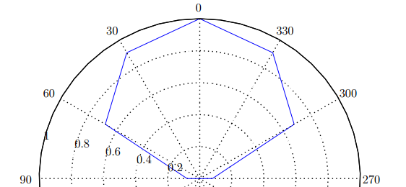

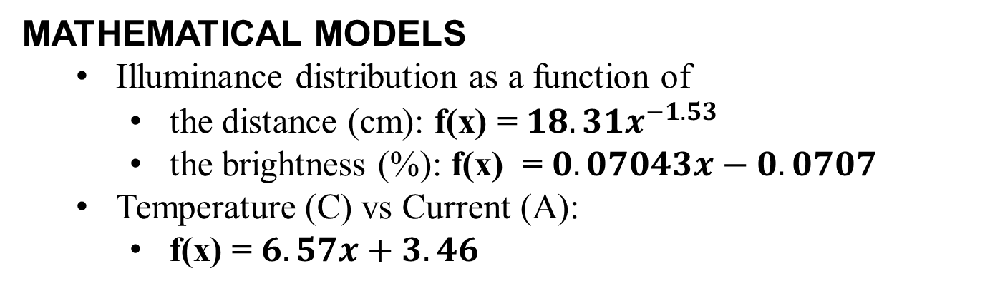


NeoPixel Sunrise Clock (NPSC)
An Intelligent Bedside Clock
BACKGROUND
OBJECTIVES
Studies made on human behavioural patterns have revealed that light of $460±10nm$ wavelength can affect the sleep-wake cycle by controlling the production of melatonin.
Create a device capable of generating light emission patterns which can produce both soporific and gentle awakening effects on humans, to control the human sleep-wake cycle in a more gentle manner that can have health benefits.
SYSTEM OVERVIEW
System Hierarchy
Software
Application (top)
Framework (middle)
Hardware (bottom)
Two user inputs type
Smartphone application
Onboard touchscreen
Alarm functionality
64KB EEPROM
Real Time Clock
Alarms from
Visual outputs
Ring for emitting light of $460±10nm$ wavelength at $30lx$
Time & Weekday
Date & Temperature
Sensors
Outside temperature
Light temperature
RING SPECIFICATIONS
180 neopixels
5V @ 7.5A max
37.5 W max
0.5W min
21 x 21 cm²
RGB colours
255 x 255 x 255 x 180 colour combinations
Refresh rate >= 5.4ms
ILLUMANCE AND BLUE LIGHT
Blue light of 465nm wavelength capable of significantly reduce the production of the sleeping hormone emit up to 30lx at an object place 1m meter away and at 90 degree angle from the normal to the Ring’s surface.
Illuminance distribution of the Ring follows Lambert’s Cosine Law. As expected, object positioned on the normal to the Ring’s surface receive most of the illuminance emitted.
MATHEMATICAL MODELS
Illuminance distribution as a function of
the distance (cm): f(x) = $18.31x^{−1.53}$
the brightness (%): f(x) = $0.07043x−0.0707$
Temperature (C) vs Current (A):
f(x) = $6.57x+3.46$
WHAT’S NEXT?
“Art is never finished, only abandoned.” Leonardo da Vinci.
This piece of art can be improved in the following ways:
Use the equations describing the behaviour of the Ring to design light patterns providing quantitative descriptions of the illuminance received by the user.
Integrate the NPSC in the IoT device family
Othniel KONAN
Electrical & Computer Engineering
Kylekojey@gmail.com +27783420721

