Slide 1

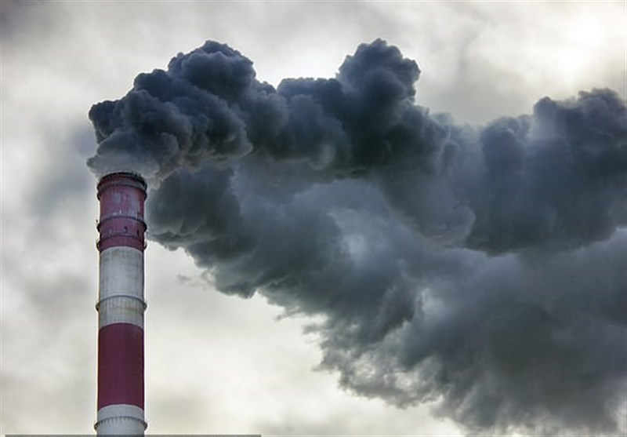
Countries with a huge land area have the highest rate death rate due air pollution
Elijah kojo danso appau
This Photo by Unknown Author is licensed under CC BY

Slide 2
URLS
https://www.kaggle.com/datasets/pavan9065/air-pollution?resource=download
https://data.worldbank.org/indicator/AG.LND.FRST.ZS?end=2020&start=1961
https://davidsuzuki.org/wp-content/uploads/2017/09/impact-green-space-heat-air-pollution-urban-communities.pdf

Slide 3
hypothesis
Pollution(air) which later leads to death are related to forest to land ratio

Slide 4
My guess
I believe the greater the land area the greater the pollution and death rate.

Slide 5
Country with the most air pollution

Slide 6


China

Slide 7
Country with the least air pollution

Slide 8
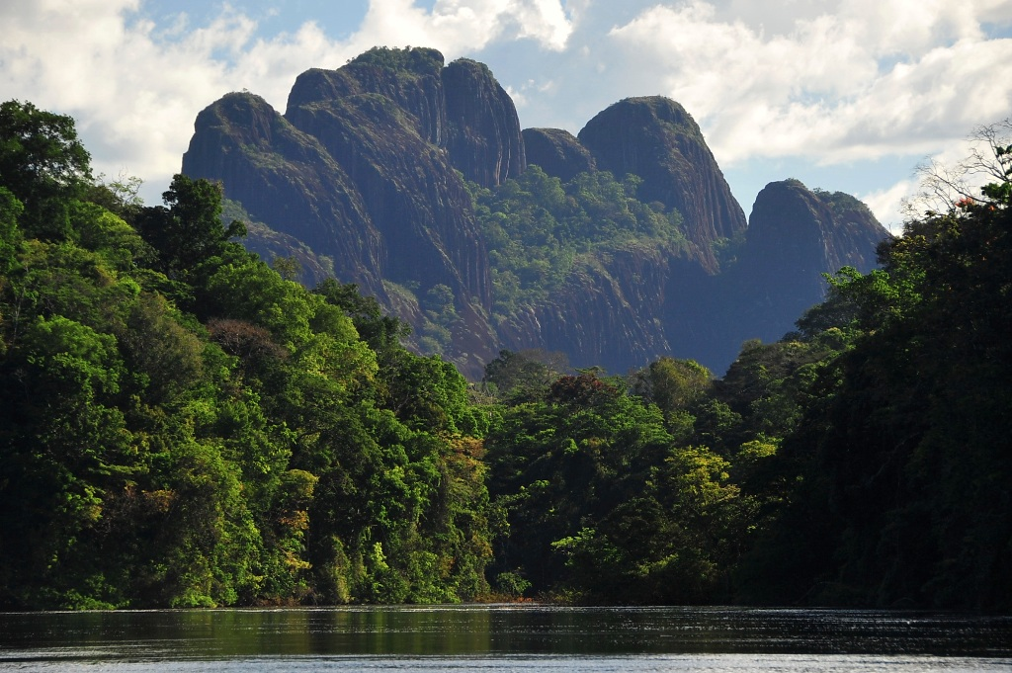
This Photo by Unknown Author is licensed under CC BY-NC
Suriname

Slide 9
The relation

Slide 10
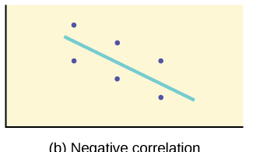
Negative correlation
This Photo by Unknown Author is licensed under CC BY

Slide 11
What are they doing differently

Slide 12

Renewable energy
This Photo by Unknown Author is licensed under CC BY

Slide 13
Conclusion
Apart From Qatar And China which were outliers, form the data and analysis done by pandas
We have a negative correlation meaning that the smaller the forest area the greater the pollution
‘’Some data indicate that increased neighbourhood green space is associated with lower surface and air temperatures as well as possible reduced exposures to air pollution at the household level. ‘’ ( Zupancic, Westmacott & Bulthuis,2015 ).
Based on my analysis and research from the David Suzuki Foundation the hypothesis were true
The greater the land size ratio the bigger the air pollutiton

