Slide 1
Evaluation of Vector-Matrix Multiplier using optical device
Koji Sato
Kyushu-University

Slide 2
Agenda
Background
Purpose
Introduction of MZI
Evaluation
Area
latency
Summary

Slide 3
Background
Needs for processing more data with low latency
Cyber physical system
Data center
Embedded system
CMOS LSI’s technical and physical limitation
Ohmic loss
Leakage current
Too high frequency

Slide 4
Background
Vector-matrix multiplier(VMM)
VMM is used in many system (e.g. neural network)
Linear transformation with optical device
Low latency, and low power consumption
MZI VMM perform at almost light speed

Slide 5
Purpose
Evaluation of Vector-Matrix Multiplier(VMM) using optical devices
Comparing optical VMM and other VMMs
Other VMM
ASIC
GPU
CPU

Slide 6

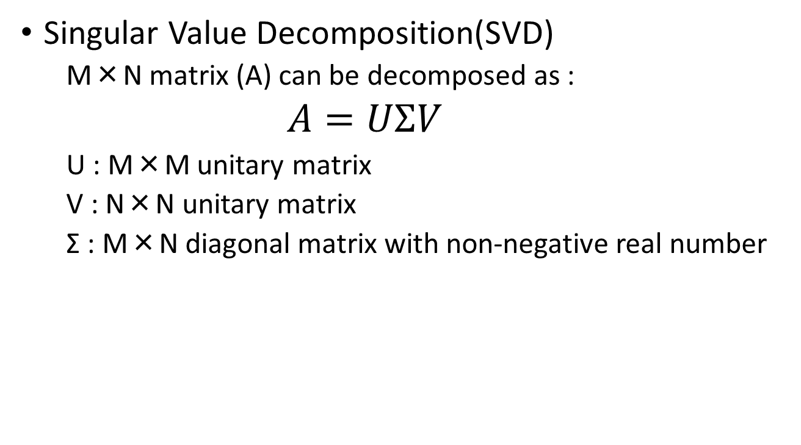
Introduction of MZI VMM
Singular Value Decomposition(SVD)
M×N matrix (A) can be decomposed as :
$A=UΣV$
U : M×M unitary matrix
V : N×N unitary matrix
Σ : M×N diagonal matrix with non-negative real number
Input
Output
Matrix A

Slide 7
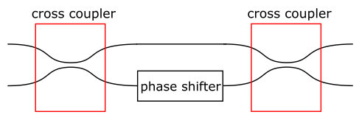
Introduction of MZI VMM
MZI(Mach-Zenhder Interferometer)
Input side
Output side
Control signal
Cross coupler : coupling two of input lightwave
Phase shifter : shift lightwave’s phase depending on control signal

Slide 8
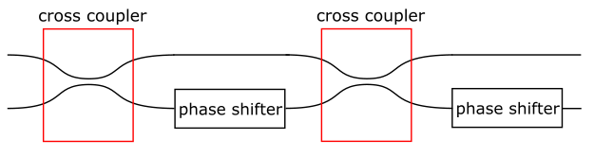
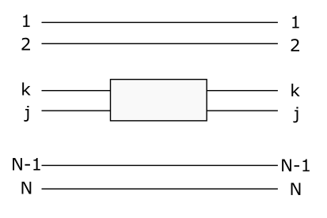
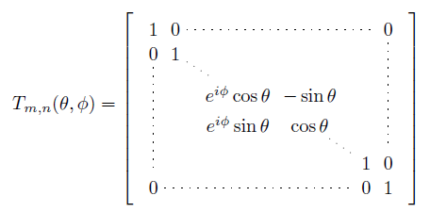


Introduction of MZI VMM
MZI unitary matrix transformation
This component corresponds to
a following matrix transformation:
$$T(θ,φ)=\left(\begin{matrix}e^{iφ}sinθ & e^{iφ}cosθ \\ cosθ & −sinθ\end{matrix}\right)$$
2θ
Φ
・・・
・・・
・・・
・・・
・・・
・・・

Slide 9
Introduction of MZI VMM

Slide 10
Introduction of MZI VMM

Slide 11

Area : evaluation
MZI VMM
Calculate from model formula
$$S={S_{S}×N+S}_{MZI}×N\left(N−1\right)+$$
$S_{AMP}×N+S_{PD}×N$
SS :size of a light source
SMZI : size of a MZI
SAMP : size of amplifier
SPD : size of photo detector
N; size of matrix

Slide 12
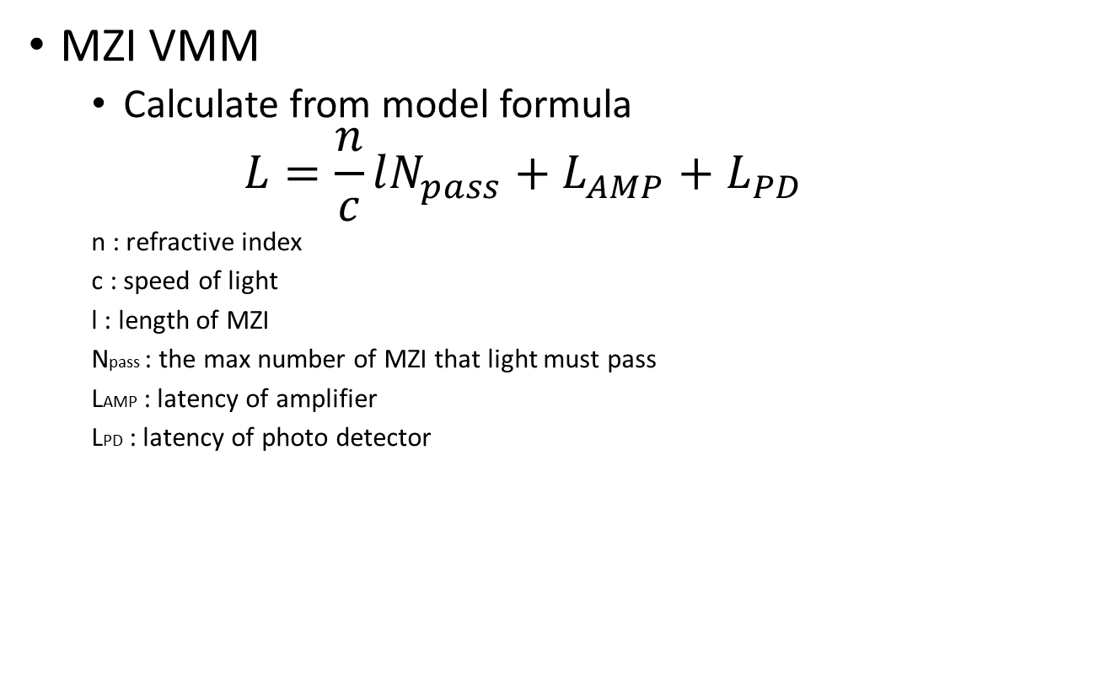
Latency :method of Evaluation
MZI VMM
Calculate from model formula
$$L=\frac{n}{c}lN_{pass}+L_{AMP}+L_{PD}$$
n : refractive index
c : speed of light
l : length of MZI
Npass : the max number of MZI that light must pass
LAMP : latency of amplifier
LPD : latency of photo detector

Slide 13
Latency :method of Evaluation
GPU
Use library CUBLAS(CUDA Basic Linear Algebra subprograms)
Run on NVIDEA Tesla k20m (354nodes)
345.6GFLOPS
Memory 128GB
Bandwidth 102.4GB
Calculate 400times and get the average time

Slide 14
Evaluation

Slide 15
Plan
Evaluate accuracy of MZI VMM
Survey about noise of optical devices
Optical amplifier
Phase shifter
Photo detector
Simulate on Optisystem
Evaluate performance of vector-matrix multiplication in other method
ASIC
CPU

Slide 16
Summary
Introduce MZI VMM
Evaluate vector-matrix multiplication
MZI VMM
GPU
Plan to survey MZI VMM’s noise

