Slide 1
Home
This is Title
Latest News in INES Lab
Menu
Categories
Home
About Us
Posts

Slide 2
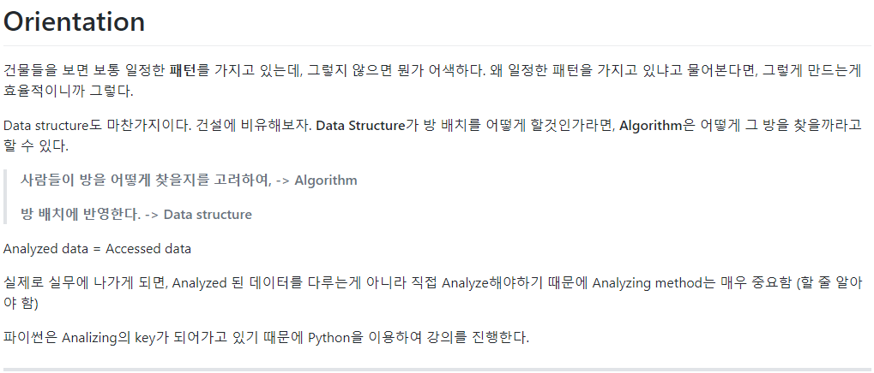
Post
Post Title
2020.06.07., Author: Jungbeom.K
Table of Contents
Orientation
Orientation

Slide 3
About Us
This is Title
Latest News in INES Lab
Menu
Categories
Home
About Us
Posts

Slide 4
Categories
This is Title
Latest News in INES Lab
Menu
Categories
Home
About Us
Posts

Slide 5
Categories

Slide 6
Home

Slide 7
About me

Slide 8
Posts
Posts
Posts

