Slide 1
Home
This is Title
Recent Posts
A Challenge to understand the needs of local readers 2021 Jun 23, Category, Author
Chromebooks get new updates for the hybrid classroom 2021 Jun 22, Category, Author
Collaboration and security in Google Workspace for Education 2021 Jun 21, Category, Author
Collaboration and security in Google Workspace for Education 2021 Jun 20, Category, Author
Collaboration and security in Google Workspace for Education 2021 Jun 19, Category, Author
Up in the Air
Categories
Home
About Us
Posts

Slide 2
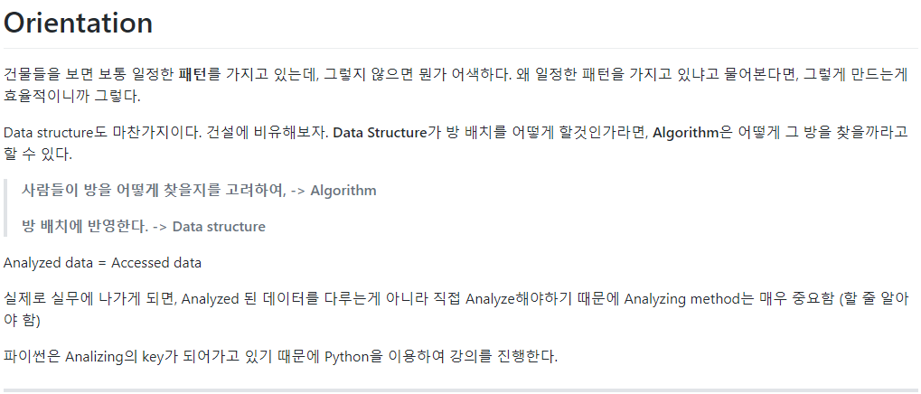
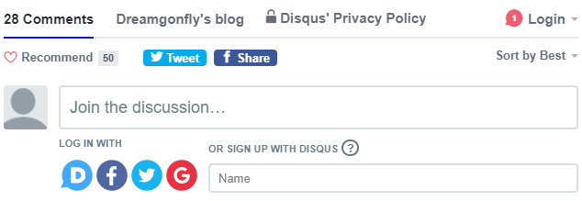
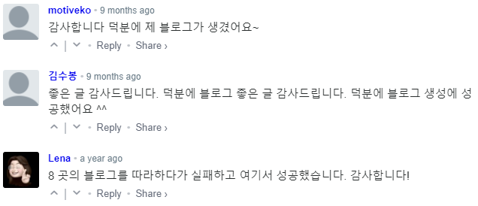
Post
Post Title
2020 June 7, Author: Jungbeom.K
Table of Contents
Orientation
Orientation

Slide 3



About Us
About Us
Team Members
Name
“ Blah blah blah.”
Name
“ Blah blah blah.”
Categories
Home
About Us
Posts

Slide 4
Categories
This is Title
Latest News in INES Lab
Menu
Categories
Home
About Us
Posts

Slide 5
Categories

Slide 6
Home

Slide 7
About me

Slide 8
Posts
Posts
Posts

