Slide 1
CS 4476 Project 1
Kok Jian Yu
jkok7@gatech.edu
jkok7
903550380

Slide 2
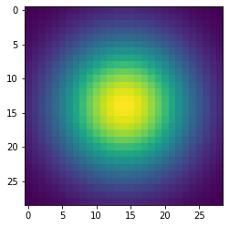
Part 1: Image filtering
Using the cutoff_frequency, calculate k, mean and std.
Calculate range of x, which is from mean – k/2 to mean + k/2.
Create 1D gaussian kernel using the formula.
Do an outer product of 1D gaussian kernel with 1D gaussian kernel to get a 2D gaussian kernel.
Normalize the 2D gaussian kernel to sum up to 1.

Slide 3
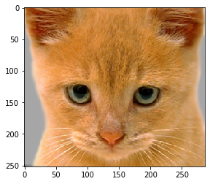

Part 1: Image filtering
Identity filter
Small blur with a box filter

Slide 4
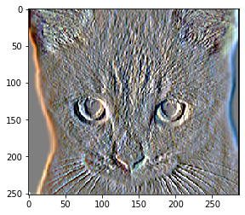
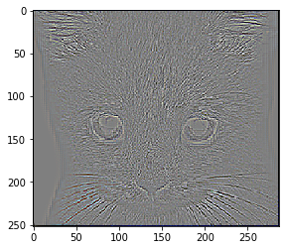
Part 1: Image filtering
Sobel filter
Discrete Laplacian filter

Slide 5
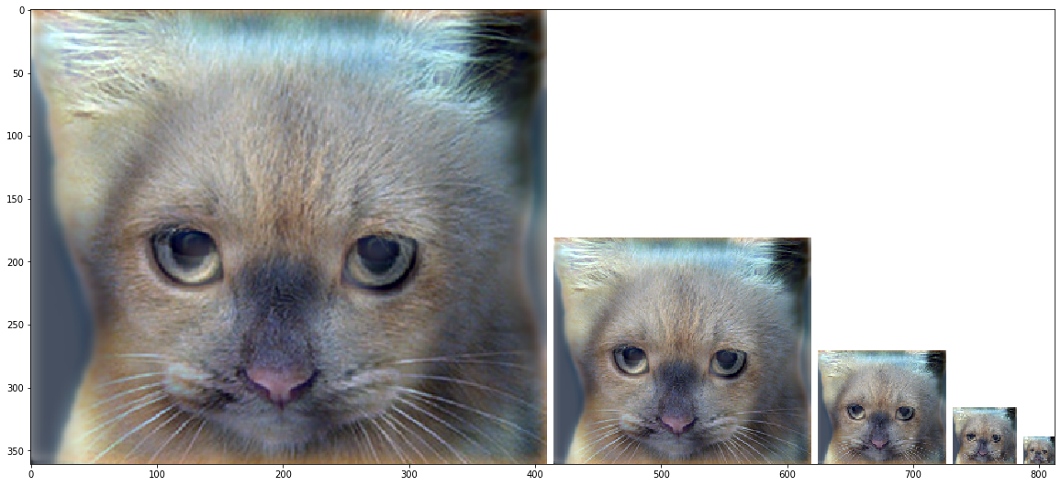
Part 1: Hybrid images
Calculate low frequency for image1 by calling my_imfilter method with image1 and the filter.
Calculate low frequency for image2 by calling my_imfilter method with image2 and the filter.
Calculate high frequency for image 2 by subtracting each value for image 2, with the low frequency value for image 2.
Calculate the hybrid image by summing up the low frequency for image1, and high frequency for image2, and performing clip to ensure values are from 0 to 1.
Cat + Dog
<insert your hybrid image here>
Cutoff frequency: 7

Slide 6
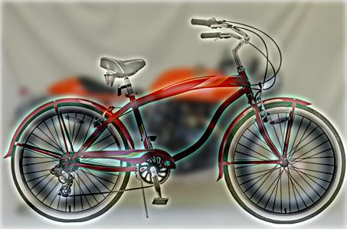
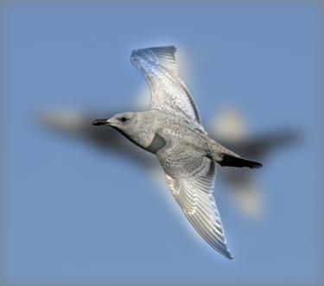
Part 1: Hybrid images
Motorcycle + Bicycle
<insert your hybrid image here>
Cutoff frequency: 4
Plane + Bird
<insert your hybrid image here>
Cutoff frequency: 9

Slide 7
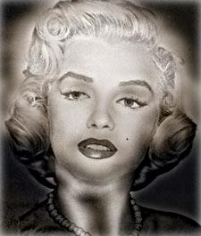
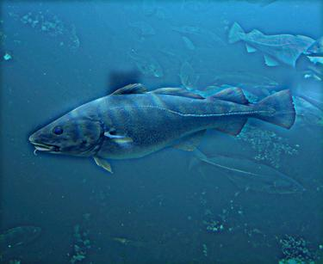
Part 1: Hybrid images
Einstein + Marilyn
<insert your hybrid image here>
Cutoff frequency: 5
Submarine + Fish
<insert your hybrid image here>
Cutoff frequency: 4

Slide 8
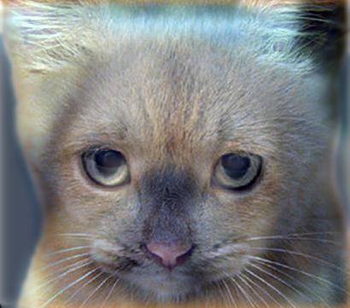
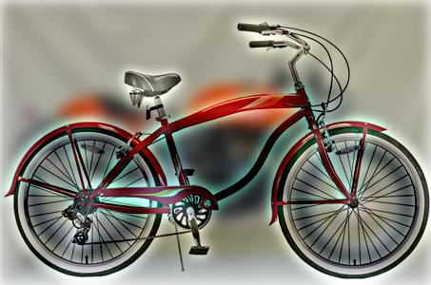
Part 2: Hybrid images with PyTorch
Cat + Dog
<insert your hybrid image here>
Motorcycle + Bicycle
<insert your hybrid image here>

Slide 9

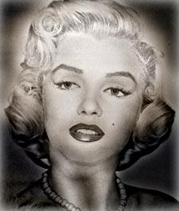
Part 2: Hybrid images with PyTorch
Plane + Bird
<insert your hybrid image here>
Einstein + Marilyn
<insert your hybrid image here>

Slide 10
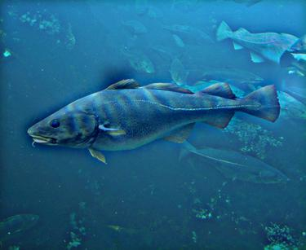
Part 2: Hybrid images with PyTorch
Submarine + Fish
<insert your hybrid image here>
Part 1 vs. Part 2
<Compare the run-times of Parts 1 and 2 here, as calculated in proj1.ipynb. What can you say about the two methods?>
Part 1: 6.090s Part 2: 3.544s
From this, we can say that pytorch is more optimized for such operations compared to simply using numpy.

Slide 11
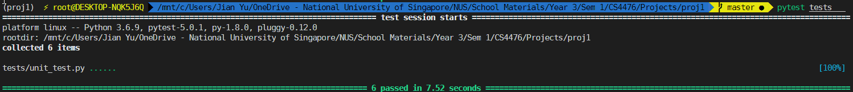
Tests
<Provide a screenshot of the results when you run `pytest tests` on your final code implementation (note: we will re-run these tests).>

Slide 12
Conclusions
I have learned that for hybrid image, the images to be merged, and the cutoff frequency must be chosen carefully for the results to look decent. For example, for the cat and dog example, simply swapping the image (cat to low freq, dog to high freq) causes the image to look extremely weird.
It is also hard to get some hybrid images to be as good as the cat and dog hybrid image despite tweaking the cutoff frequency due to the background differences.

