Slide 1
CS 4476 Project 5
Kok Jian Yu
jkok7@gatech.edu
903550380

Slide 2
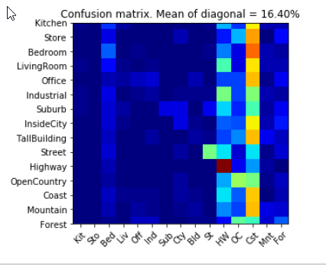
Part 1: Your confusion matrix, together with the accuracy for Part 1 with the standard param set (image_size = 16, k = 3)
<Screenshot here>

Slide 3
Part 1: Experiments: change image size and k individually using the following values, and report the accuracy (when tuning one param, keep the other as the standard (16 x 16, 3)):
ie. when you’re tuning image size, keep k at 3, when changing k, keep image size as 16x16
image size:
8 x 8: 17.27%
16 x 16: 16.40%
32 x 32: 14.73%
k:
1: 14.73%
3: 16.40%
5: 16.20%
10: 14.93%
15: 14.27%

Slide 4
Part 1: Reflection: when tuning the parameters, what have you observed about the processing time and accuracy? What do you think might lead to this observation?
Larger image size and larger K resulted in a longer processing time. A larger image size resulted in a lower accuracy, and increasing K initially increased the accuracy, but it decreases if it is increased too much.
For K, if the value is too low, the model is probably overfitting. If value is too high, the model is probably underfitting. Therefore, it performs worst when not the at “optimal” range of K when the model is neither overfitting nor underfitting.
For image size, having a larger image will result in a longer time required to calculate distance between pairs. Accuracy also reduced if image gets larger as it is less likely for images with same label to be similar to each other.

Slide 5
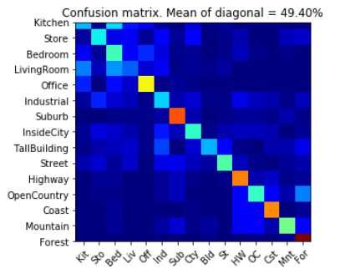
Part 2: Your best confusion matrix, together with the accuracy for Part 2. Also report your param settings to get this result.
<Plot here>
Param settings:
vocab_size: 100
stride (build_vocab): 20
step_size(get_bags_of_sifts): 5
max_iter (k-means): 100
k (kNN): 3

Slide 6
Part 2: Reflection: when experimenting with the value k in kNN, what have you observed? Compare this performance difference with the k value experiment in Part 1, what can you tell from this?
The performance is best when K is at 2 and 3, and drops when K is smaller than 2 or larger than 3.
When compared together with part 1, it shows the same trend, where the performance increases at around 3, and decreases after 3.
This tells me that for k nearest neighbour, the optimal value of K seems be around 3 no matter the dataset we are using.

Slide 7
Reflection on Tiny Image Representation vs. Bag of Words with SIFT features
Why do you think that the tiny image representation gives a much worse accuracy than bag of words? As such, why is Bag of Words better in this case?
Tiny images resize the image to a smaller resolution. This results in a loss of data. In bag of words, we are using the entire image to form the features. Therefore, it makes sense that bag of words performs better as it actually utilises most of the data, unlike tiny images which lost a lot of data due to resizing.

Slide 8
Conclusion: briefly discuss what you have learned from this project.
I have learned how does k-means and k nearest neighbour algorithm works.
I have also learned more about Tiny Image representation & nearest-neighbour classification and also on Bags of SIFT features. I gained more insight on how these algorithms works and what are some of the reasons as to why it doesn’t work very well.

Slide 9
Code and Misc. (DO NOT modify this page)
Part 1
Part 2
Late hours
Violations

Slide 10
Extra Credit
<Discuss what extra credit you did and analyze it. Include images of results as well >

