Slide 1
CS 4476 Project 4
Name
GT Email
GT ID

Slide 2
Part 1

Slide 3
What is the relation between disparity map and depth? [Text/Equations/Drawing whatever you feel is relevant]
<Solution here>
Random dot stereogram image [51x51x3] + Can you judge depth by looking them?
<copy plot here>
<Text here>

Slide 4
Random dot stereogram disparity maps
<Insert all images here>
What is the effect of increasing the block size? Explain the reasoning behind it?
<Text solution here>

Slide 5
Random dot stereogram: Why is the result poor on the left edge and not on the other edges?
<Text solution here>
Convex error profile: Input patch, search strip, error profile
<Copy images here>

Slide 6
Non-convex error profile: Input patch, search strip, error profile
<Copy images here>
Convex error profile: Can you generalize the type of regions which will generate convex profiles?
<Text here>

Slide 7
Nonconvex error profile: Can you generalize the type of regions which will generate non-convex profiles?
<Text here>
Disparity map for Set 1 (for 3 patch sizes)

Slide 8
Set 1: Can you think of an explanation as to why the backrest of the chair appears blocky?
<Text solution here>
Set 4 disparity maps (only one path size)
<Copy images here>

Slide 9
Set 3, 4: peculiar behaviour of the disparity maps near right bowling pin: what do you see in input there and can you explain disparity map there?
<Text solution here>
Set 6: Gradual shift in disparity values on the wall
<Text solution here>

Slide 10
Set 6: Effect on block size on the stairs in disparity maps
<Text solution here>

Slide 11
Smoothing
Compare these results on the chair image qualitatively to the output of the chair image without smoothing.
2. What regions of the image does smoothing seem to perform better on and why do you think that is?

Slide 12
Smoothing(contd.)
3. What regions of the image does smoothing seem to perform worse on and why do you think that is?
4. Would smoothing still work for images with both a horizontal and vertical shift?

Slide 13
Part 2

Slide 14
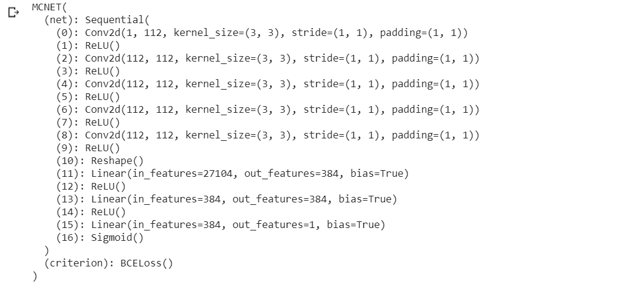
Copy the output of print(net_tr) from the notebook here. You can use screenshot instead of text if that’s easier.
<Text here>
What's the purpose of ReLU and why do we add it after every conv and fc layers?
<Text here>

Slide 15
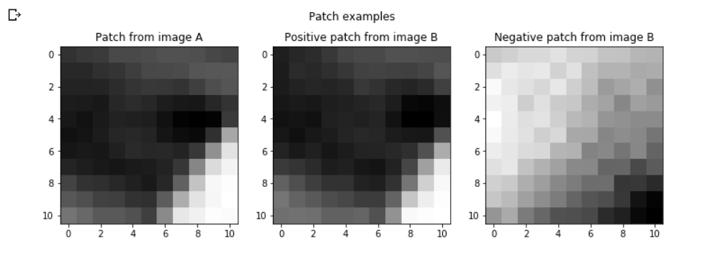
Show the patch example from your gen_patch function.
<Copy figure image here>
Giving a true disparity map for each stereo pair, how do we extract positive and negative patches for the training?
<Text here>

Slide 16
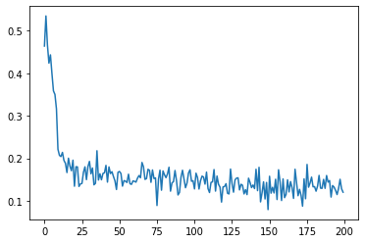
Copy the training loss plot and the final average validation loss of your best network
<Copy figure image here>
How does changing learning rate (try using large (> 1) vs small value (< 1e-5)) effect the training? Why?
Higher learning rate made the training loss plot have more variance (plot looks more unstable), but loss is reduced quickly over the epochs.
However, learning rate that is too high resulted in a situation where the training loss is constantly high, and never drops.
Lower learning rate made the plot have lower variance, but loss is reduced slower over the epochs.
Higher learning rate → Hard to hit minimum loss, values might change too much, resulting in a higher loss than before as it moves past the minimum point.
Lower learning rate → Easier to get to minimum loss, but trains slower as moves slowly.

Slide 17
What's the difference between Adam and SGD? What do you notice when switching between them?
<Text here>
Training loss in SGD seems to drop at a slower rate compared to Adam when given the same learning rate.
Is your validation loss lower or higher than your training loss? What is the reason for that? How would we get a better validation loss?
Higher. We trained on the training data, which means that it can probably predict the training data better compared to the test data.
To get a better validation loss, we need to allow the model to generalise better to the test data, and not overfit to the training data. One way to do this can be to reduce the learning rate (Not too much) to prevent overfitting.

Slide 18
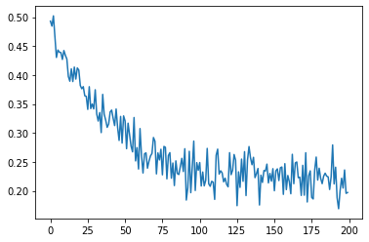
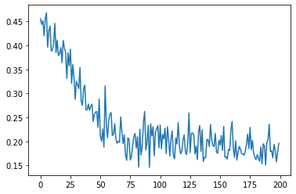
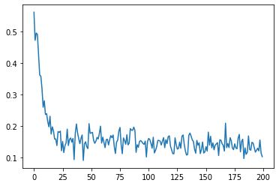
Copy the training loss plot and the final average validation loss of the networks with different window sizes
WS=5 WS=9
WS=11 WS=15
What's the effect of varying the window size on performance? Do you suppose there is an optimal window size for all images? Explain why or why not.
Increasing the window size seems to reduce the validation loss.
<Text here>

Slide 19
Copy the training loss plot and the final average validation loss of your extended network, as well as the network layer list.
<Copy figure image here>
What layers did you add? What's the effect of adding more layers without adding more data? Why?
<Text here>

Slide 20
Show the matching cost comparison plot between SSD/SAD/MCCNN
<Copy figure image here>
Based on the matching cost comparison plot, how are SSD, SAD, and MC-CNN different? Can you think of a scenario where matching with MC-CNN would be prefered over SSD/SAD?
<Text here>

Slide 21
Show the disparity map comparison between SAD and MCCNN
<Copy figure image here>
Qualitatively, between SAD and MCCNN, which disparity map do you think looks better? Explain your reasoning.
<Text here>

Slide 22
Show the quantitative evaluation between SAD and MCCNN (average error, etc.)
<Text or screenshot here>
Quantitatively, between SAD and MCCNN, which one achieve better score on the metrics? Why do you think that's the case?
<Text here>

Slide 23
Extra Credit
<Discuss What extra credit you did and analyze it. Include Images of results as well >

