Slide 1
Feature Engineering
AN INTRODUCTION
Improve the input, improve the prediction
Learning linear regression by predicting students’ math scores

Slide 2
The Big Idea
Key point: keep the model fixed and improve the input features to raise accuracy
Part 1: tidy the columns we already have
Part 2: add new columns and avoid data leakage
The big picture
Improve the input (features)
→
Same model
→
Higher accuracy
Part 1 Tidying existing columns
1

Slide 3
Tidying the Columns We Already Have
Part 1
Feature engineering: select and transform

Slide 4
Recap: From Data Prep to Deployment
Scenario: a model that predicts whether a new customer will churn
Stages: ① data preparation ② training and validation ③ deployment
Problem: accuracy turned out to be low at stage ②
The flow
① Data preparation
→
② Training and validation
→
③ Deployment
Low accuracy was found at stage ②.
Part 1 Tidying existing columns
3

Slide 5
Recap: The Big Picture
Input: the data we give the model
Model: learns patterns from the input
Output: the prediction
Churn prediction example
Customer data
→
Model
→
Churn / Stay
Part 1 Tidying existing columns
4

Slide 6
Recap: How to Improve a Model
Wrong predictions mean low model accuracy
Diagnose the symptom first, then choose the fix
Overfitting → add more data, stop training early
Underfitting → add more features
Symptom and fix
Symptom | Fix
Overfitting | Add more data / stop training early
Underfitting | Add more features
Part 1 Tidying existing columns
5

Slide 7
Today’s Focus
Input ← today (add features)
Model ← last week
Output
What we cover today
Input (today)
→
Model (last week)
→
Output
Part 1 Tidying existing columns
6

Slide 8
Adding Features (1): Churn Prediction
Scenario: predict whether a new customer will churn
Before: 5 features used for training
Now: increase to 10 features
More behavioral information makes patterns easier to find
Before (5 features)
Support calls, months subscribed, plan type, days since last login, product modules used
Now (10 features)
The 5 above + monthly logins, payment failures, contract type, days since last support call, average session time
→ Churn / Stay
Part 1 Tidying existing columns
7

Slide 9
Adding Features (2): Exam Score Prediction
Scenario: predict a student’s exam score
Before: 5 features used for training
Now: add features to give the model more information
The idea is the same in any field
Before (5 features)
Weekly study hours, attendance rate, past exam score, homework completion rate, sleep hours
Now (8 features)
The 5 above + class participation count, quiz average, cram school attendance
→ Exam score
Part 1 Tidying existing columns
8

Slide 10
What Is a Feature?
In churn prediction, it is customer behavior data
In machine learning, we call it a “feature”
It is also called a “variable”
Examples
Months subscribed
Monthly fee
Login count
＝
Features
Part 1 Tidying existing columns
9

Slide 11
What Is Feature Engineering?
Definition: the process of selecting, transforming, and creating input variables (features) from raw data
Goal: help machine learning learn patterns and improve prediction accuracy
Position: after raw data, before model training
Where it fits
Raw data
→
Feature engineering
→
Clean data
→
Model training
Part 1 Tidying existing columns
10

Slide 12
Types of Feature Engineering
Select: choose the relevant variables
Transform: reformat existing variables
Create: build new features from existing ones
Examples
Type | Example
Select | Drop customer name, keep monthly fee
Transform | Weather (text) → 0/1 columns
Create | Submitted ÷ total → submission rate
Part 1 Tidying existing columns
11

Slide 13
Select
Choose the relevant variables from the raw data
Judge each column by its link to churn
Only the necessary columns remain
① Raw data
Customer ID, name, sign-up date, phone number, monthly fee, contract type, months subscribed, favorite color, support calls, churned
② Pick
③ Clean data
Column | Verdict | Reason
Name | Drop | No link to churn
Monthly fee | Keep | Price sensitivity
Contract type | Keep | Higher churn risk
Monthly fee | Contract type | Months subscribed | Support calls | Churned
89.50 | Monthly | 4 | 5 | Yes
Part 1 Tidying existing columns
12

Slide 14
Today’s Data
Predict the number of bikes rented
Hourly data (date-time, weather, temperature, humidity, holiday)
Target column: rentals (bikes rented in that hour)
Columns in the data
Column | Type | Meaning
datetime | Datetime | Hourly, e.g. 2026-04-01 00:00
weather | Text | sunny / cloudy / rainy
temp | Number | Temperature (°C)
humidity | Number | Humidity (%)
holiday | 0/1 | 1 on weekends and holidays
rentals | Number | Bikes rented in that hour (the target)
Part 1 Tidying existing columns
13

Slide 15
Transform
Convert raw data into a format machine learning can learn from
Example 1: turn text columns into 0/1 columns
Example 2: put numbers on a similar scale
Examples
Method | Example
One-hot encoding | Weather (sunny / cloudy / rainy) → 0/1 columns
Scaling | Temperature (10, 20, 30 °C) → 0, 0.5, 1
Part 1 Tidying existing columns
14

Slide 16
One-Hot Encoding
Turn a text column into several 0/1 columns
Models handle numbers (0/1) better than text
Only the matching category’s column becomes 1
Before
After
datetime | weather | temp
2026-04-01 00:00 | sunny | 9.5
2026-04-01 01:00 | rainy | 9.4
2026-04-01 02:00 | cloudy | 11.0
weather_cloudy | weather_rainy | weather_sunny | temp
0 | 0 | 1 | 9.5
0 | 1 | 0 | 9.4
1 | 0 | 0 | 11.0
The other columns (humidity, holiday, rentals) stay unchanged.
Part 1 Tidying existing columns
15

Slide 17
Exercise (Part 1)
Goal: see that these operations can be done with sklearn / pandas
Q0: load the data
Q1: select the relevant columns
Q2: one-hot encode the text column
How it works
Code is pre-written
→
Run top to bottom
→
Check the results
Part 1 Tidying existing columns
16

Slide 18
Recap
Problem: underfitting is keeping accuracy low
Solution: improve the input side, not the model
Select, transform, and create features
This whole process is called feature engineering
The big picture
Improve the input
→
Feature engineering
Part 2 Adding new columns
17

Slide 19
Recap: Feature Engineering
Select: choose useful columns (done)
Transform: one-hot encoding (done), min-max scaling, standardization
Create: aggregate features, target encoding
Types and methods
Type | Methods
Select | Choose useful columns
Transform | One-hot encoding / min-max scaling / standardization
Create | Aggregate features / target encoding
Part 2 Adding new columns
18

Slide 20
Part 2: The Big Idea
Add new, useful columns that help models learn
Transform: put numbers on the same scale (min-max scaling, standardization)
Create: aggregate features
Today’s goal
Match the scale of columns
＋
Create new columns
Part 2 Adding new columns
19

Slide 21
Transform: Min-Max Scaling
Definition: resize numbers so every column plays on a fair, even field
Machine learning trains more easily on resized inputs
Problem: columns such as age and price differ hugely in scale
Solution: rescale every column to the range 0 to 1
The scale gap
Age: 1–10
⇔
Price: 100,000–500,000
Part 2 Adding new columns
20

Slide 22
Min-Max Scaling Example
In each column, the minimum becomes 0 and the maximum becomes 1
Age and price now share the same range (0 to 1)
The order of the values does not change
Before and after
Age (before) | Price (before) | → | Age (after) | Price (after)
1 | 500,000 | → | 0.00 | 1.00
4 | 200,000 | → | 0.33 | 0.25
6 | 100,000 | → | 0.56 | 0.00
10 | 400,000 | → | 1.00 | 0.75
Part 2 Adding new columns
21

Slide 23
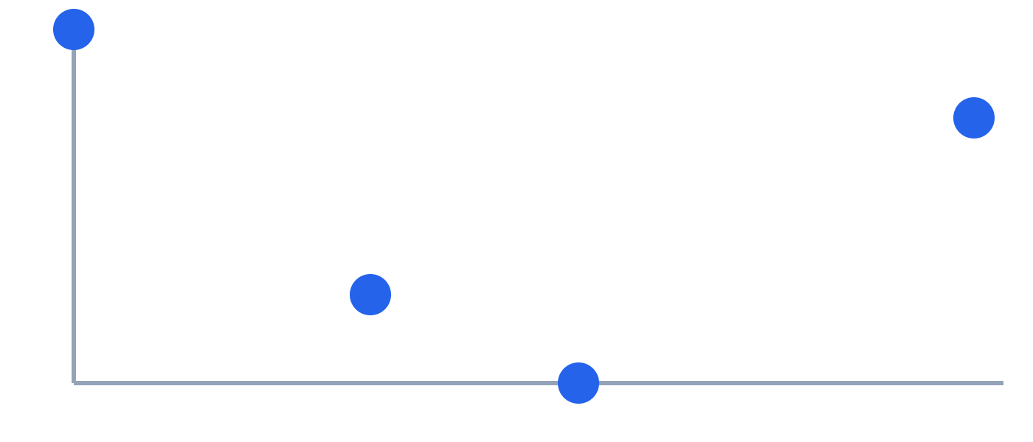
Min-Max Scaling in a Chart
Before: the horizontal and vertical ranges differ greatly
After: both axes fall within 0 to 1
The positions of the points relative to each other (the shape) are preserved
Before
After
Horizontal: age (1–10) / Vertical: price (100k–500k)
Horizontal: age (0–1) / Vertical: price (0–1)
Part 2 Adding new columns
22

Slide 24
Transform: Standardization
Rescale every feature to mean 0 and standard deviation 1
The range is not fixed (for example, −1.3 to +1.45)
Unlike min-max scaling, values need not fall within 0 to 1
Compared with min-max scaling
Item | Min-max scaling | Standardization
How it scales | Min 0, max 1 | Mean 0, std dev 1
Range | 0 to 1 (fixed) | Not fixed
Part 2 Adding new columns
23

Slide 25
Standardization Example
Values above the mean become positive; values below become negative
Age and price can be compared on one scale
Values spread out, for example from −1.3 to +1.45
Before and after
Age (before) | Price (before) | → | Age (after) | Price (after)
1 | 500,000 | → | −1.30 | +1.26
4 | 200,000 | → | −0.38 | −0.63
6 | 100,000 | → | +0.23 | −1.26
10 | 400,000 | → | +1.45 | +0.63
Part 2 Adding new columns
24

Slide 26
Creating New Columns
Create new columns from raw data
Type 1: create simply
Type 2: aggregate features
Examples
Type | Example
Simple creation | Submitted ÷ total → submission rate
Aggregate features | Purchase history → average spend
Part 2 Adding new columns
25

Slide 27
Creating a New Column Simply
Scenario: a model that predicts student exam scores
Combine existing columns into a new feature
A submission rate says more than submitted and total separately
The two original columns can be dropped
Before
After
Student ID | Homework submitted | Homework total | Study hours
1 | 8 | 10 | 12
2 | 9 | 12 | 8
3 | 5 | 10 | 3
Student ID | Homework rate | Study hours
1 | 0.80 | 12
2 | 0.75 | 8
3 | 0.50 | 3
Part 2 Adding new columns
26

Slide 28
Aggregate Features
Combine multiple rows or features into a new column
Scenario: predicting which Rakuten customers will spend more
New column: average spend
Useful for reducing the data to one row per person
Before
After
User | Day | Spend
A | Thu | 1,200
A | Mon | 800
B | Thu | 3,000
B | Mon | 2,000
User | Day | Spend | Average spend
A | Thu | 1,200 | 1,000
A | Mon | 800 | 1,000
B | Thu | 3,000 | 2,500
B | Mon | 2,000 | 2,500
Part 2 Adding new columns
27

Slide 29
Exercise (Part 2)
Goal: see that these operations also work with sklearn / pandas
Q3: scale the numbers (6 min)
Q4: create a simple new column (5 min)
Q5: create an aggregate feature (8 min)
How it works
Code is pre-written
→
Run top to bottom
→
Check the results
Part 2 Adding new columns
28

Slide 30
Linear Regression: The Big Picture
Big idea: find the relationship between inputs and outputs in data
Problem: a new student’s math score is unknown before the exam
Solution: learn the relationship from past students, then predict the score
One method for this is linear regression
Predicting math scores
Past students’ data
→
Learn the relationship
→
Predict a new score
Data: study hours, attendance rate, homework rate → math score
Introduction to linear regression
29

Slide 31
Regression vs. Classification
Regression: predicts a number
Classification: predicts a category (group)
Linear regression is a typical regression method
Math score example
Item | Regression | Classification
Predicts | A number | A category
Example | Predict 72 points | Predict pass / fail
Introduction to linear regression
30

Slide 32
Linear Regression Basics
Multiply each feature by a “weight” and add them up to predict the output
The larger the weight, the greater that feature’s influence
Training means finding the weights that make predictions accurate
Math score formula (3 features)
Math score = baseline
+ weight 1 × study hours
+ weight 2 × attendance rate
+ weight 3 × homework rate
Introduction to linear regression
31

Slide 33
Example: Predicting a Math Score
Features: study hours, attendance rate, homework rate (3 in total)
Training determines the weights (example values below)
Plug in the weights to predict a new student’s score
Formula learned in training (example)
Math score = 20 + 1.5 × study hours + 30 × attendance rate + 20 × homework rate
Student | Study hours | Attendance | Homework rate | Predicted score
A | 10 | 0.9 | 0.8 | 78 pts
B | 5 | 0.7 | 0.5 | 58.5 pts
Introduction to linear regression
32

Slide 34
Linear Regression in a Bit More Detail
Reading a weight: the change when a feature rises by 1, other things equal
Error: the gap between predicted and actual scores; smaller is better
Training: find the weights that minimize error (least squares)
The better the features, the higher the accuracy (today’s exercise)
Reading the weights (example)
Study time +1 hour → predicted score +1.5 points
Attendance rate +0.1 → predicted score +3 points
Error example
Actual score 80, predicted 78 → error of 2 points
Introduction to linear regression
33

