Slide 1

TRANSNATIONAL CRIME & THE LIMITS OF INTERNATIONAL JUSTICE
What the Epstein Case Reveals
A case study in cross-border exploitation, jurisdiction, and accountability
PRESENTED BY
Yusuke Muteki
Kai Robinson
Naoki Hayashi
Koki Kato
1120240018
1120240025
1120240007
1120230009
Group Presentation • May 2026

Slide 2



OVERVIEW
Our Central Question & Roadmap
Why is transnational sexual exploitation so hard to prosecute — and what do international law and cross-border cooperation need in order to work?
PART 1
Framing & the international scope of the case
PART 2
The legal framework — Palermo Protocol, UNTOC, jurisdiction & extradition
PART 3
Wealth, mobility, and the problem of "elite impunity"
PART 4
Accountability, transparency & lessons (incl. a Japan comparison)
This presentation centres victims and legal systems — not sensational detail.
02 / 20

Slide 3
01
SECTION 1 OF 4
Framing & the
International Scope
Who Epstein was — and why this case crosses borders
03 / 20

Slide 4
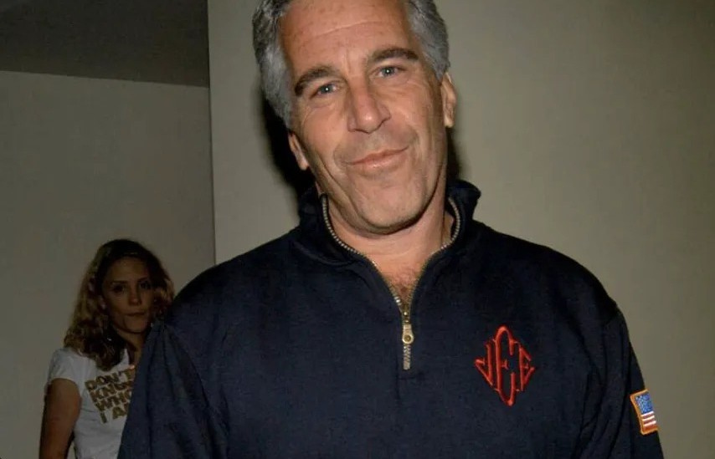
PART 1 • BACKGROUND
Who Was Jeffrey Epstein?
• A US financier who built vast wealth and a network of powerful international contacts.
• 2005–06: A Palm Beach (Florida) police investigation into abuse of minors.
• 2008: A controversial state plea deal; he registered as a sex offender.
• 2019: Arrested on federal sex-trafficking charges in New York.
• Died in custody in August 2019 (ruled a suicide), ending the criminal case.
WHY HE MATTERS HERE
His death meant accountability had to be pursued through others — and across borders.
The crime was global; the criminal case ended at one nation's border.
04 / 20

Slide 5
PART 1 • CHRONOLOGY
A Case That Spanned Two Decades
2008
2019
2021
2025
Florida state plea deal — widely criticised as lenient.
Federal trafficking charges in New York; death in custody.
Ghislaine Maxwell convicted of sex-trafficking conspiracy.
Document-release wave renews scrutiny and debate.
From a local plea bargain to a global question about justice, wealth and cross-border accountability.
05 / 20

Slide 6
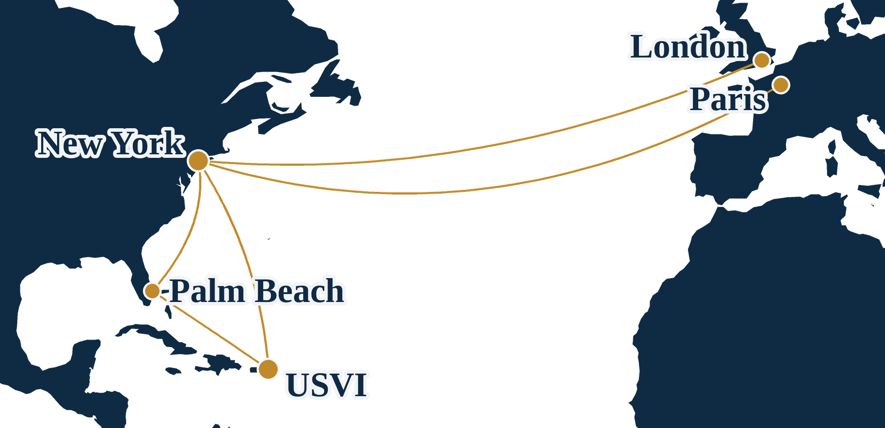
PART 1 • SCOPE
Why This Is an International Story
• Recruitment: victims, including minors and foreign nationals, moved across borders.
• Finance: wealth held through offshore structures, obscuring ownership.
• Property: residences across the US, the US Virgin Islands and Paris.
• Identity: an expired passport bore his photo, a false name, and listed Saudi Arabia as residence.
• Network: associates spanning several countries and high office.
THE CORE TENSION
The network was global; enforcement is national. That gap is the heart of this case.
A global network meets national enforcement — and falls through the gaps.
06 / 20

Slide 7
02
SECTION 2 OF 4
The International
Legal Framework
How international law addresses crime that crosses borders
07 / 20

Slide 8
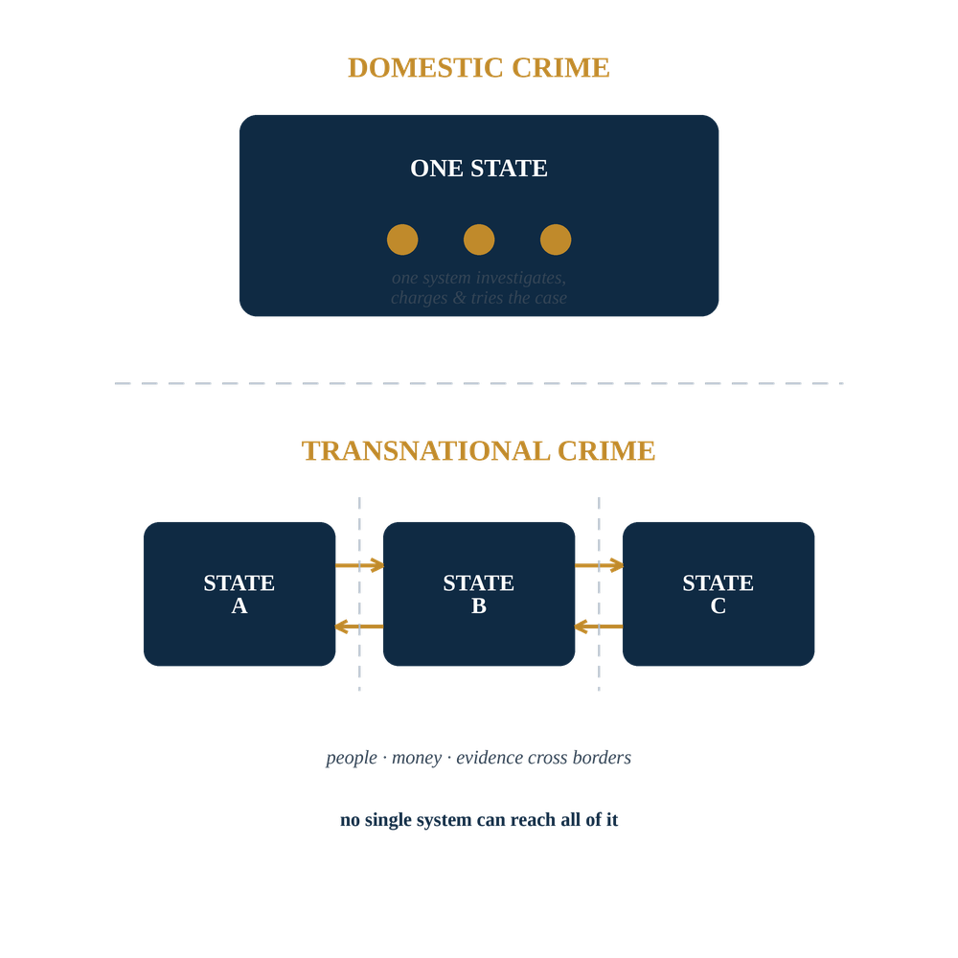
PART 2 • CONCEPTS
What Makes a Crime "Transnational"?
• Committed in more than one state — or planned, directed or felt across borders.
• Trafficking is the paradigm case: it moves people, money and evidence between countries.
• Prosecuting it needs several countries' police, courts and laws to act together.
• Domestic systems, built for domestic crime, come under strain.
The question is institutional, not just moral: can sovereign systems coordinate fast enough?
08 / 20

Slide 9
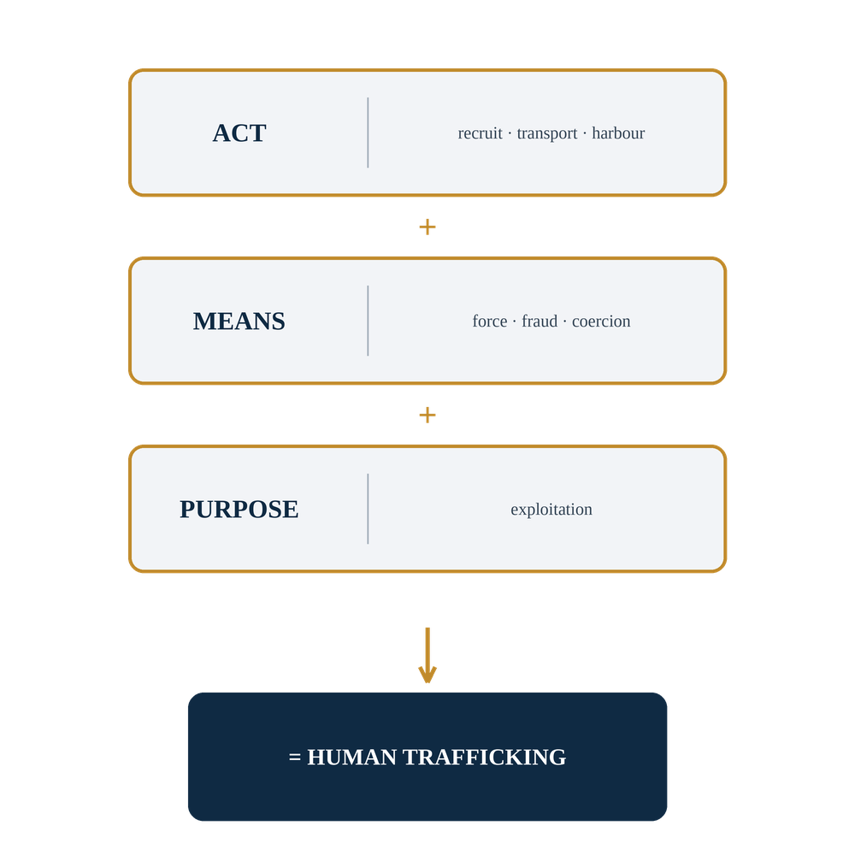
PART 2 • INSTRUMENTS
The Palermo Protocol (2000)
• The first globally agreed definition of human trafficking (UN, 2000).
• Built from three elements: act + means + purpose of exploitation.
• For children, the "means" element is not required.
• Obliges 190+ states parties to criminalise trafficking at home.
It gives 190+ states a shared vocabulary — a precondition for cooperation.
09 / 20

Slide 10
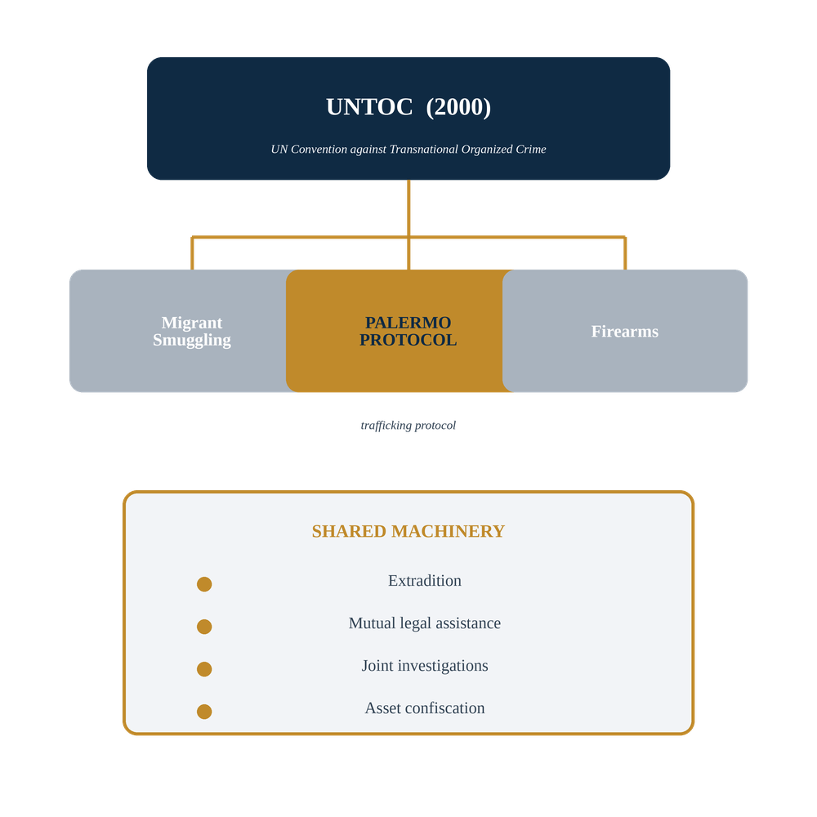
PART 2 • INSTRUMENTS
UNTOC & Cross-Border Cooperation
• Parent treaty: the UN Convention against Transnational Organized Crime.
• The Palermo Protocol supplements it; the two operate together.
• A framework for extradition, mutual legal assistance and joint investigations.
• Can be the legal basis for cooperation even with no bilateral treaty.
In short: the machinery for international cooperation already exists on paper.
10 / 20

Slide 11
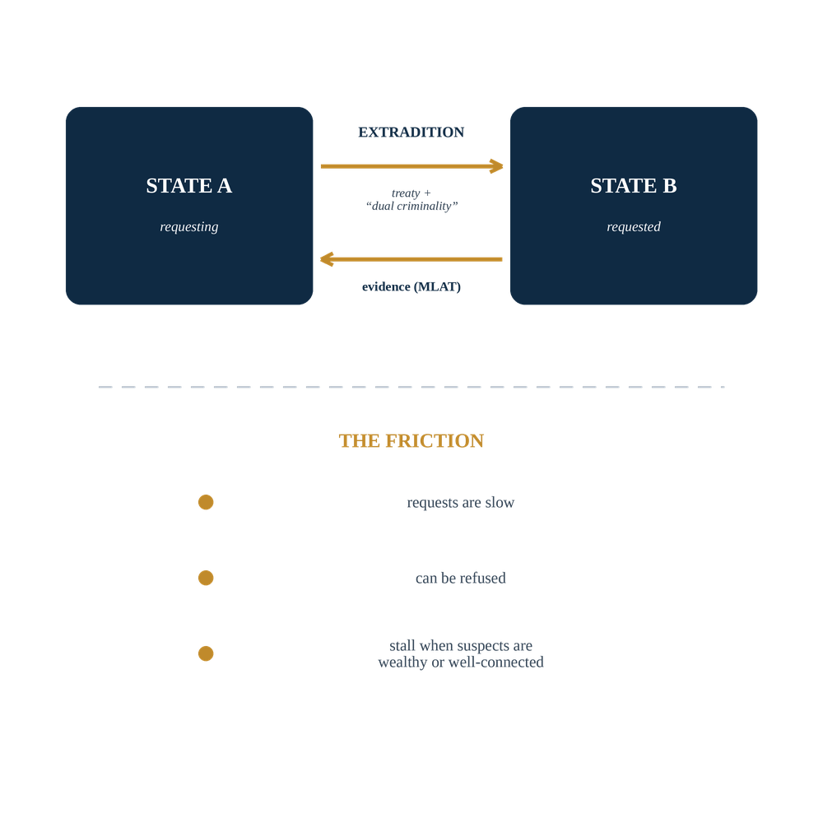
PART 2 • ENFORCEMENT
Jurisdiction, Extradition & MLATs
• Jurisdiction: claimed by territory, or by nationality of offender/victim.
• Several states may have a concurrent right to prosecute.
• Extradition needs a treaty plus "dual criminality."
• MLATs move evidence and testimony across borders — but slowly.
The tools exist — but speed and political will decide whether they work.
11 / 20

Slide 12

PART 2 • ACTORS
Foreign Nationals & Quasi-Diplomatic Figures
• Ghislaine Maxwell (UK): convicted in 2021 in a US court.
• Prince Andrew (UK): settled a US civil claim in 2022; later stepped back from royal titles.
• High status is no immunity — but it adds practical and diplomatic hurdles.
• Foreign nationality complicates arrest, extradition and gathering evidence abroad.
KEY FIGURES · WHAT IS ADJUDICATED
Ghislaine Maxwell
United Kingdom
Convicted of sex-trafficking conspiracy · 2021
Prince Andrew
United Kingdom
Settled a US civil claim · 2022
Charges, a conviction, a settled case — not speculation.
Stick to what is adjudicated: charges, a conviction, a settled civil case — not speculation.
12 / 20

Slide 13
03
SECTION 3 OF 4
Wealth, Mobility
& Impunity
How resources can delay — though not always defeat — accountability
13 / 20

Slide 14
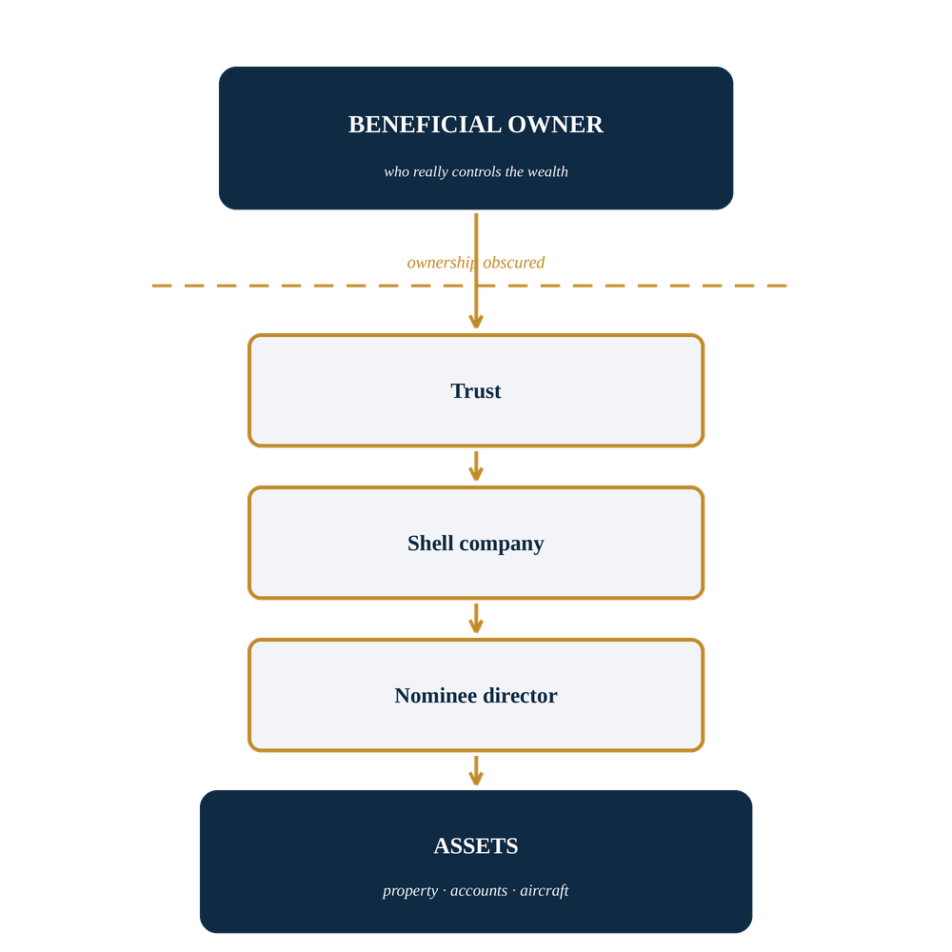
PART 3 • MECHANICS
Offshore Wealth & Global Mobility
• Offshore structures and trusts can hide who really owns assets.
• Property in several countries: places to live, store value and move between.
• Private travel reduces the scrutiny of ordinary border crossings.
• Wealth becomes mobility; mobility becomes delay.
None of this is unique to one man — it is how illicit elite wealth tends to behave.
14 / 20

Slide 15
PART 3 • COMPARISON
"Elite Impunity": 2008 vs 2019
2008 — FLORIDA
2019 — FEDERAL (NY)
• State-level plea deal
• Served ~13 months, with work release
• Non-prosecution agreement shielded others
• Victims said they were not consulted
• Federal sex-trafficking charges
• Held without bail
• Treated as serious organised wrongdoing
• Case ended only with his death in custody
The same conduct, two very different responses — a decade apart.
15 / 20

Slide 16



PART 3 • COMPARATIVE LAW
Would Other Systems Have Acted Differently?
• Adversarial vs inquisitorial: France's investigating magistrates can drive cases differently.
• Victim participation: some systems give victims a formal role earlier.
• Limitation periods: how long after the abuse can charges be brought?
• Plea bargaining is less central in many civil-law systems.
FOUR SYSTEMS COMPARED
United States
United Kingdom
adversarial
adversarial
France
Japan
inquisitorial
civil-law
Same facts — would they act faster, or slower?
Central question: would the UK, France or Japan have acted faster — or slower?
16 / 20

Slide 17
04
SECTION 4 OF 4
Accountability,
Transparency & Lessons
Designing cross-border justice that actually protects victims
17 / 20

Slide 18
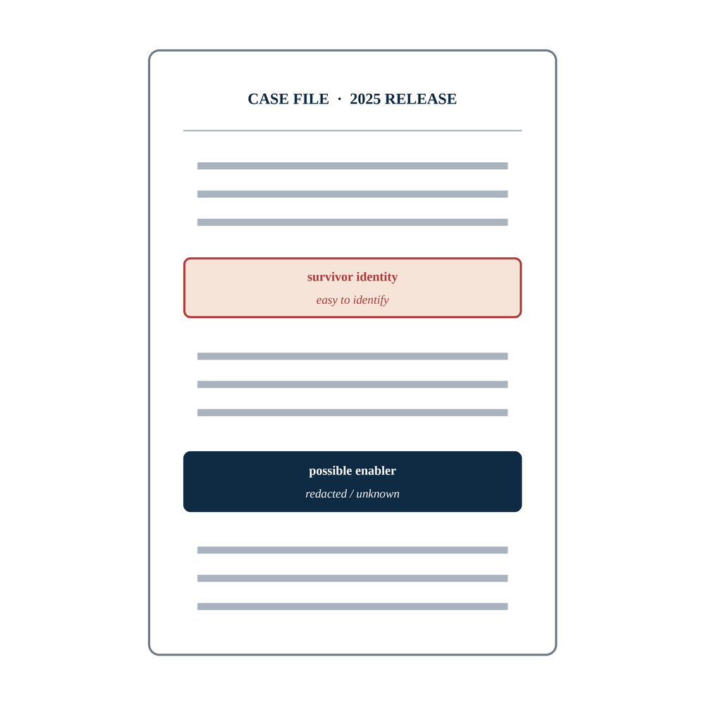
PART 4 • TRANSPARENCY
The 2025 Document-Release Wave
• US transparency legislation drove a large release of case documents.
• Meant to answer public demand for accountability and openness.
• But disclosures made victims easy to identify — enablers less so.
• A real tension: public transparency vs victim privacy and safety.
Transparency is not automatically just — its design determines who it protects.
18 / 20

Slide 19
PART 4 • LESSONS
Reform Proposals & a Japan Comparison
• Faster, better-resourced MLAT and extradition channels.
• Victim-centred disclosure rules that shield identities by default.
• Stronger cross-border asset tracing and recovery.
• Harmonised definitions so cooperation isn't blocked by mismatched laws.
JAPAN ANGLE
Japan has an anti-trafficking action framework and is assessed annually in the US State Department's TIP Report — a useful benchmark for how a non-Western system measures up on cross-border cooperation.
Better justice across borders is mostly an engineering problem, not a gap in principle.
19 / 20

Slide 20
CONCLUSION
Four Takeaways
01
Crime crosses borders — justice often doesn't.
Networks are global; enforcement is national.
02
The legal tools already exist.
Palermo & UNTOC provide the framework; coordination is the gap.
03
Wealth buys time, not immunity.
Mobility delayed — but did not finally prevent — accountability.
04
Transparency must protect victims.
Disclosure should expose enablers, not endanger survivors.
SELECTED SOURCES & INSTRUMENTS
Palermo Protocol (2000) · UN Convention against Transnational Organized Crime (UNTOC) · US DOJ filings (US v. Epstein, 2019; US v. Maxwell, 2021) · US State Dept. TIP Reports · contemporary reporting on the 2025 disclosures.
20 / 20

