Slide 1

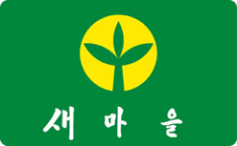
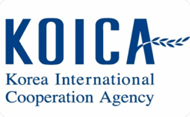
PART 2
The Role Model: Korea's Saemaul Undong
The Miracle of the Han River
Saemaul Undong
Donor from Recipient
From rubble to prosperity, South Korea's post-war transformation is one of the most studied development stories in history.
A grassroots rural modernization movement built on the values of diligence, self-help, and cooperation reshaping Korean society from the village up.
The only nation in modern history to transition from a major aid recipient to a leading aid donor, a transformation Rwanda studies closely.

Slide 2
The 'Miracle of the Han River'
$60
1st
30+
GDP Per Capita
Unique Transition
Years to Transform
South Korea's GDP per capita in the early 1950s, among the lowest in the world following the Korean War
The only nation ever to transition formally from an ODA recipient to a member of the OECD Development Assistance Committee (DAC)
Within three decades, Korea moved from war-devastated poverty to an industrialized, globally competitive economy
For a post-genocide Rwanda seeking a credible and relatable benchmark, South Korea's trajectory offered an especially powerful proof of concept, transformation is possible without natural resource wealth when paired with strong governance and a committed citizenry.

Slide 3
Parallels in State-Led Leadership
South Korea: Park Chung-hee
Rwanda: Paul Kagame
5-Year Economic Development Plans guided industrial policy, rural modernization, and export-led growth. Strong central authority coordinated investment across sectors with measurable national targets.
Vision 2020 → Vision 2050 replicates this model of state-directed long-term planning. Kagame's administration has channeled aid, investment, and reform into coherent national priorities with disciplined accountability.
Both nations demonstrate that strong governance frameworks and visionary leadership, not resource abundance are the primary drivers of development success in post-crisis environments.

Slide 4
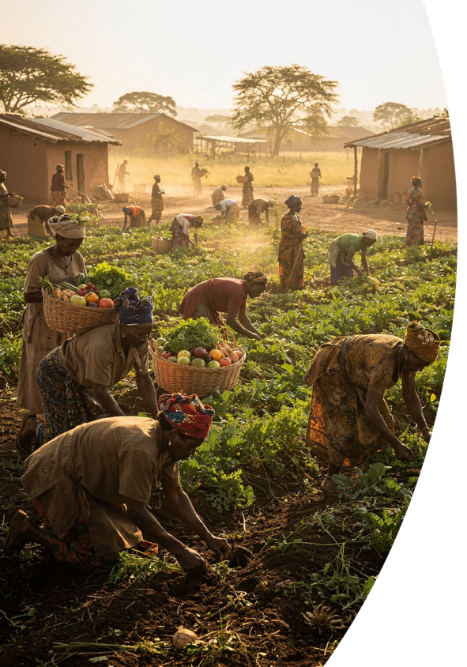
Philosophical Integration: Saemaul and Umuganda
Saemaul Undong (Korea)
Umuganda (Rwanda)
Launched in 1970, the New Village Movement mobilized rural communities through three core values: Diligence, Self-Help, and Cooperation.
Communities competed for government resources by demonstrating collective effort and local ownership of development projects.
Rwanda's pre-existing tradition of mandatory community labor, Umuganda held deep cultural resonance. Practiced on the last Saturday of each month, citizens collectively build infrastructure, clean public spaces, and address community needs.
The philosophical overlap with Saemaul Undong made Korea's model immediately legible to Rwandan communities reducing adoption barriers significantly.

Slide 5



PART 3
KOICA's Strategic ODA Projects in Rwanda
Not Charity.
Strategic Partnership.
KOICA's Country Partnership Strategy (CPS) in Rwanda operates as a direct fulfillment of Vision 2050, matching Rwanda's stated development priorities with Korea's proven expertise. Every project is designed to build capacity that outlasts the assistance itself.
Alignment
Implementation
Sustainability
KOICA priorities mapped directly to Rwanda's national roadmap
Joint teams, local ownership, and government co-investment
Institution-building and human capital over one-time transfers

Slide 6
Why Rwanda? Breaking the 'Paradox of Aid'
The Paradox Explained
In many developing nations, ODA is undermined by corruption, weak institutions, and political instability, causing funds to leak before reaching intended beneficiaries. This creates a self-defeating cycle where aid dependency grows while development stagnates.
Lowest Corruption in East Africa
Long-Term Political Stability
Rwanda's Comparative Advantage
A secure and predictable governance environment that enables sustained infrastructure investment and multi-year partnerships
Consistently ranked #1 in East Africa by Transparency International ensuring every aid dollar reaches its intended use
Rwanda has systematically built the institutional conditions that maximize aid effectiveness making it an outlier on the African continent and a flagship case for KOICA's portfolio.

Slide 7
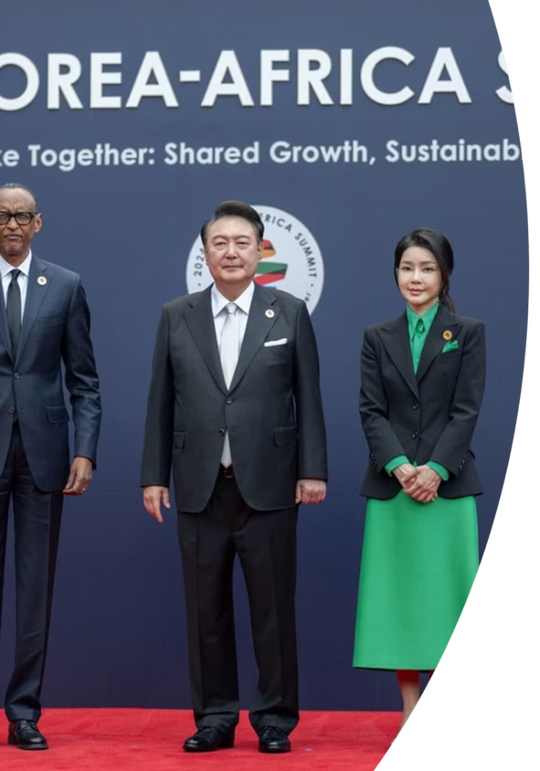
The Synergies of Success
High Aid Absorption Capacity
Unlike passive recipients, the Rwandan government exercises proactive ownership of every KOICA project, co-designing programs, contributing matching resources, and holding implementing agencies to measurable outcomes. This ownership mindset is central to the partnership's effectiveness.
Leapfrogging Strategy
Rwanda deliberately bypasses traditional industrial phases by adopting Korea's advanced ICT and digital infrastructure directly. Rather than replicating outdated development pathways, Rwanda uses Korean expertise to vault into the knowledge economy compressing decades of development into years.

Slide 8
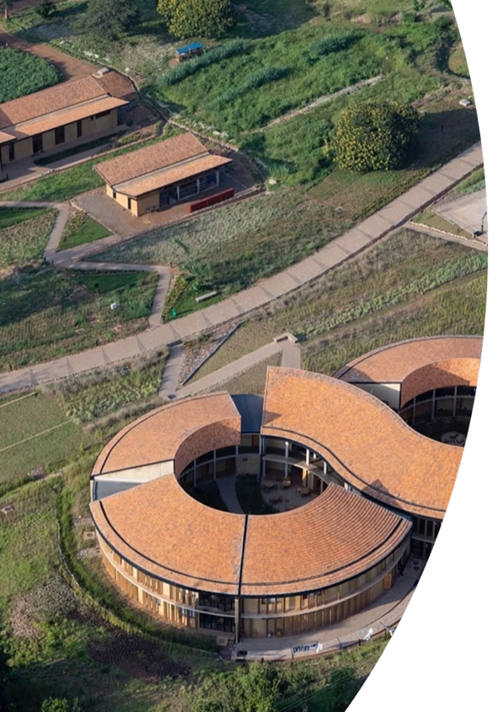
Sectoral Achievements: Agriculture & ICT
Agriculture: Upgrading the Value Chain
ICT: Digital Transformation of Governance
Applying Saemaul Undong principles to rural Rwanda, KOICA established agricultural cooperatives and post-harvest infrastructure that directly increased smallholder farmers' incomes.
Leveraging Korea's world-class e-government capabilities, KOICA played a decisive role in modernizing Rwanda's national tax and customs administration.
Digital systems reduced processing times, improved revenue collection efficiency, and minimized corruption opportunities directly strengthening the fiscal foundation for Rwanda's continued development.
Projects focused on value chain development connecting farmers to markets and reducing post-harvest losses through improved storage and processing facilities.

Slide 9



Beyond KOICA: Private Sector Engagement in ICT
KT (Korea Telecom)
Samsung Electronics
SK Hynix
Nationwide 4G LTE infrastructure & 'Smart School' network deployment.
'Samsung Smart School' programs (Providing interactive displays and tablets).
Supporting advanced hardware literacy and sustainable IT ecosystems.
Semiconductor technology and ICT are not just industries, but the defining force behind a nation's future.
Samsung Electronics' operating profit alone surpasses the combined total of Japan's top 100 listed companies.
Korea's investment in Rwanda's digital future is an investment in the next generation of global leadership.

Slide 10
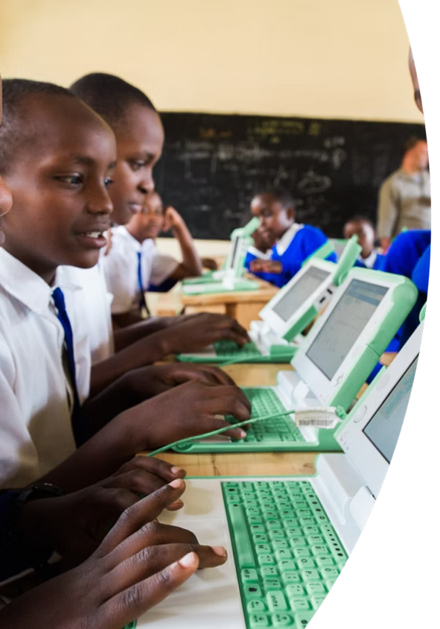
PART 4
The Core of Sustainable Development: Education
No infrastructure project is sustainable without the human capital to operate and innovate within it. KOICA recognized early that healing Rwanda's wounds and building its future required a deep investment in education and human resources development (HRD). This was especially critical in a post-genocide context where an entire generation had been deprived of stable schooling and social trust.
Healing Through Learning
Education serves as a vehicle for reconciliation, shared national identity, and restoration of social cohesion across ethnic lines.
Knowledge Economy Foundation
A skilled, digitally literate workforce is the prerequisite for sustaining Rwanda's ICT-led development and Vision 2050 ambitions.

Slide 11
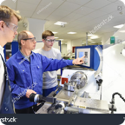
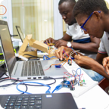
KOICA's Tailored HRD Projects
TVET: Technical & Vocational Education
ICT Innovation Centers
At the university level, KOICA has established centers of digital excellence that cultivate Rwanda's future software engineers, data scientists, and technology entrepreneurs. These hubs connect Rwandan students directly with Korean academic institutions and tech companies, creating bridges for knowledge transfer and career pathways in the global digital economy.
KOICA supports polytechnic institutes and TVET programs that train a job-ready practical workforce. Curriculum is aligned with Rwanda's priority industries construction, manufacturing, and agri-processing ensuring graduates enter the labor market with immediately applicable skills rather than theoretical knowledge alone.

Slide 12
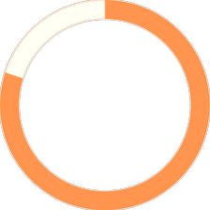
The Wave of Social Change
Youth Employment Rising
TVET and ICT programs are producing measurable labor market gains. Youth employment in sectors aligned with KOICA's investment areas has risen sharply, reversing post-genocide trends of economic exclusion and urban youth unemployment.
80%
Social Participation Expanding
Rwanda now ranks among Africa's highest nations for social and civic participation. Women hold over 60% of parliamentary seats a global record reflecting a broader transformation.
However, men are achievement-oriented animals, while women are relationship-oriented animals in anthropology. Therefore, it is questionable whether they are appropriate proportions for politics.
Aid Utilization Rate
Among the highest efficiency rates for ODA absorption in Sub-Saharan Africa

Slide 13

Conclusion: Will + Philosophical Empathy = A Miracle
Rwanda's transformation from a collapsed state in 1994 to an icon of innovation today proves that successful ODA is not determined merely by the size of the capital. It is the result of the recipient's will to stand on its own, combined with a partner's philosophical empathy.
Recipient's Will
Donor's Empathy
Rwanda's governance discipline, transparency, and proactive ownership of its own development agenda
Korea's unique credibility as a former aid recipient offering a model grounded in shared hardship, not paternalism
The Result
A replicable framework for post-conflict reconstruction that centers dignity, self-reliance, and sustainable institutions

Slide 14
References
Asian Development Bank. (n.d.). Saemaul Undong movement in the Republic of Korea. https://www.adb.org/publications/saemaul-undong-movement-republic-korea
Government of Rwanda. (2012). Rwanda Vision 2020 and Vision 2050 policy documents.
Kinzer, S. (2008). A thousand hills: Rwanda's rebirth and the man who dreamed it. John Wiley & Sons.
Korea International Cooperation Agency. (n.d.). KOICA home. https://www.koica.go.kr
Korea International Cooperation Agency. (2021). Country partnership strategy (CPS) for the Republic of Rwanda (2021-2025).
Laterite. (2020). Youth employment in Rwanda. https://www.laterite.com/wp-content/uploads/2020/06/Youth_Employment_RWANDA__PORT_WEB-FINAL.pdf
Moyo, D. (2009). Dead aid: Why aid is not working and how there is a better way for Africa. Farrar, Straus and Giroux.
Organisation for Economic Co-operation and Development. (n.d.). Development co-operation report. https://www.oecd.org/dac/development-cooperation-report/
Organisation for Economic Co-operation and Development. (n.d.). Effective development co-operation. https://www.oecd.org/dac/effectiveness/
Reyntjens, F. (2013). Political governance in post-genocide Rwanda. Cambridge University Press.
Rwanda TVET Board. (n.d.). RTB home. https://www.rtb.gov.rw/
ScienceDirect. (n.d.). https://www.sciencedirect.com/science/article/abs/pii/S0738059324000403
Straus, S., & Waldorf, L. (Eds.). (2011). Remaking Rwanda: State building and human rights after mass violence. University of Wisconsin Press.
Transparency International. (2023). Corruption Perceptions Index: Sub-Saharan Africa regional analysis.
United Nations Development Programme. (n.d.). UNDP in Rwanda. https://www.undp.org/rwanda
World Bank. (n.d.). Rwanda overview. https://www.worldbank.org/en/country/rwanda
World Bank. (2020). Rwanda human capital index and education sector analysis.
World Bank. (2024). Worldwide Governance Indicators: Rwanda country report.

