Slide 1
Introductory session: Theoretical modelling in ecology and evolution
May, 21st
Margaux Bieuville, Tom Keaney, Victor Ronget, Roman Zug

Slide 2
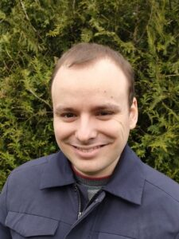
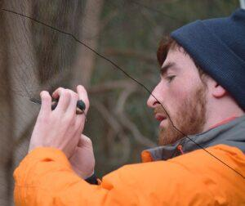
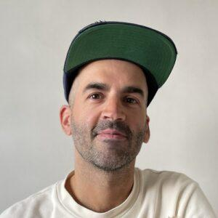
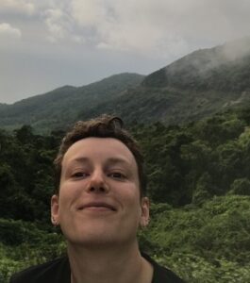
Your instructors
Victor
Keywords
Ageing, demography
Languages
R
OS
Windows
Tom
Keywords
Conflict,
Sexual selection
Languages
R (tidyverse)
OS
Windows & Mac
Roman
Keywords
Evo-devo, sex ratio
Languages
Matlab
OS
Windows & Linux
Margaux
Keywords
Ageing, cancer
Languages
R
OS
Linux
(Windows)

Slide 3
Why this module?
Development of a “theoretical hub” in eco-evo at JGU
You might be interested in the international MSc in Evolutionary Biology
https://www.blogs.uni-mainz.de/fb10-biologie-eng/master-evolutionary-biology/
A first taste of theory and theoretical modelling
→ equations are NOT scary
Before your BSc thesis: a mock-up experience of a research project

Slide 4
How?
Lectures
Hot topics in theoretical eco-evo
How do we communicate science?
“Learning by doing”
Journal Club
Workshops:
Scientific writing
Data analysis with R
Data simulation and modelling with R
Overview of the publishing process
Hands-on and project-based practical
Notes:
Hot topics in eco evo : give you the biological base knowledge to i) present papers and ii) start your project

Slide 5
Course outline: two phases
Journal club - ⅓ of the module - dates TBD
Lectures: 8 hours on 4 different topics in ecology and evolution
Break: preparation of JC in groups
Oral presentation and scientific discussion: 4 groups, 4 papers, 2 half-days (provisional)

Slide 6
Course outline: two phases
Journal club - ⅓ of the module - dates TBD
Lectures: 8 hours on 4 different topics in ecology and evolution
Break: preparation of JC in groups
Oral presentation and scientific discussion: 4 groups, 4 papers, 2 half-days (previsional)
Research project - ⅔ of the module - calendar on Jogustine
Workshops “literature review” and “scientific writing”: 8 hours
Workshops “R for data wrangling” and “R for data simulations”: 16 hours
Hands-on part, in group: 22.08, 23.08, 02.09-13.09
NB: hands-on part attendance is mandatory to some extent

Slide 7
Course outline: two phases
Journal club - ⅓ of the module - dates TBD
Lectures: 8 hours on 4 different topics in ecology and evolution
Break: preparation of JC in groups
Oral presentation and scientific discussion: 4 groups, 4 papers, 2 half-days (previsional)
Research project - ⅔ of the module - calendar on Jogustine
Workshops “literature review” and “scientific writing”: 8 hours
Workshops “R for data exploration” and “R for data simulations”: 16 hours
Hands-on part, in group: 22.08, 23.08, 02.09-13.09
NB: hands-on part attendance is mandatory to some extent
⇒ Who is taking the bioinfo course from 02.09 to 13.09?

Slide 8
Journal club: deliverables (i.e what is graded)
Oral presentation (in groups) of a scientific paper
30 minutes presentation
You can choose to present all or part of your paper
Use what we show during the thematic lectures
Steering a scientific discussion
One group in charge of asking questions to presenters
⇒ Each group reads 2 papers

Slide 9
Project: deliverable
Report in the form of a scientific paper
Abstract (150 words)
Introduction
Material and method
Results
Discussion and conclusion
A reference list
Your goal: concision
Graded by your tutor + another one of us

Slide 10
Resources
On the moodle
Course syllabus
Information
Learning objectives
Course outline
Deliverables guidelines
Papers on modelling
Lectures and workshop slides
(Additional resources)

Slide 11
Questions?

Slide 12
Previous experience with programming
Please answer the survey below :
View https://docs.google.com/forms/d/e/1FAIpQLScyIXzeqH0IhyS1j1XzoguxFOBoO1-3Bh1KHpLOEUUBeB6dwQ/viewform
Edit
https://docs.google.com/forms/d/e/1FAIpQLScyIXzeqH0IhyS1j1XzoguxFOBoO1-3Bh1KHpLOEUUBeB6dwQ/viewform?usp=sharing

Slide 13
Find dates
5 half- days
2 for our lectures (i.e on topics related to JC papers) - 2x4h
2 for your time to shine (i.e JC presentations) - 2x4h
1 to create project groups (you can re-shuffle groups and topic) + discuss potential research subjects with your tutor
Fill the When2meet :D
https://www.when2meet.com/?25006472-lPifm

Slide 14
Last logistic points: choose your abstract !
Please read the four abstracts
2 for our lectures (i.e on topics related to JC papers) - 2x4h
2 for your time to shine (i.e JC presentations) - 2x4h
1 to create project groups (you can re-shuffle groups and topic) + discuss potential research subjects with your tutor
And write your names + ranking under each in this document:
Link

