Slide 1
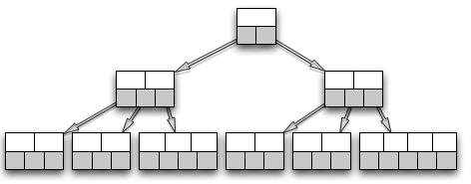
File
Parallel I/O
Hashing
MPI AlltoAllv
Insertion

Slide 2
File
Parallel I/O
Hashing
MPI AlltoAllv
Insertion

