Slide 1
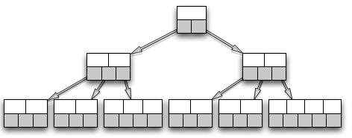
File
File
Parallel I/O
G
Hashing
G
MPI AlltoAllv
G
Insertion
G
Relation
G U T
Parallel I/O
T
Hashing
T
MPI AlltoAllv
T
Insertion
T
Relation
G U T
Time

