Slide 1
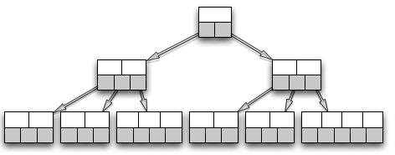
File
Parallel I/O
G
File
Relation
G U T
Parallel I/O
T
Hashing
G U T
MPI AlltoAllv
G U T
Insertion
G U T

