Slide 1
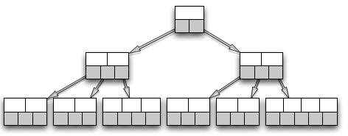
Relation G
Relation T
Relation G
Relation T
MPI AlltoAllv
G
Relation T
Join
Project
Rehash
Relation G
G Join T

