Slide 1
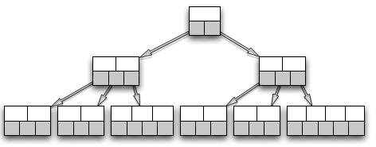
Local join
Projection
Hashing
MPI AlltoAllv
Relation T
Relation G
Relation T
Relation G
Relation T
Relation G
G Join T

