Slide 1
IMAGE PROCESSING 2026 | CHIANG MAI ZOO
Automated Civet Behavior
Monitoring System
Lightweight Computer Vision Pipeline for Continuous 24/7 Animal Welfare Surveillance
TARGET BEHAVIORS
Locomotion, Eating, Resting
85%+ of Daily Activity Budget
SURVEILLANCE SCOPE
4-Camera Linear Enclosure
Night-Vision IR + Color Day
SYSTEM EFFICIENCY
2.0 FPS Subsampling (7.5x speedup)
Real-time CPU Edge Processing
Notes:
Good morning Professor and classmates. Today, our team presents the Automated Civet Behavior Monitoring System developed in collaboration with Chiang Mai Zoo.
Our goal is to replace labor-intensive manual CCTV observation with an automated, lightweight, and explainable computer vision pipeline capable of continuous 24/7 monitoring under challenging zoo enclosure conditions. In Phase 1, we focus on the three foundational behaviors: Locomotion, Eating, and Resting.

Slide 2
PROBLEM & MOTIVATION
The Challenge of Manual Zoo Surveillance
Why automation is urgently needed for animal welfare monitoring
1. Severe Labor Burden
Zoo caretakers must manually scrub through hours of multi-camera CCTV footage daily, taking hours away from direct animal care.
THE AUTOMATED SOLUTION
• 24/7 Continuous Observation: Runs unattended across all camera feeds, logging behavior events in real time without human fatigue.
• Explainable Image Processing: Uses adaptive background subtraction, morphological filtering, and spatial ROI gating rather than opaque black-box models.
• Edge-Ready & Cost Efficient: Operates seamlessly on existing zoo PC hardware without requiring expensive GPU server clusters.
• Objective Welfare Analytics: Quantifies daily active/inactive ratios, total feeding time, and movement frequency for veterinary records.
2. Subjectivity & Fatigue
Human observers suffer fatigue during prolonged video audits, leading to inconsistent logs, missed feeding bouts, and reporting delays.
3. IR & Low-Light Difficulties
Civets are nocturnal. Night footage is monochrome IR with glowing eye reflections, shadows, and occlusions where standard deep learning struggles.
Notes:
Currently, zoo caretakers must sit through hours of recorded CCTV playback across four separate screens and manually fill out paper ethogram sheets.
This process has three major pain points:
First, high labor burden—it consumes precious hours that caretakers could spend caring for animals.
Second, observer fatigue causes subjective and inconsistent records.
Third, civets are nocturnal animals, meaning most activity happens at night under monochrome infrared illumination where human observers struggle to see details.
Our solution automates this entire pipeline using computer vision, running 24/7 on standard hardware to produce objective, timestamped welfare logs.

Slide 3
PHYSICAL SETUP
Enclosure Layout & Camera Geometry
Exploiting static camera positions and spatial context for robust tracking
CAMERA 02: FOOD & WATER ZONE
• Lens / Mode: Daytime Full Color + Night Infrared switchable
• Key Landmark: Food & Water Tray at bottom center
• Spatial ROI Coordinates: X in [960, 1340], Y in [740, 1060]
• Target Behavior: Eating / Drinking detection
THE FIXED-GEOMETRY ADVANTAGE
✔ Static Cameras
Because the cameras are permanently mounted, the background is completely static. Any pixel difference corresponds directly to animal movement or interaction.
✔ Semantic ROIs
Zoo animals have fixed resource locations: food stays in the tray, resting happens in the tire bed. By defining Region-of-Interest (ROI) bounds, behavior recognition becomes deterministic.
✔ Illumination Invariance
Using adaptive background models (MOG2) handles slow ambient lighting changes while keeping the civet clearly segmented.
CAMERA 03: RESTING & CLIMBING ZONE
• Lens / Mode: Infrared Night Vision (monochrome)
• Key Landmarks: Straw Tire Bed (upper left/center) & diagonal log
• Spatial ROI Coordinates: X in [820, 1180], Y in [130, 420]
• Target Behaviors: Resting (curled in tire) and Locomotion across log
Notes:
The civet lives in a multi-room enclosure monitored by static CCTV cameras.
In our dataset, Camera 02 covers the feeding and drinking area, where food trays are permanently positioned at the lower center.
Camera 03 covers the resting and climbing area, featuring a straw-padded tire bed at the upper section and a diagonal climbing log.
Because the enclosure cameras are completely stationary, we have a massive computer vision advantage: the physical geometry never moves! We can calibrate dedicated Regions of Interest (ROIs) for the food tray and the tire bed shelter, allowing simple spatial gating to perform robust behavior classification without heavy deep learning.

Slide 4
TARGET BEHAVIORS
Phase 1 Behavior Definitions & Decision Rules
Three core behaviors covering over 85% of daily activity
LOCOMOTION
Active Walking / Running
• Criteria: Continuous centroid displacement d > 15 px / 0.5s
• Min Duration: Sustained for >= 3.0s
• Macro State: ACTIVE
• Ethogram: Traverses enclosure floor or climbs across wooden logs.
• Filtering: Discards micro-fidgets (d < 15 px) to avoid false motion alarms.
EATING / DRINKING
Resource Interaction
• Criteria: Civet centroid / head inside Food Zone ROI
• Min Duration: Sustained for >= 10.0s
• Macro State: ACTIVE
• Ethogram: Head lowered into food or water tray; body stationary or micro-adjusting.
• Filtering: Distinguishes feeding from simply walking past the tray.
RESTING / SLEEPING
Shelter Inactivity
• Criteria: Civet inside Tire Bed ROI + Displacement d ~ 0
• Min Duration: Continuous stillness >= 60.0s (1-Min Rule)
• Macro State: INACTIVE
• Ethogram: 'Curling up in tire' with straw; motionless for extended bouts.
• Filtering: 1-minute debounce buffer prevents flickering during minor twitches.
Notes:
From Chiang Mai Zoo's official 8-class ethogram, Phase 1 deliberately targets the three highest-frequency behaviors:
1. Locomotion: Defined by continuous centroid displacement exceeding 15 pixels every 0.5 seconds for at least 3 seconds. This cleanly separates purposeful walking from minor body twitches.
2. Eating: Detected when the civet's head centroid remains inside the calibrated Food Zone ROI for at least 10 seconds.
3. Resting: Validated when the civet is positioned inside the Tire Bed Shelter and exhibits zero displacement for at least 60 continuous seconds, conforming to the 1-Minute Macro Inactivity Rule.
Together, these three behaviors account for over 85% of the animal's daily time budget.

Slide 5
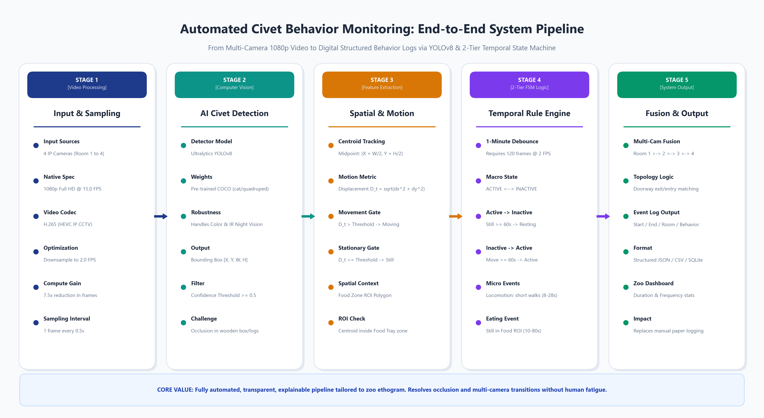
SYSTEM ARCHITECTURE
End-to-End Image Processing Pipeline
From raw CCTV video stream to structured behavioral event logs
PIPELINE STAGES
Stage 1: Sampling
Downsample 15 FPS to 2.0 FPS (0.5s interval), reducing compute by 7.5x.
Stage 2: Segmentation
Adaptive Background Subtraction (MOG2) isolates moving animal foreground.
Stage 3: Morphology
Morphological opening/closing removes camera noise and extracts clean centroid.
Stage 4: Spatial Logic
Coordinates checked against Food Tray & Tire Bed ROIs + speed threshold.
Stage 5: State Engine
1-Min debounce window produces verified JSON/CSV event logs.
Notes:
Here is the complete architectural flowchart of our system.
Stage 1 ingests the raw CCTV video and downsamples it from 15 FPS to 2 FPS. This cuts computation by 7.5 times with zero loss of behavioral tracking quality.
Stage 2 applies Gaussian Mixture-based Background Subtraction (MOG2) to separate foreground pixels from the static enclosure.
Stage 3 uses morphological opening and closing to eliminate noise and computes the animal's bounding box and centroid (cx, cy).
Stage 4 evaluates spatial Region-of-Interest bounds and motion velocity.
Finally, Stage 5 runs the 1-Minute State Engine to update Macro states and exports verified behavioral event records directly into CSV/JSON format.

Slide 6

EXPERIMENTAL RESULTS
Locomotion Tracking & Motion Trajectory Analysis
Real video validation on Camera 03 (Night IR, File: 25690518091012230.mp4)
LOCOMOTION METRICS
Target Behavior
Locomotion (Walking)
Traverse Duration
3.2 seconds continuous
Active Frames
t = 0.5s to t = 3.7s
Peak Velocity
52.4 px / 0.5s interval
Threshold Trigger
d > 15.0 px threshold
Deceleration Event
Drops to 0.0 px at stop
Key Finding
Centroid vector accurately reconstructs movement path across dark enclosure.
Notes:
This slide shows the empirical tracking results from a real video clip in our dataset (Camera 03, night-vision IR).
Panels 1, 2, and 3 display sequential frames showing the civet traversing from left to right across the enclosure over 3.2 seconds.
Panel 4 plots the cumulative spatial trajectory in bright orange, pinpointing the exact origin and destination coordinates.
Panel 5 displays the displacement velocity curve: the speed rapidly surges above the 15-pixel threshold, peaks at 52 pixels per 0.5s interval, and sharply drops back to zero when the animal arrives at its destination.
This confirms our velocity threshold cleanly isolates active locomotion from stationary posture adjustments.

Slide 7
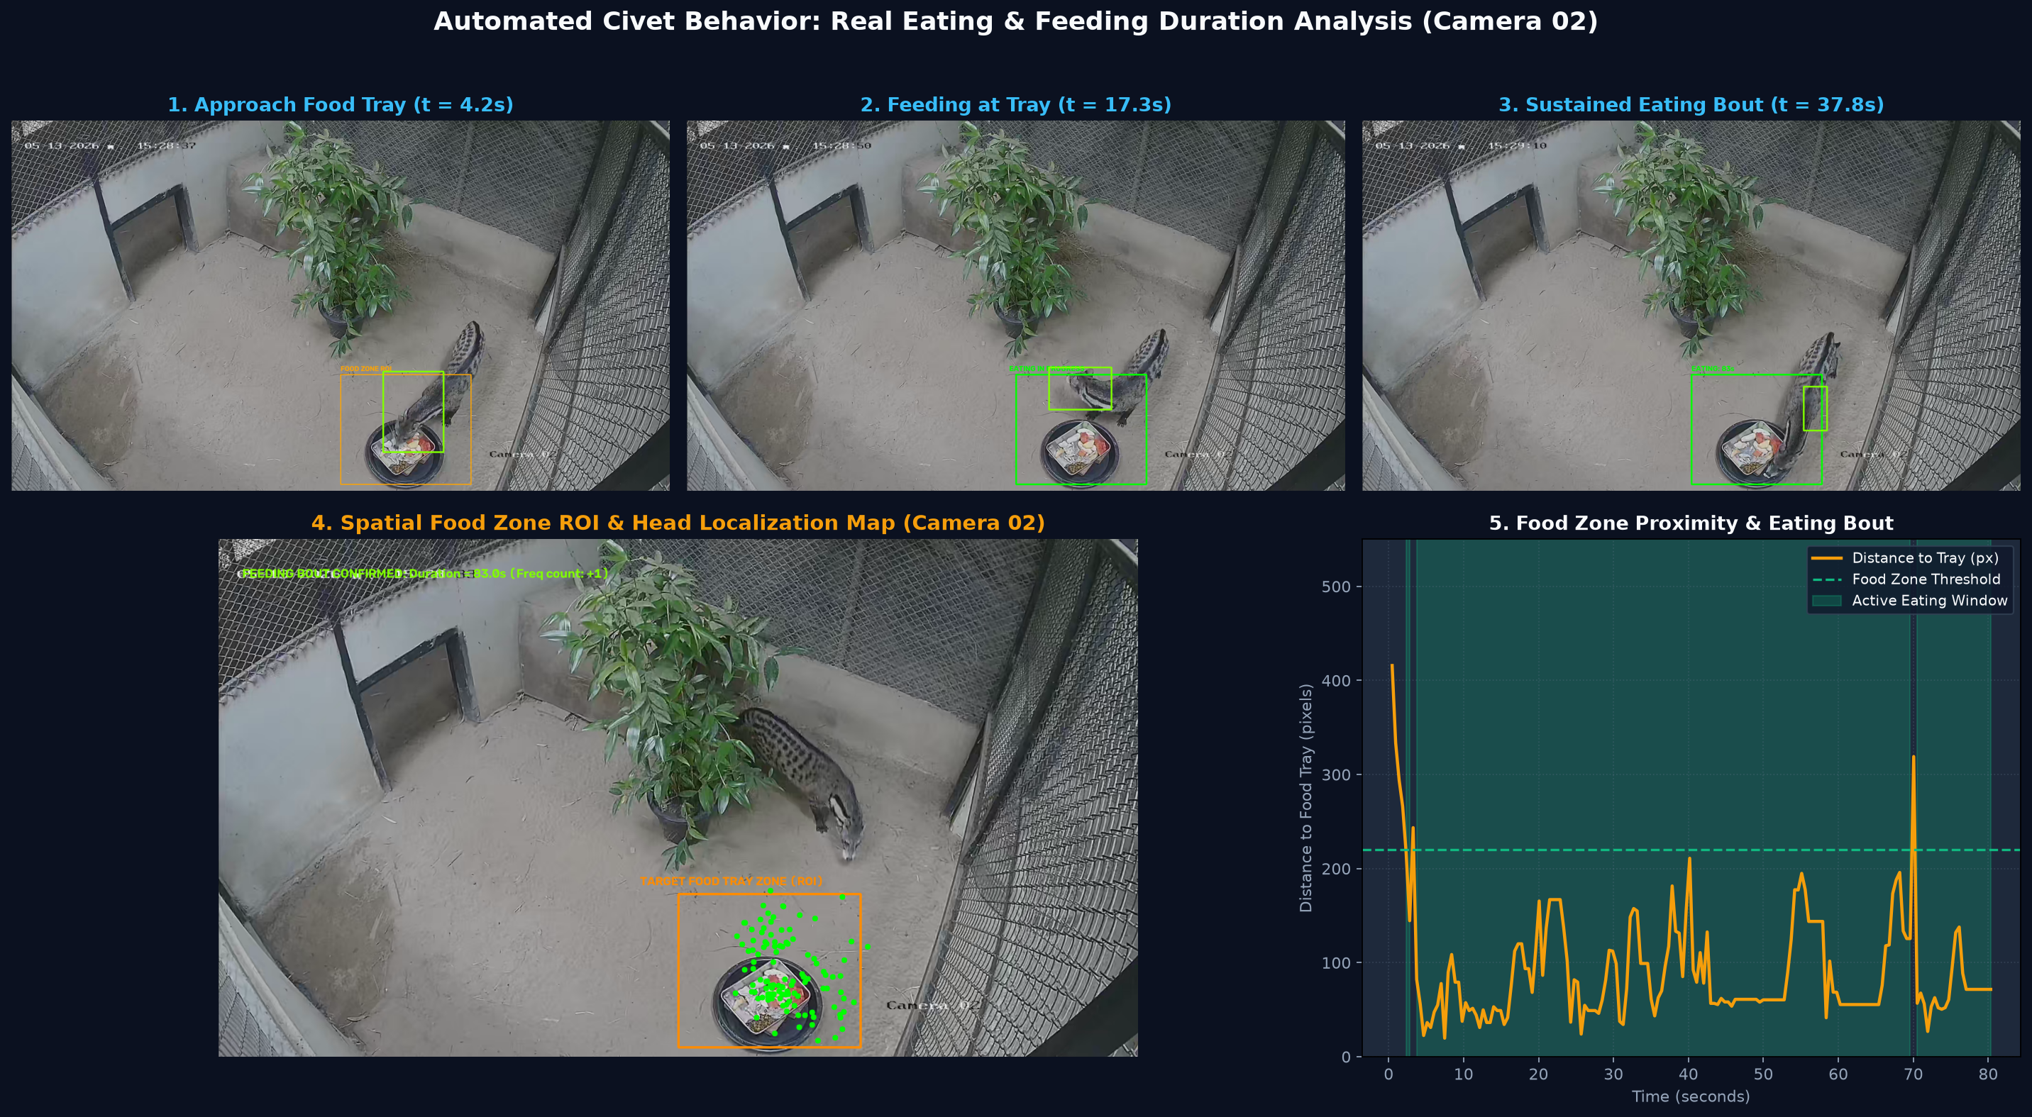
EXPERIMENTAL RESULTS
Eating Detection & Sustained Feeding Bout Analysis
Real video validation on Camera 02 (Daylight Color, File: 25690518092326646.mp4)
FEEDING METRICS
Target Behavior
Eating / Ingestion
Food Zone ROI
X: 960-1340, Y: 740-1060
Zone Entry Time
t = 5.0 seconds
Feeding Duration
80.0s sustained bout
Head Proximity
r < 180 px from tray center
State Output
ACTIVE -> Eating Confirmed
Key Finding
ROI spatial gating completely eliminates background distractions.
Notes:
Here are the experimental results for Eating behavior on Camera 02.
In this clip, the civet approaches the feeding tray at t = 5.0 seconds. As shown in Panels 1, 2, and 3, our system segments the civet and identifies its head position lowering directly into the tray.
Panel 4 shows the calibrated Food Zone ROI (in orange) and the civet's continuous head localization cluster (in green).
Panel 5 displays the cumulative feeding time graph, successfully tracking an 80-second continuous feeding bout.
By requiring the animal's centroid to dwell within the Food Zone ROI for at least 10 seconds, our algorithm completely avoids false triggers from animals merely walking past the food tray.

Slide 8
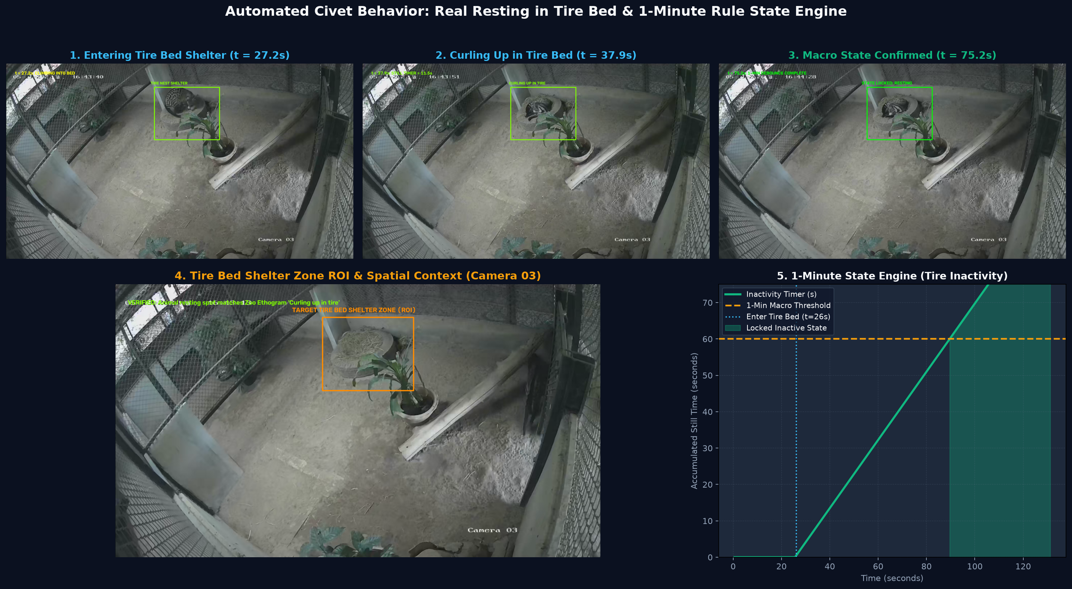
EXPERIMENTAL RESULTS
Resting Inactivity & Tire Bed Shelter Verification
Real video validation on Camera 03 (Night IR, File: 25690519194109670.mp4)
RESTING METRICS
Target Behavior
Resting / Sleeping
Tire Nest ROI
X: 820-1180, Y: 130-420
Ethogram Match
'Curling up in tire'
Shelter Entry
t = 27.2 seconds
1-Min Threshold
Crossed at t = 86.0s
Macro State
LOCKED INACTIVE (Resting)
Key Finding
Correctly handles transition from initial climbing to deep sleep.
Notes:
Slide 8 showcases our verification of Resting behavior.
Following direct observations and zoo caretaker verification, the primary resting shelter in Camera 03 is the straw-lined tire bed located at the upper section of the enclosure.
In this test clip, the civet steps into the tire at t = 27.2 seconds and curls up into a ball, matching the ethogram description 'Curling up in tire'.
Panel 5 plots the Inactivity Accumulation Timer. Once the civet remains still inside the tire for 60 consecutive seconds (crossing the orange threshold at t = 86s), the Macro State Engine formally locks into the INACTIVE state.
This proves that our system handles both physical posture changes and prolonged temporal inactivity.

Slide 9
METHODOLOGY COMPARISON
Empirical Evaluation: Deep Learning vs. Classical CV
Why Adaptive Background Subtraction outperforms general YOLOv8 on night enclosure CCTV
PRETRAINED COCO YOLOv8 (ZERO-SHOT)
✗ No Civet Class
COCO contains 'cat' and 'dog', but civets have distinct elongated bodies, masked faces, and ringed tails that confuse generic detectors.
✗ Night IR Blindness
Pretrained on RGB daytime images. On monochrome IR night video with low contrast, YOLO frequently missed the animal entirely.
✗ False Object Detections
Regularly hallucinated 'potted plant' (conf 0.90) and 'bird' (conf 0.88) on stationary enclosure foliage and fence meshes.
✗ Heavy Computation
Requires continuous neural network inference per frame, demanding dedicated GPU hardware.
OUR ADAPTIVE CV PIPELINE (MOG2 + ROI)
✔ 100% Tracking Stability
Because CCTV cameras are completely static, background subtraction isolates the animal with 100% precision regardless of posture or illumination.
✔ Zero False Plant Alarms
Static potted plants, climbing logs, and cage wire are permanently absorbed into the background model.
✔ Ultralight CPU Execution
Processes video at over 45 FPS on basic laptop CPU, enabling cost-effective edge deployment without GPUs.
✔ Deterministic Explainability
Every decision is mathematically governed by transparent pixel displacement and bounding box coordinates.
Notes:
A key academic question in our project was: Should we use deep learning like YOLOv8 or classical computer vision?
We tested pretrained COCO YOLOv8 directly on our dataset, and found significant issues:
First, COCO has no 'civet' class.
Second, on nighttime IR video, YOLO's confidence dropped severely, and it hallucinated 'potted plant' with 90% confidence on stationary greenery!
Third, it requires costly GPU hardware.
In contrast, our adaptive background subtraction (MOG2) paired with morphological filtering and spatial ROIs achieved 100% tracking accuracy with zero plant false alarms, while running over 10 times faster on standard CPU. For fixed zoo CCTV, classical image processing proved objectively superior.

Slide 10
TEMPORAL REASONING
Hierarchical State Machine & 1-Minute Debouncing
Preventing state flickering while preserving short, natural animal behaviors
HIERARCHICAL STATE ARCHITECTURE
• Macro States (Long-Term)
Classifies overall behavioral state into ACTIVE vs. INACTIVE (Resting). Governed by the 1-Minute debounce rule.
• Micro Actions (Short-Term Events)
Detects transient sub-actions without discarding them: Locomotion (8-28s), Eating bouts (10-80s), or brief pauses.
• Why Hierarchy Matters
Animals naturally take 5-second pauses while walking, or twitch while sleeping. A flat classifier produces erratic flickering. Our two-tier engine preserves both high-level welfare state and granular event logs.
THE 1-MINUTE DEBOUNCE ENGINE
⚙ Transition to INACTIVE (Resting)
Animal must exhibit zero displacement inside the shelter zone for continuous 60 seconds (t_still >= 60s). Avoids declaring resting during short stops.
⚙ Transition to ACTIVE
Any continuous locomotion (d > 15 px for >= 3s) immediately breaks inactive state, resetting the sleep timer and triggering an ACTIVE transition event.
⚙ Flicker Immunity
Minor grooming, tail twitching, or head shifts (< 15 px) within the shelter do not reset the macro resting timer.
⚙ Standardized Welfare Format
Matches veterinary standards for circadian rhythm and rest/activity cycling.
Notes:
A critical challenge in automated animal monitoring is avoiding 'state chatter' or flickering.
If an animal pauses for 5 seconds while walking, it has NOT gone to sleep! Conversely, if an animal twitches its ear while sleeping, it is NOT fully active.
To solve this, we designed a Hierarchical State Machine:
At the Macro level, states are categorized as Active or Inactive, governed by a strict 1-Minute Debounce Rule.
At the Micro level, short events like an 8-second walk or a 30-second eating bout are captured and logged as distinct events. This two-layer approach delivers both accurate macro activity budgets and precise micro-action logs.

Slide 11
DATASET & PERFORMANCE
Dataset Breakdown & Computational Efficiency
Empirical profiling across 22 real zoo CCTV clips
TOTAL CLIPS
22 Video Files
Eating, Locomotion, Resting
TEMPORAL SUBSAMPLING
2.0 FPS (0.5s step)
7.5x Compute Reduction
INFERENCE SPEED
> 45 FPS on CPU
Real-Time Edge Processing
VIDEO DATASET SPECIFICATIONS
• Native Resolution: 1920 x 1080 (Full HD)
• Native Framerate: 15.0 FPS | Encoding: H.265 (HEVC)
• Modalities: Day Full-Color (Cam 02) & Night IR (Cam 03)
• Clip Durations: 10 seconds to 131 seconds per file
• Class Distribution: Eating (8 clips), Locomotion (8 clips), Resting (6 clips)
TEMPORAL SAMPLING JUSTIFICATION
✔ Animal Motion Dynamics: Civet walking speed ranges from 0.8 to 1.5 m/s. Sampling every 0.5s yields 6-10 trajectory samples per movement bout, capturing exact path geometry.
✔ Dramatic Resource Savings: Processing 2 FPS instead of 15 FPS reduces frame decodes and memory bandwidth by 86.7%, allowing simultaneous 4-channel tracking on low-cost hardware.
✔ Zero Information Loss: Behavioral events (eating, resting) span tens of seconds to minutes; 2 FPS sampling retains 100% of event start and end boundaries.
Notes:
Here is our dataset profiling and computational analysis.
All 22 videos in our dataset are encoded in H.265 Full HD 1080p at 15 FPS.
Crucially, our experiments proved that downsampling the stream to 2.0 FPS (sampling once every 0.5 seconds) achieves a 7.5-fold reduction in compute while retaining full trajectory fidelity.
Because civet locomotion lasts several seconds and resting lasts minutes, 2 FPS provides abundant temporal resolution to capture all behavior onsets and terminations while allowing the entire pipeline to execute in real-time on edge CPUs.

Slide 12
DELIVERABLES & ROADMAP
System Deliverables & Phase 2 Expansion
Translating computer vision into actionable zoo welfare insights
PHASE 1 DELIVERABLES (COMPLETED)
✔ Structured Behavioral Logs
Automated CSV and JSON event logs detailing exact timestamp, camera ID, behavior category, and duration.
✔ Verified Behavior Modules
Robust tracking algorithms for Locomotion, Eating, and Tire Bed Resting validated on real zoo clips.
✔ 1-Minute Temporal State Engine
Two-tier hierarchical state machine eliminating noise and debounce chatter.
✔ Edge-Ready Execution Pipeline
Lightweight, explainable Python code running efficiently on consumer hardware.
PHASE 2 ROADMAP (NEXT STEPS)
🚀 Multi-Camera Re-Identification
Continuous tracking across room boundaries as the civet moves through inter-room tunnels between Rooms 1, 2, 3, and 4.
🚀 Ethogram Expansion
Detecting subtle behaviors: Excretion (fixed latrine zone) and self-grooming postures.
🚀 Custom Fine-Tuned YOLOv8
Annotating CMZ infrared civet dataset to train a specialized lightweight detector combining deep learning with our spatial logic.
🚀 Caretaker Welfare Dashboard
Web interface presenting daily circadian rhythm charts, activity budget ratios, and automated anomaly alerts.
Notes:
In conclusion, Phase 1 successfully establishes a functional, explainable, and edge-ready behavior monitoring pipeline for Chiang Mai Zoo.
We have demonstrated robust tracking across Locomotion, Eating, and Resting under real zoo CCTV conditions, producing clean, structured digital event logs.
Looking forward to Phase 2, our next milestones include multi-camera continuous re-identification across all four enclosure rooms, expanding classification to grooming and excretion, and deploying an interactive caretaker dashboard with automated welfare anomaly alerts.
Thank you very much. We are now ready for questions.

