Slide 1


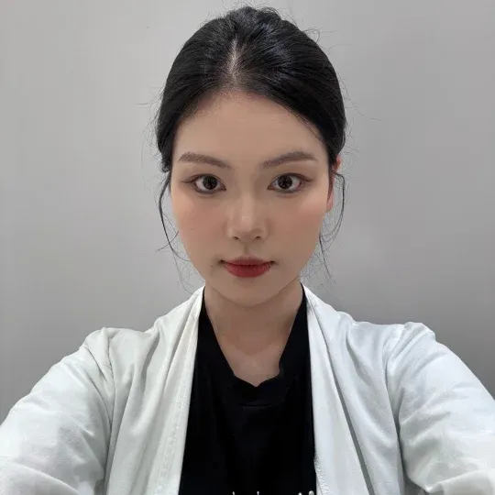
Retail Dashboard
Period
2025.10.20 – 2025.10.26
Piloting Account
Account with Paid Promo
Notes Published
Notes with Paid Promo
Engagement
Engagement from Paid
当前KOSA账号数
投广账号总数
发布笔记数
投广笔记数
笔记总互动数
投广带来的互动量
20
13
113
28
6,499
56
Chats Initiated
Inquiries Received
WeCom Recruitment
WeCom Recruiment Efficiency
CPR (Cost per Recruitment)
Turnover
私信进线数
私信开口数
企微留资数
企微招募效率
企微留资成本
期间成交量
496
402
107
22.97%
￥35.35
￥168,858
Weekly Top 3
 | Store Code 所属店铺 | Notes Published 发布笔记数 | Engagement 笔记互动量 | Inquires Received 私信开口数 | WeCom Recruitment 企微留资数 | Turnover 期间成交量
Sylvia Ma | MNDJ | 1 | 0 | 1 | 1 | ¥31,000
Vanna Xue | MNDJ | 6 | 1 | 0 | 3 | ¥25,700
Adeline Lei | MCS | 11 | 7 | 2 | 7 | ¥17,220

Slide 2






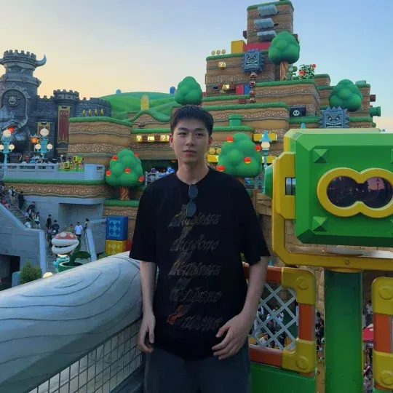
Retail Piloting Performance
Period
2025.09.29 – 2025.10.26
 |  | Store Code 所属店铺 | Notes Published 发布笔记数 | Engagement 笔记互动量 | Inquires Received 私信开口数 | WeCom Recruitment 企微留资数 | Turnover 期间成交量
 | Vanna Xue | MNDJ | 22 | 16 | 6 | 13 | ¥138,960
 | Ada Liu | MNDJ | 9 | 14 | 16 | 38 | ¥134,360
 | Sylvia Ma | MNDJ | 13 | 10 | 9 | 1 | ¥132,850
 | Guanguan | MQT | 32 | 27 | 16 | 46 | ¥98,230
 | Kern Ding | MCS | 71 | 30 | 13 | 71 | ¥93,930
 | Amy Fan | MHMC | 7 | 19 | 8 | 30 | ¥83,650
 | Adeline Lei | MCS | 35 | 33 | 10 | 53 | ¥63,570
 | Bonnie Luo | MZD | 27 | 40 | 11 | 36 | ¥51,700
 | Summer Wang | MBTK | 14 | 16 | 7 | 26 | ¥48,350
 | Gold Wang | MWH | 21 | 39 | 10 | 4 | ¥46,050

Slide 3


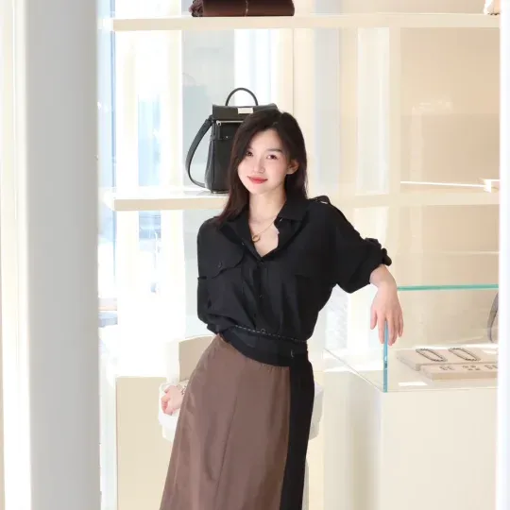
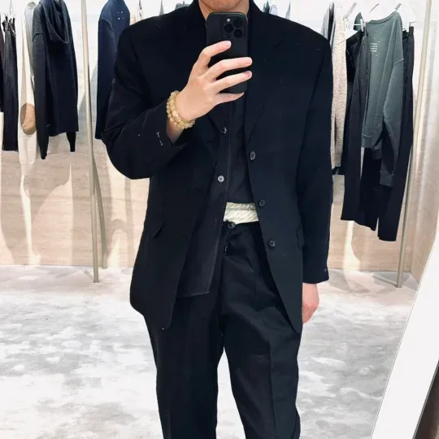


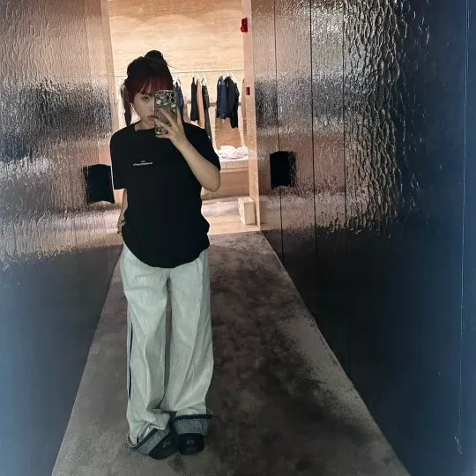

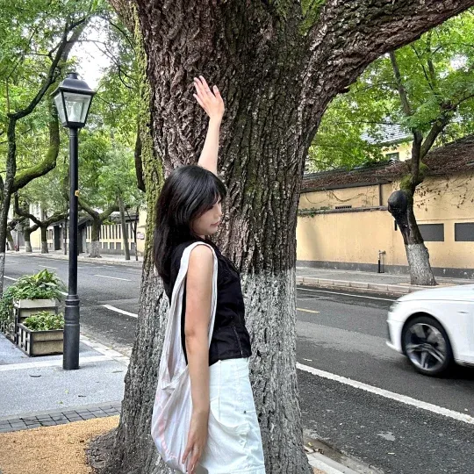

Retail Piloting Performance
Period
2025.09.29 – 2025.10.26
 |  | Store Code 所属店铺 | Notes Published 发布笔记数 | Engagement 笔记互动量 | Inquires Received 私信开口数 | WeCom Recruitment 企微留资数 | Turnover 期间成交量
 | Aoki Li | MCQM | 14 | 33 | 12 | 21 | ¥43,760
 | Eddie Yuan | MJC | 11 | 30 | 16 | 16 | ¥34,260
 | Linda Luo | MCQM | 19 | 43 | 16 | 15 | ¥26,000
 | Elson Men | MBCW | 18 | 35 | 12 | 2 | ¥24,910
 | Eddie Wang | MHMC | 6 | 21 | 13 | 7 | ¥17,328
 | Jessica Zhang | MGTKH | 18 | 23 | 5 | 40 | ¥16,250
 | Nikki Ke | MRE | 56 | 39 | 14 | 22 | ¥15,850
 | Yuki Zhang | MGTKH | 10 | 26 | 16 | 12 | ¥14,300
 | Chenille | MZD | 18 | 20 | 18 | 2 | ¥12,130
 | Ella Wang | MQT | 35 | 24 | 8 | 4 | ¥10,800

Slide 4
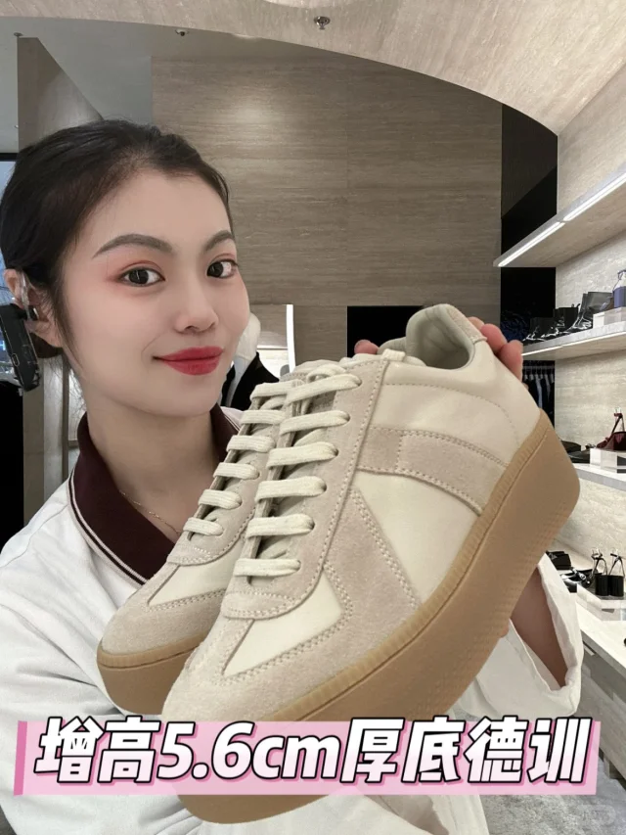
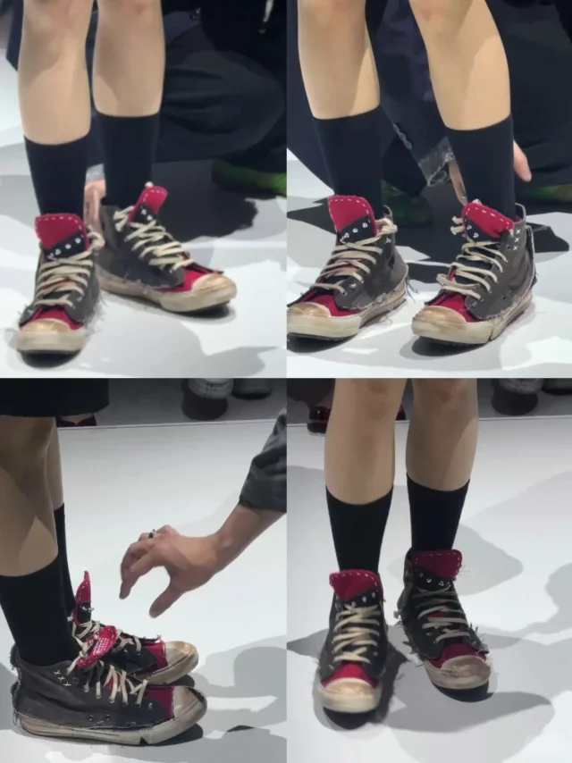
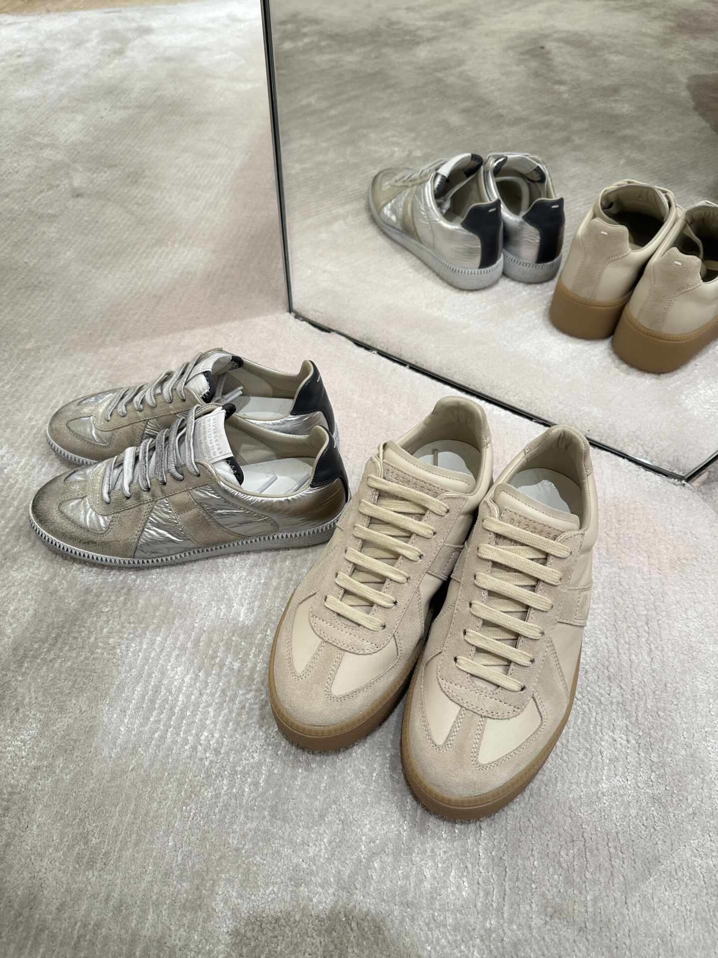
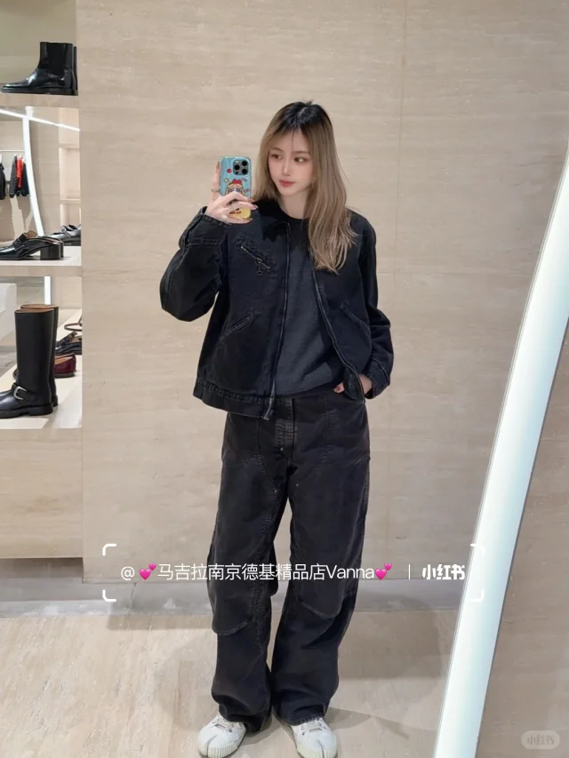
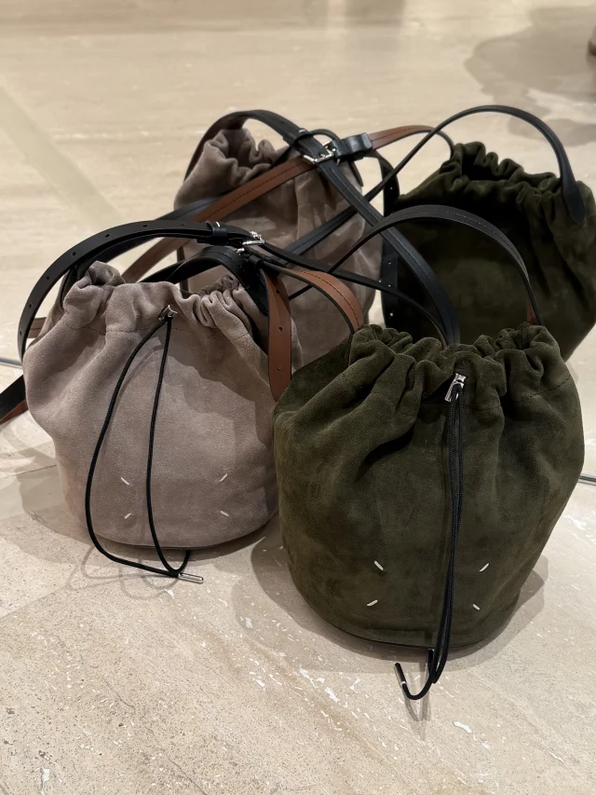
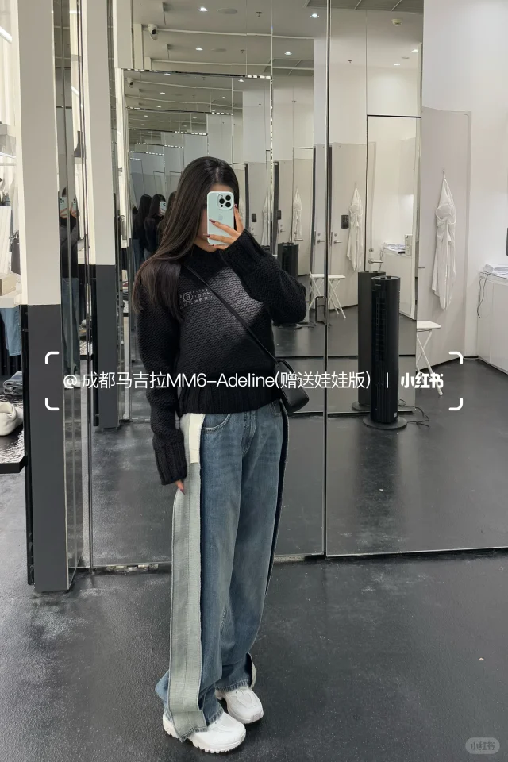
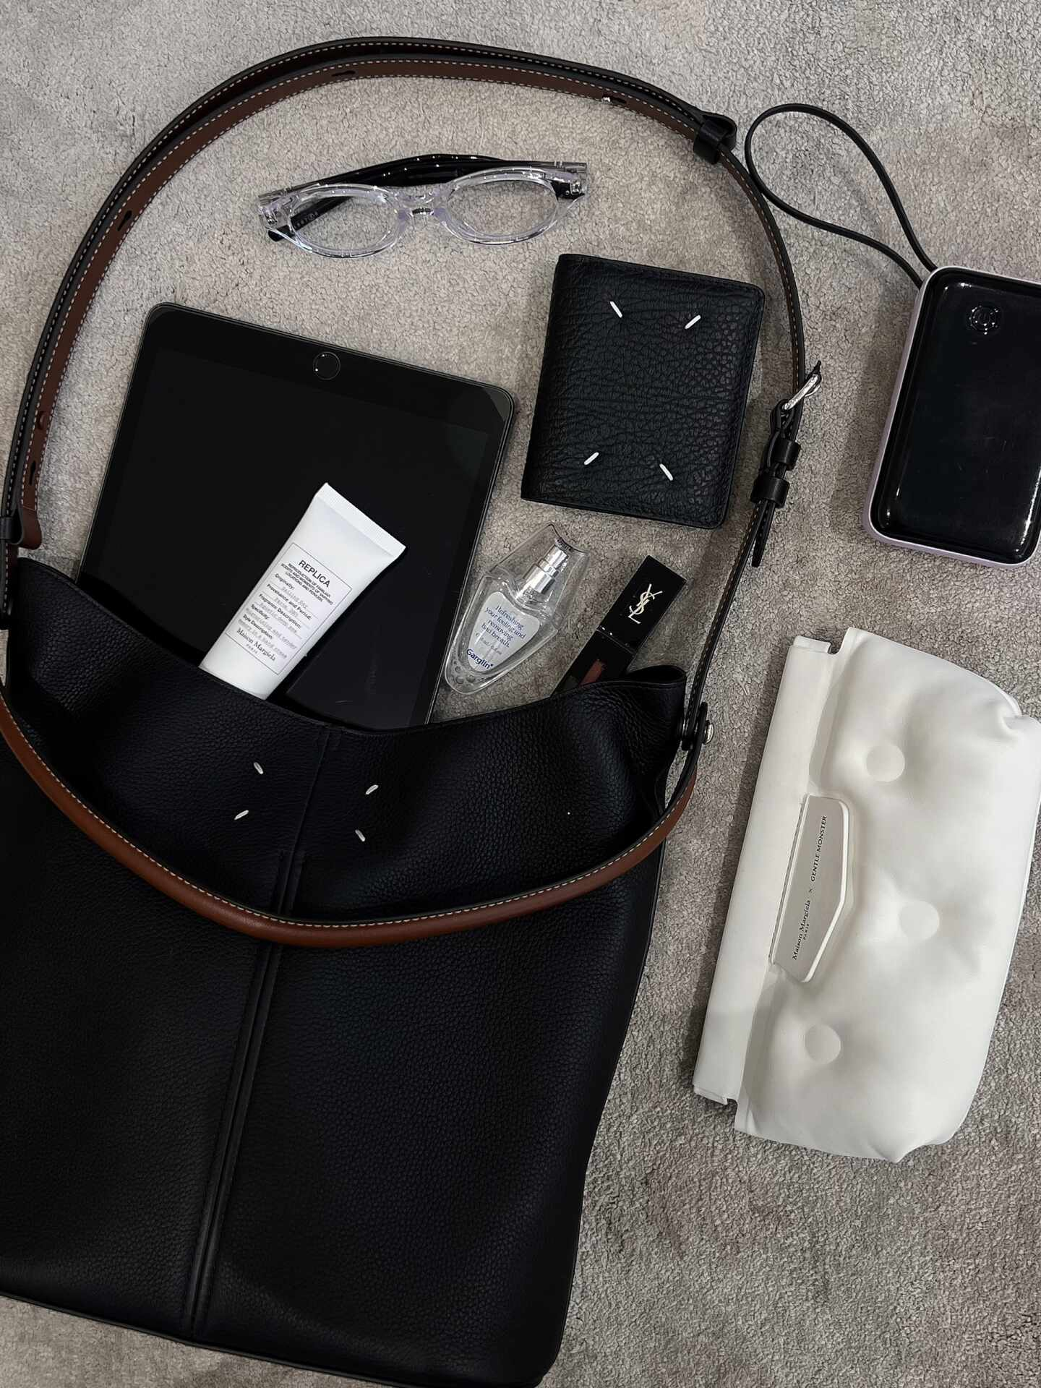
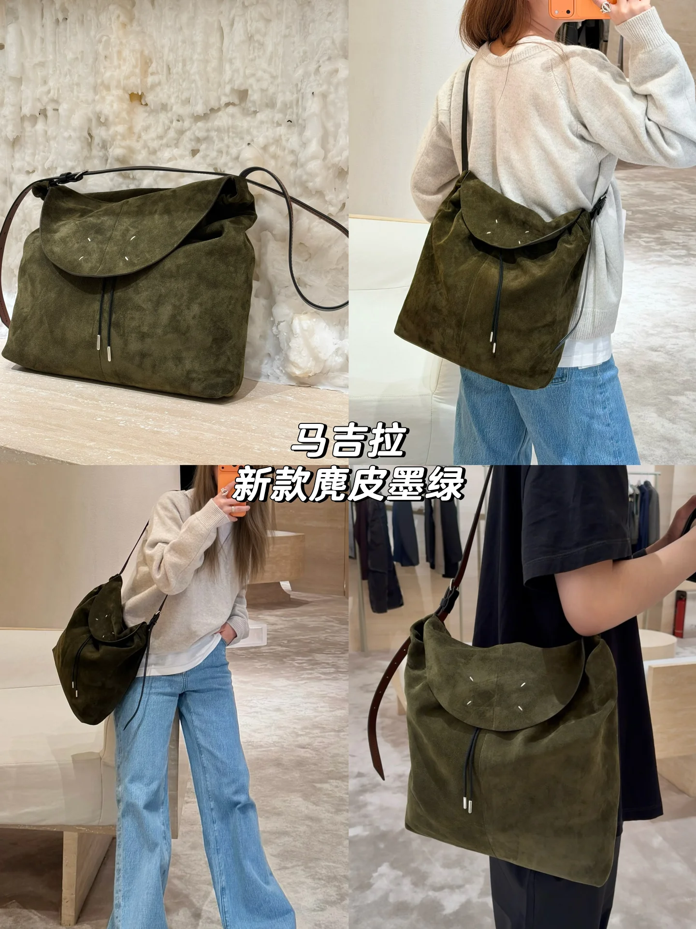
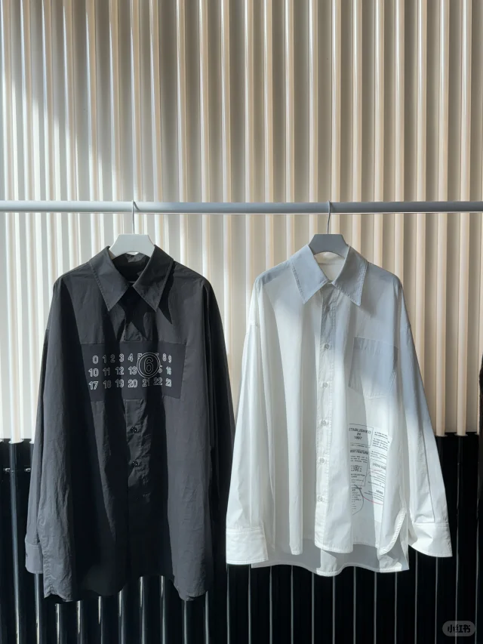
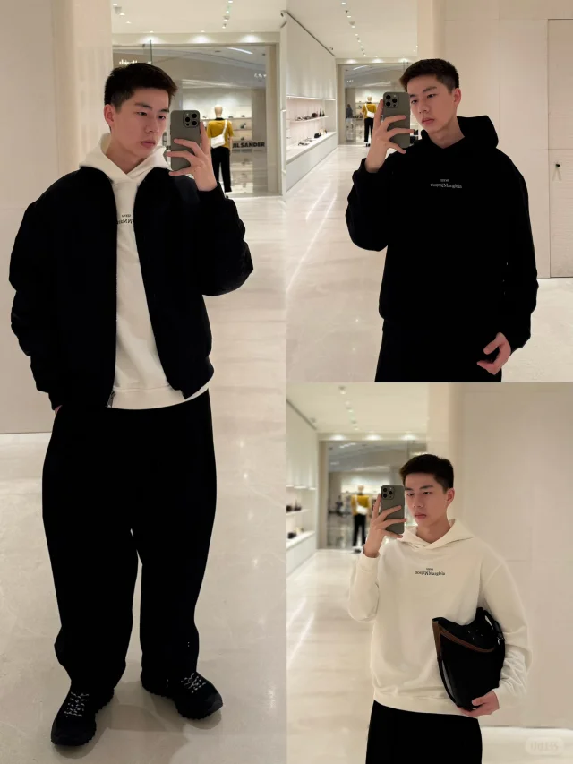
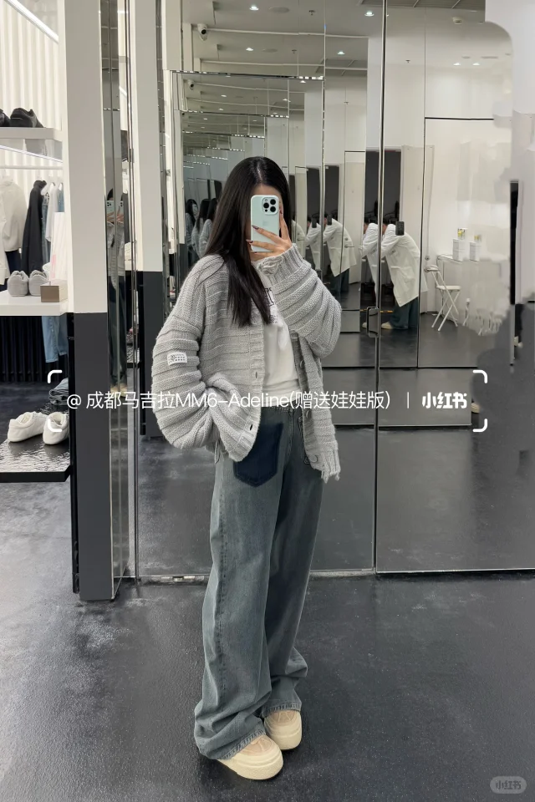
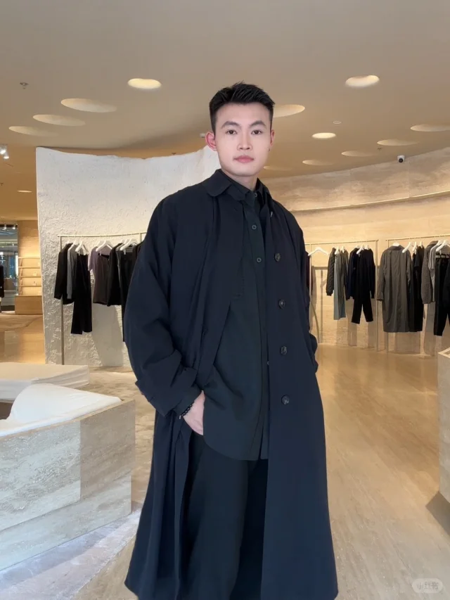
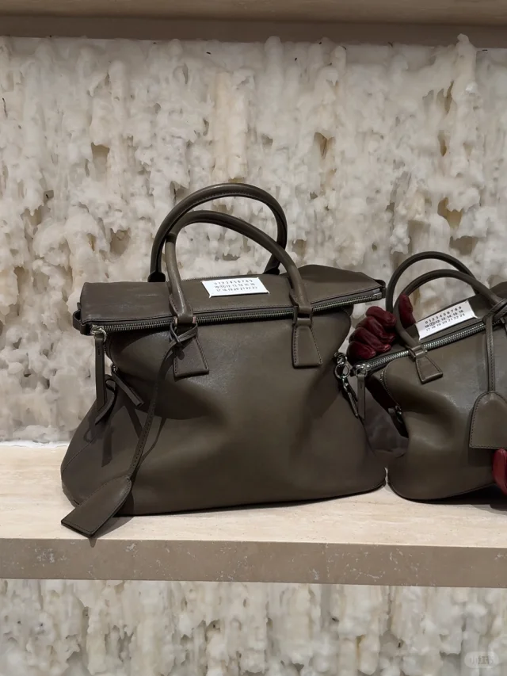
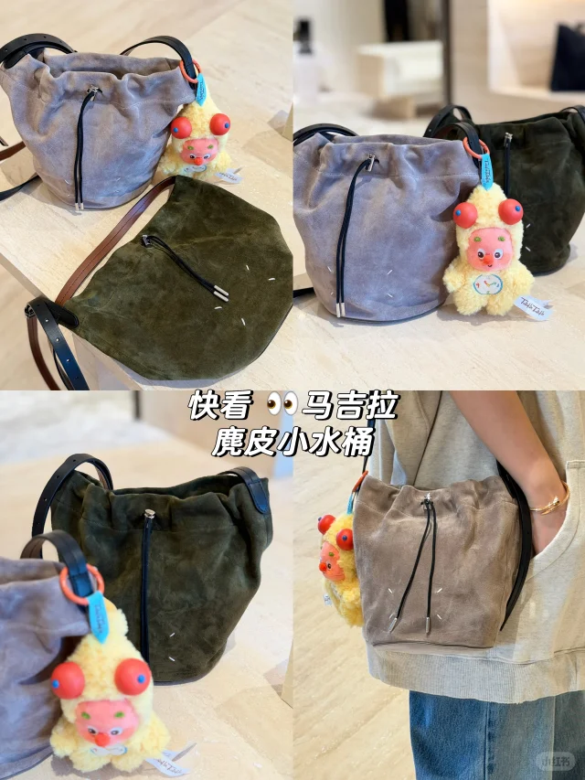
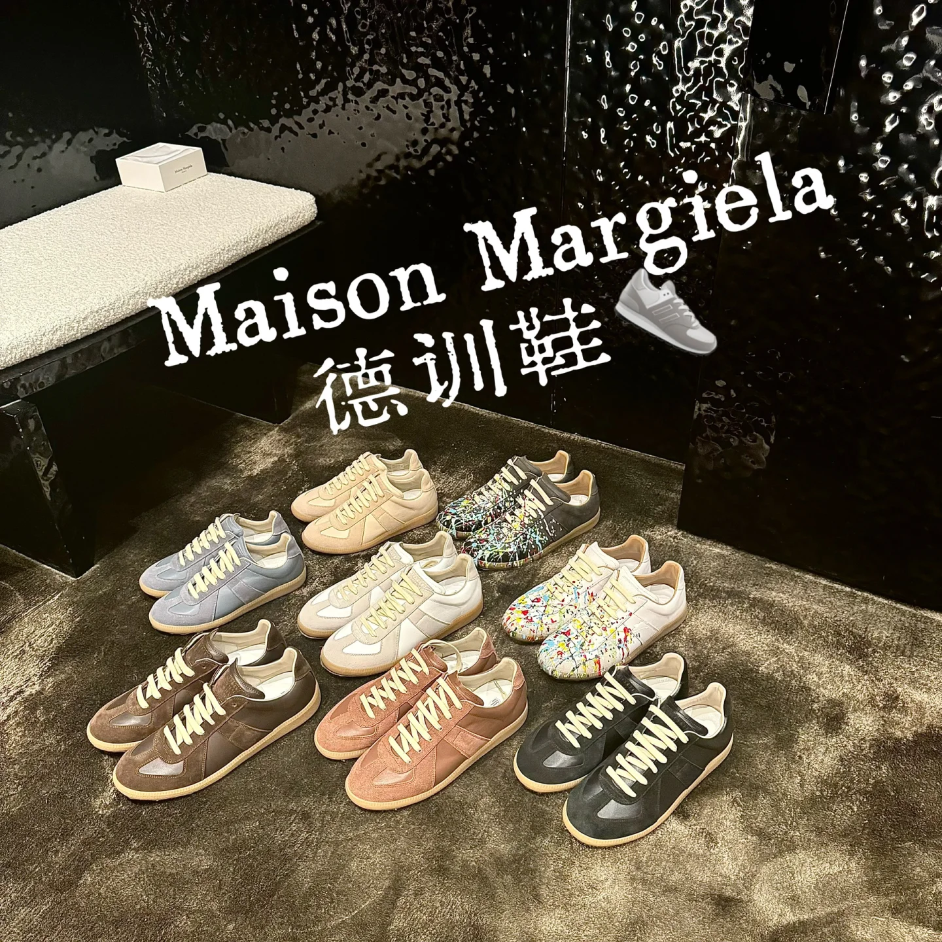
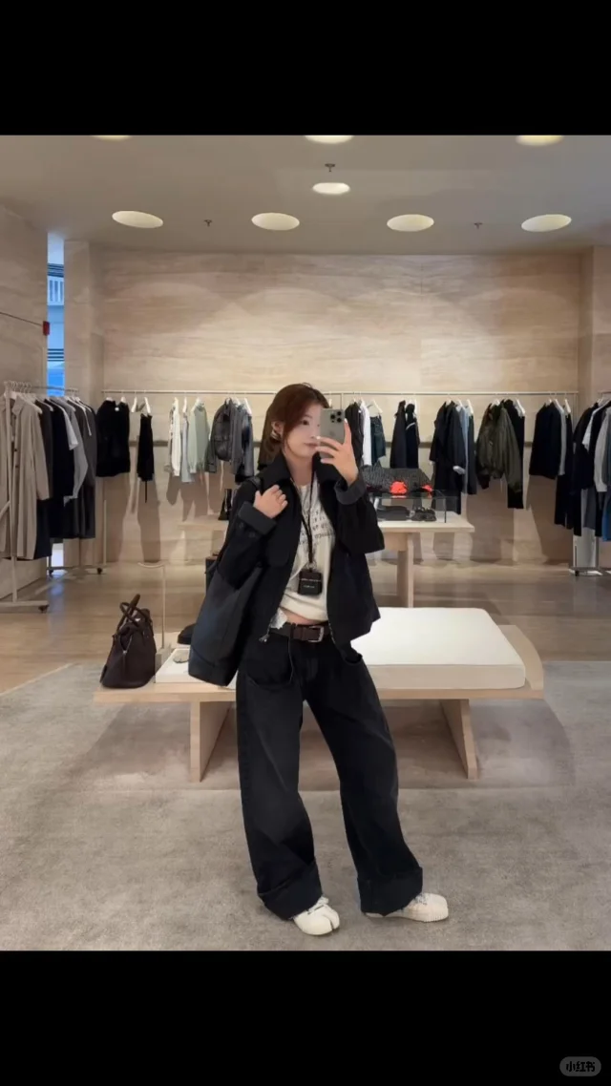
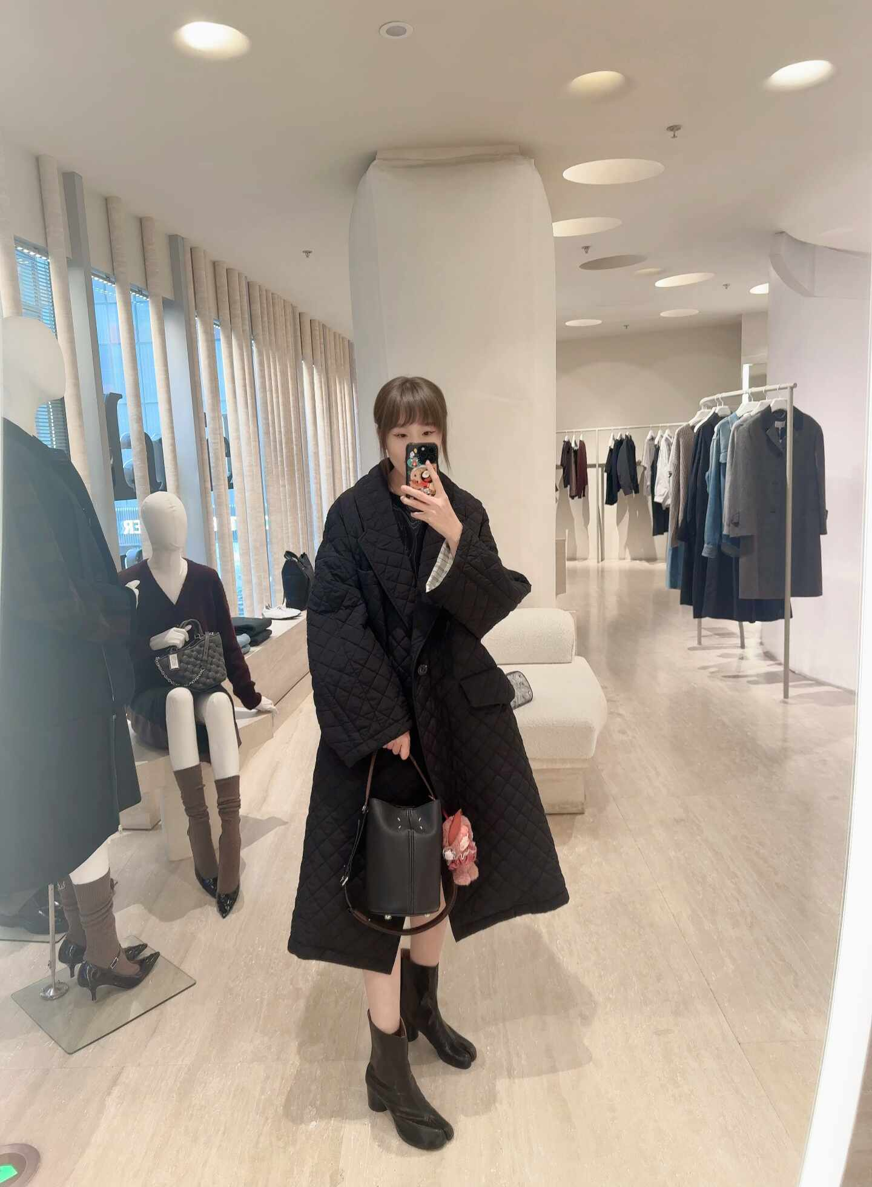
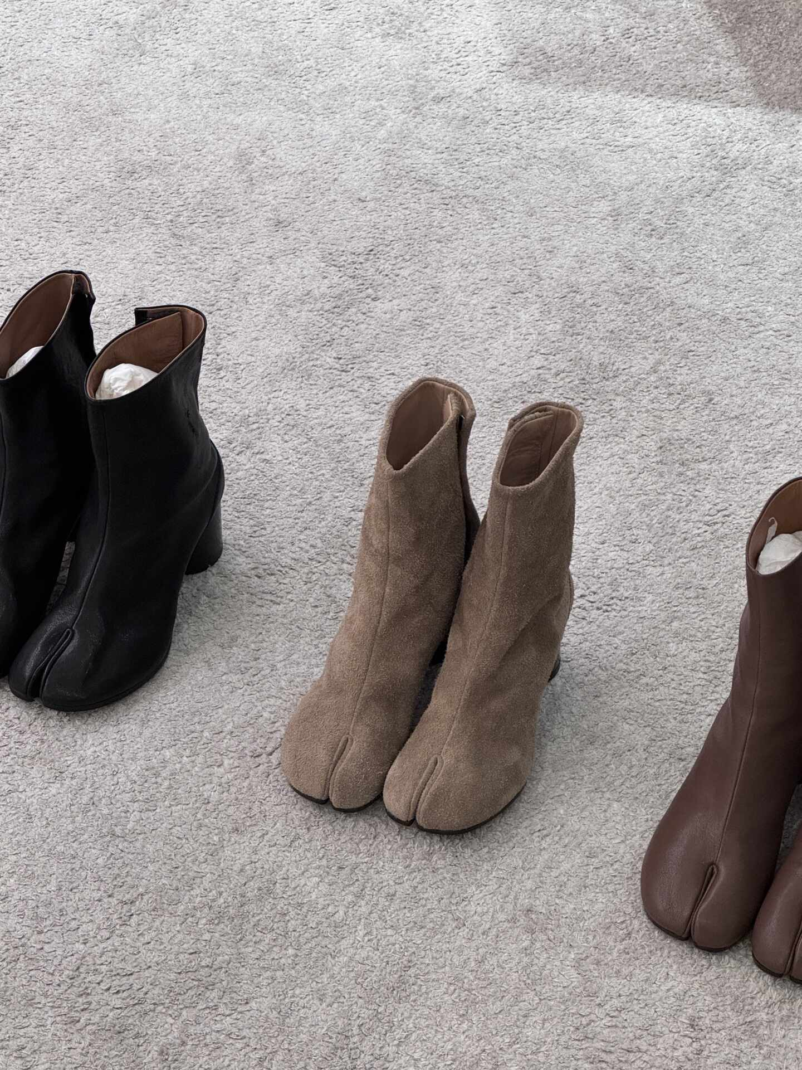
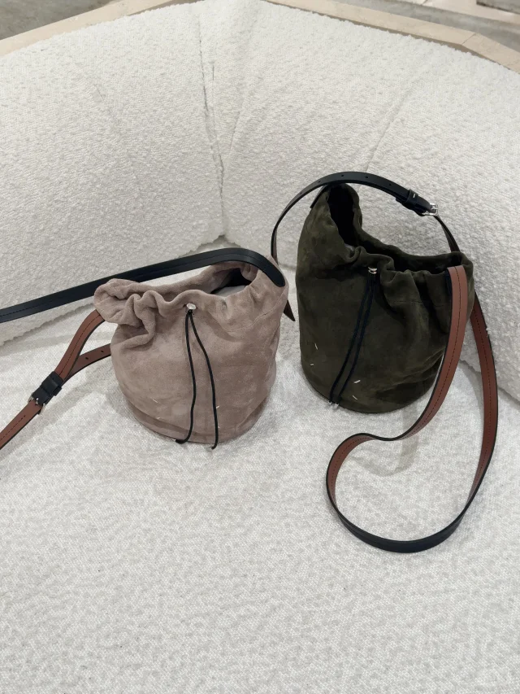
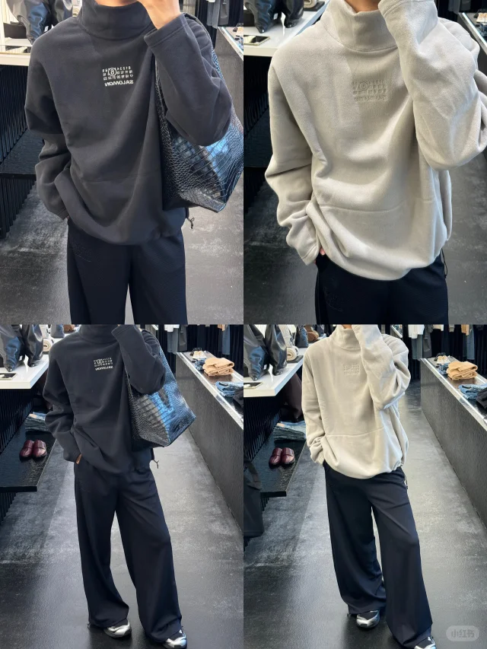
Retail Performance (by Note)
Period
2025.10.20 – 2025.10.26
Note 笔记 | Note Link 笔记 链接 | Store Code 所属账号 | Cost 投放消耗 | Engagement 笔记互动量 | CPE 互动成本 | Inquires Received 私信开口数 | 私信开口成本 | 笔记内容总结
 | Link | Eddie Yuan | 317 | 10 | 32 | 6 | 53 | "视频讲解与多场景穿搭展示，突出增高显瘦。"
 | Link | Eddie Wang | 229 | 2 | 115 | 2 | 115 | "新品速递，直观展现产品亮点"
 | Link | Jessica Zhang | 213 | 6 | 35 | 0 | - | "多角度实拍+口语化表达，引导用户互动选择。"
 | Link | Bonnie Luo | 210 | 9 | 23 | 1 | 210 | "直观视觉呈现，包袋收纳与品牌感。"
 | Link | Kern Ding | 177 | 5 | 35 | 2 | 89 | "纯粹商品视觉展示，缺乏具体描述。"
 | Link | Adeline Lei | 177 | 3 | 59 | 1 | 177 | "真人试穿大牌新品，视觉直观呈现休闲穿搭。"
 | Link | Sylvia Ma | 171 | 0 | - | 1 | 171 | "直接展示产品特性与搭配场景"
 | Link | Gold Wang | 158 | 3 | 53 | 2 | 79 | "多款德训鞋上脚展示，视觉冲击力强。"
 | Link | Summer Wang | 136 | 0 | - | 1 | 136 | "潮流穿搭实测，兼顾风度与温度"
 | Link | Summer Wang | 114 | 2 | 57 | 1 | 114 | "简约实物展示，搭配日常穿搭。"
Note 笔记 | Note Link 笔记 链接 | Store Code 所属账号 | Cost 投放消耗 | Engagement 笔记互动量 | CPE 互动成本 | Inquires Received 私信开口数 | 私信开口成本 | 笔记内容总结
 | Link | Nikki Ke | 112 | 6 | 19 | 1 | 112 | "秀场视角，聚焦解构设计感鞋款细节。"
 | Link | Vanna Xue | 105 | 1 | 105 | 0 | - | "新品试穿分享，细节特写，风格休闲。"
 | Link | Adeline Lei | 83 | 4 | 21 | 1 | 83 | "品牌混搭日常穿搭，镜面自拍展示。"
 | Link | Amy Fan | 76 | 1 | 76 | 0 | - | "多场景上身，细节亮点突出"
 | Link | Gold Wang | 67 | 1 | 67 | 1 | 67 | "对比穿搭展示，细节特写。"
 | Link | Eddie Wang | 66 | 0 | - | 1 | 66 | "动态穿搭展示，激发用户互动选色"
 | Link | Amy Fan | 56 | 1 | 56 | 0 | - | "视频实物展示，多色细节种草"
 | Link | Ella Wang | 53 | 0 | - | 0 | - | "秋日慵懒风穿搭分享"
 | Link | Ella Wang | 51 | 1 | 51 | 0 | - | "多色Tabi靴展示，视觉精致"
 | Link | Kern Ding | 48 | 0 | - | 0 | - | -

Slide 5
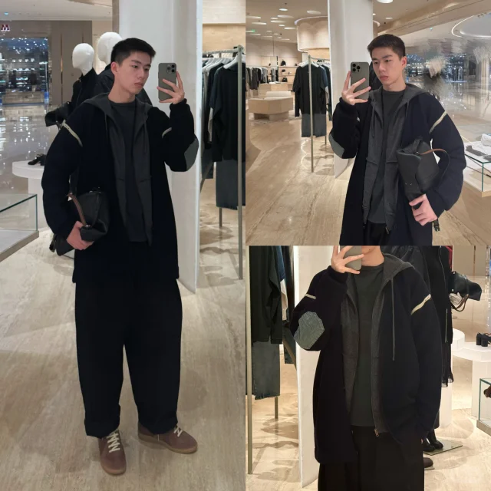
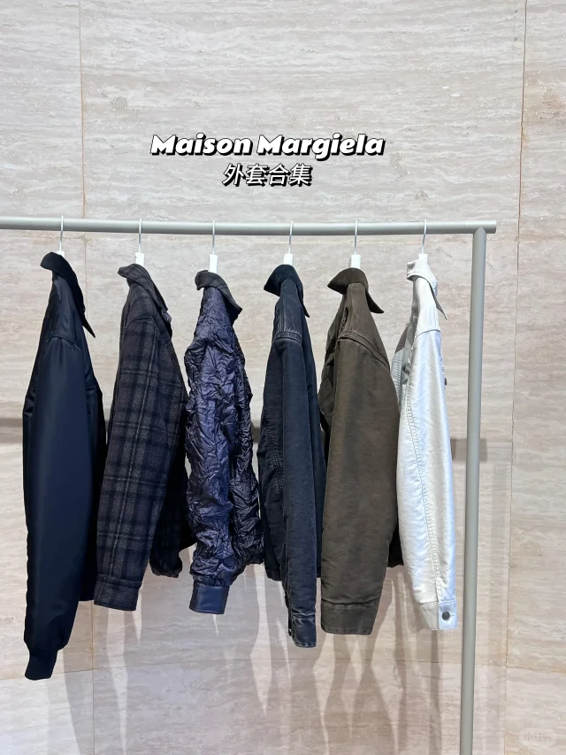
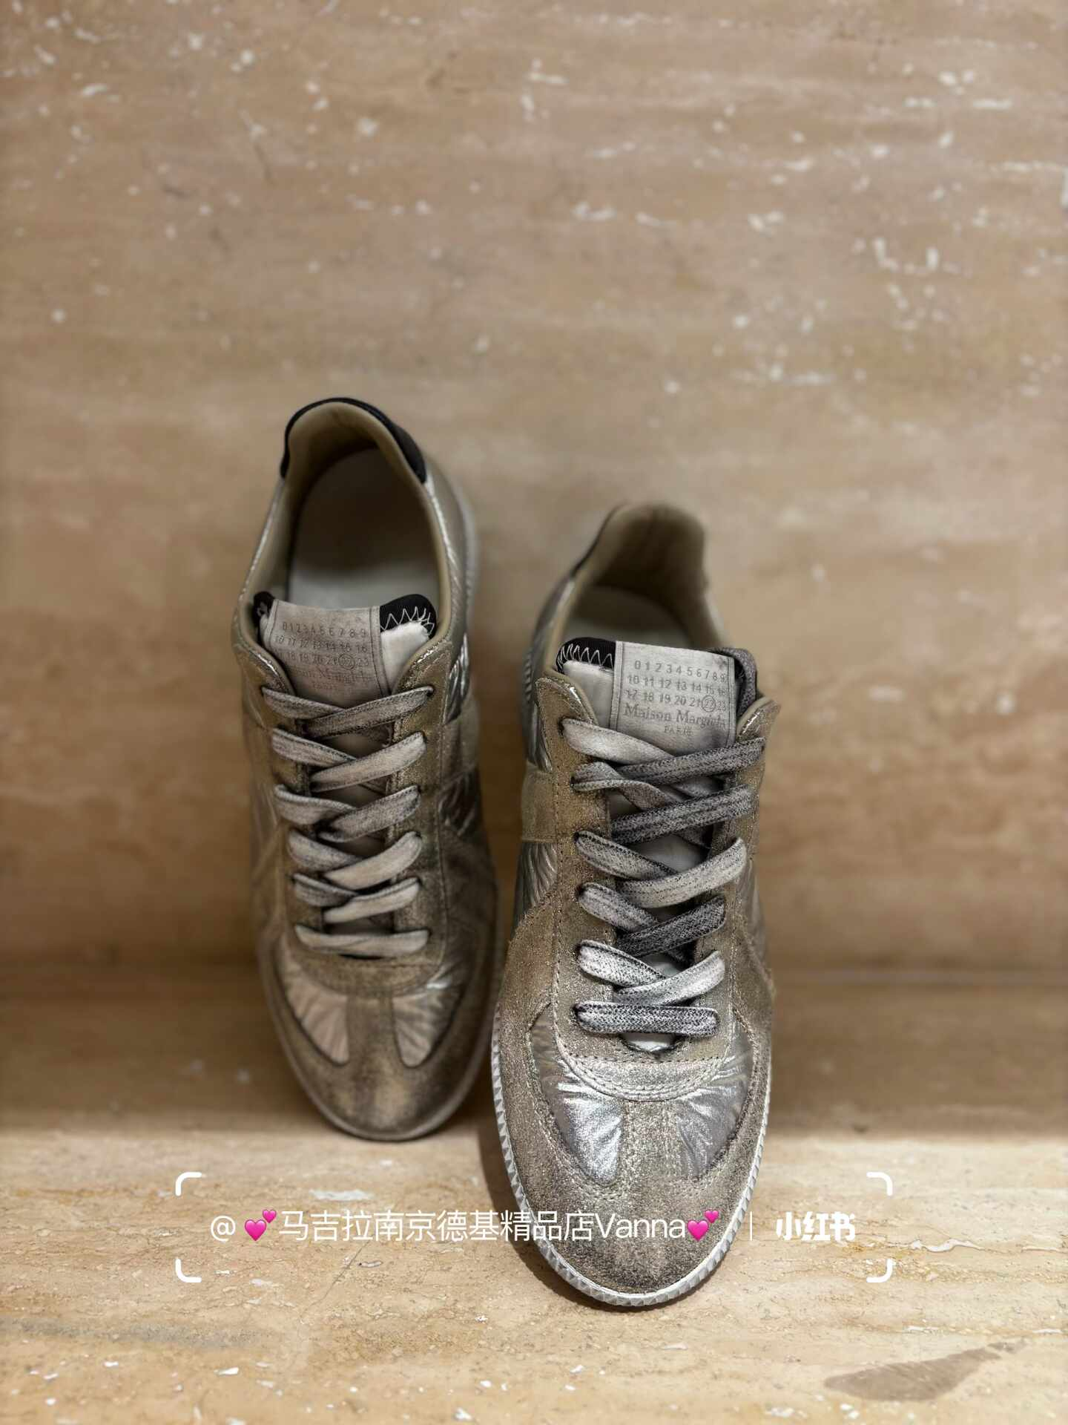
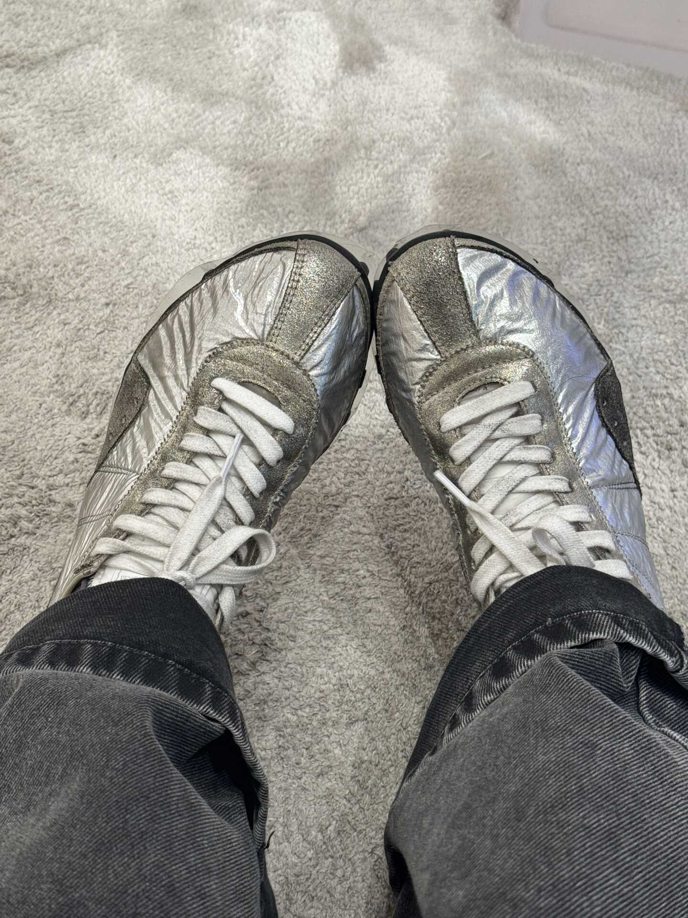
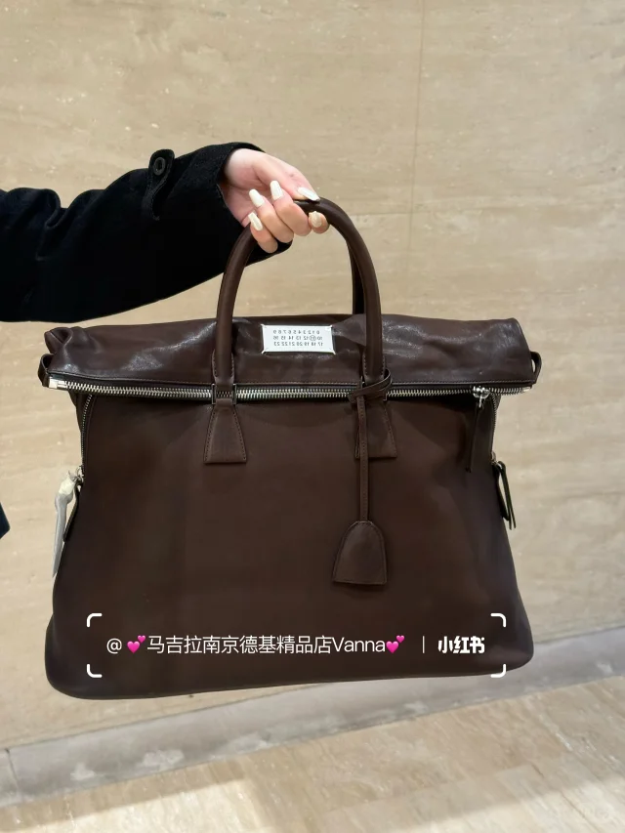
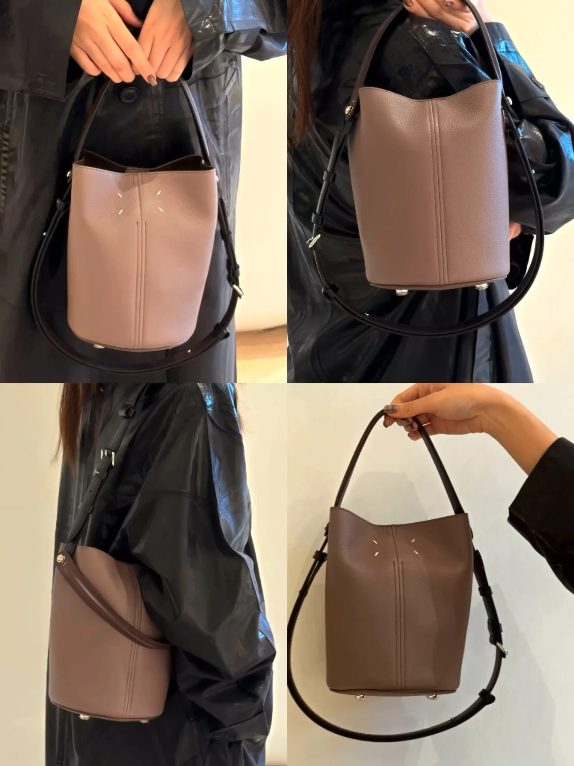
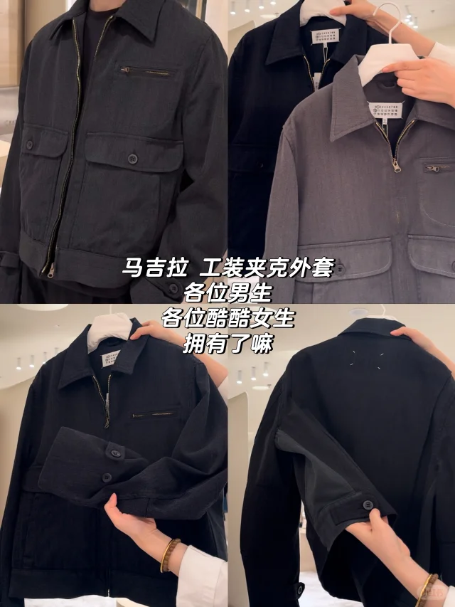
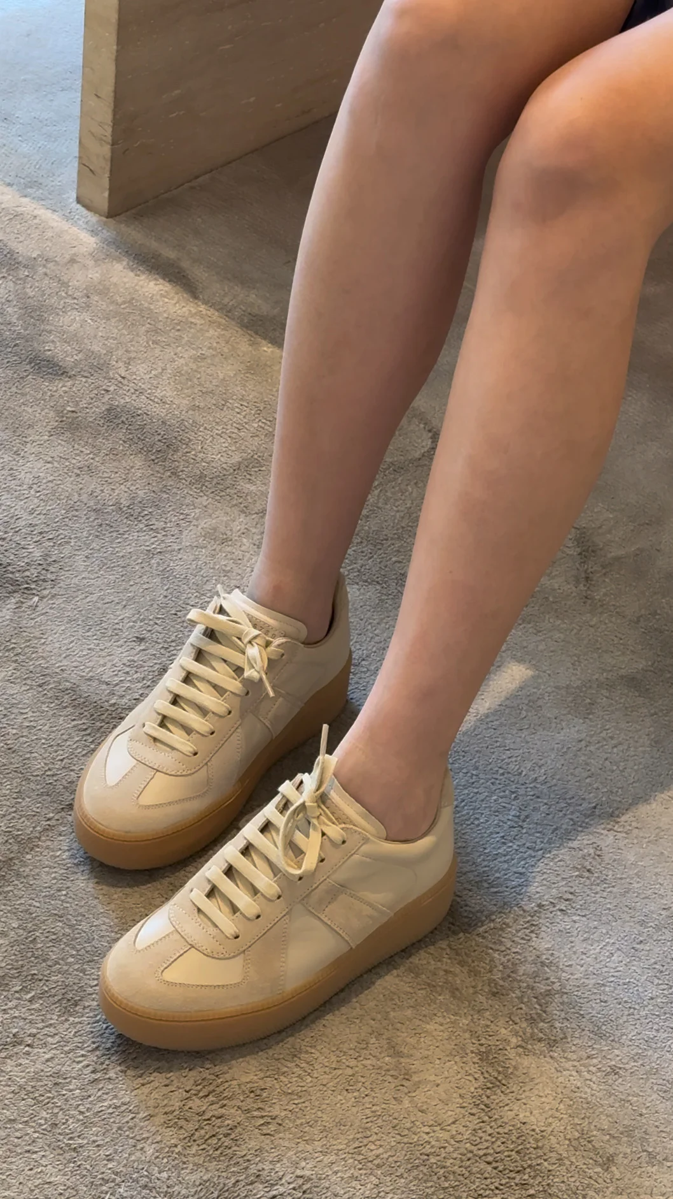
Retail Performance (by Note)
Period
2025.10.20 – 2025.10.26
Note 笔记 | Note Link 笔记 链接 | Store Code 所属账号 | Cost 投放消耗 | Engagement 笔记互动量 | CPE 互动成本 | Inquires Received 私信开口数 | 私信开口成本 | 笔记内容总结
 | Link | Gold Wang | 39 | 0 | - | 0 | - | "镜面自拍展示品牌秋冬穿搭，强调层次与复古感。"
 | Link | Bonnie Luo | 36 | 1 | 36 | 2 | 18 | "新款外套合集，简洁直观。"
 | Link | Vanna Xue | 29 | 0 | - | 0 | - | "多色实物展示，直接互动引导选择。"
 | Link | Summer Wang | 23 | 0 | - | 0 | - | "强调单品时尚力，穿搭场景化，视觉吸睛。"
 | Link | Vanna Xue | 22 | 0 | - | 0 | - | "直观上身展示，强调功能实用性。"
 | Link | Nikki Ke | 12 | 0 | - | 0 | - | "多角度动态展示新款包包的简约实用性"
 | Link | Amy Fan | 10 | 0 | - | 0 | - | "新款夹克实穿展示，材质细节讲解"
 | Link | Nikki Ke | 3 | 0 | - | 0 | - | "鞋款直观展示，强调舒适与时尚兼具。"

Slide 6


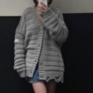
Wholesale Dashboard
Period
2025.10.20 – 2025.10.26
Piloting Account
Account with Paid Promo
Notes Published
Notes with Paid Promo
Engagement
Engagement from Paid
当前KOSA账号数
投广账号总数
发布笔记数
投广笔记数
笔记总互动数
投广带来的互动量
9
1
60
3
1,846
4
Chats Initiated
Inquiries Received
WeCom Recruitment
WeCom Recruiment Efficiency
CPR (Cost per Recruitment)
Turnover
私信进线数
私信开口数
企微留资数
企微招募效率
企微留资成本
期间成交量
232
219
-
-%
￥-
￥-
Weekly Top 3
 | Store Code 所属店铺 | Notes Published 发布笔记数 | Engagement 笔记互动量 | Inquires Received 私信开口数 | WeCom Recruitment 企微留资数 | Turnover 期间成交量
Allo | HZ MixC | 8 | - | - | - | -
Rick | HZ MixC | 4 | - | - | - | -
Yoyo | HZ MixC | 4 | - | - | - | -

Slide 7






Wholesale Piloting Performance
Period
2025.09.29 – 2025.10.26
 | Store Code 所属店铺 | Notes Published 发布笔记数 | Engagement 笔记互动量 | Inquires Received 私信开口数 | WeCom Recruitment 企微留资数 | Turnover 期间成交量
Allo | HZ MixC | 47 | 46 | 13
Rick | HZ MixC | 29 | 32 | 20
Yoyo | HZ MixC | 25 | 37 | 18
Ada | NB Hankyu | 13 | 20 | 5
Luna | WX Hanglung | 34 | 38 | 15
Vivi | CS IFS | 45 | 40 | 13
Cathy | NB Hankyu | 13 | 26 | 13
Josie | CS IFS | 75 | 27 | 18
Sarah | CS IFS | 23 | - | -

Slide 8
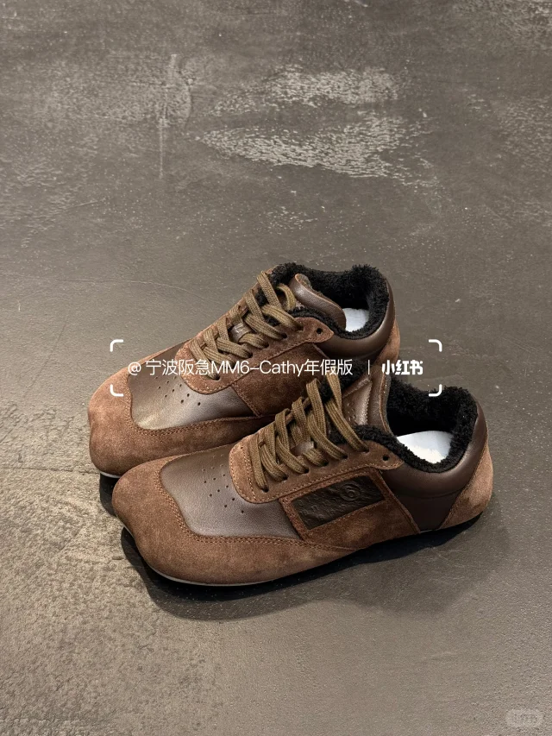
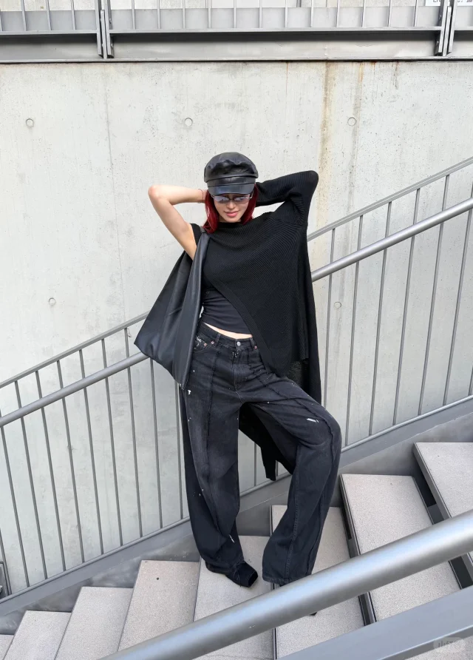

Wholesale Performance (by Note)
Period
2025.10.20 – 2025.10.26
Note 笔记 | Note Link 笔记 链接 | Store Code 所属账号 | Cost 投放消耗 | Engagement 笔记互动量 | CPE 互动成本 | Inquires Received 私信开口数 | 私信开口成本 | 笔记内容总结
 | Link | Cathy | 98 | 2 | 49 | 1 | 98 | "多色展示，强调造型与搭配感。"
 | Link | Cathy | 22 | 1 | 22 | 0 | - | "酷飒暗黑穿搭，突出品牌调性。"
 | Link | Cathy | 14 | 1 | 14 | 0 | - | "品牌单品穿搭示范，营造松弛感。"

