Slide 1


SMART INDIA HACKATHON 2025
TITLE PAGE
Problem Statement ID – 25028
Problem Statement Title - Smart Classroom and Timetable Scheduler
Theme – Smart Education
PS Category - Software
Team ID – 67993
Team Name - TENSORS

Slide 2
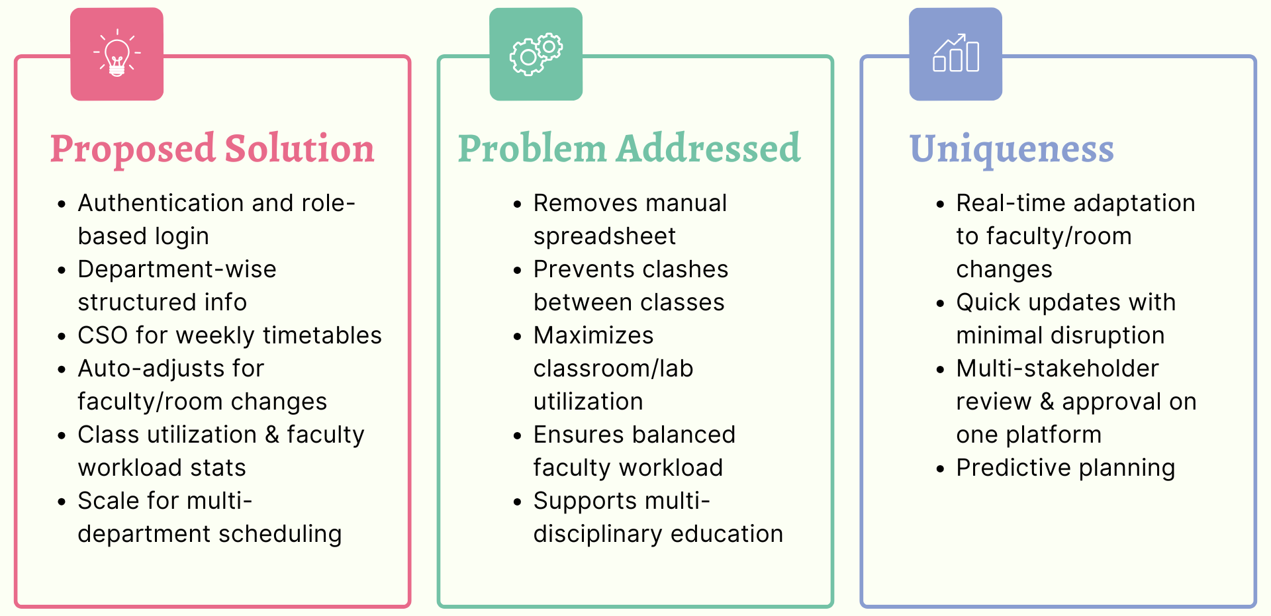
IDEA TITLE
TENSORS
Proposed Solution (Describe your Idea/Solution/Prototype)
Detailed explanation of the proposed solution
How it addresses the problem
Innovation and uniqueness of the solution

Slide 3
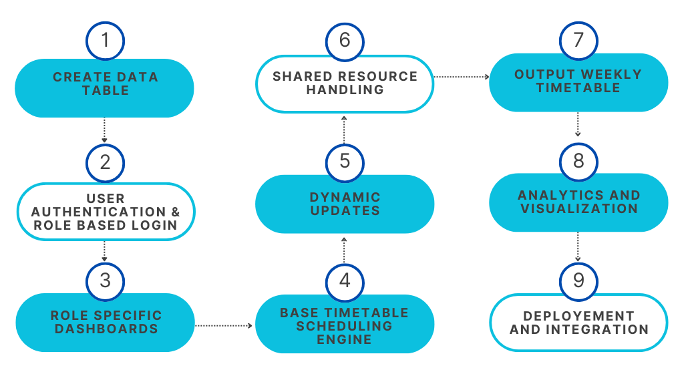
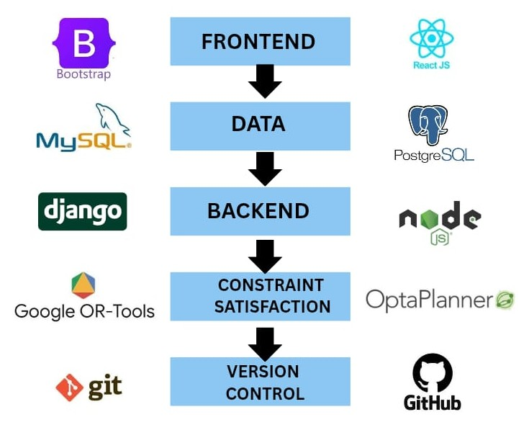
TECHNICAL APPROACH
TENSORS
Technologies to be used (e.g. programming languages, frameworks, hardware)
Methodology and process for implementation (Flow Charts/Images/ working prototype)

Slide 4
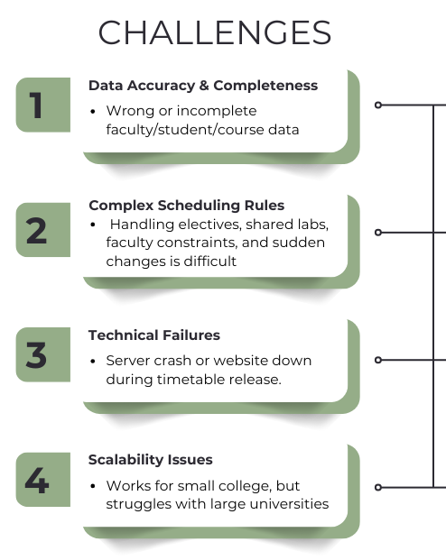
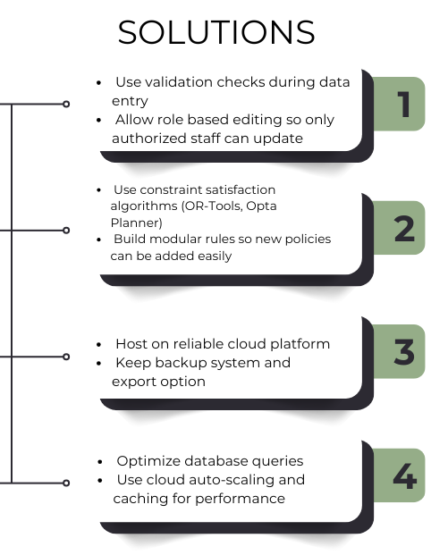
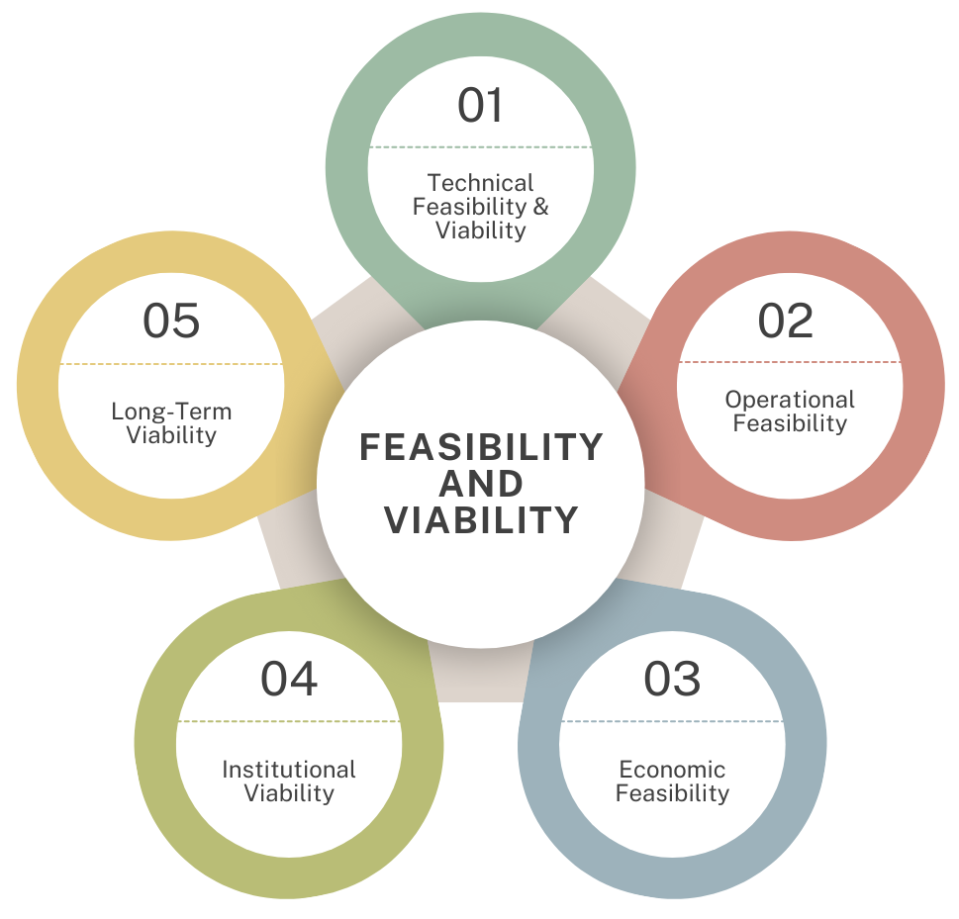
FEASIBILITY AND VIABILITY
TENSORS

Slide 5
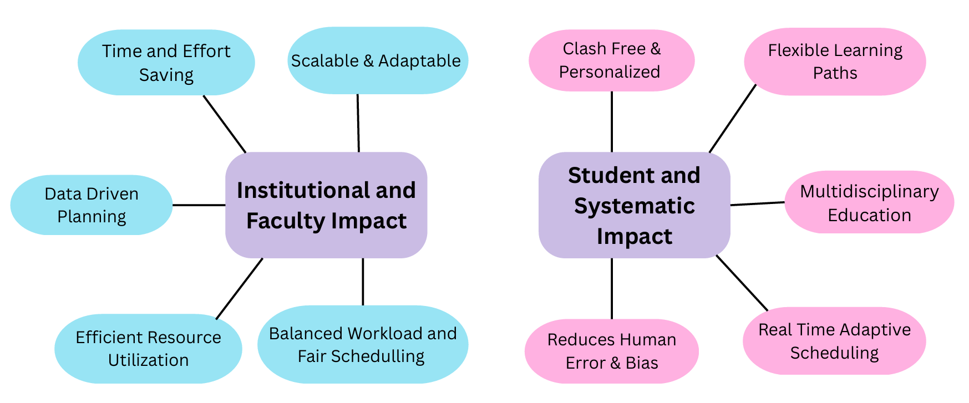
IMPACT AND BENEFITS
TENSORS
Potential impact on the target audience
Benefits of the solution (social, economic, environmental, etc.)

Slide 6
RESEARCH AND REFERENCES
TENSORS
Before building our dynamic classroom scheduler, we studied manual timetabling in colleges, identifying challenges like overlapping lectures and uneven workload.
We grounded our design in AICTE policies for faculty workload. Aicte-regulations.pdf
Recent CSP and Integer Programming studies show up to 50-80% faster scheduling and fewer conflicts in large universities. Casestudy-iim-culcutta
Solvers like Google OR-Tools and OptaPlanner are proven and scalable for real-world timetabling. comparison-open-source-constraint-solving-tools.pdf
THANK YOU

