Slide 1
FOOD & RESTAURANT ANALYTICS
Zomato Analytics
Dashboard
Restaurant, Customer Rating & Delivery Insights
Excel
SQL
Power BI
Tableau
1. Kola Shivani 2. S Asifa Kausar 3 .Suhana M V 4. Kandati Sai Kumar Reddy 5 .Guvva Mahesh
Domain: Food & Restaurant Analytics

Slide 2
ROADMAP
Agenda
Project Goal & Introduction
Cuisine, Pricing & Rating Analysis
1
5
Dataset Description & Data Model
Delivery & Table Booking Insights
2
6
Key Performance Indicators (KPIs)
SQL Analysis & Business Findings
3
7
Restaurant & City Analysis
Recommendations & Conclusion
4
8
ZOMATO ANALYTICS
02

Slide 3
OVERVIEW
Introduction
This presentation analyzes the Zomato restaurant dataset to understand restaurant distribution, pricing, ratings, cuisines and service availability.
The analysis converts raw restaurant-level data into measurable KPIs and business insights that can support location strategy, customer experience and digital delivery decisions.
The workbook contains a Main restaurant table plus Country, Currency and Date supporting sheets.
WORKBOOK
Main
9,551 restaurant records
Country
CountryCode → country
Currency
Currency → USD rate
Date
Calendar / time table
ZOMATO ANALYTICS
03

Slide 4
OBJECTIVES
Project Goal
1
Measure the overall restaurant ecosystem using count, city coverage, cuisine diversity and customer ratings.
2
Identify high-concentration cities and popular cuisine categories.
3
Understand how price range relates to customer ratings.
4
Evaluate online delivery and table-booking adoption.
5
Generate practical recommendations from the observed patterns.
ZOMATO ANALYTICS
04

Slide 5
DATA SOURCE
Dataset Description
Source: Zomato_Analytics_Date_Sheet_Filled.xlsx
9,551
141
1,825
15
2.89
Restaurants
Cities
Unique Cuisines
Country Codes
Avg. Rating
Field Group | Important Columns
Identity | RestaurantID, RestaurantName
Location | CountryCode, City, Address, Locality, Latitude, Longitude
Food | Cuisines
Services | Has_Table_booking, Has_Online_delivery, Is_delivering_now
Commercial | Price_range, Average_Cost_for_two
Customer | Votes, Rating
Opening | Year Opening, Month Opening, Day Opening
ZOMATO ANALYTICS
05

Slide 6
STRUCTURE
Data Model Overview
Main is the central restaurant-level dataset with 9,551 records and 22 columns.
Country maps CountryCode to country names.
Currency provides currency-to-USD reference rates.
Date is a calendar table with year, month, quarter, weekday and financial-period attributes.
This structure supports time-based analysis and dashboard filtering.
MAIN
9,551 rows
Country
Currency
Date
ZOMATO ANALYTICS
06

Slide 7
SNAPSHOT
Dashboard Overview
1.50M
$1,199
25.7%
Total Votes
Avg. Cost for Two
Online Delivery
Customer votes across all restaurants
Raw currency values, unconverted
Restaurants offering digital ordering
HOW TO READ THIS DASHBOARD
Use the dashboard to compare geography, customer perception, pricing and digital-service adoption.
Recommended filters: City (narrows to a market), Price Range (segments spend tiers), Rating (surfaces top/bottom performers), Online Delivery and Table Booking (isolates digitally-enabled restaurants).
Combine filters — e.g. City + Price Range — to see how a specific market performs against the national averages on the Dataset Description slide.
ZOMATO ANALYTICS
07

Slide 8
GEOGRAPHY
Restaurant Distribution by City
5,473
New Delhi restaurants
New Delhi dominates the dataset with 5,473 restaurants.
Gurgaon and Noida follow with 1,118 and 1,080 respectively.
The restaurant base is highly concentrated in a small number of cities, indicating strong geographic skew.
ZOMATO ANALYTICS
08

Slide 9
MENU TRENDS
Cuisine Analysis
936
1,825
Top Mix
North Indian records
Unique cuisine values
North Indian & Chinese lead
Most represented cuisine value
Shows substantial menu variety
Among the most common cuisine categories in the dataset
North Indian: 936 of 9,551 restaurant records (9.8%)
North Indian is the most represented cuisine value in the dataset, with 936 records.
North Indian and Chinese are among the leading cuisine categories recorded.
The dataset contains 1,825 unique cuisine values, showing substantial variety across restaurants.
ZOMATO ANALYTICS
09

Slide 10
PRICING
Price Range & Customer Ratings
Band 4
Band 3
Band 2
Band 1
2.38
↑
↑
3.84
Average customer rating increases as price range increases — from 2.38 in Band 1 to 3.84 in Band 4.
$1,199
2.89
3.84
Avg. Cost for Two
Overall Avg. Rating
Highest Price-Band Rating
ZOMATO ANALYTICS
10

Slide 11
CUSTOMER PERCEPTION
Rating Distribution
2.89
2,148
3.84
Overall average rating
Records rated 1.0
Highest price-band rating
Most frequent single rating value
Rating rises with price range
Overall average rating across the dataset is 2.89.
The 1.0 rating value appears 2,148 times in the source data — the most frequent single rating figure.
Higher price bands show higher average ratings in this dataset, with the highest band averaging 3.84.
ZOMATO ANALYTICS
11

Slide 12
DIGITAL SERVICES
Service Availability & Delivery Insights
25.7%
12.1%
0.4%
Online Delivery
Table Booking
Delivering Now
Online delivery is much more prevalent than table booking in the dataset (25.7% vs 12.1%).
The 'Is_delivering_now' field has very few Yes records (0.4%), so it should be interpreted as a snapshot rather than broad delivery adoption.
Digital ordering capability is therefore a stronger differentiator than live-delivery status in this source.
ZOMATO ANALYTICS
12

Slide 13
TIMELINE
Restaurant Opening Trend
Expansion Window
2010
2012
2014
2016
2018
Opening years in the dataset range from 2010 to 2018.
The year trend helps identify periods of expansion and can be combined with city or cuisine filters.
Use the Date table for consistent year/month/quarter slicing in BI dashboards.
ZOMATO ANALYTICS
13

Slide 14
ENGAGEMENT LEADERS
Top Restaurants by Customer Votes
Restaurant | City | Votes | Rating
Toit | Bangalore | 10,934 | 4.8
Truffles | Bangalore | 9,667 | 4.7
Hauz Khas Social | New Delhi | 7,931 | 4.3
Peter Cat | Kolkata | 7,574 | 4.3
AB's - Absolute Barbecues | Bangalore | 6,907 | 4.6
Barbeque Nation | Kolkata | 5,966 | 4.9
Big Brewsky | Bangalore | 5,705 | 4.5
AB's - Absolute Barbecues | Hyderabad | 5,434 | 4.9
Bangalore restaurants lead engagement, with Toit topping the list at 10,934 votes and a 4.8 rating.
ZOMATO ANALYTICS
14

Slide 15
SUMMARY
Key Performance Indicators
9,551
141
1,825
2.89
Total Restaurants
City Coverage
Cuisine Diversity
Average Rating
Scale of restaurant ecosystem
Geographic reach
Unique cuisine values
Customer perception
1.50M
$1,199
25.7%
12.1%
Total Votes
Avg Cost for Two
Online Delivery
Table Booking
Engagement volume
Pricing indicator
Digital service adoption
Reservation adoption
ZOMATO ANALYTICS
15

Slide 16
QUERY LAYER
SQL Analysis
Restaurant count by city
Average rating by price range
SELECT City, COUNT(*) AS Restaurant_Count
FROM Main
GROUP BY City
ORDER BY Restaurant_Count DESC;
SELECT Price_range, ROUND(AVG(Rating),2) AS Avg_Rating
FROM Main
GROUP BY Price_range
ORDER BY Price_range;
Online delivery split
Top 10 cuisines
SELECT Has_Online_delivery, COUNT(*) AS Restaurants
FROM Main
GROUP BY Has_Online_delivery;
SELECT Cuisines, COUNT(*) AS Restaurant_Count
FROM Main
GROUP BY Cuisines
ORDER BY Restaurant_Count DESC
LIMIT 10;
ZOMATO ANALYTICS
16

Slide 17
INSIGHTS
Key Findings
1
Geography
2
Cuisine
3
Pricing
New Delhi accounts for 5,473 restaurants, making it the dominant city in the source.
North Indian is the leading cuisine value with 936 records.
Average rating rises across the four price bands: 2.38 → 3.84.
4
Digital
5
Engagement
6
Data Quality
Online delivery is available for 25.7% of restaurants, much higher than table-booking adoption.
The dataset records 1.50M total customer votes.
Cuisines has 9 missing values; all other listed Main fields are populated in the workbook.
ZOMATO ANALYTICS
17

Slide 18
BEFORE YOU PRESENT THIS
Data Quality & Limitations
!
Missing Values
!
Snapshot Field
!
Partial Price-Band Detail
The Cuisines field has 9 missing values; every other listed Main-table field is fully populated.
'Is_delivering_now' shows Yes for only 0.4% of records — treat it as a point-in-time flag, not a measure of overall delivery adoption.
Only the lowest (2.38) and highest (3.84) price-band average ratings are called out in this deck; confirm Band 2 and Band 3 averages directly in the workbook before quoting them.
!
Cuisine Field Format
!
Currency
!
Validation Step
Cuisines is a free-text, multi-value field (1,825 unique combinations) rather than a fixed category list, so cross-cuisine comparisons need care.
Average_Cost_for_two is shown in raw local currency; use the Currency sheet's USD rate before comparing costs across countries.
Re-check any filtered total in Power BI or Tableau against the equivalent Excel pivot before it goes into a stakeholder-facing report.
ZOMATO ANALYTICS
18

Slide 19
ACTION PLAN
Recommendations
1
Prioritize high-density markets for restaurant acquisition, while monitoring saturation in the largest cities.
2
Use cuisine-level demand patterns to guide partnerships, promotions and category expansion.
3
Promote online ordering and delivery capabilities because adoption is substantially higher than table booking.
4
Use rating and vote metrics together to identify restaurants with strong customer trust and engagement.
5
Create price-sensitive campaigns by segmenting restaurants into the four observed price bands.
6
Build BI dashboards with City, Price Range, Rating, Cuisine and Service filters for faster decision-making.
ZOMATO ANALYTICS
19

Slide 20
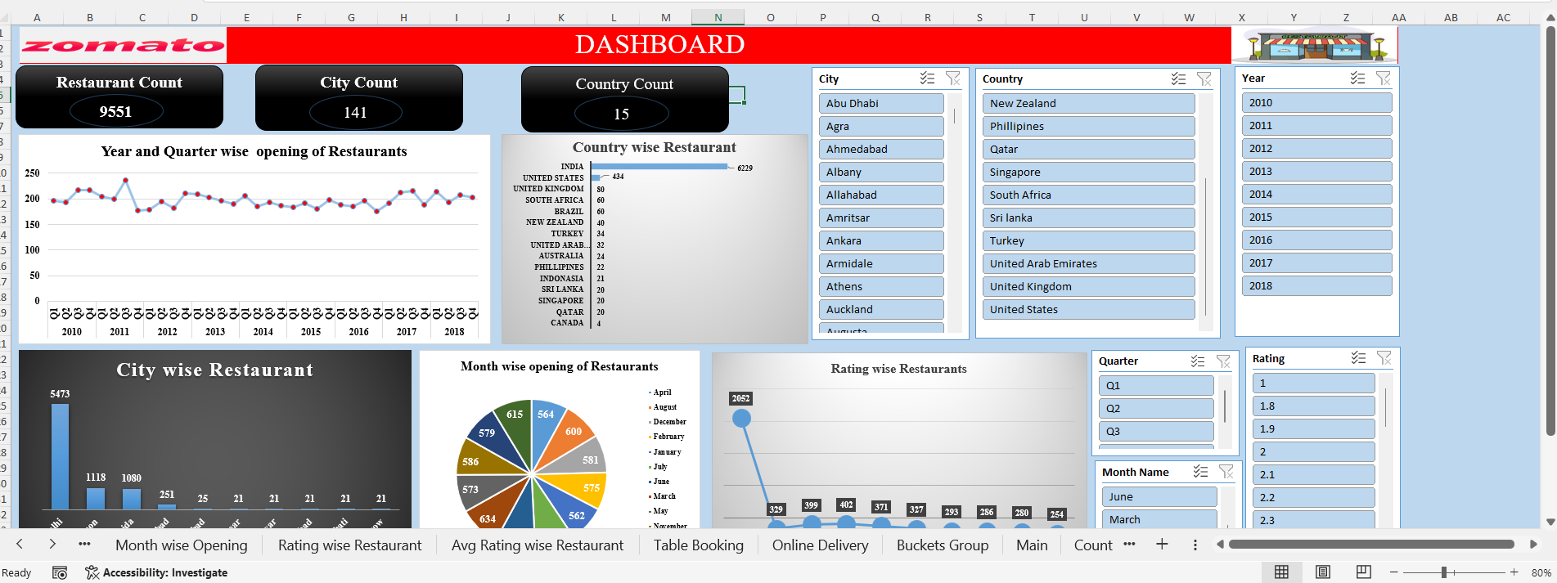
TOOL SPOTLIGHT
Excel Dashboard Overview
Restaurant-level analysis built from the uploaded Zomato Excel workbook
Excel dashboard — KPI cards, city/country charts, opening trend and slicers
Headline KPI cards (Restaurant Count, City Count, Country Count) sit above city, country, year and rating charts, all connected to a shared slicer panel.
Use the City, Country, Year and Rating slicers on the right to filter every chart on the sheet at once.
Source: Zomato_Analytics_Date_Sheet_Filled.xlsx
ZOMATO ANALYTICS
20

Slide 21
TOOL SPOTLIGHT
SQL Analysis Overview
Query-layer analysis built from the zomato.sql script against the Main table
-- top 10 cities by restaurant count
SELECT city, COUNT(*) AS restaurant_count FROM main
WHERE city IS NOT NULL GROUP BY 1 ORDER BY 2 DESC LIMIT 10;
-- percentage of restaurants with online delivery
SELECT has_online_delivery, COUNT(*) restaurant_count,
ROUND(COUNT(*)*100/(SELECT COUNT(*) FROM main),2) pct
FROM main GROUP BY 1;
-- most popular restaurants by votes
SELECT restaurantname, city, rating, votes
FROM main ORDER BY votes DESC LIMIT 10;
zomato.sql — 19 queries covering counts, costs, ratings, cuisines, delivery and rankings
The script runs against the Main table (plus Country lookup) in MySQL, covering restaurant counts, average cost and rating, and city/country/cuisine breakdowns.
Additional queries break down opening trends by year/quarter/month, price-bucket counts, table-booking and delivery rates, and the top 10 most-voted restaurants.
ZOMATO ANALYTICS
21

Slide 22
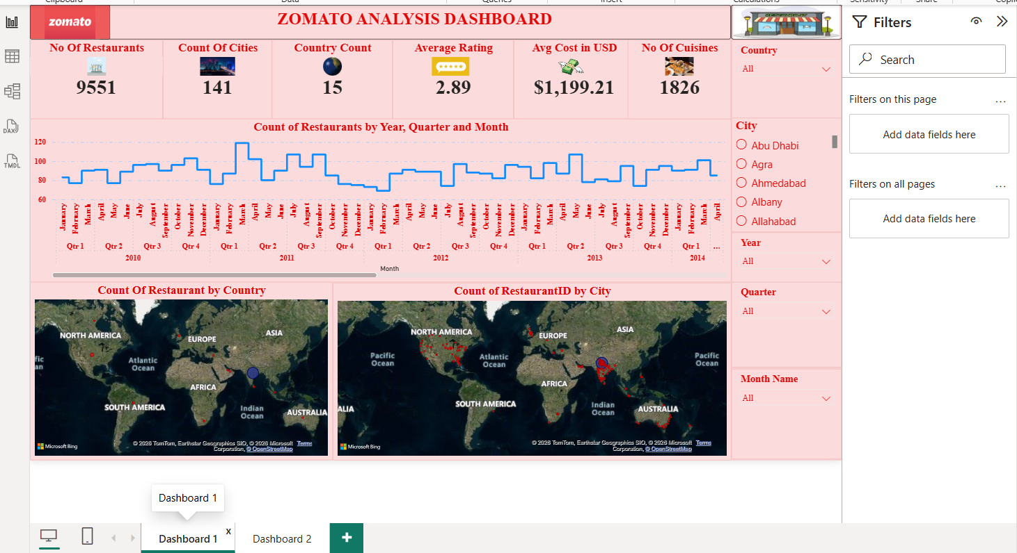
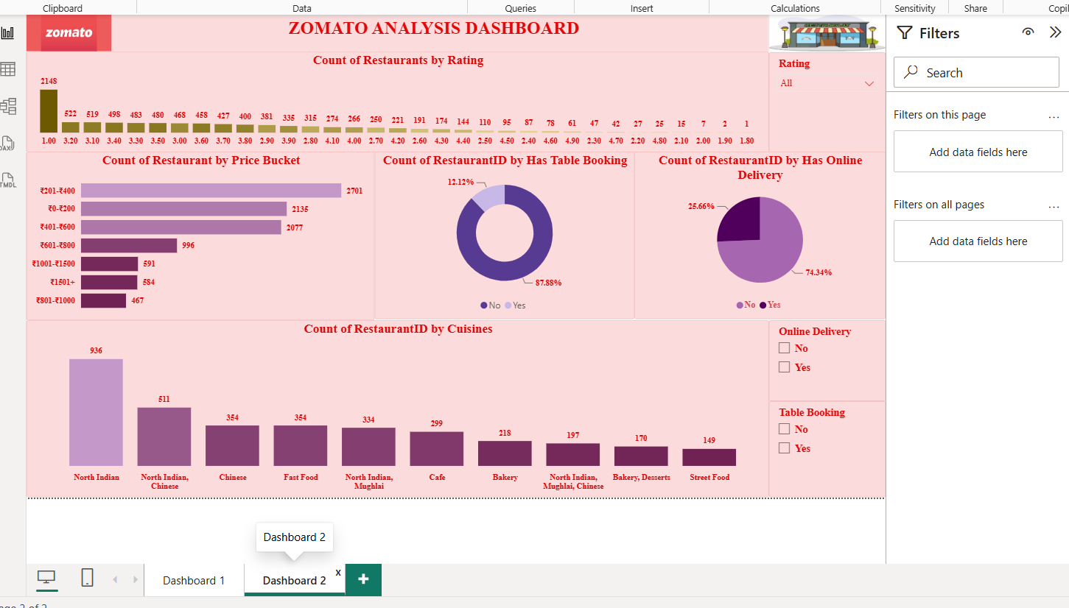
TOOL SPOTLIGHT
Power BI Dashboard Overview
Interactive business intelligence view for Zomato restaurant analytics
Dashboard 1 — KPI cards, opening trend and world maps
Dashboard 2 — rating, price bucket, cuisine and service visuals
Dashboard 1 leads with KPI cards (Restaurants, Cities, Countries, Rating, Avg. Cost, Cuisines) plus a month/quarter trend and two filled maps by country and city.
Dashboard 2 breaks the same records down by rating, price bucket, cuisine and service adoption (table booking / online delivery), all driven by the shared Country, City, Year, Quarter and Rating filters.
ZOMATO ANALYTICS
22

Slide 23
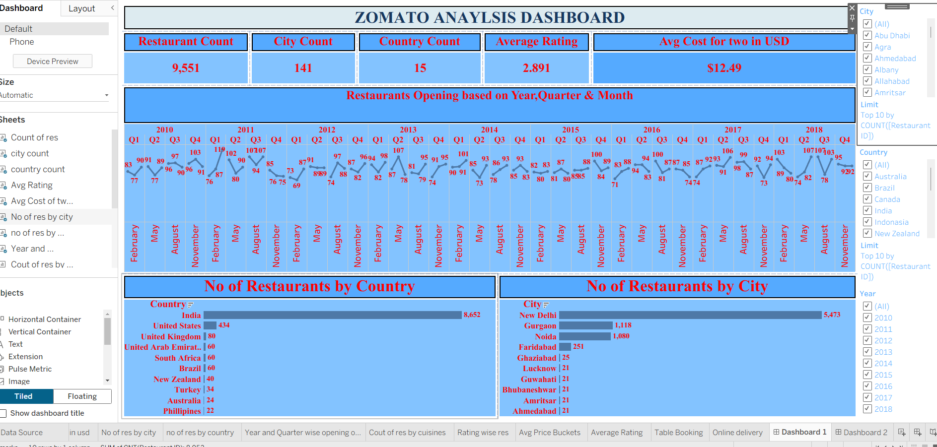
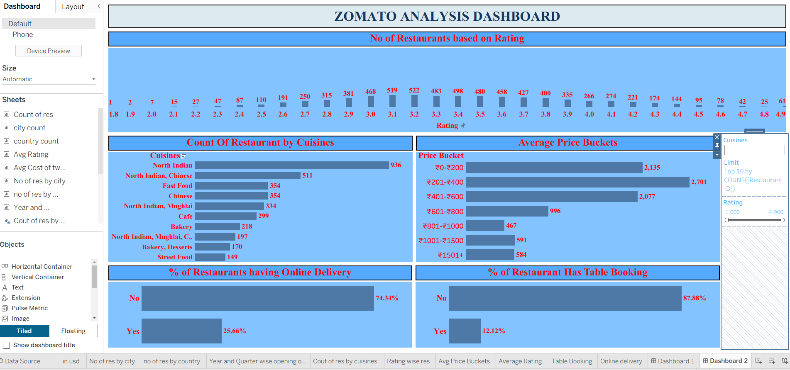
TOOL SPOTLIGHT
Tableau Dashboard Overview
Interactive visual storytelling for restaurant, customer and service insights
Dashboard 1 — KPI strip, opening trend, restaurants by country & city
Dashboard 2 — ratings, cuisines, price buckets and service adoption
Dashboard 1 opens with Restaurant/City/Country counts, average rating and average cost, then a year-quarter-month trend line and country/city bar charts.
Dashboard 2 drills into rating distribution, top cuisines, price-bucket counts and the online-delivery vs table-booking split, filterable by cuisine and rating.
ZOMATO ANALYTICS
23

Slide 24
WRAP UP
Conclusion
Turning restaurant data into actionable business intelligence.
The dataset provides a broad view of 9,551 restaurants across 141 cities.
Geographic concentration, cuisine popularity, pricing and service adoption are the strongest analytical themes.
An average rating of 2.89 and 1.50M votes provide useful customer-engagement signals.
The analysis can be operationalized in Power BI or Tableau for interactive monitoring and drill-down analysis.
9,551
Restaurants
141
Cities
2.89
Avg. Rating
1.50M
Votes
ZOMATO ANALYTICS
24

