Slide 1
Socket Programming
Shadman Kolahzary
Kurdistan University

Slide 2
Lecture Today
Motivation for sockets
What’s in a socket?
Working with socket
Concurrent network applications
Project 1

Slide 3
Programmer?
Web?
Python?
RFC?
JS?
Socket?
Socket?

Slide 4
Network Layering
7
Application
Application
6
Presentation
Presentation
5
Session
Session
4
Transport
Transport
3
Network
Network
Network
2
Data link
Data link
Data link
1
Physical
Physical
Physical

Slide 5
Network Layering
Why layering?
7
Application
Application
6
Presentation
Presentation
5
Session
Session
4
Transport
Transport
3
Network
Network
Network
2
Data link
Data link
Data link
1
Physical
Physical
Physical

Slide 6
Layering Makes it Easier
Application programmer
  Doesn’t need to send IP packets
  Doesn’t need to send Ethernet frames
  Doesn’t need to know how TCP implements reliability
Only need a way to pass the data down
  Socket is the API to access transport layer functions

Slide 7
What Lower Layer Need to Know?
We pass the data down. What else does the lower layer need to know?

Slide 8
What Lower Layer Need to Know?
We pass the data down. What else does the lower layer need to know?
How to identify the destination process?
  Where to send the data? (Addressing)
  What process gets the data when it is there? (Multiplexing)

Slide 9
Identify the Destination
Addressing
  IP address
  hostname (resolve to IP address via DNS)
Multiplexing
  port
Server socket address
208.216.181.15:80
Client socket address
128.2.194.242:3479
FTP Server
(port 21)
Client
HTTP Server
(port 80)
Connection socket pair
(128.2.194.242:3479, 208.216.181.15:80)
Client host address
128.2.194.242
Server host address
208.216.181.15

Slide 10
Sockets
How to use sockets
  Setup socket
    Where is the remote machine (IP address, hostname)
    What service gets the data (port)
  Send and Receive
    Designed just like any other I/O in unix
    send -- write
    recv -- read
  Close the socket

Slide 11
Overview
Client
Server
socket
socket
bind
open_listenfd
open_clientfd
listen
Connection
request
connect
accept
Client / Server
Session
write
read
read
write
close
EOF
read
close

Slide 12
Step 1 – Setup Socket
Both client and server need to setup the socket
server = socket.socket(address_family, protocol)
Address family
  AF_INET -- IPv4 (AF_INET6 for IPv6)
protocol
  SOCK_STREAM -- TCP
  SOCK_DGRAM -- UDP
For example:
- server = socket.socket(socket.AF_INET, socket.SOCK_STREAM)

Slide 13
Step 2 (Server) - Binding
Only server need to bind
  server.bind((ip, port))
IP
  IP address to listen on
Port
  Port to listen on
Example
  server.bind(('localhost',5960))

Slide 14
Step 3 (Server) - Listen
Now we can listen
  server.listen()

Slide 15
Step 4 (Server) - Accept
Server must explicitly accept incoming connections
  conn, addr = server.accept()
Example:
def handle_connection(conn, addr):
print(f'New connection from: {addr}')
while True:
conn, addr = server.accept()
thread = threading.Thread(target=handle_connection, args= (conn, addr))
thread.start()

Slide 16
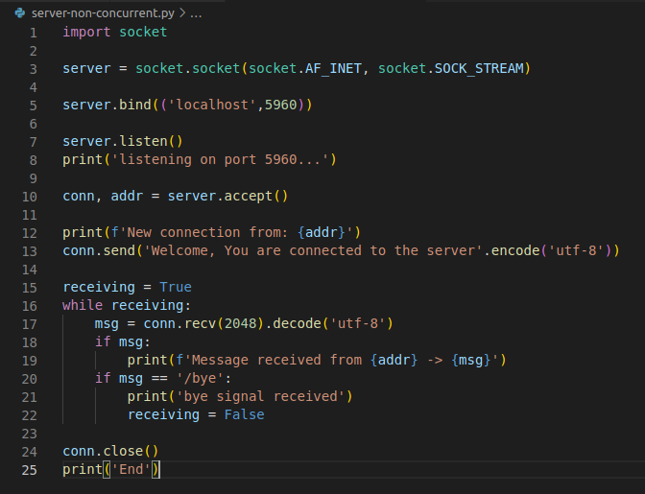
Put Server Together

Slide 17
What about client?
Client doesn’t need bind, listen, and accept
All client need to do is to connect
  server.bind((ip, port))
For example,
  client = socket.socket(socket.AF_INET, socket.SOCK_STREAM)
  client.connect(('localhost',5960))

Slide 18
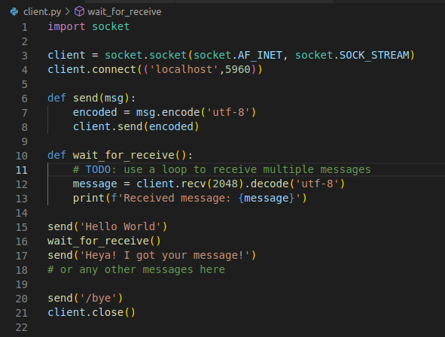
Put Client Together

Slide 19
We Are Connected
Server accepting connections and client connecting to servers
Send and receive data
  client.recv(size).decode(encoding)
  conn.send(message.encode(encoding))
For example,
  client.recv(2048).decode('utf-8')
  conn.send('Welcome, You are connected to the server'.encode('utf-8'))

Slide 20
TCP Framing
TCP does NOT guarantee message boundaries
  IRC commands are terminated by a newline
  But you may not get one at the end of read(), e.g.
    One Send “Hello\n”
    Multiple Receives “He”, “llo\n”
  If you don’t get the entire line from one read(), use a buffer

Slide 21
Revisited
Client
Server
socket
socket
bind
open_listenfd
open_clientfd
listen
Connection
request
connect
accept
Client / Server
Session
write
read
read
write
close
EOF
read
close

Slide 22
Close the Socket
Don’t forget to close the socket descriptor, like a file
  socket.close()
Now server can loop around and accept a new connection when the old one finishes
What’s wrong here?

Slide 23
Server Flaw
client 1
server
client 2
call accept
call connect
ret connect
ret accept
call fgets
call read
Server blocks
waiting for
data from
Client 1
call connect
User goes
out to lunch
Client 1 blocks
waiting for user
to type in data
Client 2 blocks
waiting to complete
its connection
request until after
lunch!
Taken from D. Murray, R. Bryant, and G. Langale 15-441/213 slides

Slide 24
Concurrent Servers
client 1
server
client 2
call accept
call connect
call connect
ret connect
ret accept
call fgets
call read (don’t block)
call accept
User goes
out to lunch
Client 1 blocks
waiting for user to type in data
ret connect
ret accept
call fgets
write
call read
call read
write
close
end read
close
Taken from D. Murray, R. Bryant, and G. Langale 15-441/213 slides

Slide 25
Concurrency
Threading
  Easier to understand
  Race conditions increase complexity
EventLoop (NodeJs, etc.)
  Callbacks
  Async/Await

Slide 26
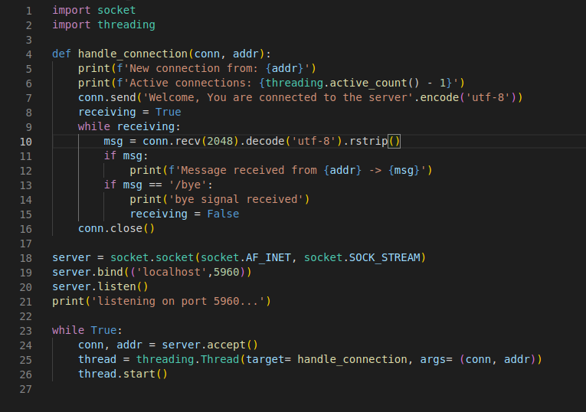
The Server

Slide 27
What about checking clients?
The main loop only tests for incoming connections
  There are other reasons the server wakes up
  Clients are sending data, pending data to write to buffer, clients closing connections, etc.
Store all client file descriptors
  in pool
Keep the while(1) loop thin
  Delegate to functions
Come up with your own design

Slide 28
Summary
Sockets
  socket setup
  I/O
  close
Client: socket()----------------------->connect()->I/O->close()
Server: socket()->bind()->listen()->accept()--->I/O->close()
Concurrency
  threading

Slide 29
About Project 1
Chat
  Checkpoint 1: Single Client Chat (You got it!)
    Inputs from server console should be printed on client console
    Inputs from client console should be printed on server console
  Checkpoint 2: Multi-User Chat (You’re a great student)
    First take own username from user
    Then take target username
    Create a dictionary of username → connection on server
    Users should be able to start a bi-directional chat together
  Checkpoint 3: Users list (You’re a pro programmer!)
    Create a specific request which returns list of online usernames
    Create a UI to show users list and start a chat after clicking on a username

Slide 30
Suggestions
Start early!
  Work ahead of checkpoints
Read the documentation
Try to implement it in another language
Email (shadman.ko@gmail.com)

