Slide 1
PROJECT TITLE
CAPSTONE PROJECT
Presented By: K. Anusri
Student Name : K. Anusri
College Name & Department : Institute of Aeronautical Engineering
Computer Science and Engineering
(Data Science)

Slide 2
OUTLINE
Problem Statement
Technology used
Wow factor
End users
Result
Conclusion
Git-hub Link
Future scope

Slide 3
Problem Statement
Digital communication requires secure methods to hide sensitive data.
Traditional encryption methods can attract attention.
Need for a covert data hiding technique.
Solution: Embedding text messages within images using steganography.

Slide 4
Technology used
Programming Language: Python
Libraries Used: OpenCV, NumPy
Concepts Implemented: Binary Encoding, Least Significant Bit (LSB) Steganography

Slide 5
Wow factors
Stealthy Communication: Hidden messages are imperceptible to the human eye.
Random Image Generation: Each encoded image is unique.
Efficient Retrieval: The message can be extracted without quality loss.
Secure Communication: Works well for secure data transfer.

Slide 6
End users
Journalists & Activists: To securely communicate in restrictive environments.
Cybersecurity Experts: For confidential data transmission.
Government & Intelligence Agencies: For covert operations.
General Users: To share personal secrets securely.

Slide 7
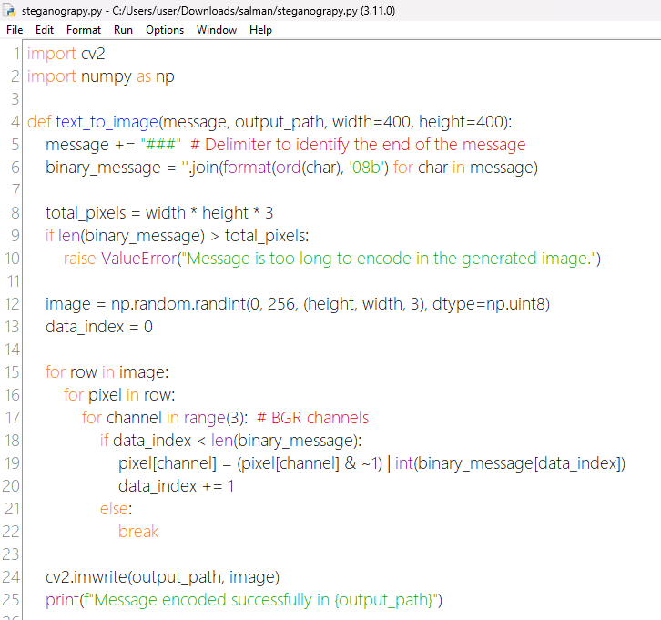
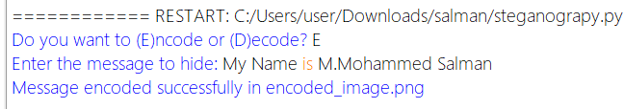
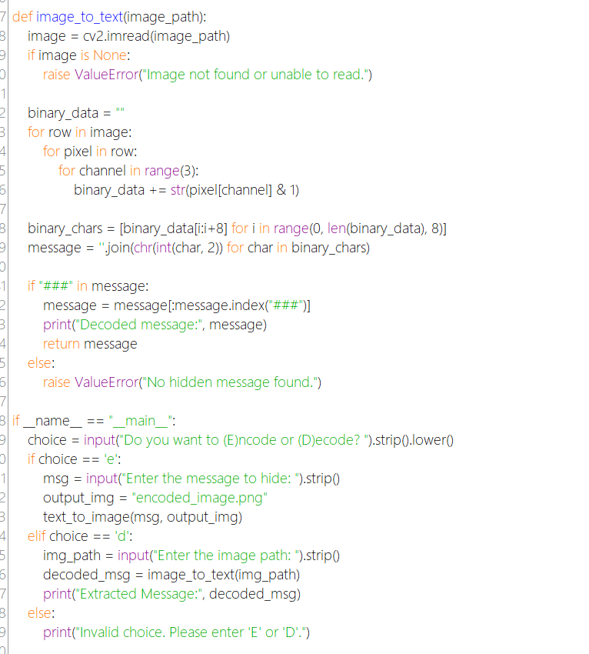
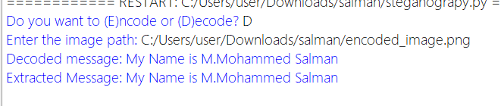
Results
Results

Slide 8
Conclusion
Implemented an effective method for hiding text inside images.
Ensured secure, imperceptible message embedding and retrieval.
Demonstrated the feasibility of steganography in modern communication

Slide 9
GitHub Link
Repository : https://github.com/Kolakani-Anusri/AICTE-CYBERSECURITY-IBMSKILLSBUILD

Slide 10
Future scope(optional)
Implement encryption before embedding for enhanced security.
Develop a GUI-based tool for non-programmers.
Expand to video and audio steganography.
Optimize for larger data storage without noticeable image distortion.

Slide 11
THANK YOU

