Slide 1
Task - 1
Create Spring Boot REST API with CRUD operations using data JPA

Slide 2
StartUp Class
Config Files
Dependencies
@SpringBootApplication
Main method
application.properties
log4j.properties
pom.xml
spring-boot-starter-parent
log4j
spring-boot-starter-web
spring-boot-starter-data-jpa
spring-boot-starter-test
maven-surefire-report-plugin

Slide 3
@Repository
Model @Table @Entity
Models
@RestController
@Service
@Table @Entity => Loan
@Id =>loanNumber(PK)
@Column => aadharNumber, firstName, lastName, loanAmount, loanStartDate, tenure
@RequestMapping
Endpoints: /loan/all /loan/loanNum /loan/add /loan/update/loanNum /delete/loanNum /delete/all
Operations: getLoan() getLoanByNumber(int n) addNewLoan(Loan l) updateLoan(Loan l) deleteLoanByNum(int n) deleteAllLoans();

Slide 4
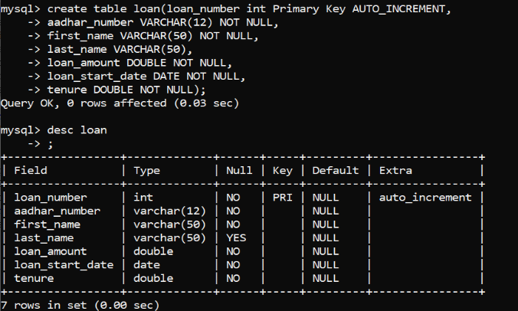
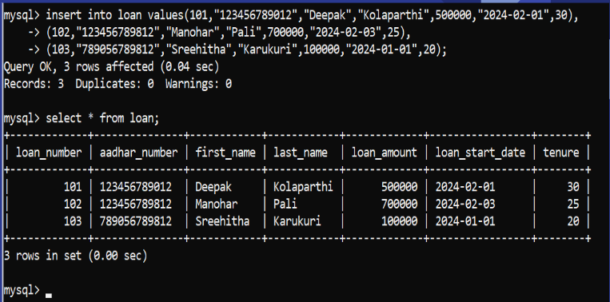
Table Creation

Slide 5
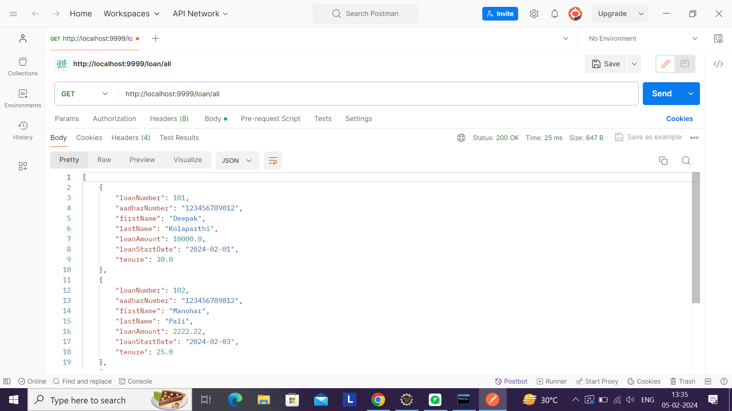
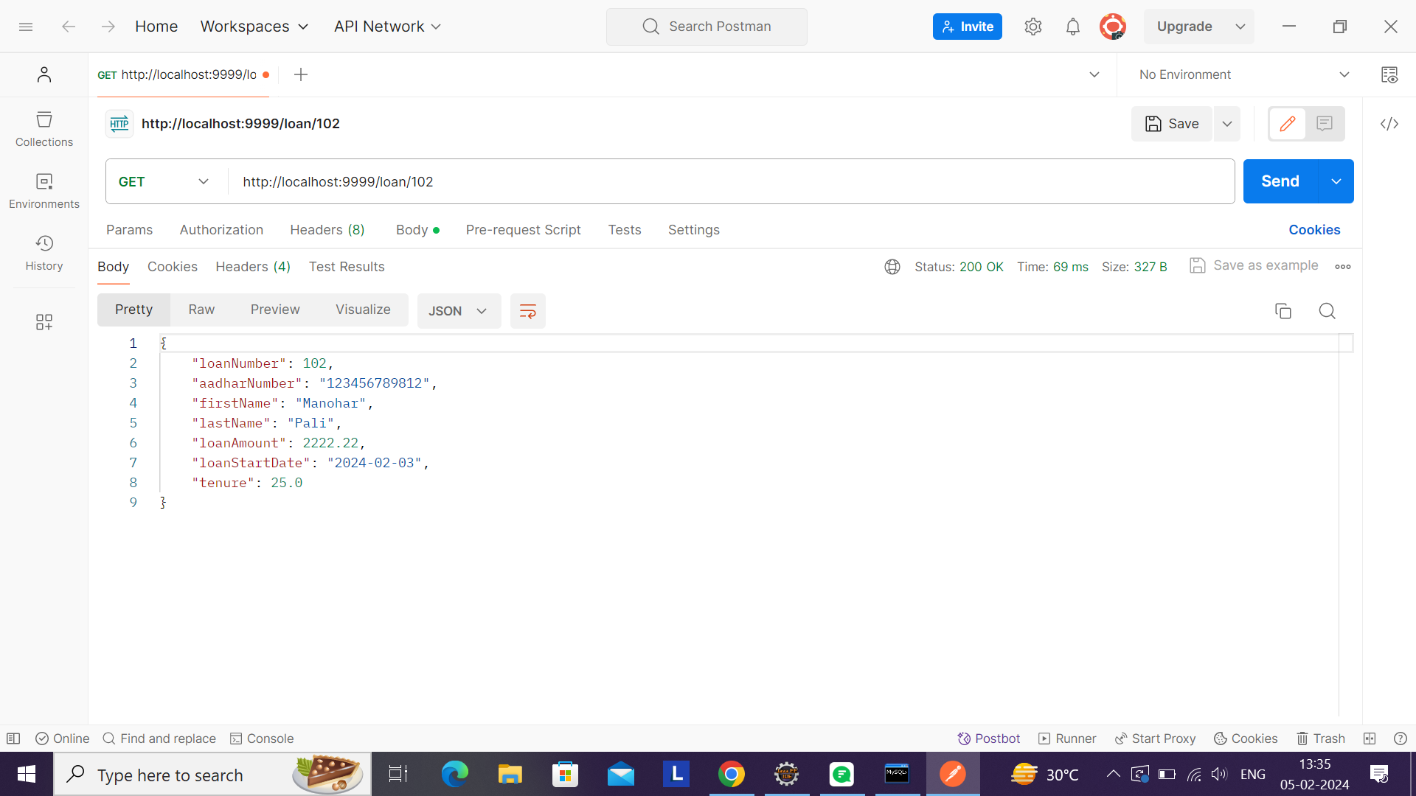
GETALL GET

Slide 6
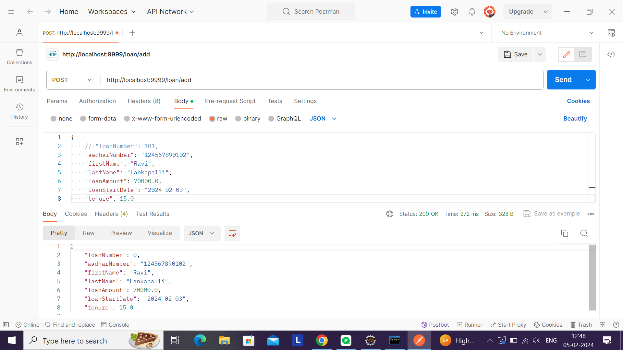
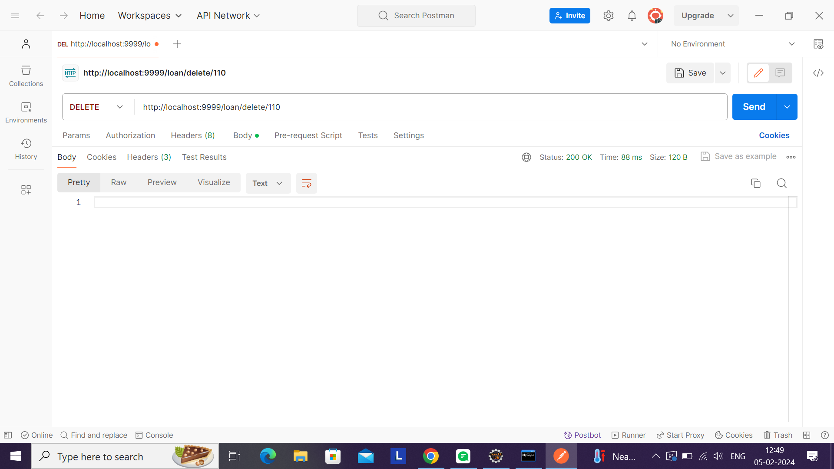
ADD DELETE

Slide 7
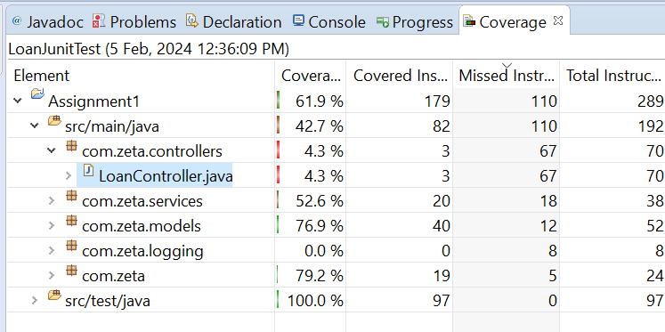
Code Coverage

Slide 8
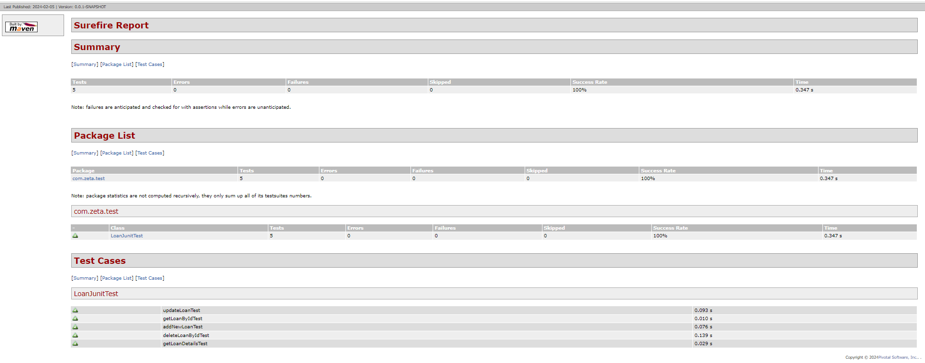
Surefire Report

Slide 9
Task - 2
Create a consumer app with REST-Template for given API

Slide 10
StartUp Class
Config Files
Dependencies
@SpringBootApplication
Main class
@Bean
RestTemplate
log4j.properties
pom.xml
spring-boot-starter-parent
log4j
spring-web
spring-boot-starter-web

Slide 11
Models
UserDetails
SupportDetails
DataSupport
ApiDetails
@JsonProperty
Id email firstName lastName avatar
@JsonProperty
url text
@JsonProperty
userDetails supportDetails
@JsonProperty
pageNumber recordsPerPage totalPages userDataList supportData
PostApiDetails
@JsonProperty
id name job createdAt

Slide 12
@RestController
@Service
@RequestMapping
Endpoints: /users /users/id /users/page/pageNum /users/add
Operations: getUsers() getUserByid(int id) getUsersByPage(int n) addUser(PstApiDetails p)
@Autowired
@Autowired

Slide 13
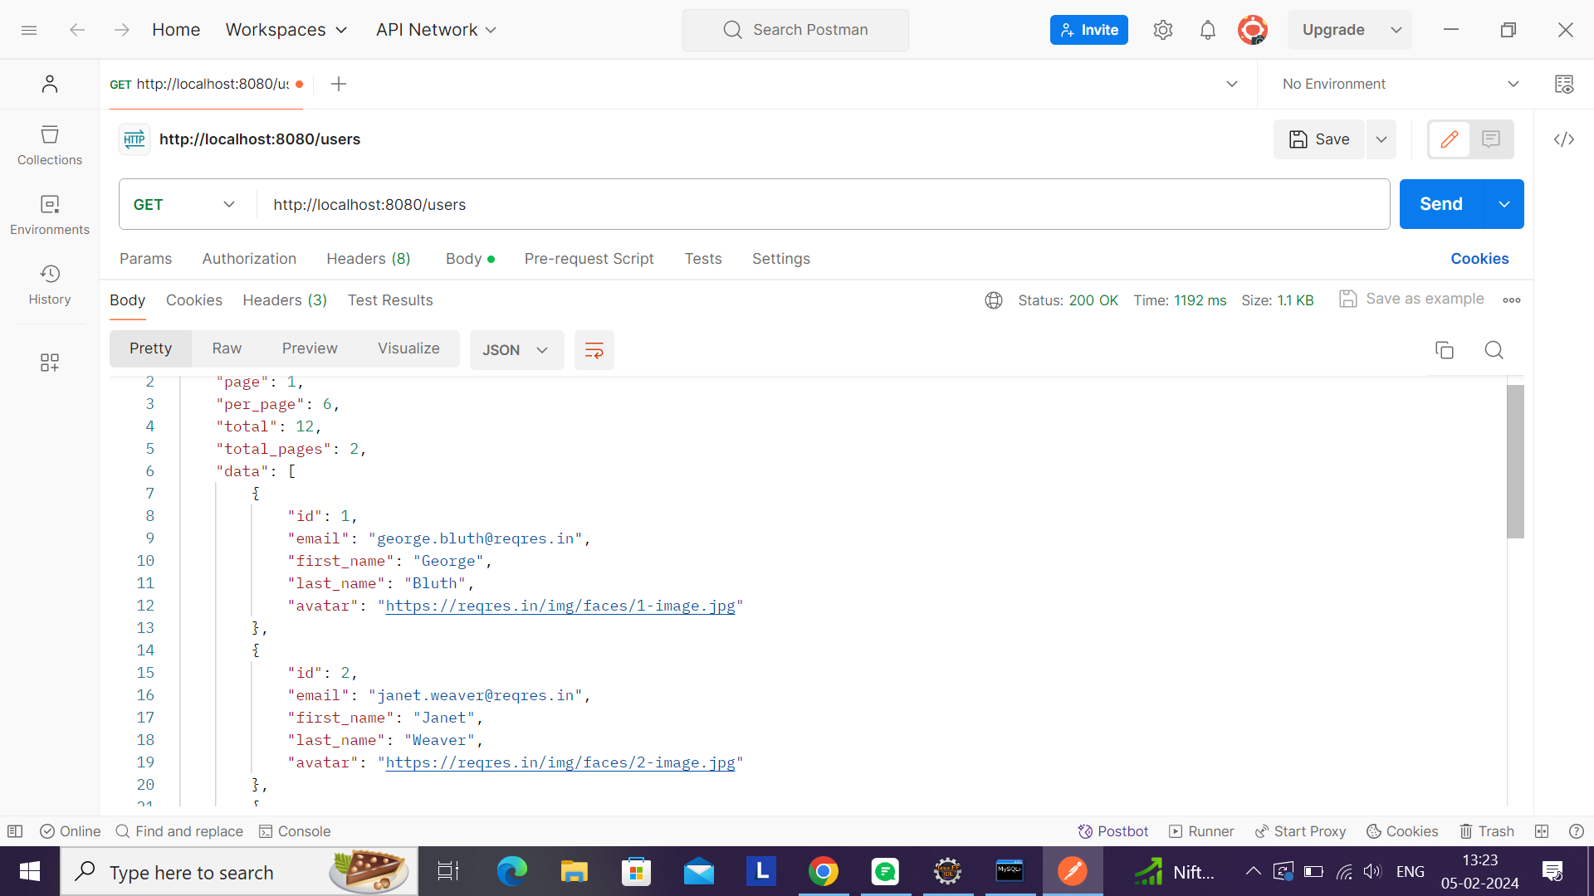
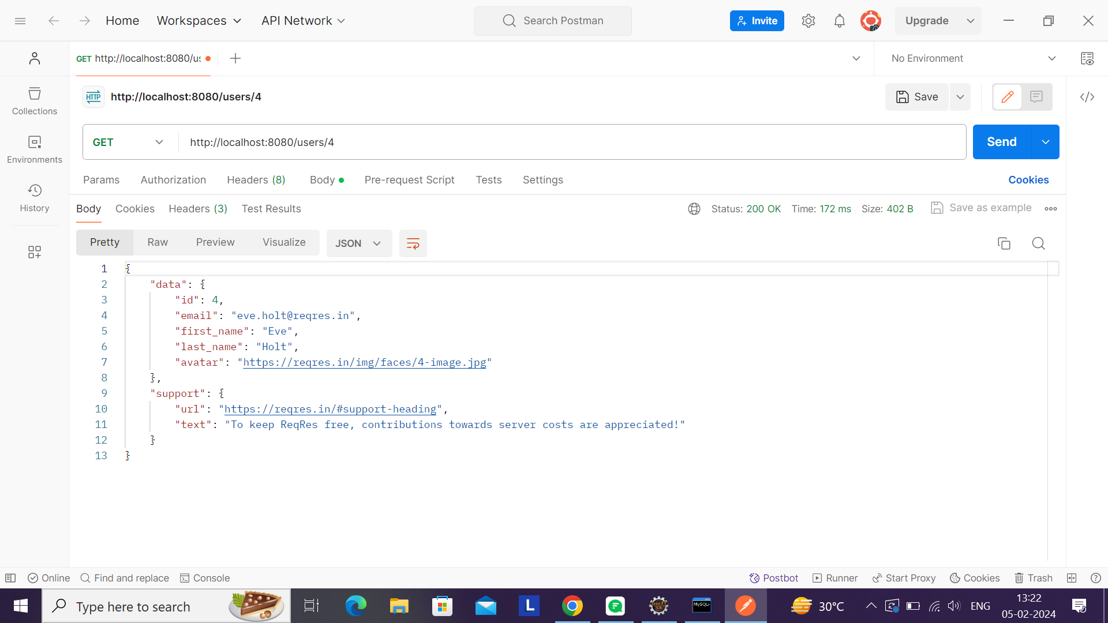
/users /users/id

Slide 14
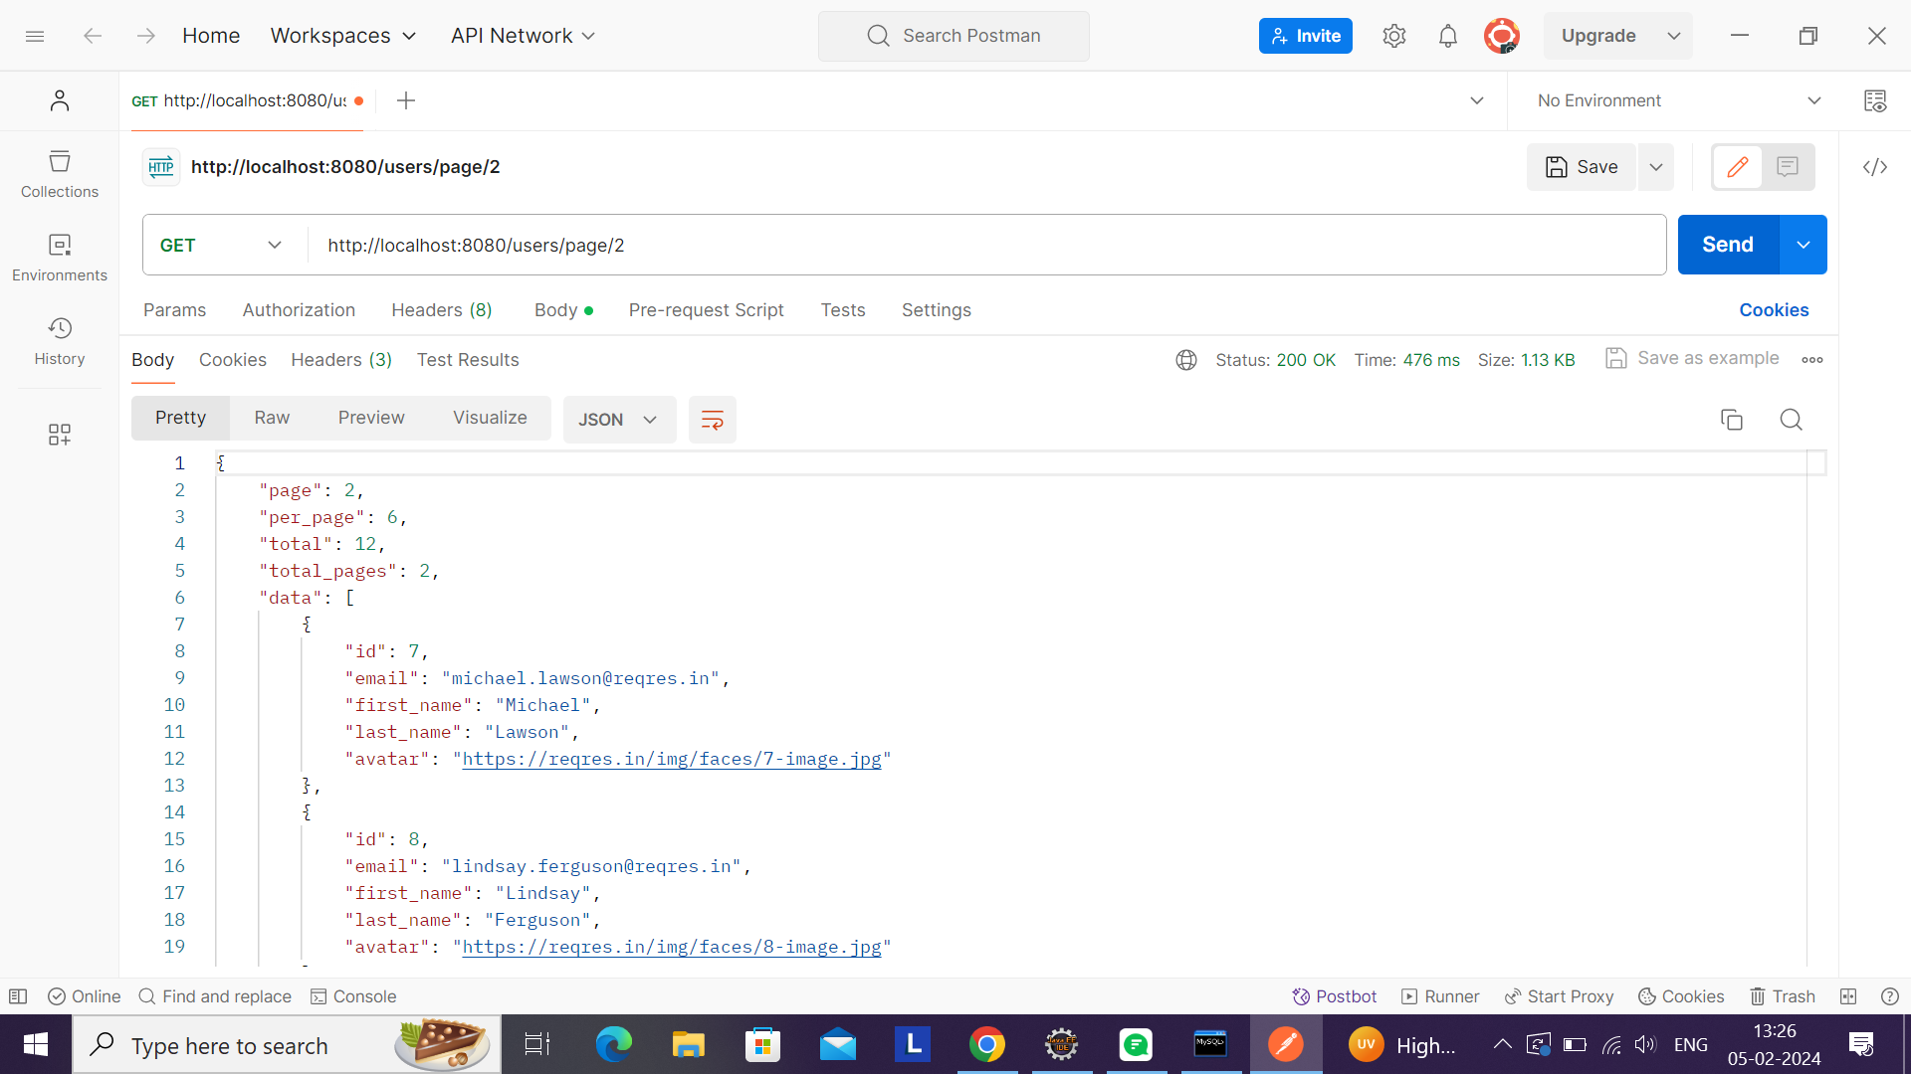
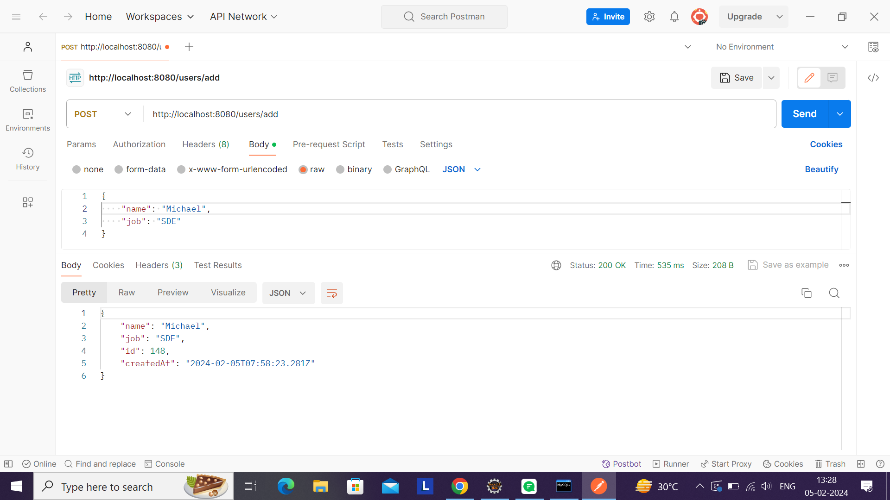
/users/page/n /users/add

Slide 15
THANK YOU

